Slide 1
Predicting Disease Outbreaks Using Time Series Analysis and Classification
Data Mining
Aniket Ranjeet Sharma
Jayanand Hiremath
Preetham Reddy Vinnamala

Slide 2
Aim
Project is intended to provide insights and predictions concerning potential future outbreaks.
Predictions of disease outbreaks aid in resource allocation, policymaking, and public health interventions.
Prediction models can be used to identify high-risk populations and target preventive measures - vaccination campaigns, health screenings, and educational programs.

Slide 3
Brief
Data collection from recognized and established platforms to address the credibility of data concern. (sources: WHO, Disease Control and Prevention (CDC)).
Preprocessing of the data to ensure the integrity of the data. Accuracy, completeness, consistency, and validity of the data is paramount. (Handling Outliers, Missing Values, Data Consistency).
Employed time series analysis to reveal insights, patterns, and trends of the data ordered over time. Effective identification of past disease trends and predict future trajectories. (ARIMA & SARIMA(Autoregressive Integrated Moving Average and seasonal ARIMA), Prophet, LSTM).
Classification process is essential to leverage information, categorize regions or populations effectively to create actionable insights and strategies. Features are studied and categorized under defined categories.(Decision Trees, Random Forest, Neural Networks).

Slide 4
Approach
Identified reliable and comprehensive data sources. (Disease Outbreak data).
Brief description on the files:
Files | Description
COVID_outbreaks | Provides information of the countries affected by the virus.
DONsRaw
isocodes | Provides information of the country code and region(continent).
Outbreaks | Provides information of the disease outbreaks till date based on country.
WHO-COVID-19-global-data | Provides information of the new cases, total cases, total deaths based on country and date of data collection.

Slide 5
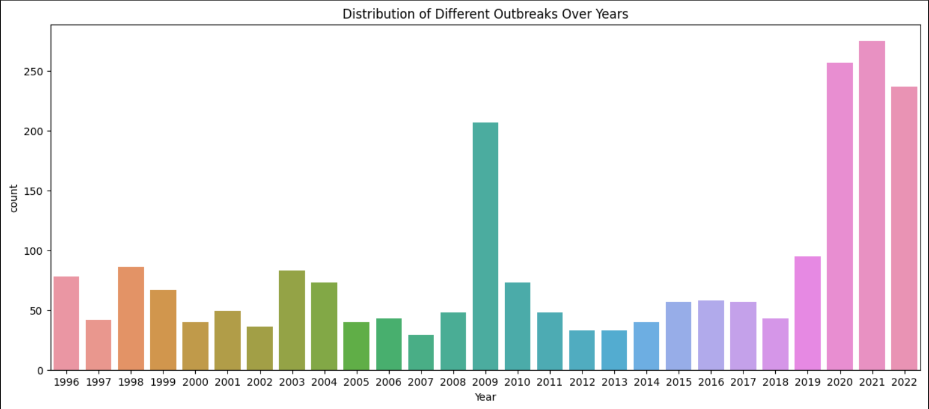
Approach
Created a consolidated data sets based on country, country iso code, date and year of outbreaks.
Pre-processed the data to eliminate null values and missing data.
Plotted the graph to identify the total outbreaks per year worldwide:

Slide 6
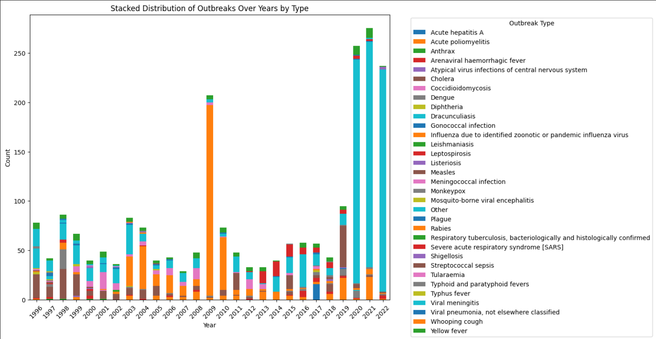
Approach
Stacked distribution of outbreaks over years by type of diseases:

Slide 7
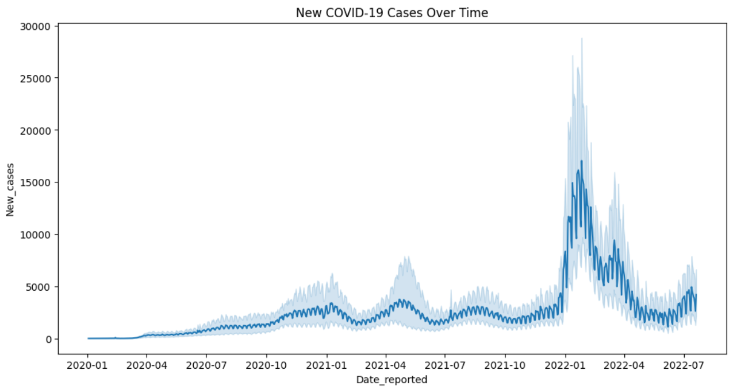
Approach
Eliminated incorrect data in the data frame.
Plotted new COVID-19 reported cases over time worldwide:

Slide 8
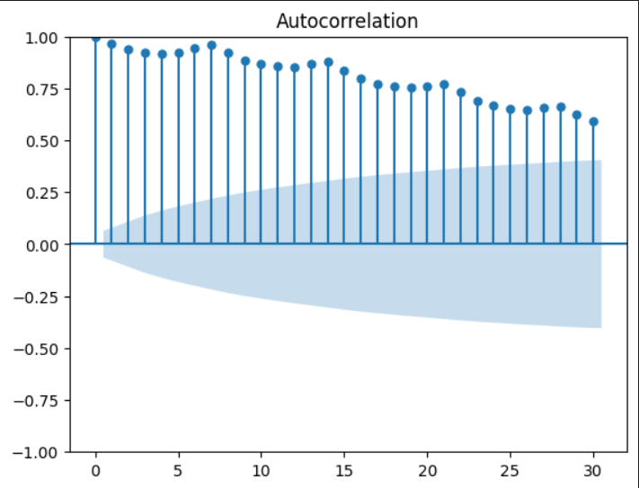
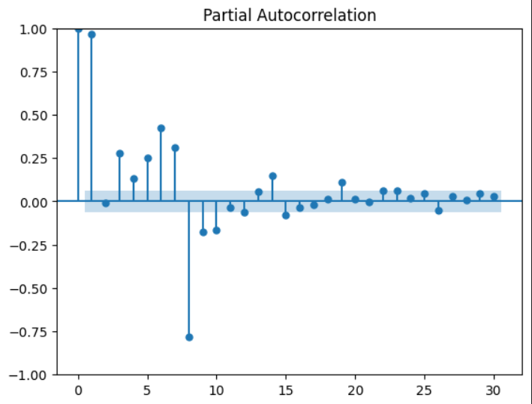
Approach
ADF test to test the stationarity of a time series is done on ‘new_cases’ of covid19 data- this gives the ADF stat value and p-value. If p-value <= 0.05: The time series is likely to be stationary(mean, variance, and autocorrelation do not change over time). Obtained p-value from our test shown the time-series isn’t stationary.
Visualized the autocorrelation and partial autocorrelation essential for understanding the temporal dependencies within the data:

Slide 9
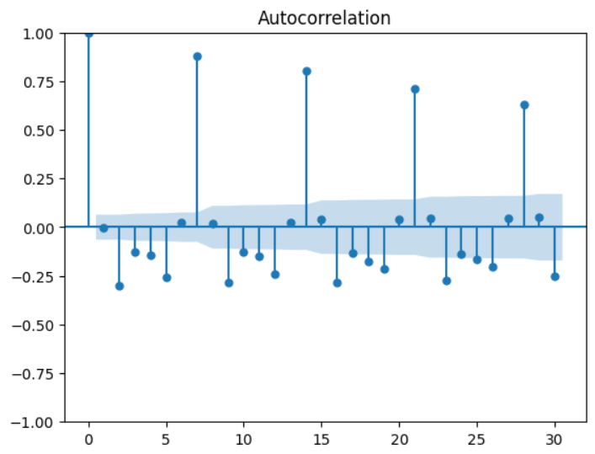
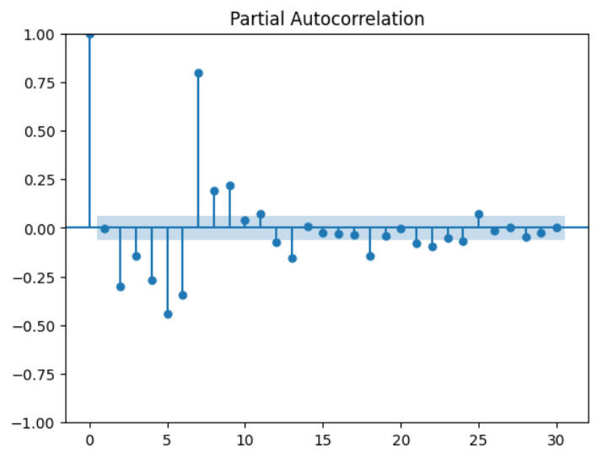
Approach
To overcome the unsatisfactory acf and pacf plots on new cases, differencing is done make the data potentially more stationary.
Dealt with introduction of NaN values from differencing by eliminating them:
acf and pacf plots on the differenced data:

Slide 10
ARIMA Approach
# ADD INFO ABOUT THE ADFULLER SUMMARY.
We performed the previous operations to identify and make the data stationary before applying ARIMA, because these model capture the temporal (time dependent) patterns and dependencies in stationary time series data set. More steady and predictable patterns are seen in stationary time series, which results in more precise forecasts.
Brief description on forecasting models ARIMA and SARIMA:
ARIMA (AutoRegressive Integrated Moving Average): components autoregression, differencing, and moving averages. Autoregressive(AR) component represents the linear dependence of the current value on its past values(p) indicating the number of past observations to consider. Integrated component represents the differencing needed to make the time series stationary order of differencing is denoted by d, moving average component represents the linear dependence of the current value on past forecast errors, number of past errors to consider is denoted by q. ARIMA models are often built based on observed patterns in autocorrelation and partial autocorrelation functions.

Slide 11
ARIMA Approach
SARIMA(Seasonal ARIMA): Extension of ARIMA that includes a seasonal component to handle data with periodic patterns, such as monthly or yearly seasonality. Components - SAR component represents the linear dependence on past seasonal values. The order is denoted by P. SI component represents the order of seasonal differencing. The order is denoted by D. SMA component represents the linear dependence on past seasonal forecast errors. The order is denoted by Q.
ARIMA model over the data-set gives the best model by providing integer values for each of the p,d,q .
Dataset is distributed in [80:20] [training:testing].

Slide 12
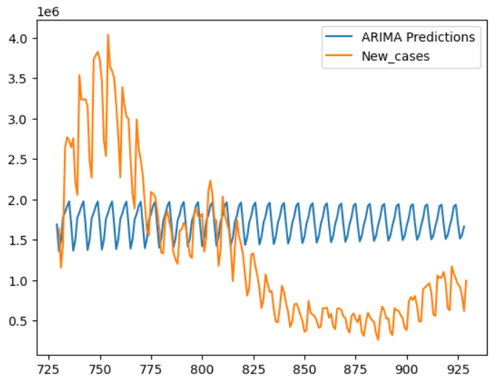
ARIMA Approach
ARIMA predictions vs new cases data was plotted:
To understand the reason for plot giving not best fit the training dataset parameters (mean and root mean square error) are calculated:
The values obtained for the mean and the root mean square error were out of the spec.

Slide 13
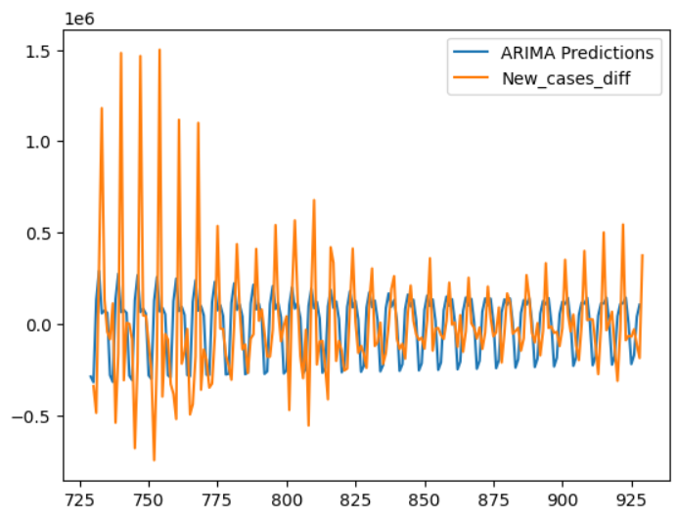
ARIMA Approach
Differencing is done on the data of ‘new cases’ to improve the ARIMA model performance. The updated plot :

Slide 14
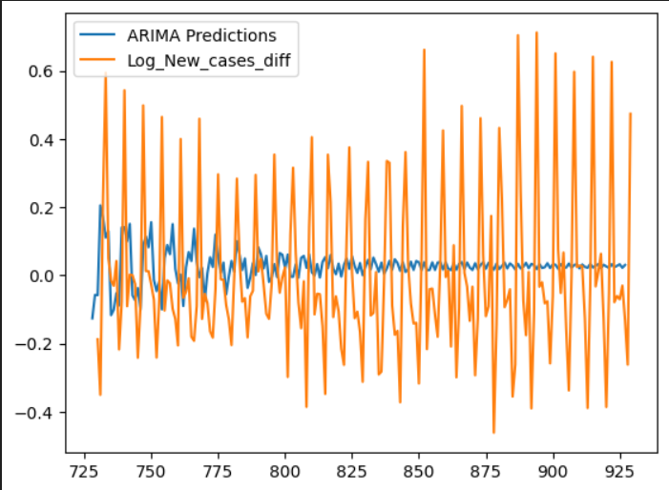
ARIMA Approach
The second plot of differenced data is much better than the first plot, but the results are still not satisfactory.
To improve the performance of ARIMA model logarithmic operation is performed on data set. The plot of ARIMA model predictions with the logarithmic function data vs log_new_cases:

Slide 15
Prophet Approach
Prophet: forecasting tool developed by Facebook for time series forecasting. Prophet deals with multiple seasonalities and irregular patterns. Reasons for implementing the prophet as it is capable of handling seasonality, and flexibility in incorporating external factors, unlike ARIMA which performs better for well-behaved time series data.
Implementing the prophet model: prophet model provides flexibility to provide instructions and information about the seasonalities. (Original data set of new cases is used).
The prophet model is fitted for the data (new cases). A new Data-Frame containing future dates necessary to make predictions is derived. Generates predictions for the future dates provided by the data-frame containing future dates.

Slide 16
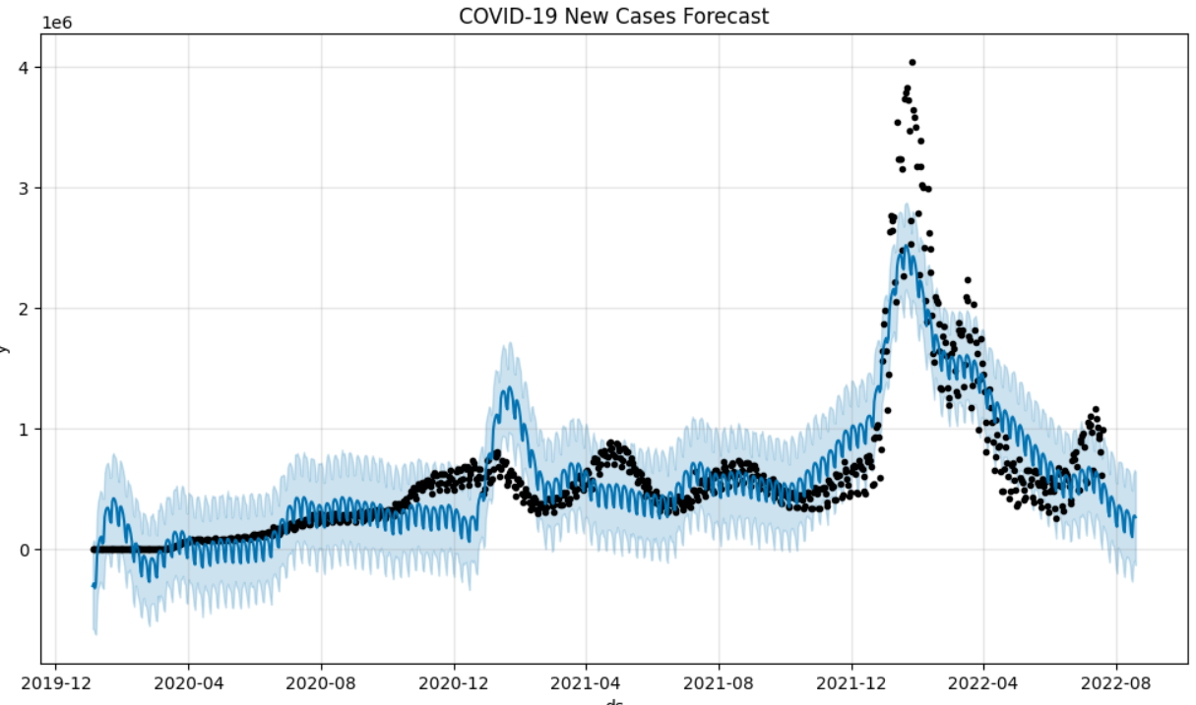
Prophet Approach
The plot below shows that the prediction from prophet model closely follows the original data set:

Slide 17
Prophet Approach
To assess the performance of the prophet model predictions on the original training data cross validation is done. Cross validation provides a data-frame with predictions for each observation in the original time series, helping to study performance metrics of the prediction model. Performance metrics is performed on cross validation data frame to calculate the forecast accuracy metrics.
MAPE (Mean Absolute Percentage Error): measures the percentage difference between predicted and actual values, giving information of the accuracy of model's predictions. MAPE provides the average percentage error across all observations, a lower MAPE indicates better accuracy. To deduce more comprehensive evaluation Mean Squared Error (MSE) or Root Mean Squared Error (RMSE) may be used in conjunction with MAPE.

Slide 18
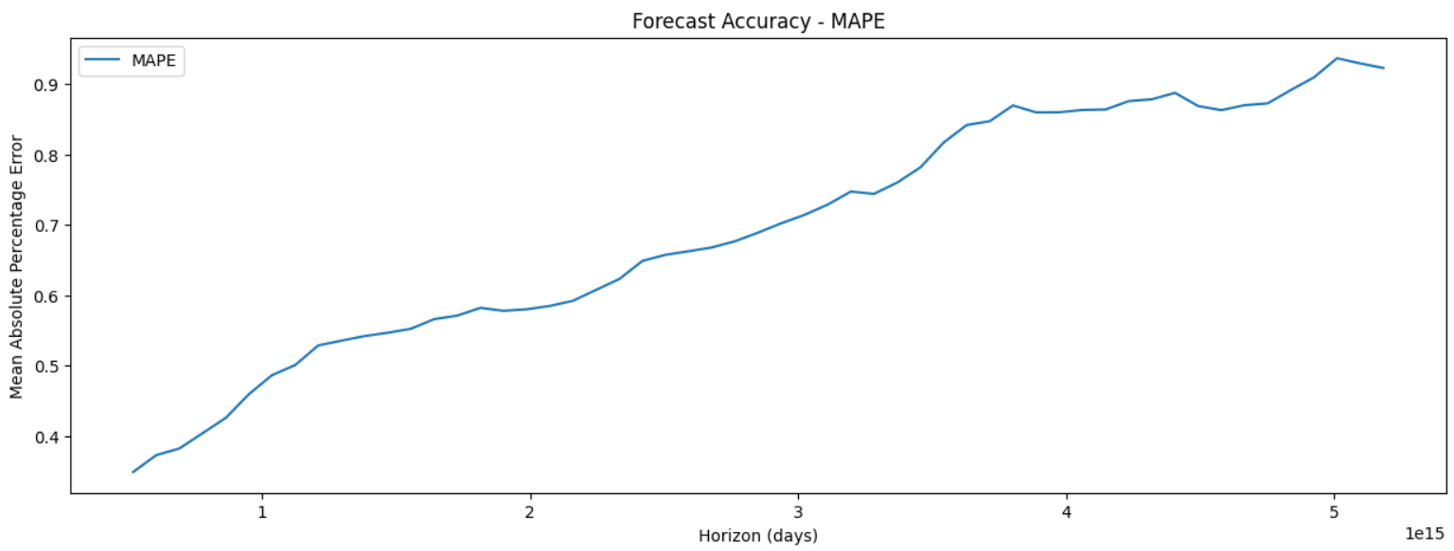
Prophet Approach
MAPE value assessment of the Prophet model gives the inference that model is not accurate enough as MAPE value is high. Below plot gives MAPE value graph to test the prophet model accuracy :

Slide 19
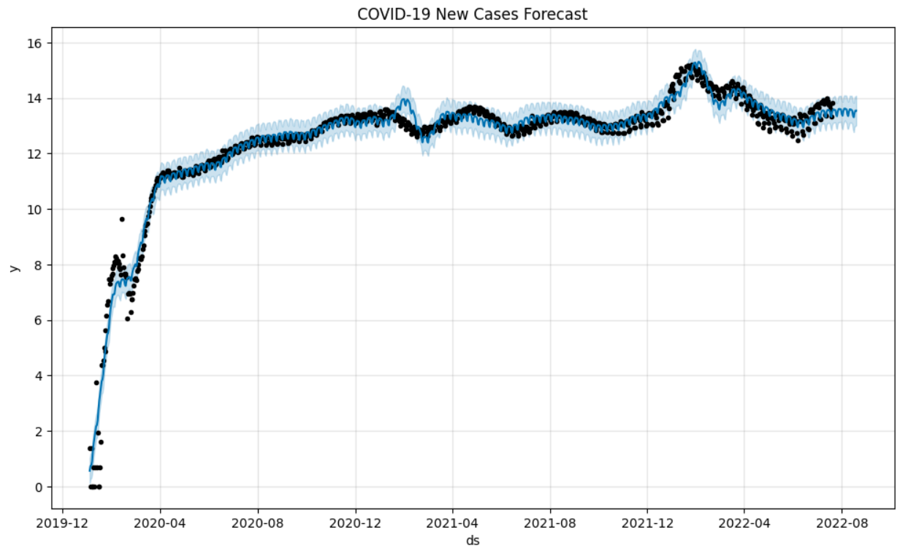
Prophet Approach
For improvement of Prophet model prediction, logarithmic operated data-set of ‘new-cases’ is fitted. A new Data-Frame containing future dates necessary to make predictions is derived. Generates predictions for the future dates provided by the data-frame containing future dates.
The plot below shows the forecast from prophet model with logarithmic operated data-set :

Slide 20
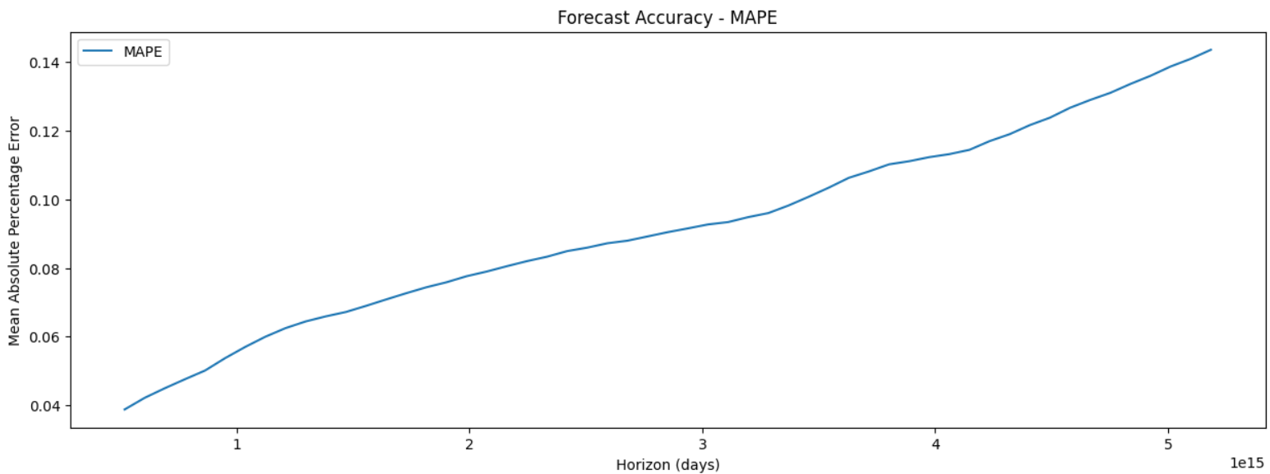
Prophet Approach
MAPE value assessment of the Prophet model for logarithmic operated data-set gives the inference that accuracy of forecast model is good as the value of MAPE is low. Below plot gives MAPE value graph to test the prophet model accuracy :

Slide 21
LSTM Approach
LSTM(Long Short-Term Memory): Historical time series dataset, LSTMs are trained to predict future values. Training a model on historical time series data and using the trained model to make predictions for future time steps. LSTM is type of recurrent neural network (RNN) works best with sequential prediction and long term dependency data alongside.
Employing the LSTM for ‘new-cases’. Scaling of the data is done to maintain Consistent Model behavior by ensuring different features or variables in the time series data are on a similar scale and scaling also gives numerical stability. The model is trained by 80% of the dataset(training dataset).
Data set matrix is generated from the array of values and is reshaped in-order to include features and timesteps. Sequential is used to develop neural networks layer by layer, this is suitable for feedforward neural networks, where information flows in one direction. Layers are defined: dropout-regularization technique used to prevent overfitting, dense-used for tasks such as classification or regression.

Slide 22
LSTM Approach
Fitted model is used to make predictions for both the training dataset and testing dataset.
Predictions are inverted back to original scale by inverse transforming.
Root mean square error for training and testing data sets prediction.
MAPE and accuracy of prediction model is calculated for both test and train datasets.
The data is utilized to plot the predictions vs actual data.

Slide 23
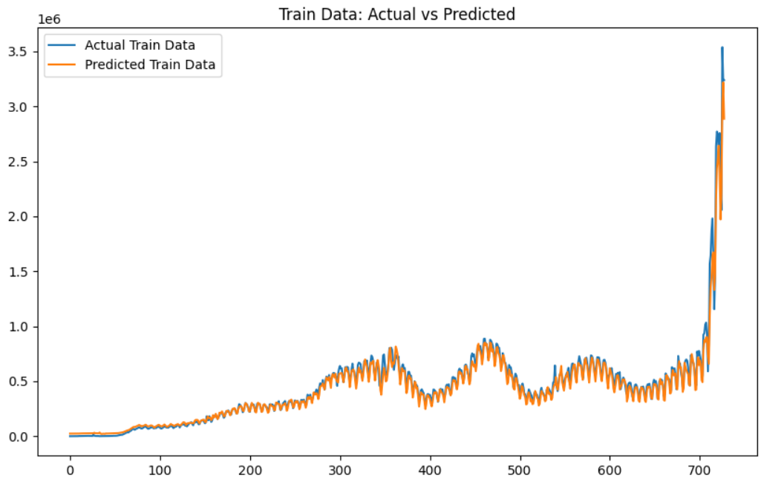
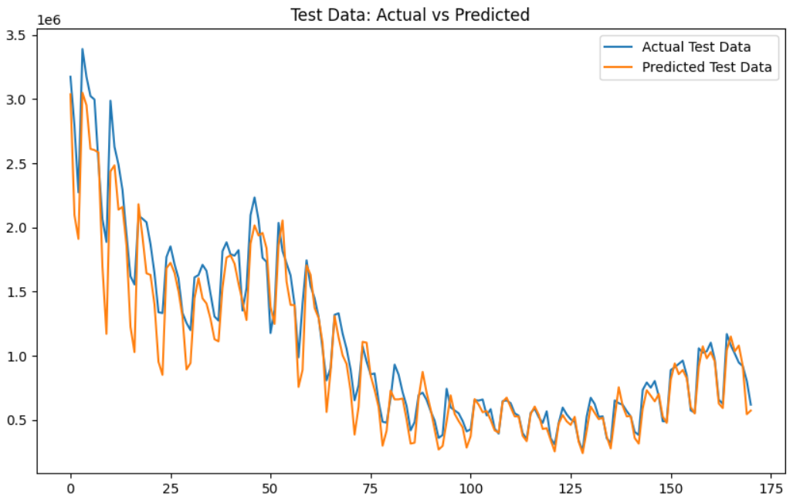

LSTM Approach
The plots shows how the prediction closely follows the actual dataset. This can be observed in both the training dataset as well as testing dataset. The analysis of the performance metrics gives the model accuracy of prediction on test dataset of 89%.

Slide 24
Decision tree

Slide 25
Approach

