Slide 1

Deep Learning for Automated Music Genre Classification Using Audio and Lyrical Features
Manav Mandal, Hrushikesh Attarde, Jayanand Hiremath
Deep Learning Systems

Slide 2
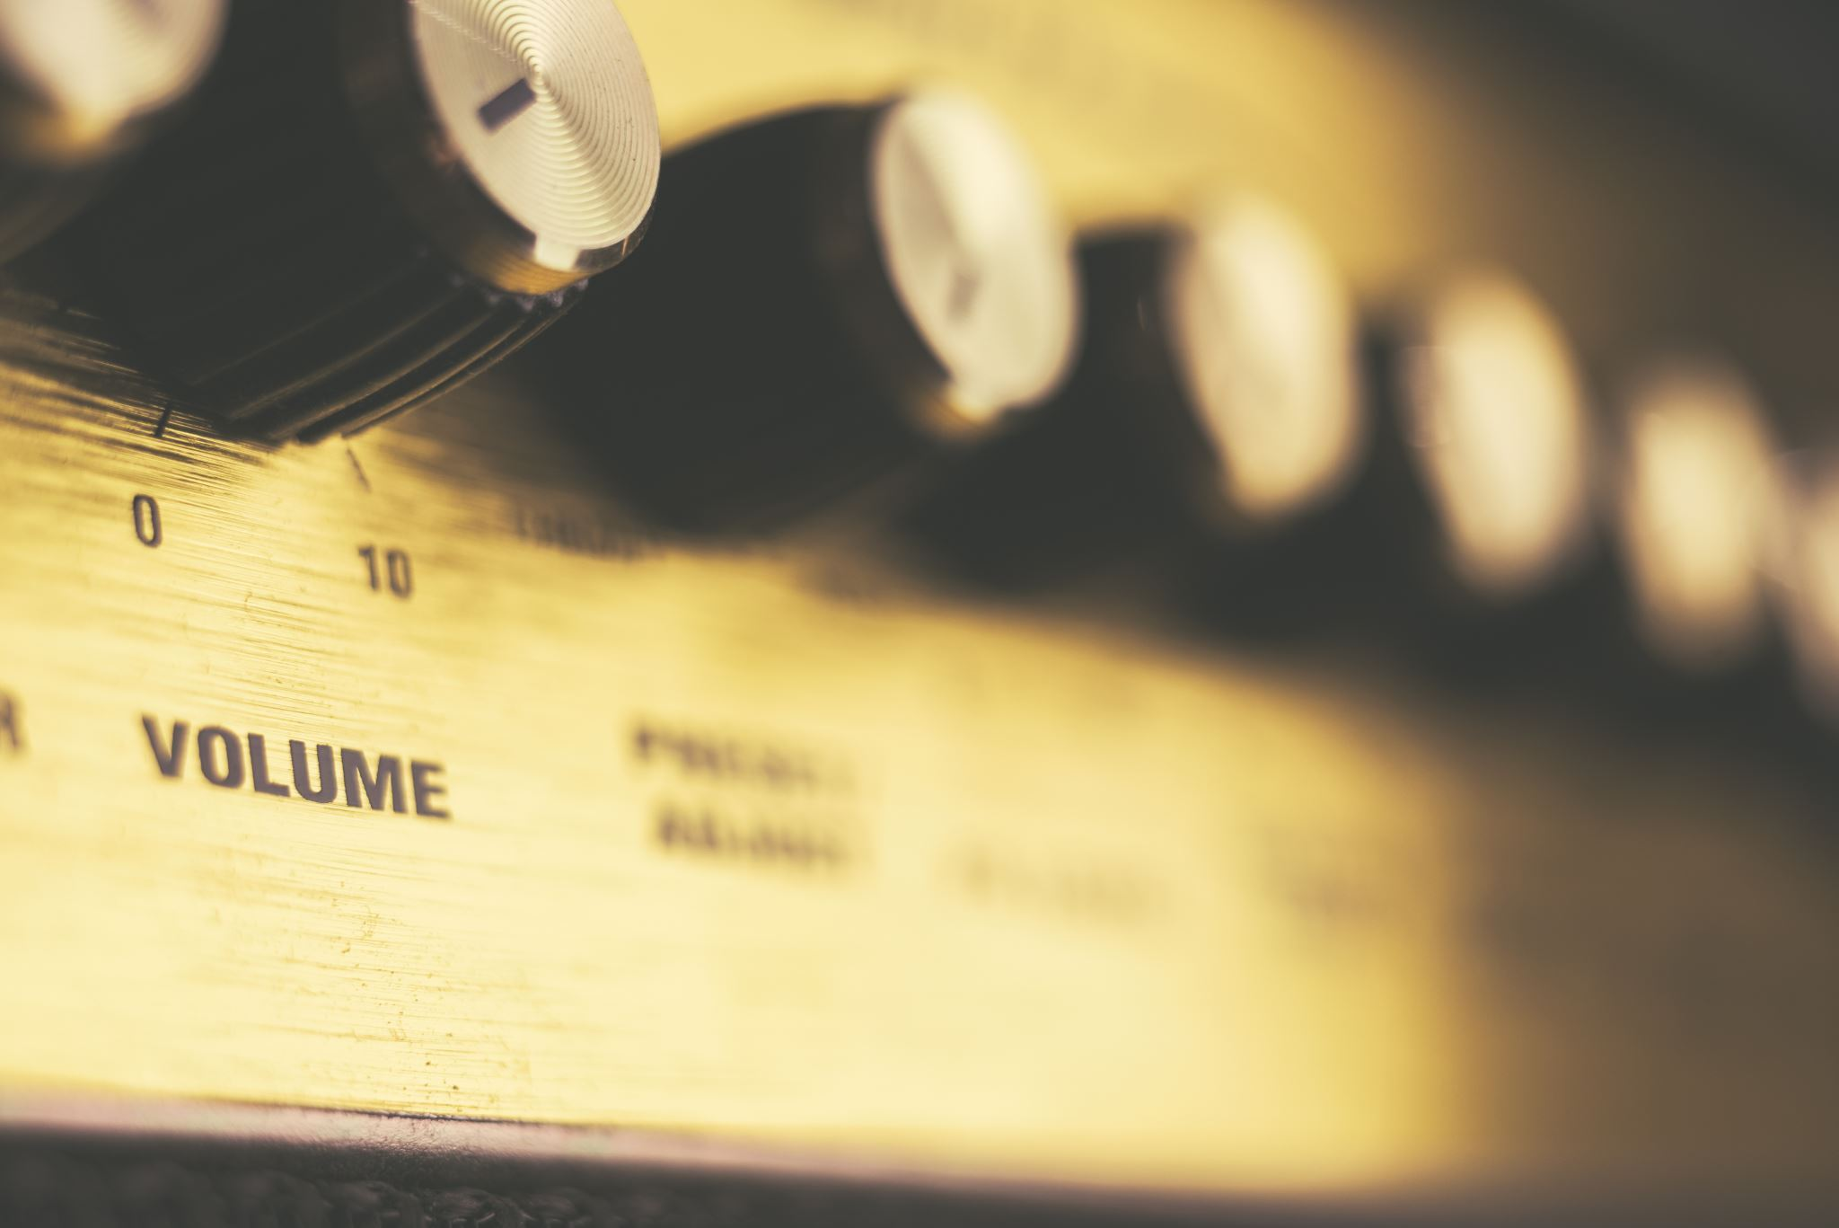
Introduction
Overview:
Music genre classification has applications in music recommendation, playlist generation, and audio content organization.
Goal:
Develop a multi-modal model that integrates audio and lyrical features to improve genre classification accuracy.
Why Multi-Modal?
Audio features capture rhythm, timbre, and pitch.
Lyrics provide semantic and cultural context.
Motivation:
Combining these features can provide a more holistic understanding of a song's genre.

Slide 3
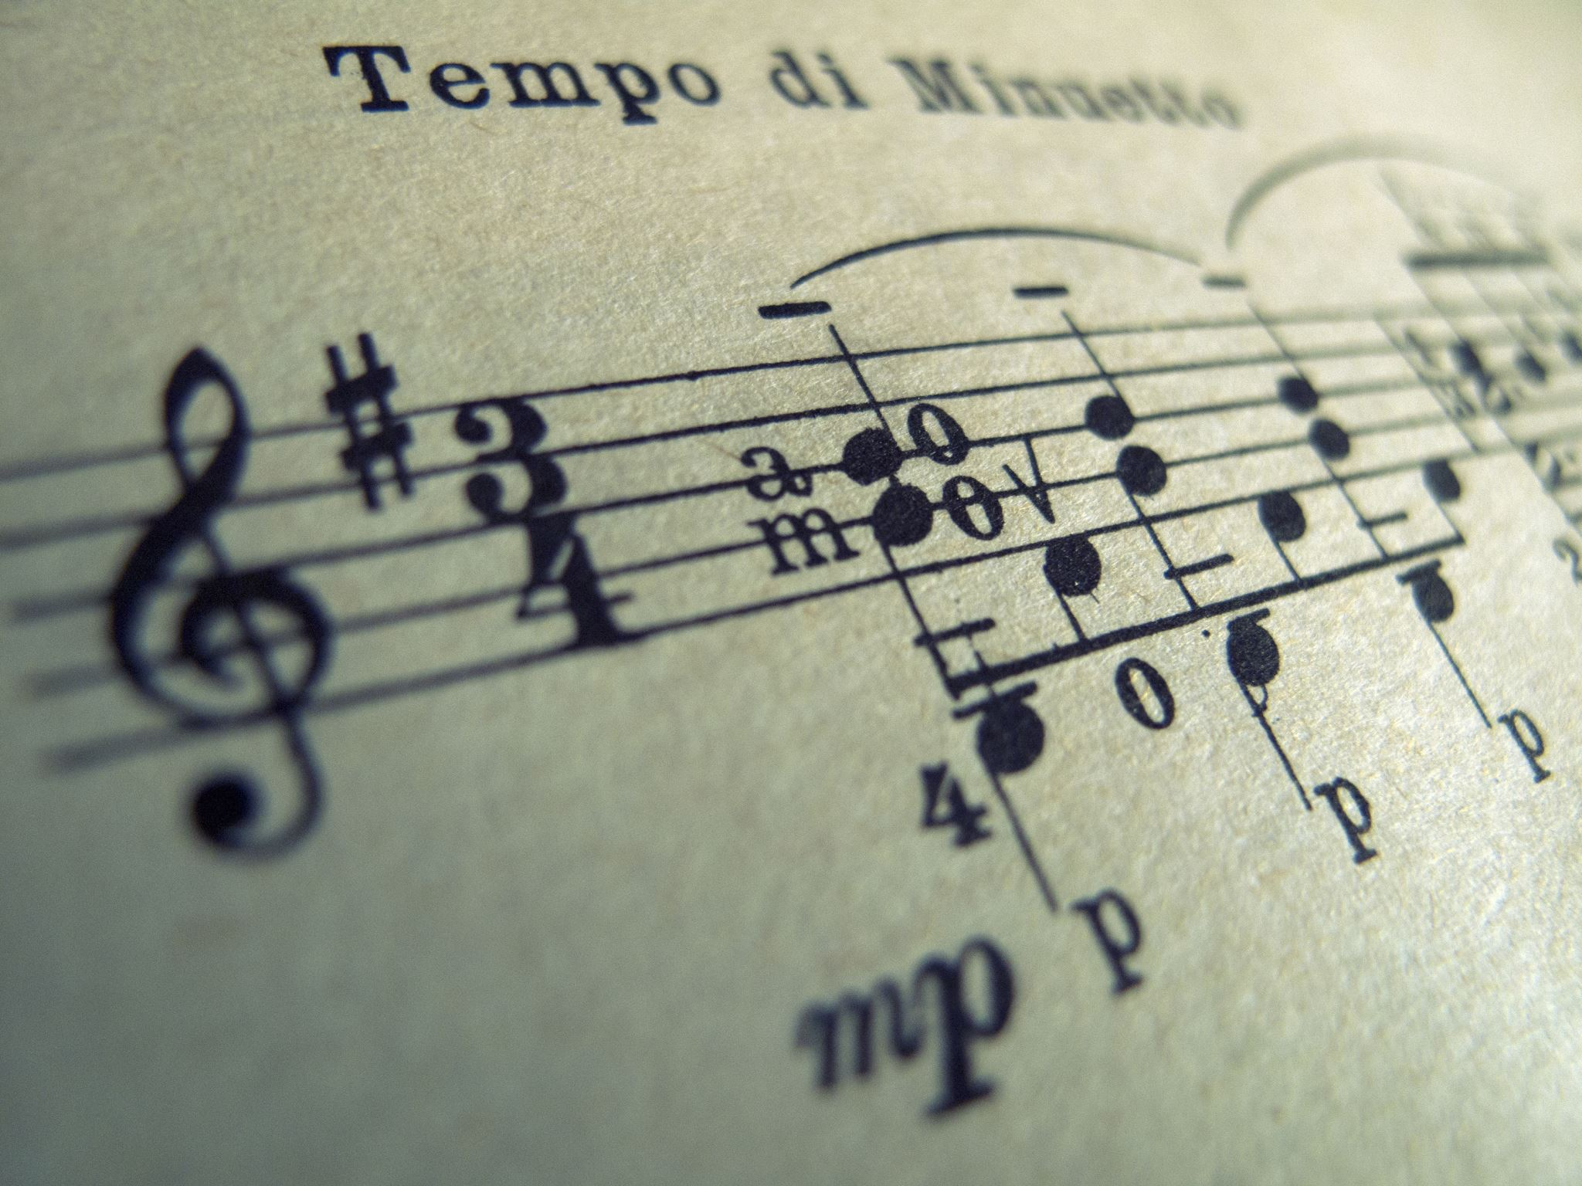
Motivation
Limitations of Single-Modality Approaches:
Audio-Only: Limited to acoustic patterns, missing lyrical context.
Lyrics-Only: Misses the tonal and instrumental cues from audio.
Examples:
Country music: Storytelling lyrics + distinct acoustic patterns.
Hip-hop: Repetitive hooks + beat patterns.
Objective:
Combine both modalities to create a more robust and accurate classifier.

Slide 4

Related Work
Choi et al. (2016):
Approach: CNNs using mel-spectrograms.
Outcome: State-of-the-art results with GTZAN dataset.
Limitations: Only considers audio data.
Oramas et al. (2018):
Approach: Textual data from album reviews for genre classification.
Outcome: Improved accuracy for genres where lyrics play a key role.
Limitations: Text-only approach.
Our Contribution:
A multi-modal approach combining CNN (audio) and BERT (lyrics).

Slide 5

Novelty of the Project
Multi-Modal Architecture:
Combines CNN for audio and BERT for lyrics.
Fusion Strategy:
Concatenation-based fusion of audio and lyrical features.
New Insights:
Analyzing the contributions of each modality using attention visualization.
Benchmarking against single-modality baselines.
Innovation:
Bridging the gap between acoustic analysis and semantic interpretation in genre classification.

Slide 6

Methodology Audio Feature Extraction
Dataset: GTZAN Genre Collection (1000 tracks, 10 genres).
Preprocessing Steps:
Convert to Mel-Spectrograms using Librosa.
Normalize spectrograms for consistency.
Model:
CNN Architecture:
3 convolutional layers with ReLU activation.
Batch Normalization and Dropout to prevent overfitting.
Flattened output used for fusion.

Slide 7

Methodology Lyrical Feature Extraction
Dataset: musiXmatch lyrics dataset.
Preprocessing Steps:
Tokenize lyrics.
Encode using pre-trained BERT model.
Generate fixed-length embeddings.
Model:
BERT extracts contextual and semantic information.
Output embedding passed to the fusion layer.

Slide 8
Fusion and Classification
Fusion Layer:
Concatenation of CNN and BERT feature vectors.
Potential for attention-based fusion (future improvement).
Classification Layer:
Fully connected dense layers with ReLU activation.
Softmax output layer for predicting 10 genres.
Output:
Probability distribution over genres:
Blues, Classical, Country, Disco, Hip-Hop, Jazz, Metal, Pop, Reggae, Rock.

Slide 9
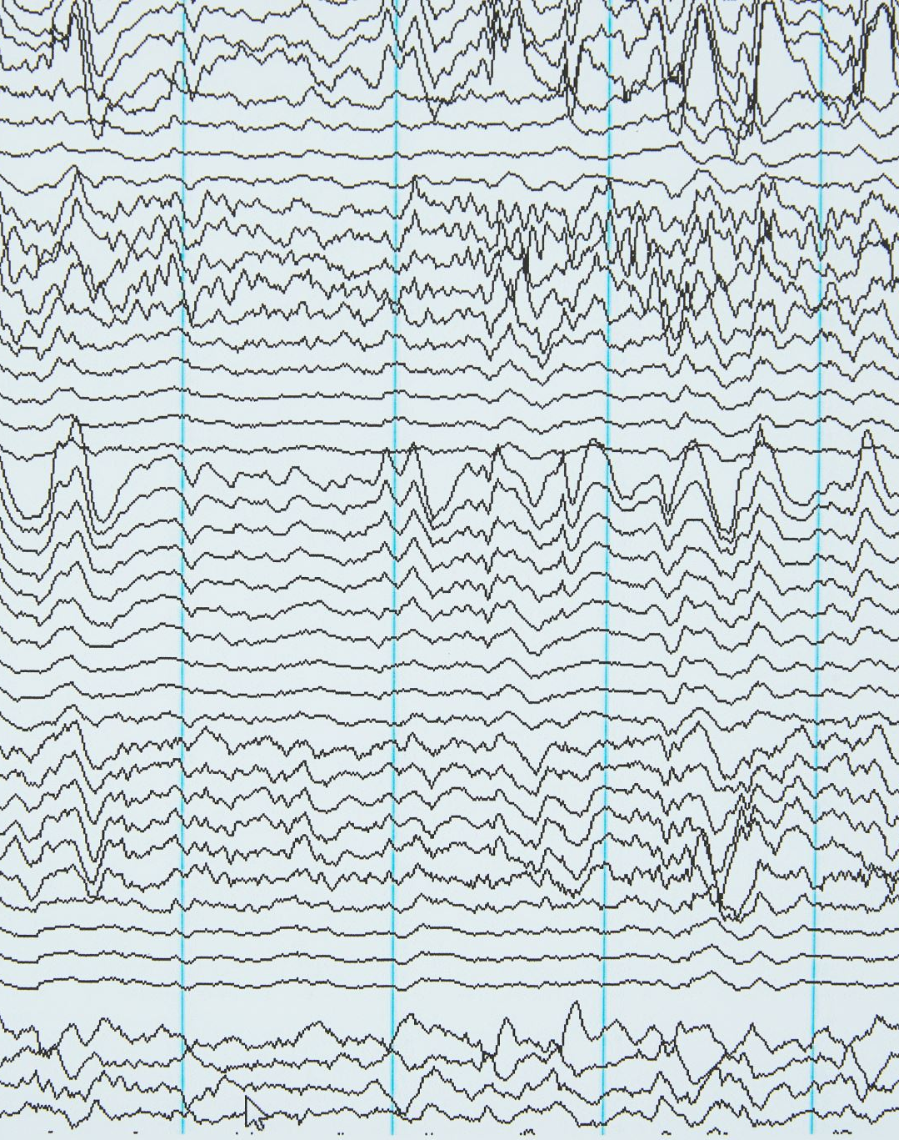
Audio Path:
Input Mel-Spectrogram ➔ CNN Layers ➔ Flatten ➔ Dense Layer (256) ➔ Audio Feature Vector (256)
Lyrics Path:
Input Lyrics ➔ BERT ➔ Dense Layer (256) ➔ Lyrical Feature Vector (256)
Fusion Path:
Concatenate Audio and Lyrical Feature Vectors (512) ➔ Dense Layer (256) ➔ Fused Feature Vector (256)
Classification:
Fused Feature Vector (256) ➔ Dense Layer (128) ➔ Output Layer (Softmax, 10 units) ➔ Predicted Genre

Slide 10
Experiment – Training and Evaluation
Train-Validation-Test Split:
70% Train, 15% Validation, 15% Test.
Training Parameters:
Loss Function: Categorical Cross-Entropy.
Optimizer: Adam (learning rate: 5e-5).
Epochs: 20.
Regularization: Batch Normalization, Dropout.
Evaluation Metrics:
Accuracy, Precision, Recall, F1-Score.

Slide 11
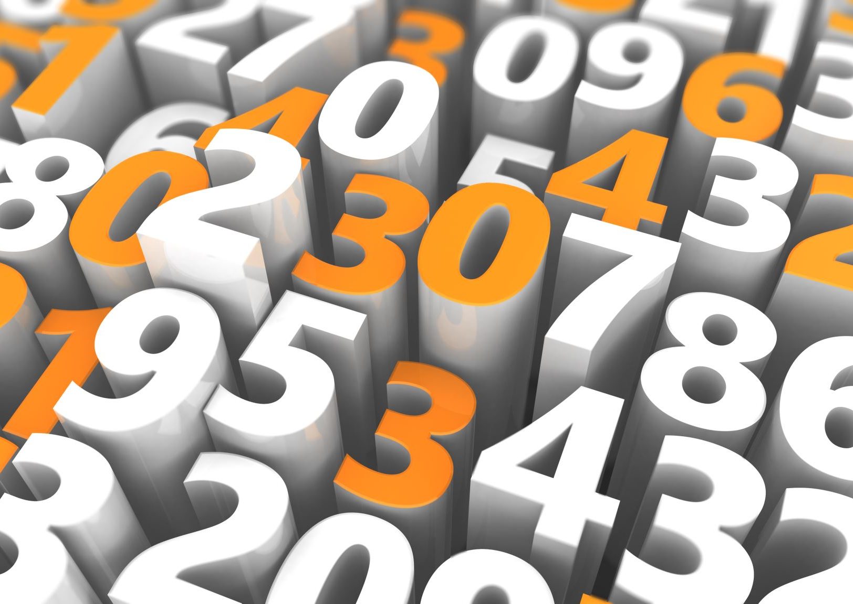
Results
Overall Accuracy: 29.33%.
Best Performing Genres:
Genre 1 (F1-Score: 0.56).
Genre 8 (F1-Score: 0.57).
Challenges:
Genres 2, 3, 5, and 9 show low accuracy due to overlapping features.
Confusion Matrix:
Visual representation highlighting genre misclassifications.

Slide 12

Challenges and Future Work
Challenges:
Computational demands of training BERT.
Balancing contributions from audio and lyrics.
Differentiating genres with overlapping features.
Future Improvements:
Attention-Based Fusion.
Data Augmentation for lyrics and audio.
Exploring Transformer-Based Audio Models.

