Slide 1
Blue Feathers College LAN Network
Network Design Exceeding Expectations
By Aaron Barlow, Cameron Justice, Jeremy Blair, and Kevin Tipton

Slide 2
Project Delegation
Aaron Barlow - task 4 and PowerPoint Presentation
Kevin Tipton - Task 1
Cameron Justice - Task 2
Jeremy Blair - Task 3

Slide 3
Broad Requirements
2 adjacent computer labs
Rack: 2 2-U network switches, 1 2-U router, 2 2-U panels
Horizontal cabling: 30 computers and 2 printers per lab
Minimum of 100 Mbps ethernet speed
Cat 6 ethernet cables
Only 8, 12, 16, 24, or 48 port switches allowed
Horizontal cable minimum length is 80 meters

Slide 4
Subnet Setup
IP Addressing Parameters | Value
Subnet address | 192.168.0.0
Subnet mask | 255.255.255.128
Broadcast address | 192.168.0.127
Usable IP address range | 192.168.0.1 - 192.168.0.126
Default gateway address | 192.168.0.1

Slide 5
Cabling
96 Cable Slots between two 48-Port Patch Panels
64 Used Cable Slots
32 Unused Cable Slots
All Cable Runs use CAT-6 UTP Ethernet Cables

Slide 6
Network Components
 | Quantity | Unit Price | Total Cost | Sources
Patch cord | 128 | $5.94 | $760.32 | Amazon.com
RJ-45 Jack | 75 (3 packs of 25) | $54.99 | $164.97 | Newegg.com
Wall outlet | 16 (8 per room) | $19.99 | $319.84 | Newegg.com
Horizontal Cable | 64 | $169.99 | $10879.36 | Cables4Sure.com
Patch panel | 2 | $103.82 | $207.64 | Amazon.com
Router | 1 | $588.95 | $588.95 | Newegg.com
Switch | 2 | $116.48 | $232.96 | Newegg.com
Rack | 1 | $322.76 | $322.76 | Newegg.com

Slide 7
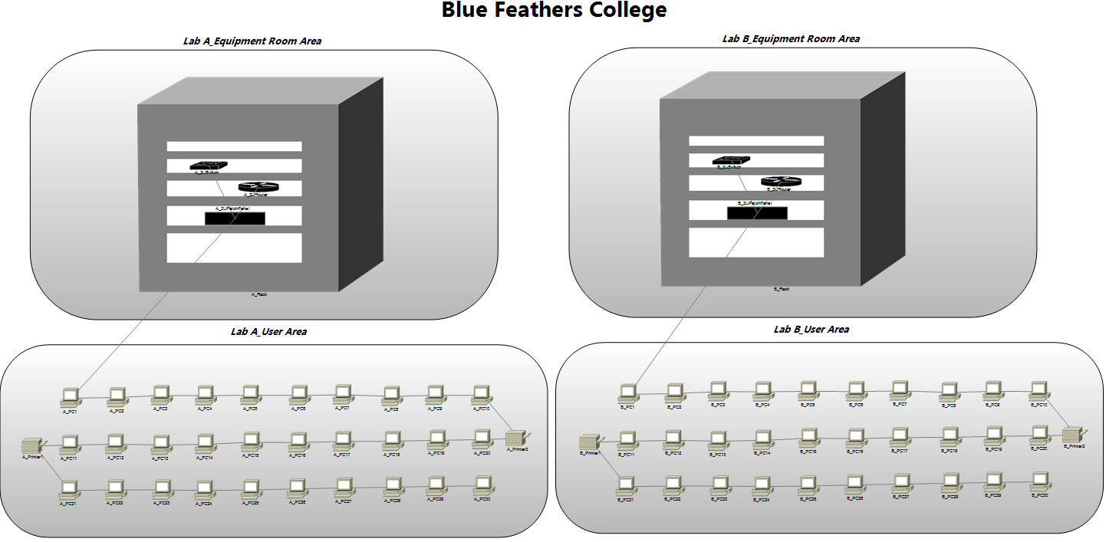
Network Diagram

Slide 8
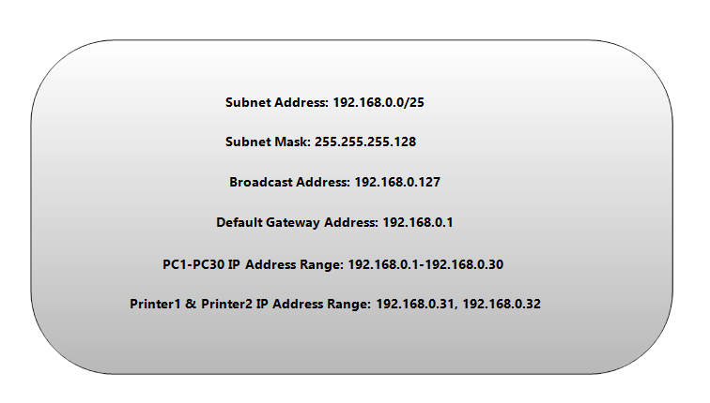
Lab A Logical Addressing Scheme

Slide 9
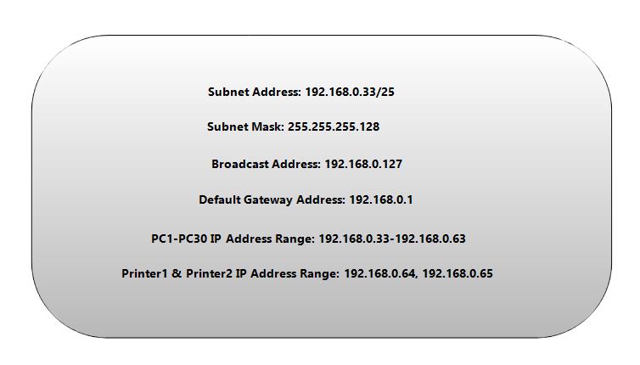
Lab B Logical Addressing Scheme

Slide 10
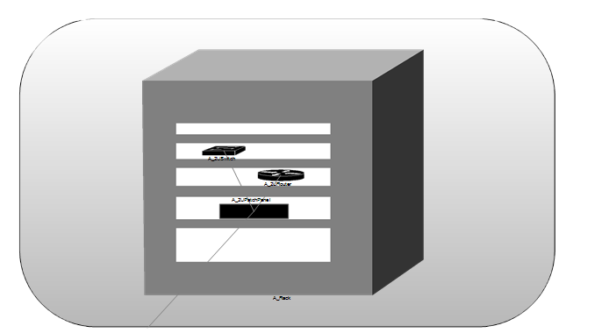
Lab A Equipment Room

Slide 11
Lab B Equipment Room

Slide 12
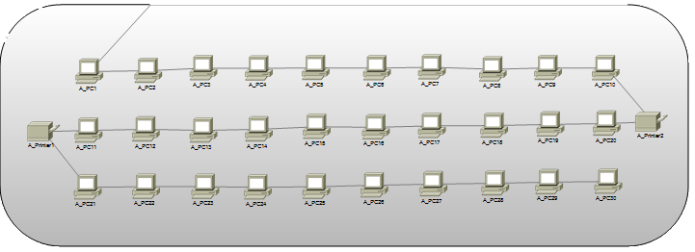
Lab User Area A

Slide 13
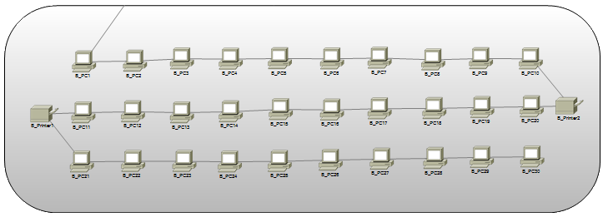
Lab User Area B

Slide 14
Conclusion
Fully functional network
The requirements were exceeded:
100 Mbps ethernet speed requested
Up to 1 Gbps ethernet speed provided
The cost was $13,476.80

