Slide 1
ALADIN: Active Learning for Statistical Intrusion Detection
Jay Stokes, Microsoft Research
John Platt, Microsoft Research
Joseph Kravis, Microsoft Network Security
Michael Shilman, ChatterPop, Inc.
NIPS Workshop 2007 – Machine Learning in Adversarial Environments for Computer Security
12/8/2007

Slide 2
Motivation
Metadata of Microsoft’s external internet traffic is logged using ISA Server Firewall
  ISA – Internet Security and Acceleration
Up to 35 million log entries per day
Security analysts must search for and identify new anomalies
Looking for new malware, bad PTP, etc.
Can machine learning help?
NIPS Workshop 2007 – Machine Learning in Adversarial Environments for Computer Security
12/8/2007

Slide 3
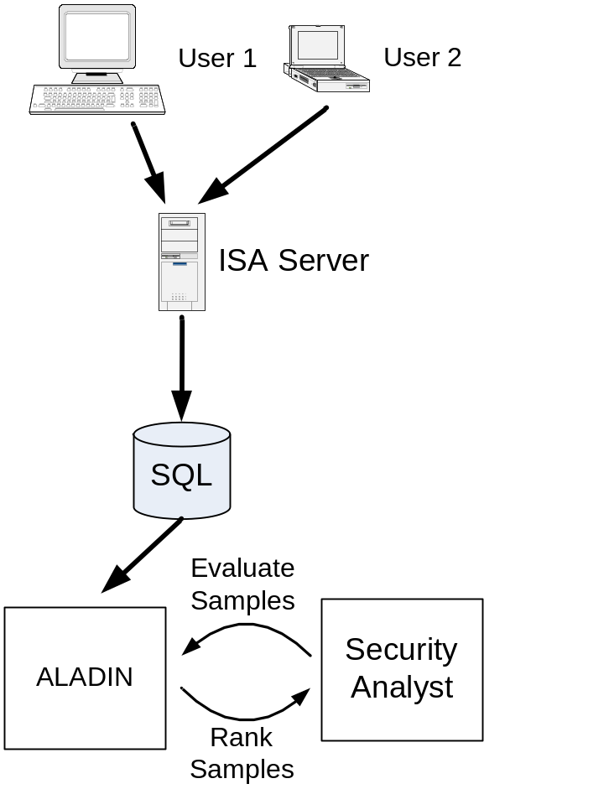
Active Learning
Human interactively provides labels for new sample
Network traffic metadata logged to SQL
ALADIN evaluates and ranks samples
Security Analyst labels samples
ALADIN reranks samples and repeats
NIPS Workshop 2007 – Machine Learning in Adversarial Environments for Computer Security
12/8/2007

Slide 4
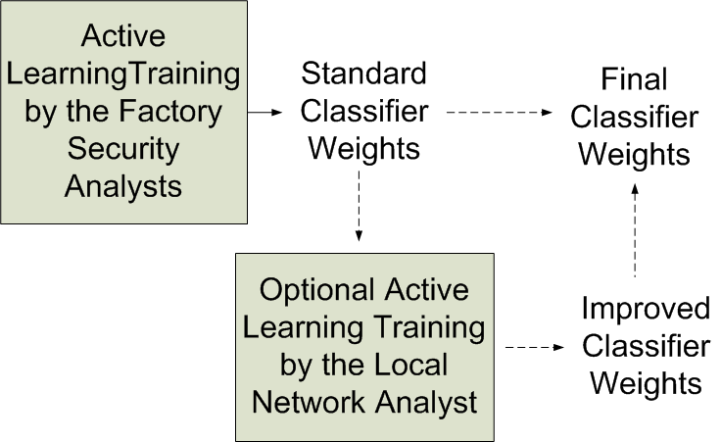
ALADIN
Multiclass classifier for monitoring network traffic
Goal: Minimize analyst labeling time
Weights can be adaptively improved at user’s site
NIPS Workshop 2007 – Machine Learning in Adversarial Environments for Computer Security
12/8/2007

Slide 5
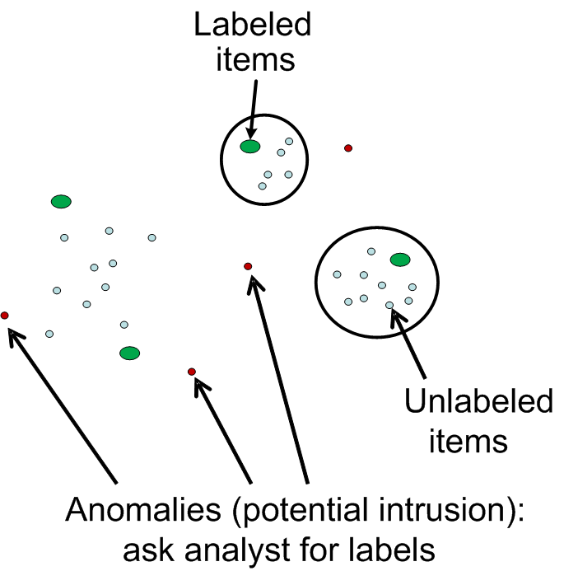

Choosing Samples for Labeling – Active Anomaly Detection
Label only anomalies (Pelleg, Moore, NIPS04)
Discover rare and interesting classes
Multiclass model
  Avoid “Normal” vs. “Not Normal” problem
Leads to high error rates
NIPS Workshop 2007 – Machine Learning in Adversarial Environments for Computer Security
12/8/2007

Slide 6
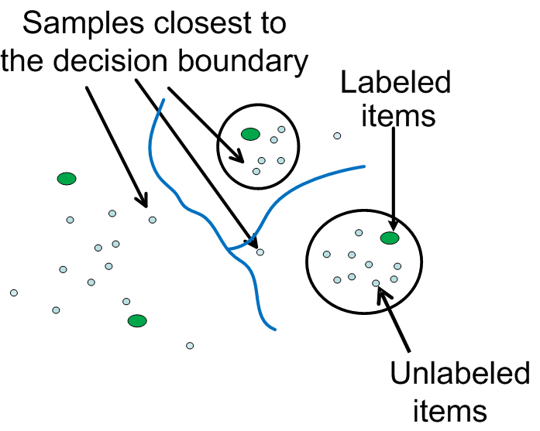

Choosing Samples for Labeling – Active Learning
Label only samples closest to the decision boundary (Almgren, Jonsson, CSFW04)
RBF SVM
Ignore samples located away from the decision boundaries
May not find new classes
NIPS Workshop 2007 – Machine Learning in Adversarial Environments for Computer Security
12/8/2007

Slide 7
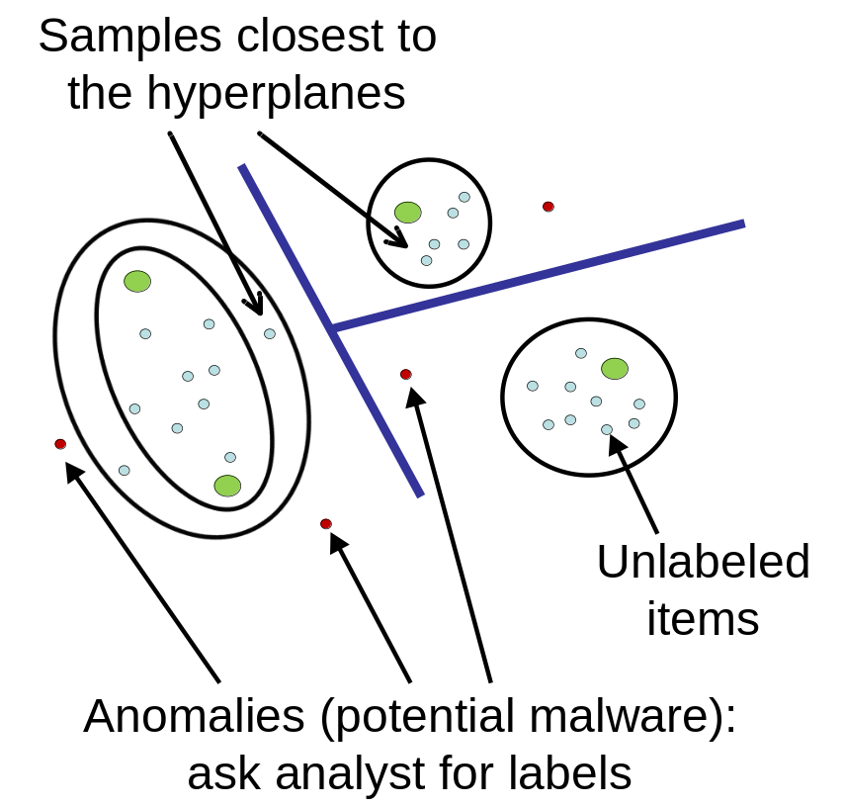
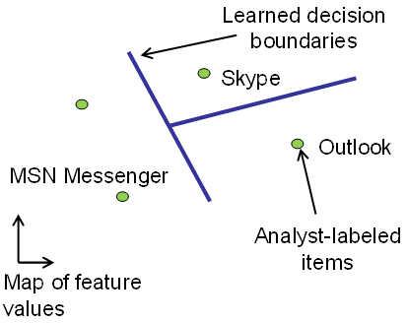
ALADIN: Combines Active Anomaly Detection and Active Learning
NIPS Workshop 2007 – Machine Learning in Adversarial Environments for Computer Security
12/8/2007

Slide 8
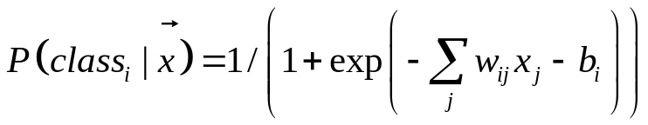
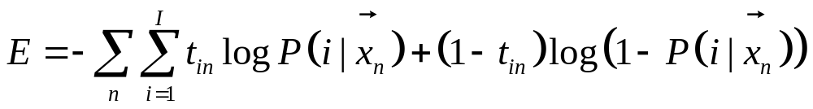
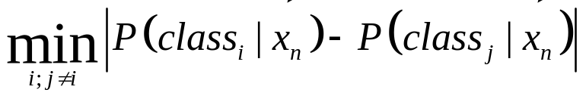
Classification Stage
Discriminative Learning, Logistic Regression
Minimize cross entropy function
Uncertainty Score
Fast computation for interactive labeling
Scales well
NIPS Workshop 2007 – Machine Learning in Adversarial Environments for Computer Security
12/8/2007

Slide 9
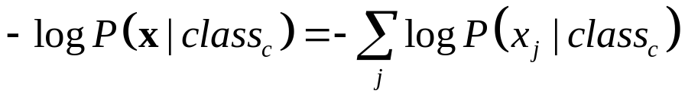
Modeling Stage
naïve Bayes Model
Training Data
  labeled data
  predicted labels of the unlabeled data
Anomaly Score
Fast computation for interactive labeling
Scales well
NIPS Workshop 2007 – Machine Learning in Adversarial Environments for Computer Security
12/8/2007

Slide 10
Network Intrusion Detection Results
KDD-Cup 99 Data Set
Provides Oracle Labels
100K Samples
Use All Features in the Data
Label 10 Initial Samples Randomly
100 Samples Labeled per Iteration
NIPS Workshop 2007 – Machine Learning in Adversarial Environments for Computer Security
12/8/2007

Slide 11
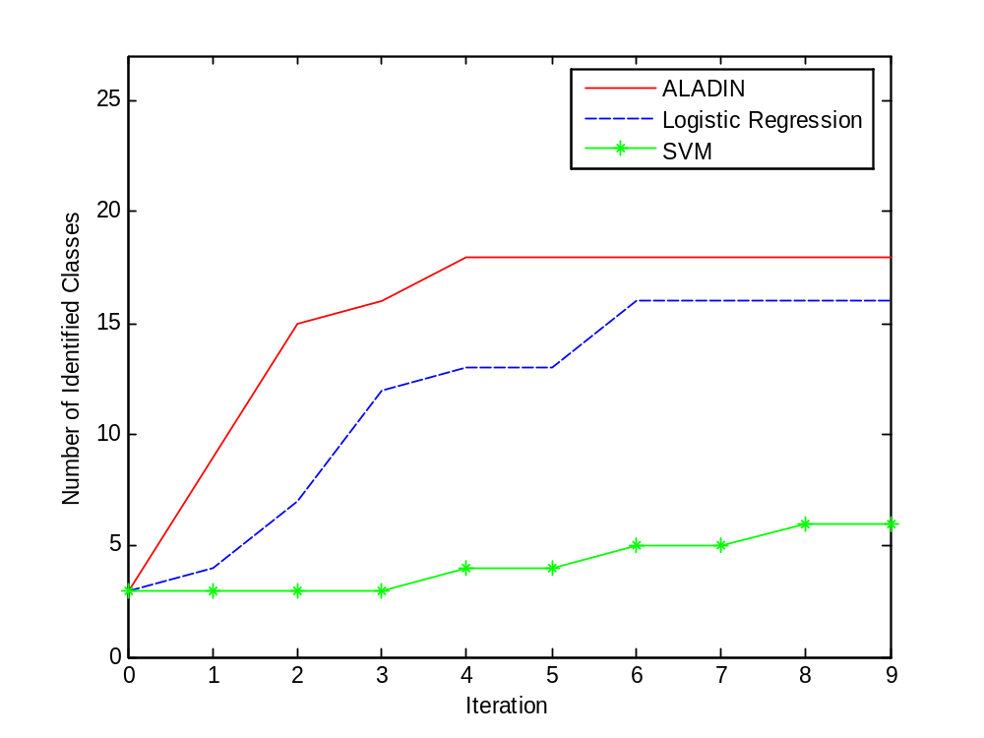
Results – Anomaly Detection
NIPS Workshop 2007 – Machine Learning in Adversarial Environments for Computer Security
12/8/2007

Slide 12
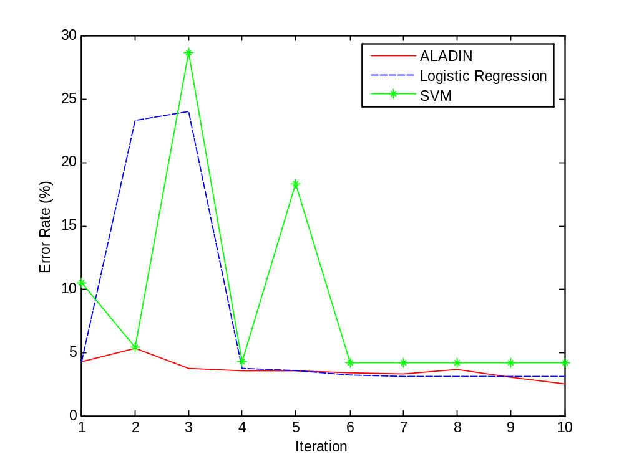
Results – Prediction Accuracy
NIPS Workshop 2007 – Machine Learning in Adversarial Environments for Computer Security
12/8/2007

Slide 13
FP/FN Per Class
True Label | Num Labeled Samples | True Predicted Label | TP Count | Incorrectly Predicted Label | FN Count | FP Rate | FN Rate
normal | 551 | normal | 55715 | satan | 3 | 4.12% | 0.20%
 |  |  |  | guess_passwd | 10
 |  |  |  | ipsweep | 67
 |  |  |  | back | 2
neptune | 57 | neptune | 20425 |  |  | 0.00% | 0.00%
smurf | 82 | smurf | 18904 | normal | 7 | 0.00% | 0.04%
back | 36 | back | 5 | normal | 1961 | 0.00% | 99.75%
ipsweep | 58 | ipsweep | 675 | normal | 27 | 0.07% | 3.85%
satan | 49 | satan | 470 | normal | 20 | 0.00% | 4.08%
portsweep | 54 | portsweep | 223 | normal | 1 | 0.00% | 0.45%
NIPS Workshop 2007 – Machine Learning in Adversarial Environments for Computer Security
12/8/2007

Slide 14
Malware Detection on Microsoft Network Logs
Analyzed several daily log files.
Identified “5.exe” on the corporate network which was not previously identified
  Trojan.Esteems.D. 5.exe monitors user Internet activity and private information. It sends stolen data to a hacker site.
Identified several other worms (NewApt Worm, Win32.Bropia.T, W32.MyDoom.B), and keyloggers (svchqs.exe)
  All of which were currently logged
  Some waiting to be labeled
  All currently blocked by ISA firewall rules
NIPS Workshop 2007 – Machine Learning in Adversarial Environments for Computer Security
12/8/2007

Slide 15
Conclusions
ALADIN discovers rare and interesting classes
ALADIN maintains low classification error
Scales due to fast learning with logistic regression and naïve Bayes
Identifies network intrusion attacks
Identifies malware via network traffic patterns
Tech Report: http://research.microsoft.com/~jstokes
NIPS Workshop 2007 – Machine Learning in Adversarial Environments for Computer Security
12/8/2007

Slide 16
ALADIN: Active Learning for Statistical Intrusion Detection
Jay Stokes, Microsoft Research
John Platt, Microsoft Research
Joseph Kravis, Microsoft Network Security
Michael Shilman, ChatterPop, Inc.
NIPS Workshop 2007 – Machine Learning in Adversarial Environments for Computer Security
12/8/2007

