Slide 1
IVP COURSE PROJECT
“COVID-19 detection in Chest X-ray images using deep learning techniques”
C-3
Group NO. - 10
Presented By -
NIKHIL DUBEY (IIT2020016)
Raunak Krishan Jaiswal (IIT2020031)
Aditya Biswakarma (IIT2020033)
Anupam raj (IIT2020034)
Katam Bala Prasanna Babu (IIT2020040)
Jay Suthar (IIT2020087)
Rohan Tirkey (IIT2020088)
Instructor - Prof. Anupam Agarwal

Slide 2
Index
Problem Statement
Introduction
Literature review
Methodology & flowchart
Experimental data descriptions
Tools, Language & libraries used for implementation
Activity chart
Intermediate result snapshots with their description
Work remaining
References

Slide 3
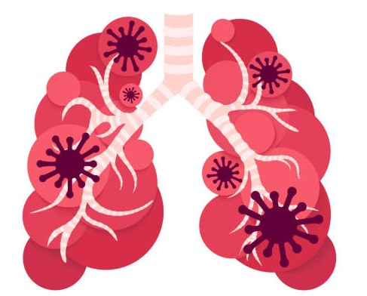
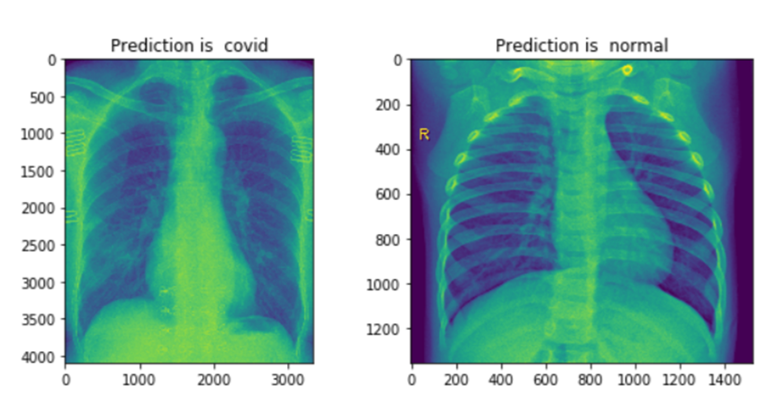
Problem Statement
The objective is to create a model which
detects the
COVID-19 Chest X-ray images using deep learning techniques.

Slide 4
Introduction
The year 2020 was marked by a pandemic disease caused by a type of the coronavirus (CoV) family, called COVID-19 or SARS-CoV-2, which led to more than four million infections and more than 355,000 deaths worldwide.
This research paper has created an accurate classification method to perform reliable detection of the viral COVID-19 patterns. we have proposed a Deep Convolutional Neural Network-based solution which can detect the COVID-19 +ve patients using chest X-Ray images.
We have proposed a solution based on a deep convolutional neural network that can detect patients with COVID-19+ using chest X-rays. Several state-of-the-art CNN models – VGG16, VGG19, and ResNet50 – were adopted in the proposed work. We will also implement a custom CNN architecture model. These models will be individually trained to make independent predictions. And at the end, we compare the results for each approach for accuracy.
The widespread use of CNNs for image classification tasks is due to the fact that they have demonstrated high accuracy in the areas of image recognition and object detection.

Slide 5
Literature review
We have used 8 research papers for our reference -
The Complete LR can be accessed with the following link -
https://docs.google.com/spreadsheets/d/1LQwwrCzTIFYpspgto2lBXqFJiUETaC6q/edit?usp=sharing&ouid=102962082556326646196&rtpof=true&sd=true

Slide 6
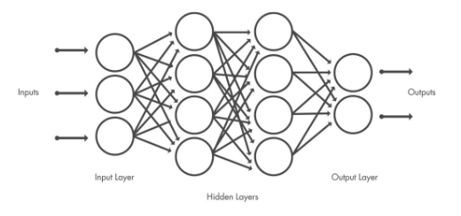
Methodology & flowchart
Convolutional Neural Network (CNN)- A Convolutional Neural Network (ConvNet/CNN) is a Deep Learning algorithm that can take in an input image, assign importance (learnable weights and biases) to various aspects/objects in the image, and be able to differentiate one from the other. The pre-processing required in a ConvNet is much lower as compared to other classification algorithms. While in primitive methods filters are hand-engineered, with enough training, ConvNets have the ability to learn these filters/characteristics.
Like other neural networks, a CNN is composed of an input layer, an output layer, and many hidden layers in between.

Slide 7
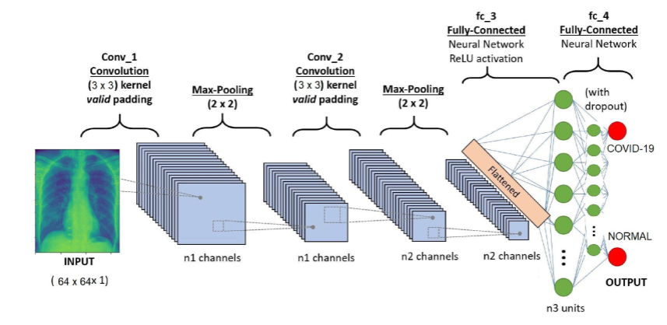
The proposed CNN is based on pre-trained transfer models such as VGG16, VGG19, and ResNet50 as well as our own architectural model in order to obtain high prediction accuracy from a small sample of X-ray images. The images are classified into two classes, No_findings/normal and Covid-19.
To overcome the insufficient data and training time, a transfer learning technique is applied by employing the ImageNet dataset. The implementation will use Keras with a TensorFlow backend, which will be performed, then adapted to our dataset full of X-ray images in Covid-19 and No_findings folders.

Slide 8
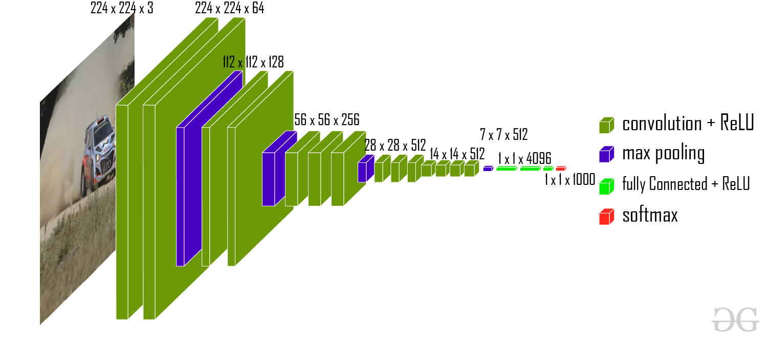
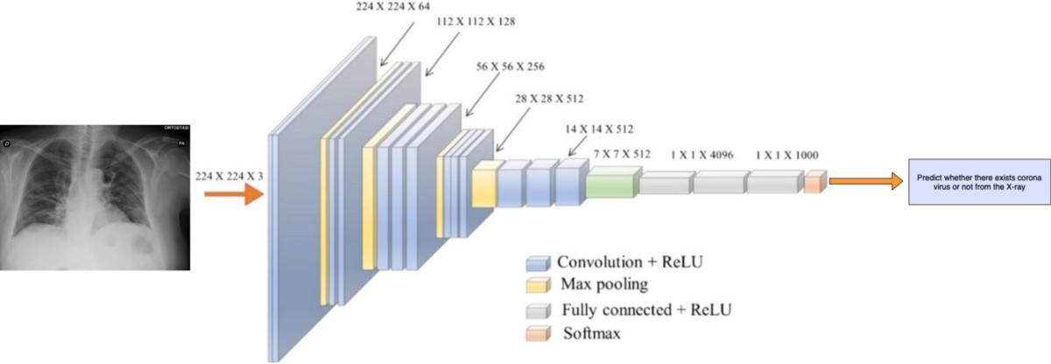
VGG16 -
VGG19 -

Slide 9
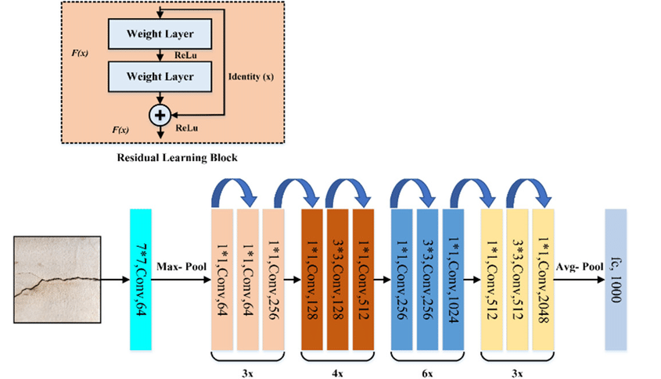
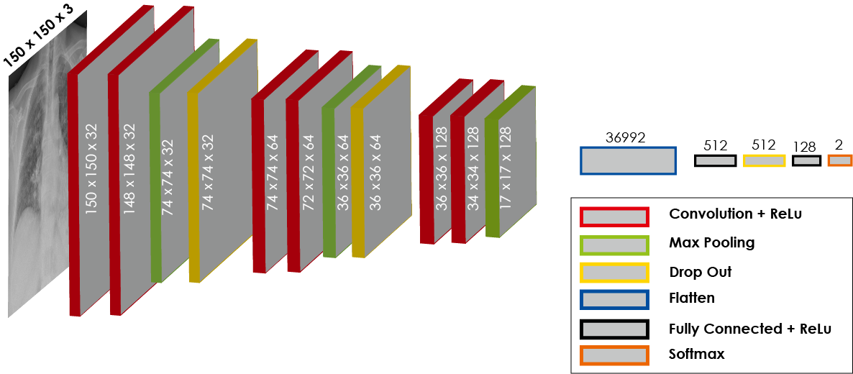
ResNet50
Custom Architecture(Own Architecture)

Slide 10
Experimental data descriptions
We have taken the dataset for this model from https://github.com/ieee8023/covid-chestxray-dataset .
This Data is collected from public sources as well as through indirect collection from hospitals and physicians.
Data impact: Image data linked with clinically relevant attributes in a public dataset that is designed for ML will enable parallel development of these tools and rapid local validation of models.

Slide 11
Tools, Language & libraries used for implementation
Software Technologies Required -
Python (latest version)
Or Google Colab Or Jupyter Notebook for running ipynb file
Other important libraries required will be -
TensorFlow
Keras
Scikit-Learn (sklearn)
Pandas
Numpy
Matplotlib (pyplot)
seaborn
Hardware Requirements
Graphics Card / GPU (if possible) (Google Colab will perform better)

Slide 12
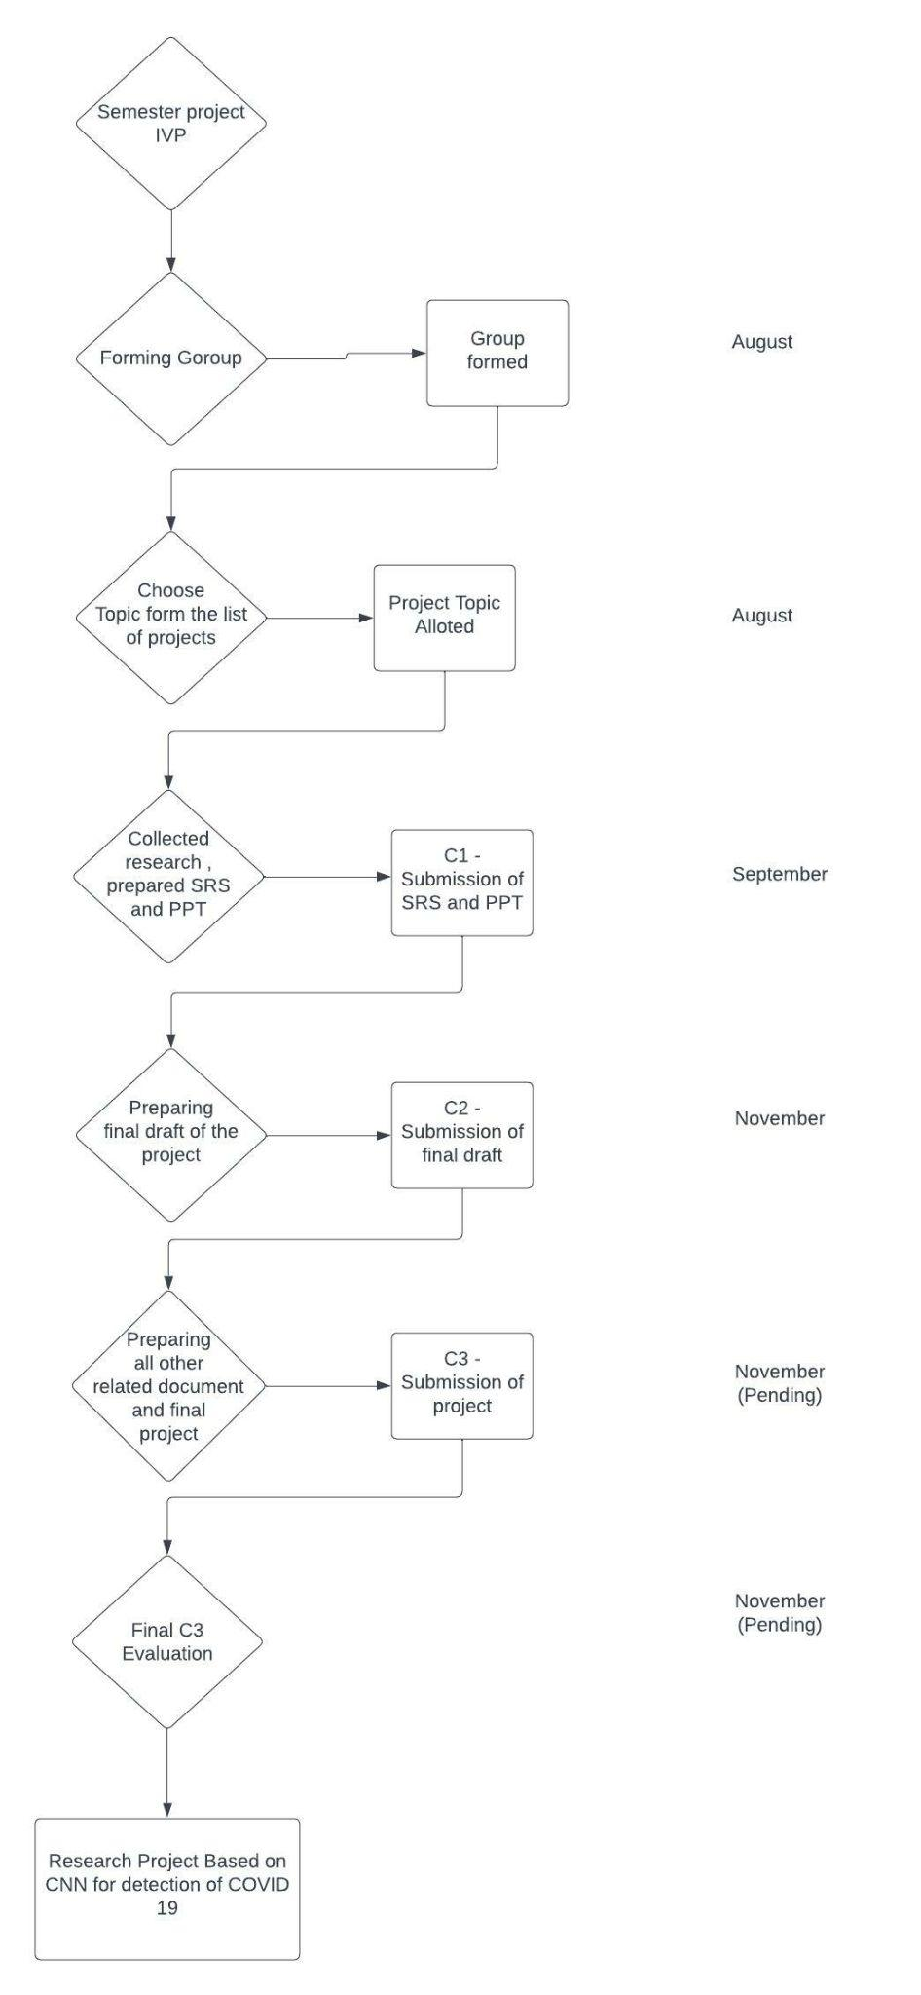
Activity Time Chart

Slide 13
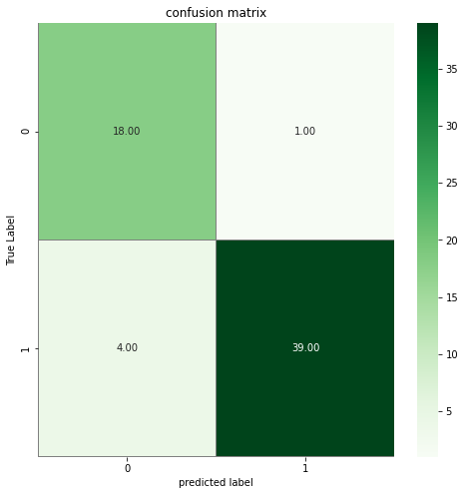
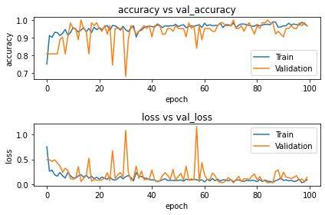
Intermediate result snapshots with their description
ResNet50
train/validation Accuracy and Loss graphs -
Confusion Matrix
— Please note that 0 and 1 values represent Covid-19 and No_findigs respectively.

Slide 14
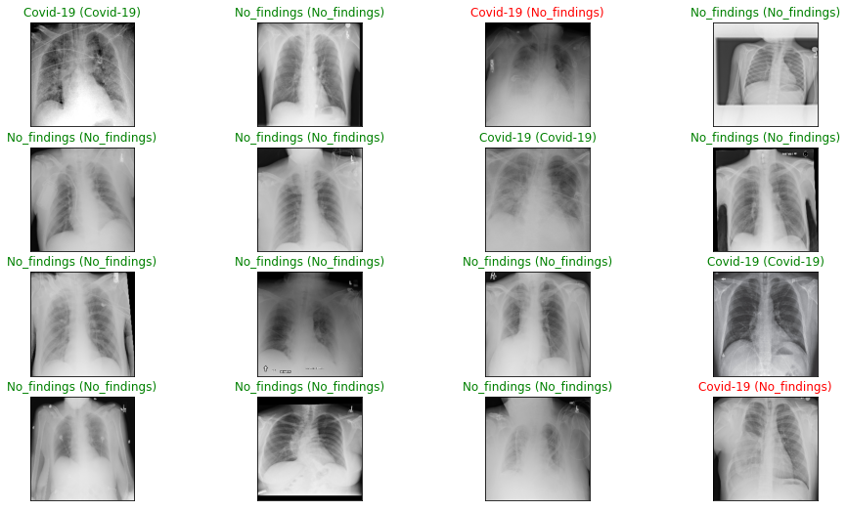
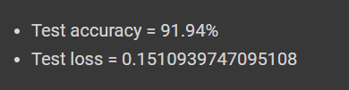
test of our model against more random samples from the test data -

Slide 15
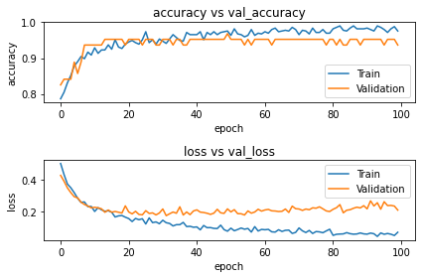
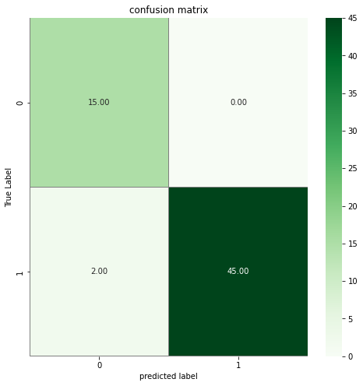
VGG16
train/validation Accuracy and Loss graphs -
Confusion Matrix
— Please note that 0 and 1 values represent Covid-19 and No_findigs respectively.

Slide 16
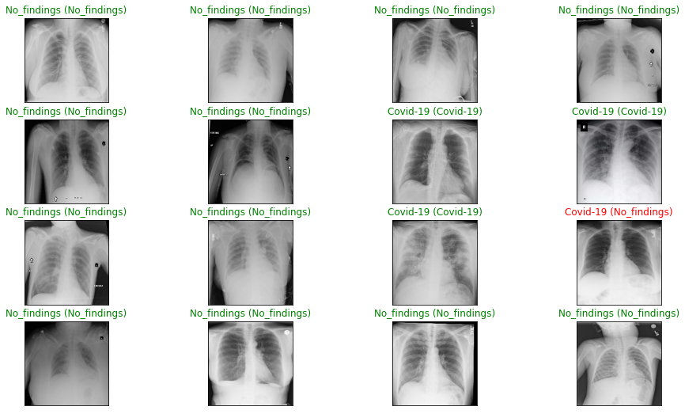

test of our model against more random samples from the test data -

Slide 17
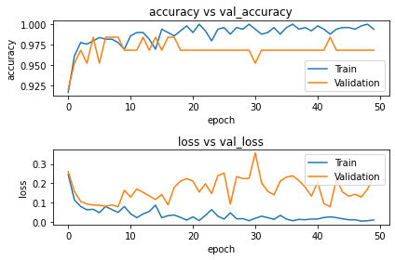
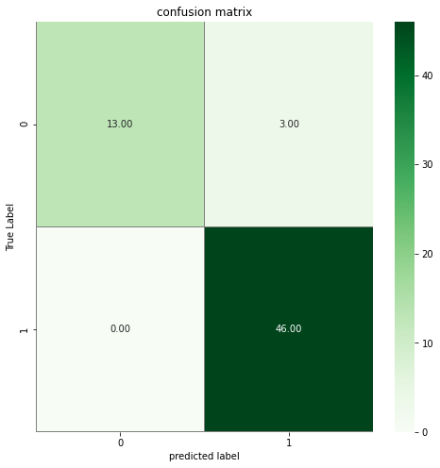
VGG19
train/validation Accuracy and Loss graphs -
Confusion Matrix
— Please note that 0 and 1 values represent Covid-19 and No_findigs respectively.

Slide 18
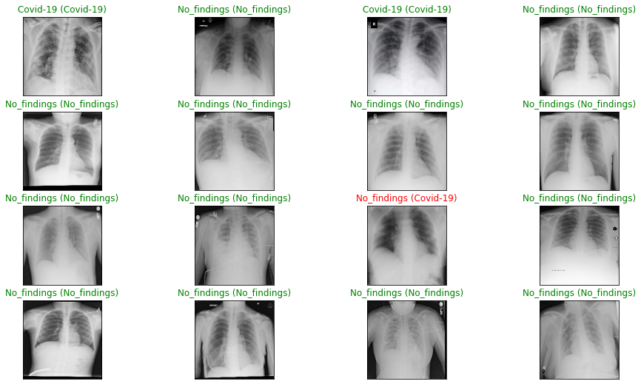

test of our model against more random samples from the test data -

Slide 19
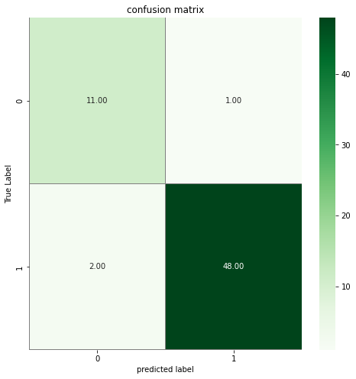
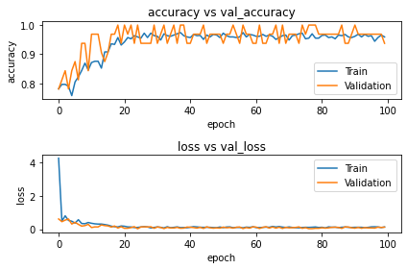
Custom(Own Model)
train/validation Accuracy and Loss graphs -
Confusion Matrix
— Please note that 0 and 1 values represent Covid-19 and No_findigs respectively.

Slide 20
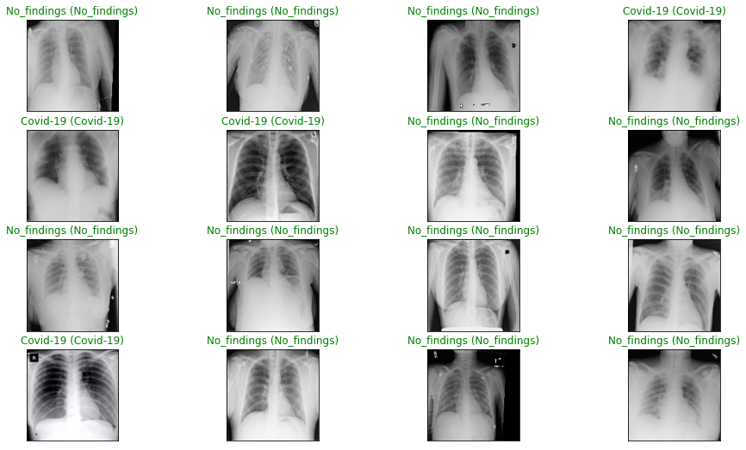

test of our model against more random samples from the test data -

Slide 21
Work Remaining
We need to do more testing of this model for evaluating the performance of a fully trained model on a testing set.
We need to use more dataset for hyperparameter tuning for maximizing the model's performance, minimizing a predefined loss function to produce better results with fewer errors.

Slide 22
References
Ahsan, Mominul, Md Abdul Based, Julfikar Haider, and Marcin Kowalski. "COVID-19 detection from chest X-ray images using feature fusion and deep learning." Sensors 21, no. 4 (2021): 1480.
Das, Amit Kumar, Sayantani Ghosh, Samiruddin Thunder, Rohit Dutta, Sachin Agarwal, and Amlan Chakrabarti. "Automatic COVID-19 detection from X-ray images using ensemble learning with convolutional neural network." Pattern Analysis and Applications 24, no. 3 (2021): 1111-1124.
Chen, Joy Iong-Zong. "Design of accurate classification of COVID-19 disease in X-ray images using deep learning approach." Journal of ISMAC 3, no. 02(2021): 132-148.
Makris, Antonios, Ioannis Kontopoulos, and Konstantinos Tserpes. "COVID-19 detection from chest X-Ray images using Deep Learning and Convolutional Neural Networks." In 11th hellenic conference on artificial intelligence, pp. 60-66. 2020.
·

Slide 23
References(Contd.)
Hussain, Emtiaz, Mahmudul Hasan, Md Anisur Rahman, Ickjai Lee, Tasmi Tamanna, and Mohammad Zavid Parvez. "CoroDet: A deeplearning based classification for COVID-19 detection using chest X-ray images." Chaos, Solitons & Fractals 142 (2021): 110495.
Akter, Shamima, FM Javed Mehedi Shamrat, Sovon Chakraborty, Asif Karim, and Sami Azam. "COVID-19 detection using deep learning algorithm on chest X-ray images." Biology 0, no. 11 (2021): 1174.
Yang, Dandi, Cristhian Martinez, Lara Visuña, Hardev Khandhar, Chintan Bhatt, and Jesus Carretero. "Detection and analysis of COVID-19 in medical images using deep learning techniques." Scientific Reports 11, no. 1 (2021): 1-13.
Reshi, Aijaz Ahmad, Furqan Rustam, Arif Mehmood, Abdulaziz Alhossan, Ziyad Alrabiah, Ajaz Ahmad, Hessa Alsuwailem, and Gyu Sang Choi. "An efficient CNN model for COVID-19 disease detection based on X-ray image classification." Complexity 2021 (2021).

Slide 24
THANKS!

