Slide 1
Operating system Presentation
Topic : Segmentation
Presented by :
240160510026 : Falguni Maththar
240160510015 : Jay Heruwala

Slide 2
Memory allocation :
There are 2 type of memory allocation technique.
Contiguous memory allocation
Non-Contiguous memory allocation
Non-Contiguous memory allocation technique
There are 2 technique to allocate the memory in Non-contiguous memory allocation.
Paging : memory management technique that divides the virtual memory into fixed-size blocks called pages and maps them to physical memory frames.
Segmentation : memory management technique that divides the process into variable-sized logical segments, such as code, data, and stack.

Slide 3
What is Segmentation?
Segmentation is a memory management technique in which divided process into a variable size parts. Each part is known as segment which can be allocated to the process.
Each segment corresponds to a meaningful part of a program, such as its code, data, or stack.
Segmentation gives the user’s view of the process which paging does not provide.

Slide 4
How Segmentation Works:
1. Code Segment (Text Segment)
2. Data Segment
Stores the executable instruction of program
Read-only to prevent modification during execution.
Shared among processes running the same program
Stores global and static variables used by the program.
3. Stack Segment
Stores function calls, local variables, and return addresses
Works on a Last-In, First-Out (LIFO) basis.

Slide 5
Types of Segmentation
Virtual Memory Segmentation:
In this technique, each process is divided into multiple variable-sized segments.
Unlike simple segmentation, these segments are not all loaded into RAM at once.
The operating system loads only the required segments into RAM, while others remain on disk (swap space) until needed.
When a process requests a segment that is not in RAM, a segment fault occurs, and the OS loads the segment from disk into memory.
Simple Segmentation:
Each process is divided into a number of segments, all of which are loaded into RAM at run time, but not placed contiguously.

Slide 6
There is no simple relationship between logical addresses and physical addresses in segmentation. A table stores the information about all such segments and is called Segment Table.
A Segment Table is a data structure used in segmentation-based memory management to keep track of each segment's details in a process. It helps the Memory Management Unit (MMU) translate logical addresses into physical addresses.
Base Address: It contains the starting physical address where the segments reside in memory.
Segment Limit: It specifies the length of the segment.
What is Segment Table ?

Slide 7
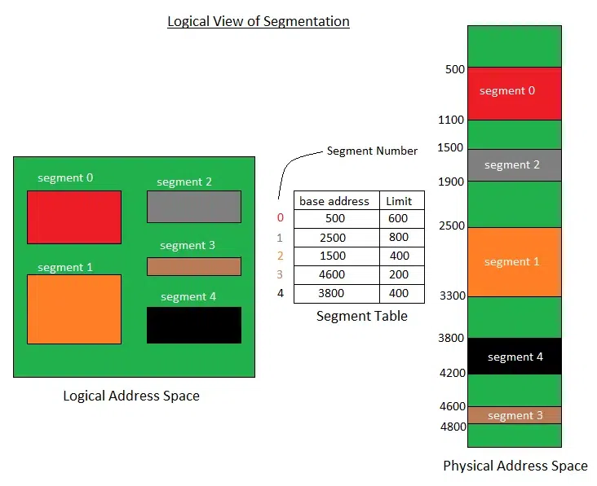

Slide 8
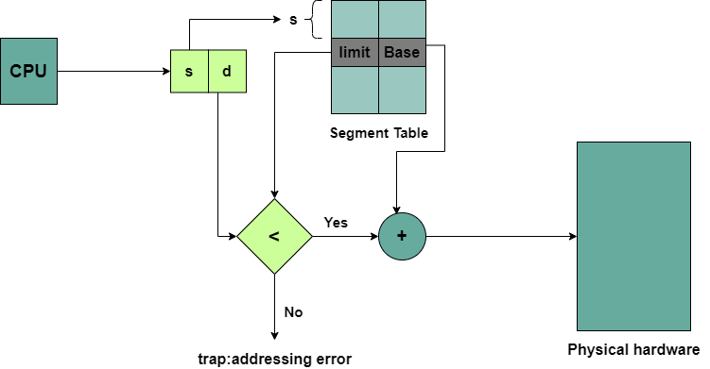

Slide 9
Segment number (s): Identifies which segment is being accessed.
Segment offset (d): Specifies how far into the segment the required data is located.

Slide 10
Paging and Segmentation
Paging
Segmentation
Divides memory into fixed-size blocks called pages.
Divides both physical and virtual memory into equal-sized pages.
Each page has a fixed size(1kb, 4kb)
More efficient as pages are fixed and easy to manage.
Supports virtual memory and demand paging efficiently.
Divides memory into variable-sized logical segments based on program structure.
Divides logical memory into segments (code, data, stack, heap).
Each segment has a variable size depending on program needs.
Less efficient due to variable segment sizes and fragmentation.
Swapping segments is more complex due to variable sizes.

Slide 11
Advantages of Segmentation
Memory Protection
Sharing
The user specifies the segment size, whereas, in paging, the hardware determines the page size.
Segmentation provides a level of protection between segments, preventing one process from accessing or modifying another process’s memory segment.
Segmentation allows for sharing of memory segments between process. This can be useful for inter-process communication
Reduced Internal Fragmentation
Logical Organization
Segments are of variable length, fitting memory more precisely and minimizing wasted space.
Aligns memory allocation with the program's logical structure, enhancing modularity and readability.

Slide 12
Disadvantages of Segmentation
Fragmentation
Complex Memory Management:
As mentioned, segmentation can lead to external fragmentation as memory becomes divided into smaller segments. This can lead to wasted memory and decreased performance.
Managing variable-sized segments adds complexity to the operating system's memory management routines.
External Fragmentation
Complexity
As processes are loaded and removed from memory, the free memory space is broken into little pieces, causing external fragmentation. This is a notable difference from paging, where external fragmentation is significantly lesser.
Segmentation can be more complex to implement and manage than paging.

Slide 13

Thank You!

