Slide 1

Requirements:- 1 – pandas 2- sklearn 3- xgboost 4 – hyperparameter tuning 5 – cross validation 6 – machine learning

Slide 2


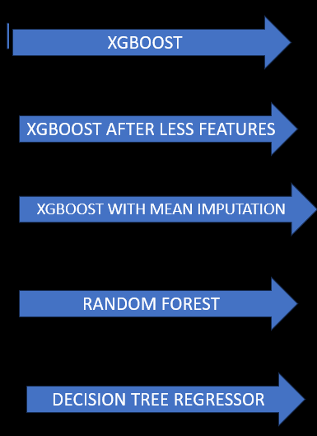


Problem ML Flow Solves
METRICS
RMSE
MAE
R2

Slide 3
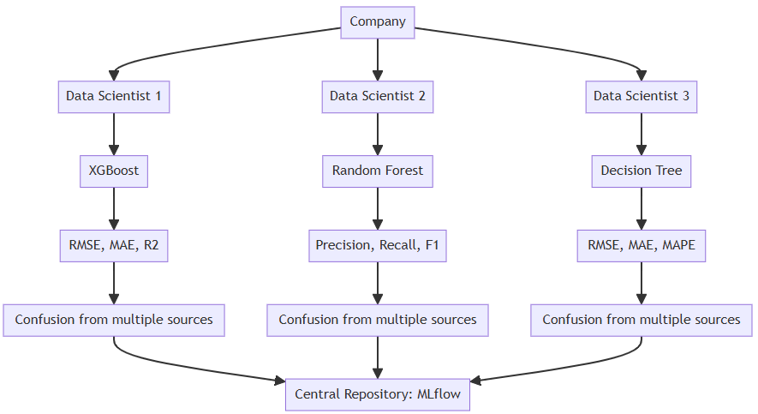

Slide 4
Go THROUGH THE ML FLOW UI

Slide 5
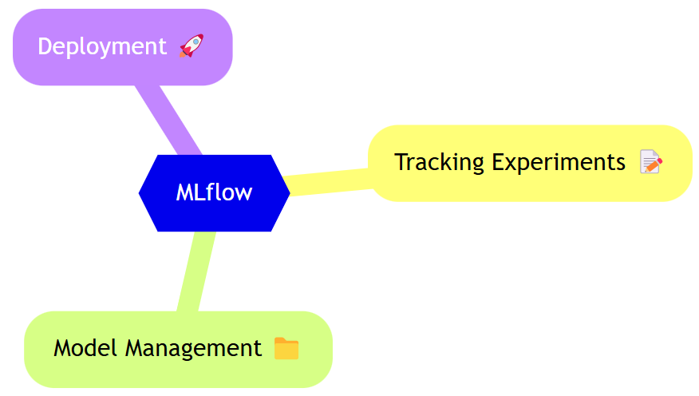
What is ML Flow?
Comparison between models

Slide 6
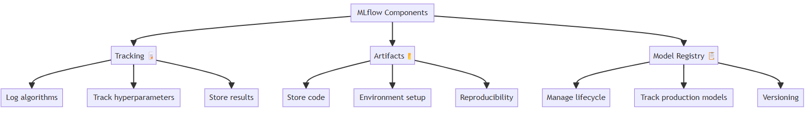

Slide 7
FULL Code in the next video

