Slide 1

Input
Output
function

Slide 2
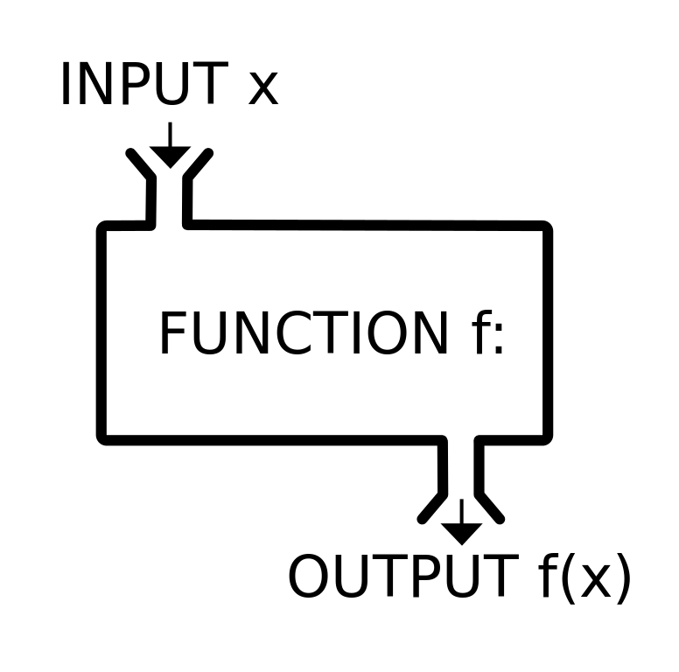
Functions are objects
object

Slide 3
Just like objects, functions can be
Assigned to a variable
Assigned to an object
Passed as arguments to a function
Returned from functions
Can have methods and properties
Can be created dynamically

Slide 4
Passing function as an argument to a function
function run(f){
f();
}
function greeting(){
console.log('hello world!');
}
run(greeting);

Slide 5

Callbacks

Slide 6


Slide 7
Callback pattern
A callback is a function that is passed as an argument to other code. The receiving code is expected to call back (execute) the argument when needed.

Slide 8
Callback
var list = [5,8,9,2,7,6,3,1,4];
function callback(list){
// to be done
}
function filter(list, callback){
// to be done
}
var filtered = filter(list, callback);

Slide 9
Callback filter in JS
array.filter(callback)

Slide 10
Callback filter in JS
var list = [5,8,9,2,7,6,3,1,4];
function callback(item){
// return true for included items
}
var filtered = list.filter(callback);

Slide 11
Callback sort in JS
/* ---------------------------------------------------------
The logic of the compare function is as follows.
if (compareFunction(a,b) < 0) a comes first, a lower index
if (compareFunction(a,b) > 0) b comes first, b lower index
if (compareFunction(a,b) === 0) leave a and b unchanged
--------------------------------------------------------- */
function compare(a, b) {
// write the callback
}
var numbers = [4,2,5,1,3];
numbers.sort(compare);

Slide 12

Callbacks
CALLBACKS EVERYWHERE

