Slide 1

New Horizon Institute of Technology and Management, Thane
Department of Artificial Intelligence & Data Science
Mini Project – 2A Presentation Sem -V (2023-24)
MU Result Extractor
By
Prathmesh Kalgutkar 12126013
Dhruv Shah 12126020 Jay Patel 12126016
Shikhar Vishwakarma 12126010
Guided by:
Dr. Anu Malhan /Co guide Suhas Waghmare

Slide 2
New Horizon Institute of Technology and Management, Thane
Department of Artificial Intelligence & Data Science
Index
▪ Introduction
▪ Need / Motivation
▪ Problem Definition
▪ H/w and S/w required
▪ Existing system
▪ Block diagram
▪ Implementation Plan
▪ Proposed system
▪ Results
▪ Conclusion
▪ References

Slide 3
New Horizon Institute of Technology and Management, Thane
Department of Artificial Intelligence & Data Science
Introduction
In today’s world, most of the documents help us to present and share a variety of information.
They contain tables to represent the data that shows associations between concepts.
Tables are extensively used for exhibiting structural and functional information.
There is a lack of a universal open-source tool which works on textual formats like PDFs as well as scanned documents.
Table detection techniques in scanned documents involve Optical Character Recognition and these techniques can vary from the methods used for PDFs.
These open-source tools fail to correctly detect the data from borderless tables.

Slide 4
New Horizon Institute of Technology and Management, Thane
Department of Artificial Intelligence & Data Science
Need / Motivation
Summary, the motivation for a result extracting system lies in its ability to streamline data management, improve data quality, and empower educational institutions with the tools and insights necessary to enhance their academic processes and outcomes
The primary motivation for a result extracting system is to significantly enhance data management and analysis within educational institutions by automating the extraction of student result data from various sources. This system not only expedites the often time-consuming and error-prone data entry process but also ensures data accuracy, standardization, and security. It empowers institutions to make data-driven decisions for academic planning and student support, leveraging real-time updates and efficient scalability.

Slide 5
New Horizon Institute of Technology and Management, Thane
Department of Artificial Intelligence & Data Science
Problem Definition
It is difficult for lots of student and also teachers to find student marks subject wise and it becomes hectic to convert it into proper excel file as the data is not stored in tabular format and there are tool available for same but not that efficient.
To overcome the above problem we have come up with an idea to extract data from pdf file to proper csv file so it becomes easy to search student information for a Teacher

Slide 6
New Horizon Institute of Technology and Management, Thane
Department of Artificial Intelligence & Data Science
H/w and S/w required
Name of the component | Specification
Processor | Minimum Intel i3 or i5
RAM | Minimum 2 GB RAM
Operating System | All operating systems are compatible
Language | Python

Slide 7
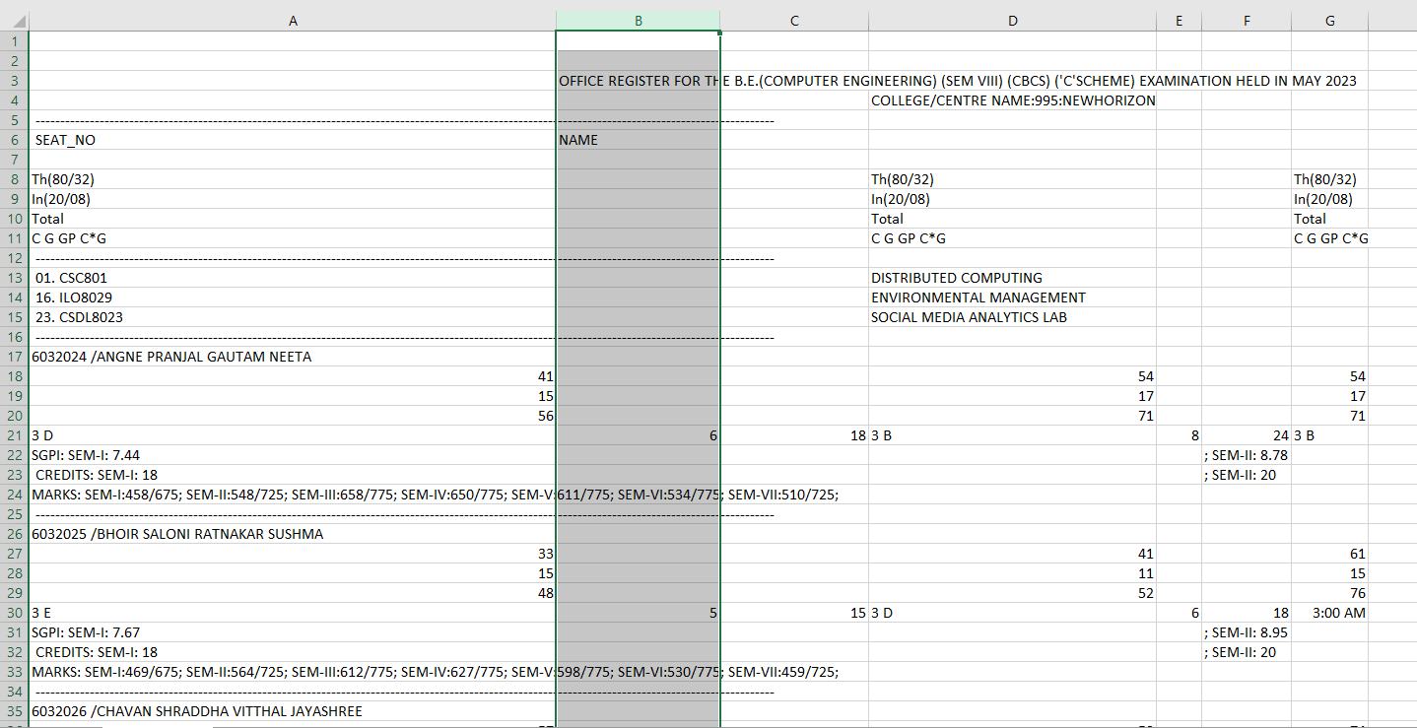
New Horizon Institute of Technology and Management, Thane
Department of Artificial Intelligence & Data Science
Existing System
https://www.zamzar.com/convert/pdf-to-csv/

Slide 8
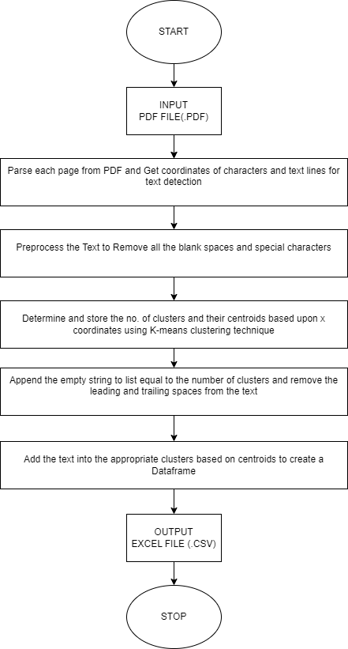
New Horizon Institute of Technology and Management, Thane
Department of Artificial Intelligence & Data Science
Block diagram

Slide 9
New Horizon Institute of Technology and Management, Thane
Department of Artificial Intelligence & Data Science
Implementation Plan
Project Duration (in Weeks) | Activity Completed
Week 1 | Selection Of Topic
Week 2 | Topic Selection Presentation/ stage 1 presentation
Week 3 | Conversation from pdf to text format for precise extraction
Week 4 | Extraction of students name and seat number

Slide 10
New Horizon Institute of Technology and Management, Thane
Department of Artificial Intelligence & Data Science
Implementation Plan
Project Duration (in Weeks) | Activity Completed
Week 5 | Extraction of students marks accordingly and creating data frame
Week 6 | Extracting pass fail criteria along with reservation and total marks and creating a dataframe for it
Week 7 | Extraction of students cgpa accordingly and creating a dataframe for it
Week 8 | Combining all the dataframe and and preparing for stage 2 presentation

Slide 11
New Horizon Institute of Technology and Management, Thane
Department of Artificial Intelligence & Data Science
Proposed system
Creating a system to extract MU (Mumbai University) exam results from PDF files and convert them into CSV format involves several steps, including text extraction, data parsing, and CSV file generation. Here's a high-level overview of the proposed system:
Data Collection: Gather the PDF files containing MU exam results. Ensure that the PDFs are well-structured, with consistent formatting.
PDF Text Extraction: Use a PDF text extraction library like PyPDF2, pdfplumber, or pdfminer to extract the text from the PDF files. These libraries can help you extract both structured and unstructured data.
CSV File Generation: Use a CSV library like pandas in Python to create a CSV file from the structured data. Define the CSV file format, such as column headers for student name, roll number, subject names, and marks.

Slide 12
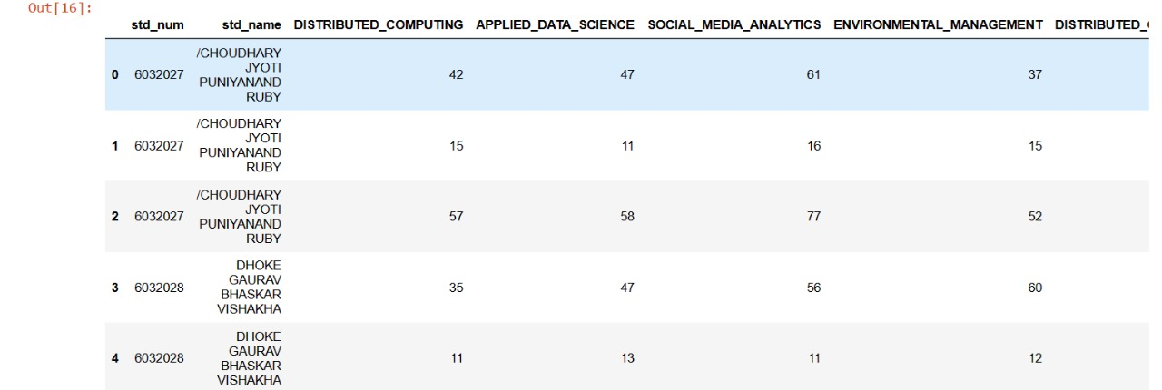
New Horizon Institute of Technology and Management, Thane
Department of Artificial Intelligence & Data Science
Results
First output extraction of name seat no and marks

Slide 13
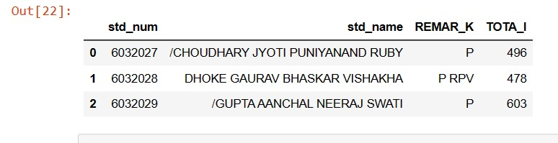
New Horizon Institute of Technology and Management, Thane
Department of Artificial Intelligence & Data Science
Results
Output 2 extraction of remark and total marks

Slide 14
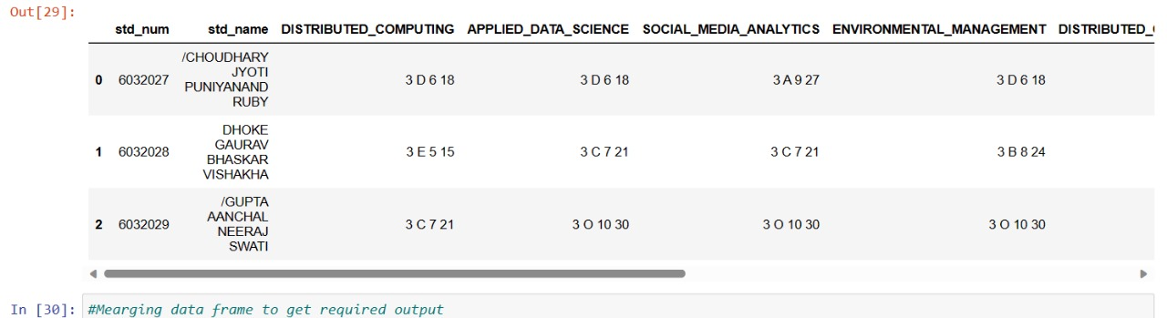
New Horizon Institute of Technology and Management, Thane
Department of Artificial Intelligence & Data Science
Results
output 3 extraction of C G CG C*G and pointer

Slide 15
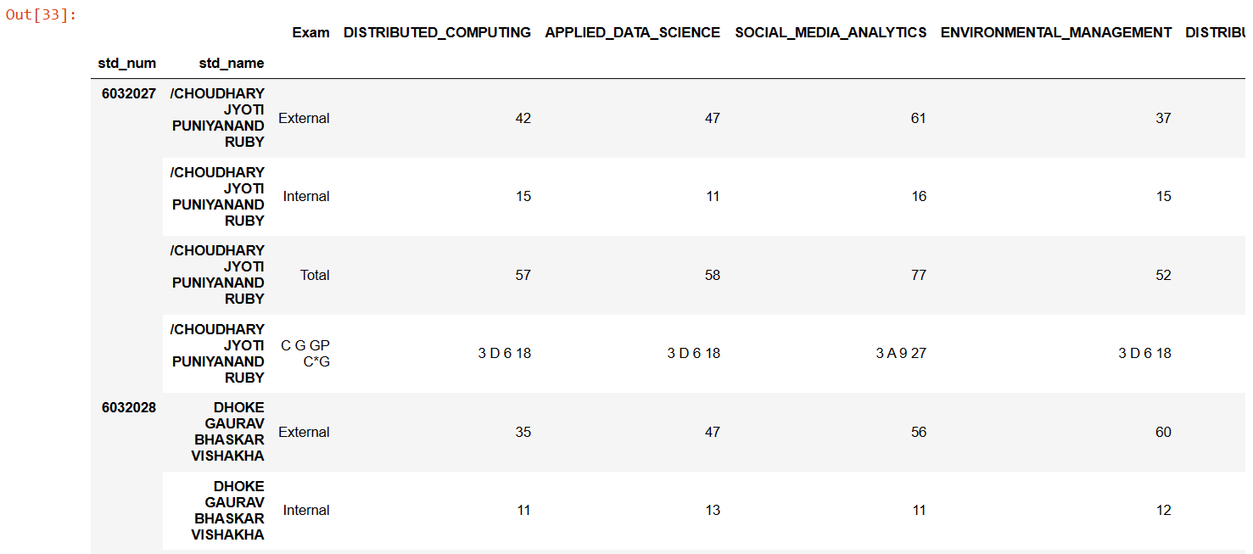
New Horizon Institute of Technology and Management, Thane
Department of Artificial Intelligence & Data Science
Results
output 4 extraction of C G CG C*G and pointer

Slide 16
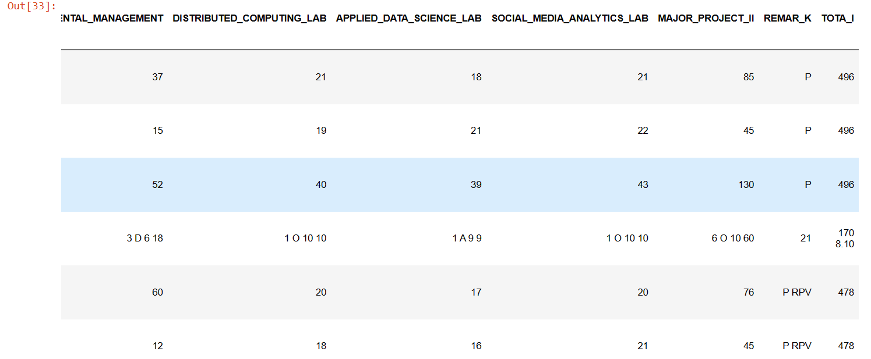
New Horizon Institute of Technology and Management, Thane
Department of Artificial Intelligence & Data Science
Results
output 4 extraction of C G CG C*G and pointer

Slide 17
New Horizon Institute of Technology and Management, Thane
Department of Artificial Intelligence & Data Science
Conclusion
We conclude that by developing an application for extracting data from PDF to Excel presents an opportunity to overcome numerous challenges and streamline data processing workflows the application can offer a reliable and efficient solution.
With a user-friendly interface the application caters to the needs of users, allowing them to extract data from PDF files.

Slide 18
New Horizon Institute of Technology and Management, Thane
Department of Artificial Intelligence & Data Science
References
[1] B. Yildiz, K. Kaiser, and S. Miksch, “pdf2table: A method to extract
table information from pdf files,” in IICAI, 2005, pp. 1773–1785.
[2] T. M. Breuel, “Two geometric algorithms for layout analysis,” in
Document analysis systems v. Springer, 2002, pp. 188–199.
[3] “Applying the t-recs table recognition system to the business letter
domain,” in Document Analysis and Recognition, 2001.
Proceedings. Sixth International Conference on. IEEE, 2001, pp.
518–522.

