Slide 1
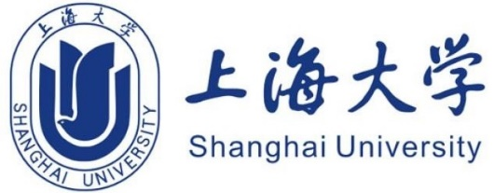
Analysis of Chinese and Western Education
20721997 王思成
20722017 吕良良
20722018 张瑞
20722028 刘镇

Slide 2

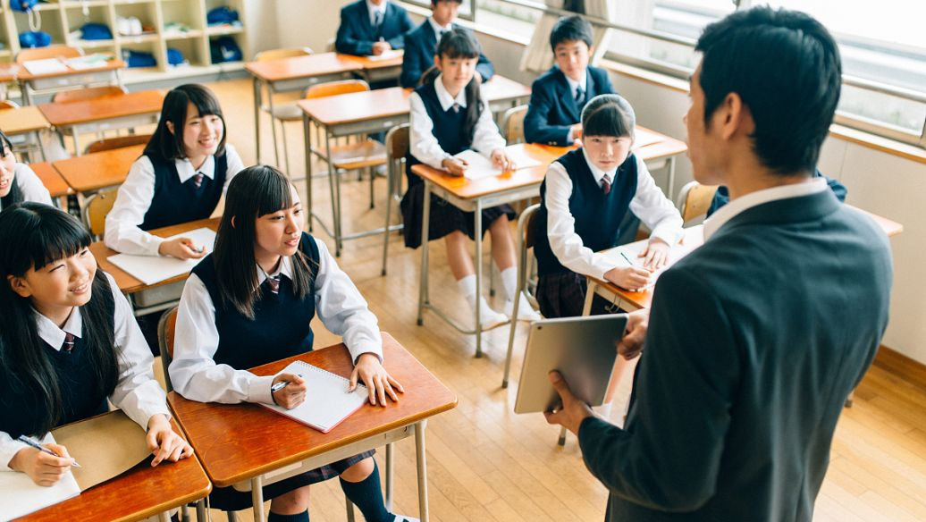
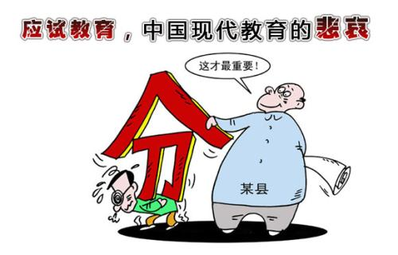
Introduction

Slide 3
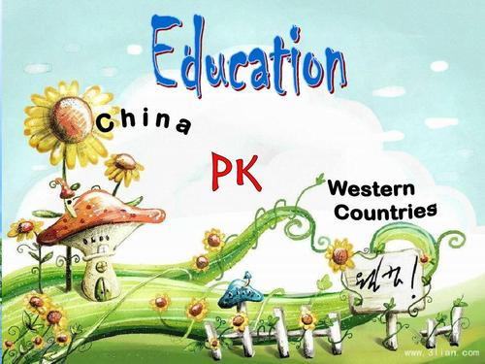

catalog
EDUCATION IN school
The family education
teaching methods

Slide 4
Difference: the aspect of school
West
Their education is all-round. Western basic education allows students to have greater freedom of choice on the basis of meeting the most basic requirements.
For instance, if a student is not interested in physics, chemistry or biology and feels extremely rough, he can select more basic level on those, and learn more courses of interest that he is good at.
Advantage:
Suppose that you take only one of physics, chemistry, and biology, you can meet equally the requirements for graduation from high school . Finally , you enter a top university and have identical opportunity to become an "elite".
Notes:
Teach students in accordance with their aptitude.
Although teaching students in accordance with their aptitude is mentioned every day in our country, few people understand the true meaning of teaching in accordance with their aptitude. On the contrary, Western education is better in this aspect, and it is more suitable for the development of students and taps out their potential.

Slide 5
the aspect of school
China
Chinese education is an "elite" education, which eliminates those who cannot learn profound knowledge. Chinese education requires that all subjects of mathematics, physics and chemistry are comprehensive. If you grasp better, you stand out certainly.
However, poor mastery of any subject may have a fatal impact on the future of life.
Ideal:
Not only do you pay attention to your child's academic performance, but also care about the cultivation of the child's ability, so that he can adapt to various environments from an early age. Let children have independent thinking so as to adapt to various changes in society
Notes:
China’s basic education has a bunch of advantages. In recent years, foreign countries are also extracting from our education methods. Eastern and Western education have their own advantages and disadvantages, and they need complement each other.

Slide 6
view
Western-style innovations have never been suitable for us, and those are also suitable for our education reform. Any copying of Western educational models will not work.
If the educational models of the East and the West are organically combined, they will be Chinese. Let me use the best core of the western education model and being gradually on the way of China.
Notes:
In any case, only when we connect the fundamentals of Eastern and Western traditional education can we comprehend the key cultural differences between the two traditions. Betray own current situation based on two education systems.

Slide 7
Difference: the aspect of FAMILY
West
In the West, parents pay more attention to the cultivation of their children's interests and hobbies when they are young, pay more attention to the healthy growth of their children, and pay less attention to the paper results of exams.
China
When I was a kid, I used to hear that after good study, you make a lot of money. I think this sentence to a certain extent reflects the many family learning utility is too strong, too much emphasis on learning, and too little attention to the development of the child itself interest, for example, when we face the university entrance exam to college don't know what they like.

Slide 8
view
I think the possible reason behind is: 1. The difference in the level of national economic development, when life is facing difficulties, and what to talk about the cultivation of interest. 2. China's large population more competitive, the corresponding spent on interest training time is reduced.

Slide 9
Difference: the aspect of teaching methods
China west
have heavy pressure on learning class atmosphere is relaxed
endless homework and lively。
repeated mechanical memoring
Endless tutoring；
Notes:
i think everyone sits here must
have heavy pressure on learning when you were a child，such as endless homework and repeated mechanical memoring .
chinese education is eager to instill knowledge into children，even during weekends，they still have to take part in
various remedial classes，so that students regard learning as a task that they have to finish。
chinese students have no questions，or they do not dare to put it because the atmosphere of class is serious.
on the contrary western education is relaxed and lively,students would ask questions and discuss with teacher actively.

Slide 10
view
The differences in teaching ，may result in the difference of abilities and habits.
the autonomous learning ability
social skills and basic life skills。
Parents：“what you need to do is just to improve your score！

