Slide 1














Project presentation
TEAM - 08

Slide 2
Language Translator

Slide 3
Linguistic Text
Translation
01.
Project mission
Linguistic voice Translation
02.
03.
Summarizer

Slide 4
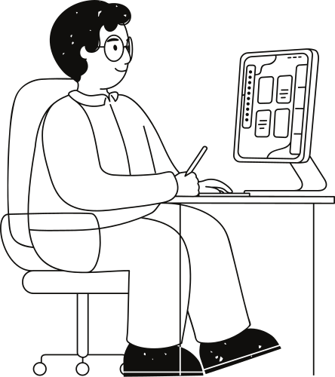
These tools can recognize the text and spoken language in various languages and translate it into English.
This eliminates language barriers for documents and any visual text you encounter.
This facilitates communication with people speaking different languages during conversations, interviews or lectures.

Slide 5

This project can seamlessly translate
text into over 107 global
languages.
This project goes beyond
translation by summarizing
the recognised text or translated
speech.
This provides a concise
understanding of the content,
saving time and effort.

Slide 6
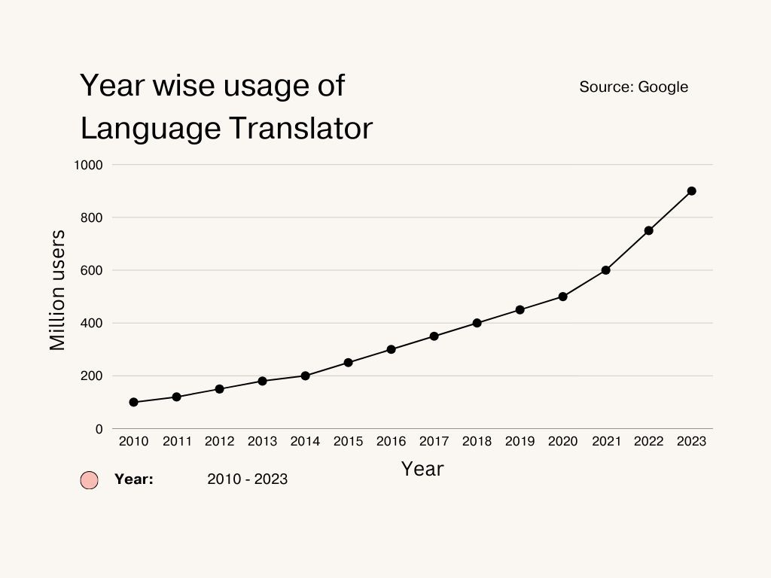

Slide 7
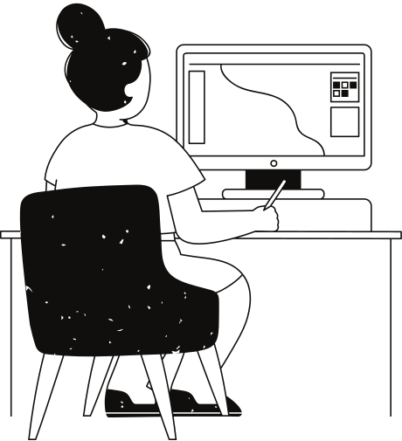
Why use this
Utilizing this Language Translator offers a myriad of compelling reasons, each stemming from the increasing globalization of our world and the consequent need for effective cross-language communication tools.

Slide 8

Speech Recognition Module
This module uses SpeechRecognition Library to recognize speech input from the user.
It converts spoken words into text format for further processing.

Slide 9
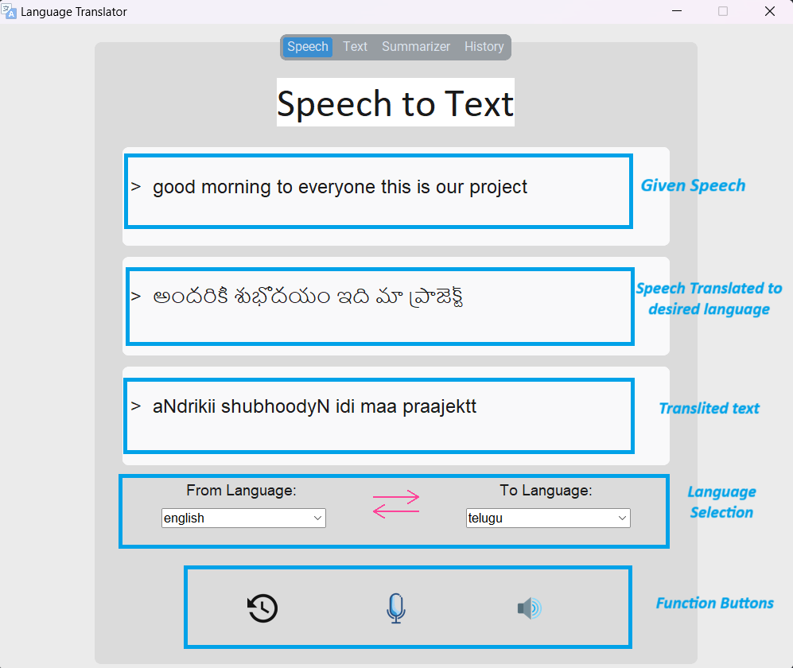

Slide 10
Text Translation Module
Utilizing translation API like
Google Translate, this module can
convert the text input into the desired
language.
Offers a myraid of language options for translation based on user preference.

Slide 11
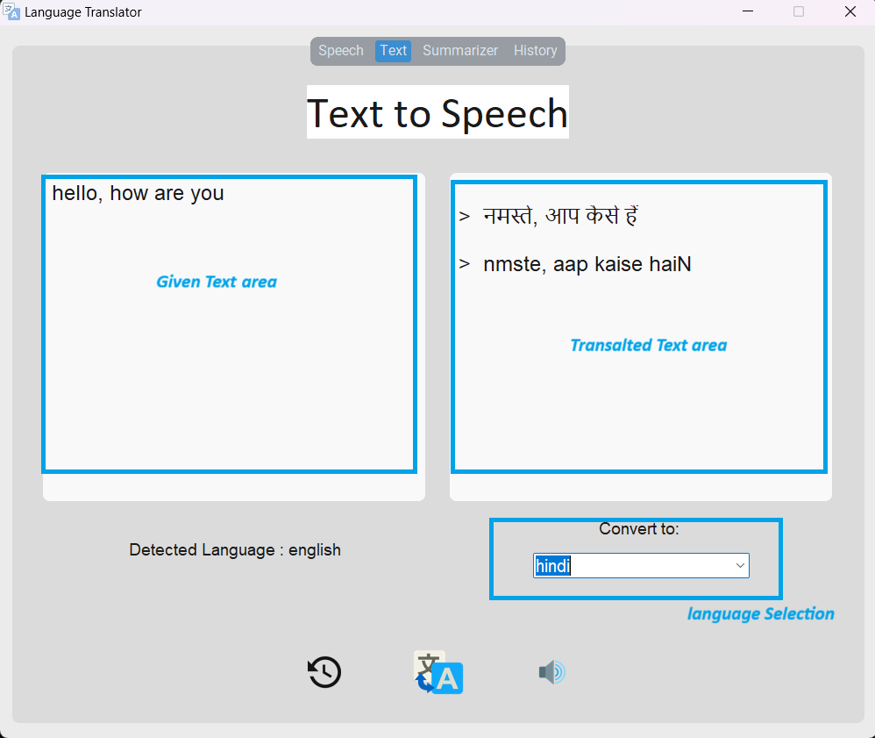

Slide 12

Summarization Module
The Text Summarization module leverages the NLTK library for natural language processing capabilities.
It incorporates the PageRank Algorithm to rank the importance of sentences within the text structure.
This also utilizes cosine similarity to compare and evaluate the relevance of sentences, resulting in concise and coherent summaries.

Slide 13
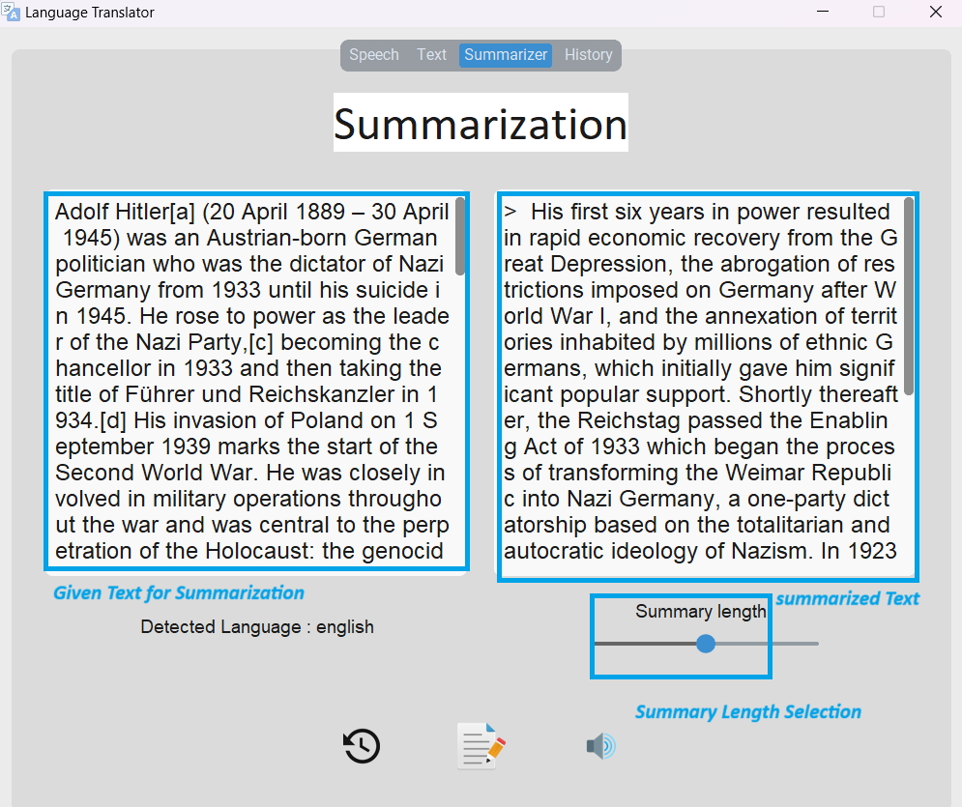

Slide 14
User Interface Module
The user interface module integrates the CustomTkinter Library to enhance the visual and interactive components of this project.
This aims to provide users with a seamless and promoting ease of use and with the translation functionality.

Slide 15
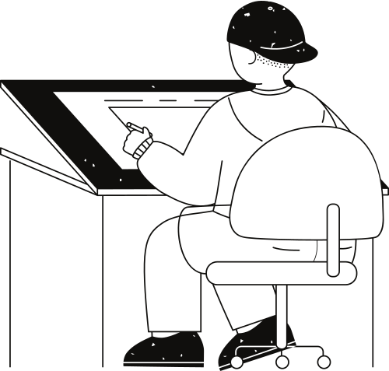
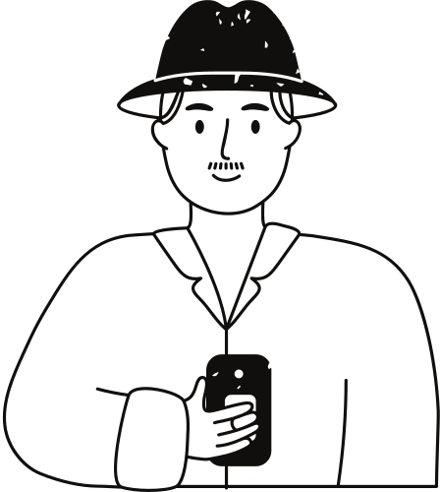



Breaks down language Barriers
Enhances Accessibility
Uses
Improves Efficiency
Summarizes

Slide 16

Advantages Over Google Translator
Enhanced Accuracy in Diverse Conditions
Focused Translation Solutions
Better handling of various
speech attributes and
environmental conditions
makes it highly
suited in multilingual
environments.
By possibly offering specialized translations, this tool becomes invaluable where nuanced
terminology is crucial.
Efficiency and Productivity
Improved Data Management
Summarization features save
time and improve productivity
by allowing users to grasp
essential information.
Advanced history saving
capabilities enhance users
ability to manage large
volumes of ongoing translations.

Slide 17
Real-time Applications
01
02
03
04
Travelers
Business Meetings
Educational Settings
Everyday Multilingual interactions

Slide 18
Thank you very much!

