Slide 1

Shree Chanakya Education Society’s Indira Institute of Management, Pune Summer Internship Project MBA Semester III (Batch 2020-22) Name of the Student : Jay Rajesh Dixit Roll No. : BA-03 Specialization : Business Analytics
Title : Study of Customer Behaviour towards the different distribution channels of Life Insurance products of Shriram Life Insurance
Name of the Organization: Shriram Life Insurance
Name of the Internal Guide : Prof. Sunita Bangal
Name of the External Guide : Pranita Bhavar

Slide 2
CHAPTER I: INTRODUCTION AND RATIONALE OF THE STUDY
Introduction to the title :
Life Insurance can provide a financial security to an individual and his family at the time of disaster or calamity.
Life Insurance can be defined as a contract between an insurer (company) and a Life Insurance policyholder. This contract states that the Insurer pays the policyholder, a sum of money upon the death of the insured person
The key objective of any insurer (Life Insurance Company) is to provide effective distribution channels of products, so that the potential policyholders can avail it.
The distribution channels can be beneficial to an organization to gain profit with the virtue of its different methods to reach and approaches towards the customers.
Significance of the study:
A Company provides its services to customers in order to satisfy the needs in return to gain profits and income. A company ensures that its products should be availed by as many customers.
Company introduces different business channels to sells its products and services.
This study can be helpful for evaluating the customer behavior towards various distribution channels, which a Life Insurance Company possesses.
Can be helpful to the organization to evaluate different factors (income, occupation, education etc.) to develop strategies to reach the customers through these distribution channels.

Slide 3
CHAPTER II: INDUSTRY/ SECTOR PROFILE
Overview of the industry/ sector :
Life insurance sector is one of the fastest growing sectors in India since 2000.
Life Insurance increases the opportunities for savings among the individuals, safeguards their future and helps the sector to form massive pool of funds. These massive funds are utilized for contribution in capital markets, thus increasing, large infrastructure developments in India.
The Life Insurance Corporation of India (LIC) is the sole public sector company.
The Government of India appointed the “R N Malhotra “committee, to allow the private players in the Insurance sector, in 1993.
This amended the Insurance Act of 1938 and legislating the Insurance Regulatory and Development Authority Act of 2000

Slide 4
CHAPTER II: INDUSTRY/ SECTOR PROFILE (contd..)
Contribution of the sector towards GDP (Two lines)
1) In Life Insurance business, India stands 10th in the world.
2) India's share in global life insurance market was 2.73% during 2019.
3) The life insurance industry in India is expected to increase at a CAGR of 5.3% between 2019 and 2023.
4) Currently, the insurance penetration in India is 3.7% of the gross domestic product (GDP)
Major players (Top five companies):
Life Insurance Corporation of India (LIC)
HDFC Standard Life
SBI Life Insurance
ICICI Prudential Life Insurance
Aditya Birla Sun life Insurance

Slide 5
CHAPTER II: INDUSTRY/ SECTOR PROFILE (contd..)
Regulatory framework:
The Insurance sector in India is regulated by IRDA (Insurance Regulatory and Development Authority). IRDA is formed for the overall supervision of the Insurance activities in India. It came under the Act of Parliament, i.e., Insurance Regulatory and Development Authority Act, 1999 (IRDAI Act 1999)
The key objectives of IRDAI include promotion of competition, to enhance customer satisfaction, through increased customer choice and fair premiums.

Slide 6
CHAPTER III: Company Overview
Mission, visions etc. :
The Shriram Life Insurance Company was founded with the objective of reaching out to the “common man” with products and services that would be helpful to him as he sets out on the path to “prosperity”.
Operational efficiency, integrity and a strong focus on catering to the needs of the average Indian, by offering him high quality and cost-effective products and services, are the core values that drive the organization. These values have been strongly adhered to over the decades and are now an integral part of the organization's DNA.
The company prides itself on its deep understanding of the customer. Each product or service is tailor-made to specifically suit the needs of the customer. It is this guiding philosophy of putting people first that has brought the group company closer to the grassroots and has made it the preferred choice for all truck financing requirements amongst the customers.
Financial performance :
Premium income has increased from 1723 Crores to 2013 Crores in FY21. Jump of 17%.
Other Income has increased from 322 Crores to 520 Crores in FY21.
Commission expense has increased 112 Crores to 122 Crores in FY21.
PAT of 106 Crores in FY21 which was just 35 Crores in FY20.

Slide 7
CHAPTER III: Company Overview (contd..)
Achievements :
1) Gold Award for Customer Service Handling –CLAIMS during the 8 th Excellence Competition on Best Practice Sharing Fest conducted by Confederation Of Indian Industry on 28 & 29 August-2020.
2) Gold Award for Morale Boosting HR Practices during the 8 th Excellence Competition on Best Practice Sharing Fest conducted by Confederation Of Indian Industry on 28 & 29 August-2020.
3) Best Customer Experience in Financial Sector – Non Banking, 2020 by Kamikaze B2B Media
6) Shriram Life receives ‘India’s Greatest Brands Award 2017-18’ (3rd edition) – Pride of the Nation Series Awards & Business Summit

Slide 8
CHAPTER III: Company Overview (contd..)
Products :
Individual Plans: Saving Plans, Investment Plans
Group Plans: Employee Benefit Plans, Micro-insurance plans
Online Plans: Comprehensive cancer care, online term plan
Featured Plans: Assured Income Plan, Super income Plan

Slide 9
CHAPTER IV: REVIEW OF LITERATURE
Literature review:
Banana, K et al (2018) has stated that insurance is a protection against economic losses arising due to an unexpected event
Robert L. Carter et al (2009) examined that the key success of insurer is based on the ability to establish cost effective in distribution channels to make contract with new policyholder for sale of insurance products, and also discussed about various innovation to reduce distribution costs in life insurance business
Sumnider Kaw Bana et al (2016) the life insurance need to improve the perceptive of the clients regarding various channels by providing awareness, knowledge and guiding to the policyholder about the policy and procedure of distribution channels
PR Chang et al (2011) has opined that traditional sales channels are performing well with compare to Bancassurance channels, Salesperson of traditional channels sell policy by diversified financial products, where the bancassurance need more training about the insurance products.

Slide 10
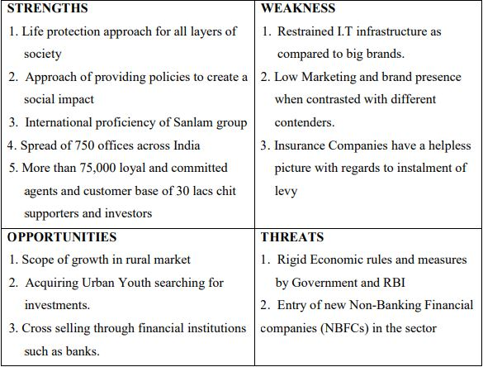
CHAPTER V: APPLICATION OF BUSINESS MODELS (VIZ., MKTG MODELS, FINANCIAL MODELS etc.,)
SWOT Analysis:

Slide 11
CHAPTER V: APPLICATION OF BUSINESS MODELS (VIZ., MKTG MODELS, FINANCIAL MODELS etc.,)
PESTLE Analysis:
Political: Business processes heavily depend on type of the government in the nation. An open-minded government and stable political environment present promising
Economic: This includes economic factors such as interest rate, employment and unemployment rate, savings, low return, inflation rate.
Social: Factors include population, lifestyle, and education. Shriram life Insurance serve people in bottom of the pyramid and provide better value and wider range of services to its customers.
Technological: This includes technological tools such as digital, mobile and social media to provide services to the customers.
Legal: An organization must understand what is legal and allowed within the region they operate. They also must adhere to the changes in legislation and its impact on business operations.
Environmental: Recycling and waste management and the growing environmental pollution has adopted business to adopt innovative recycling and waste management. Shriram Life Insurance has adopted these methods in concern for environment.

Slide 12
CHAPTER VI: OBJECTIVES AND SCOPE OF PROJECT
Objectives:
To study the customers’ perception towards the selection of a distribution channel.
To study certain factors which can influence the customers towards buying the products through the distribution channel.
Scope of Project:
1) The most preferred Product distribution channel by the respondents/customer.
2) How factors such as Occupation, Education, Annual Income, Type of Insurance plan and amount invested in buying them, can be considered in ordered to increase the reach of distribution channel towards the customers

Slide 13
CHAPTER VII: RESEARCH METHODOLOGY
Rational for the study :
The main aim of the study to determine the customer behavior towards the various distribution channels of the products of Shriram Life Insurance. Factors such as Annual income, Investment capacity of individual, Education and occupation are studied for fulfilling the aim of study.
Statement of problem :
When it comes to selling of a product, the method of selling or the way it is being sold is to be considered. In case of a Life Insurance, a product is sold in many ways, through different channels. So, which channels help in maximum sales of Life Insurance product is studied.
Significance of the Problem :
It is important to understand which media to be used to sell the product, through which a company can attain maximum sales/profit. This problem can be utilized by an organization to determine proper channel for product distribution.

Slide 14
CHAPTER VII: RESEARCH METHODOLOGY (contd..)
Research Objectives :
Primary objective: To understand the customer behavior towards a product distribution channel.
Secondary objective: To study certain factors which can influence the customers towards buying the products through the distribution channel

Slide 15
CHAPTER VII: RESEARCH METHODOLOGY (contd..)
Research design (Research Type) :
Research type is survey research.
Data sources (Primary and secondary sources) :
The primary data was collected through questionnaire. The respondents were asked to fill the Google Forms. Secondary data was collected through various sources such as websites, reports etc.
Data Collection Instrument (for e.g. Questionnaire) :
Data is collected through a questionnaire which was circulated using Google Forms. It includes basic questions such as name of respondent, age group, education, occupation, Annual Income etc

Slide 16
CHAPTER VII: RESEARCH METHODOLOGY (contd..)
Sampling Design :
Sample Size - 110
Sampling Method - Convenience Sampling
Sampling Unit – An individual person
Outline of analysis (a brief outline of tools and techniques to be used for analysis, statistical tools and tests to be used) :
The data was collected through online questionnaire circulated through Google Forms. This data was maintained in the form of an excel sheet (a feature of Google Forms to compile the responses into excel sheet). Thus a dataset was created through the responses.
This dataset was further subjected to visualization through Tableau (a data visualization tool). This tool is easy to visualize the data with the feature of applying filters to plots. This creates an easy way to look at the data and its implications.

Slide 17
CHAPTER VII: RESEARCH METHODOLOGY (contd..)
Limitations of the Project :
This project contains majority of respondents of same age group, it is difficult to analyze the results on the basis of age factor.

Slide 18
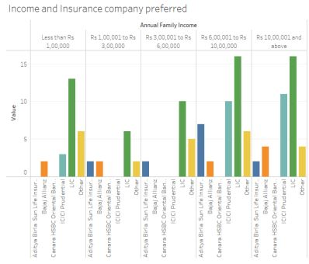
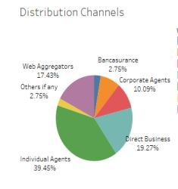
CHAPTER VIII: DATA ANALYSIS
Charts:

Slide 19
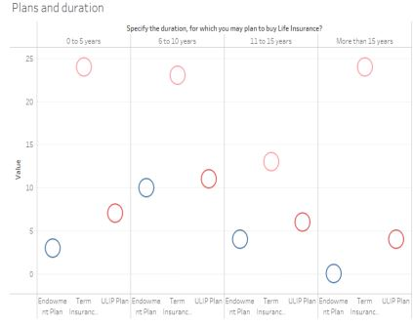
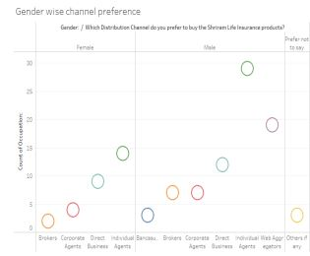
CHAPTER VIII: DATA ANALYSIS

Slide 20
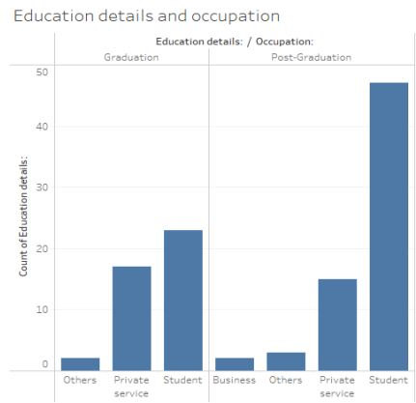
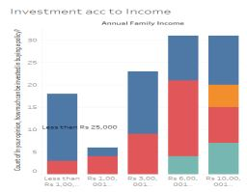
CHAPTER VIII: DATA ANALYSIS

Slide 21
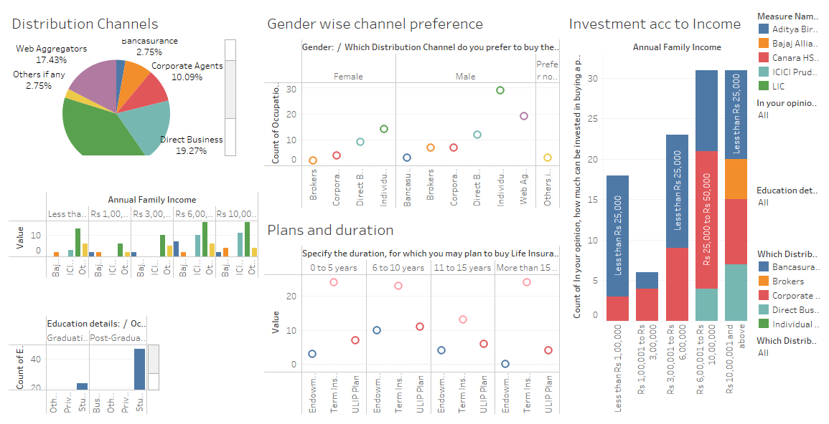
CHAPTER VIII: DATA ANALYSIS
Overall Dashboard:

Slide 22
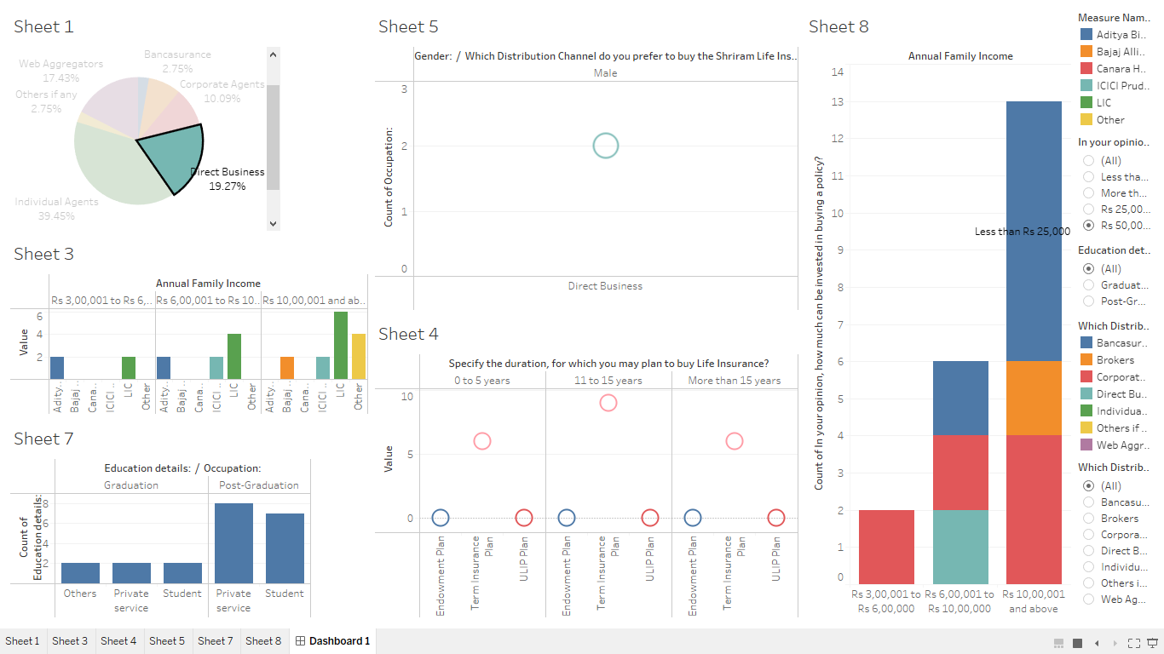
CHAPTER VIII: DATA ANALYSIS
Dashboard:
Direct Business:

Slide 23
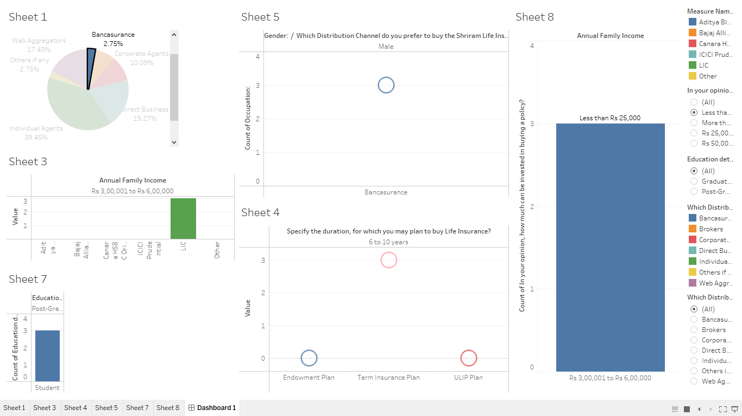
CHAPTER VIII: DATA ANALYSIS
2) Bancassurance:

Slide 24
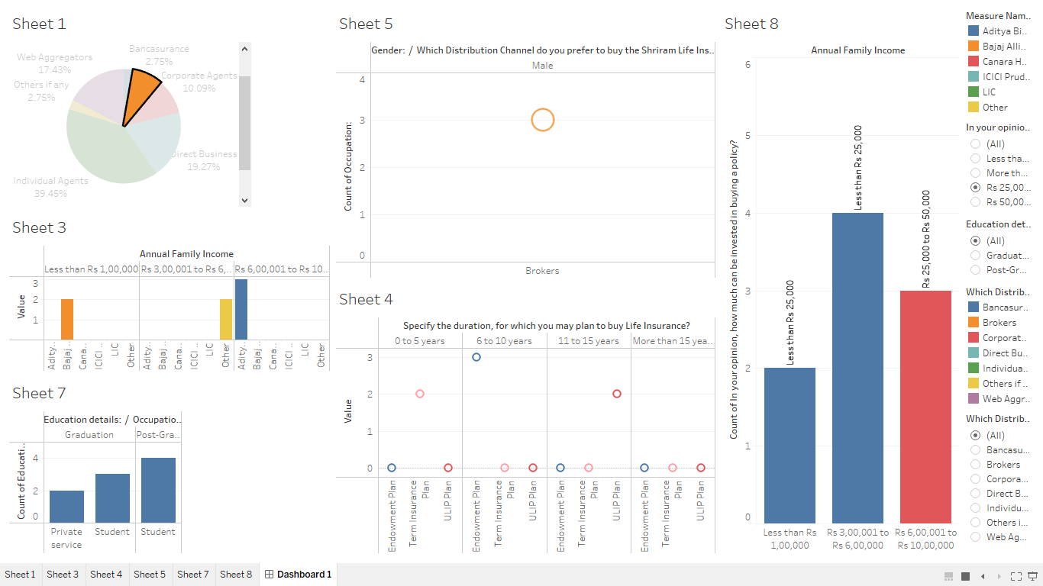
CHAPTER VIII: DATA ANALYSIS
3) Brokers:

Slide 25
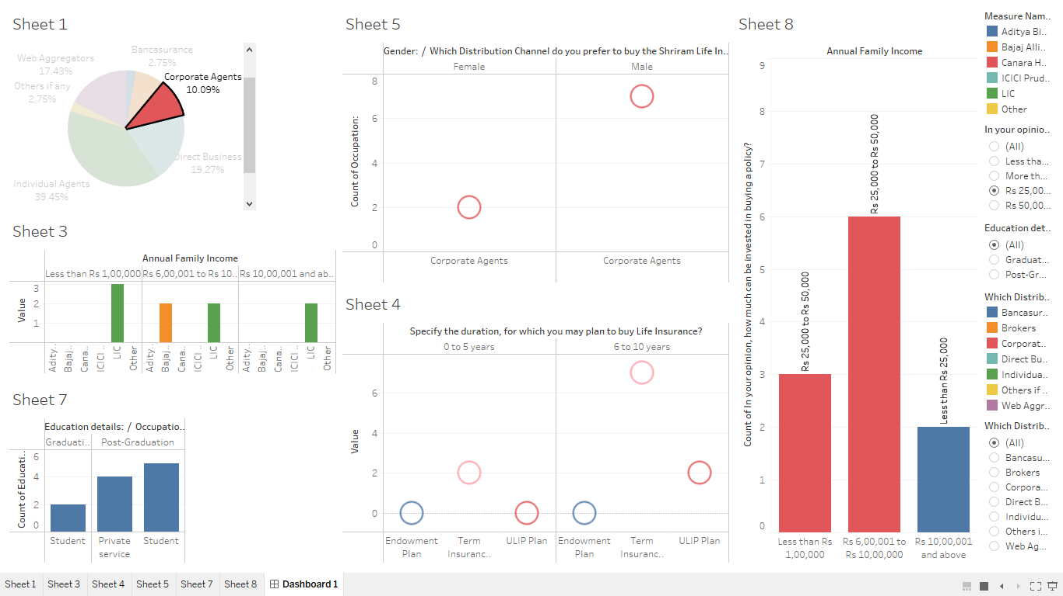
CHAPTER VIII: DATA ANALYSIS
4) Corporate Agents:

Slide 26
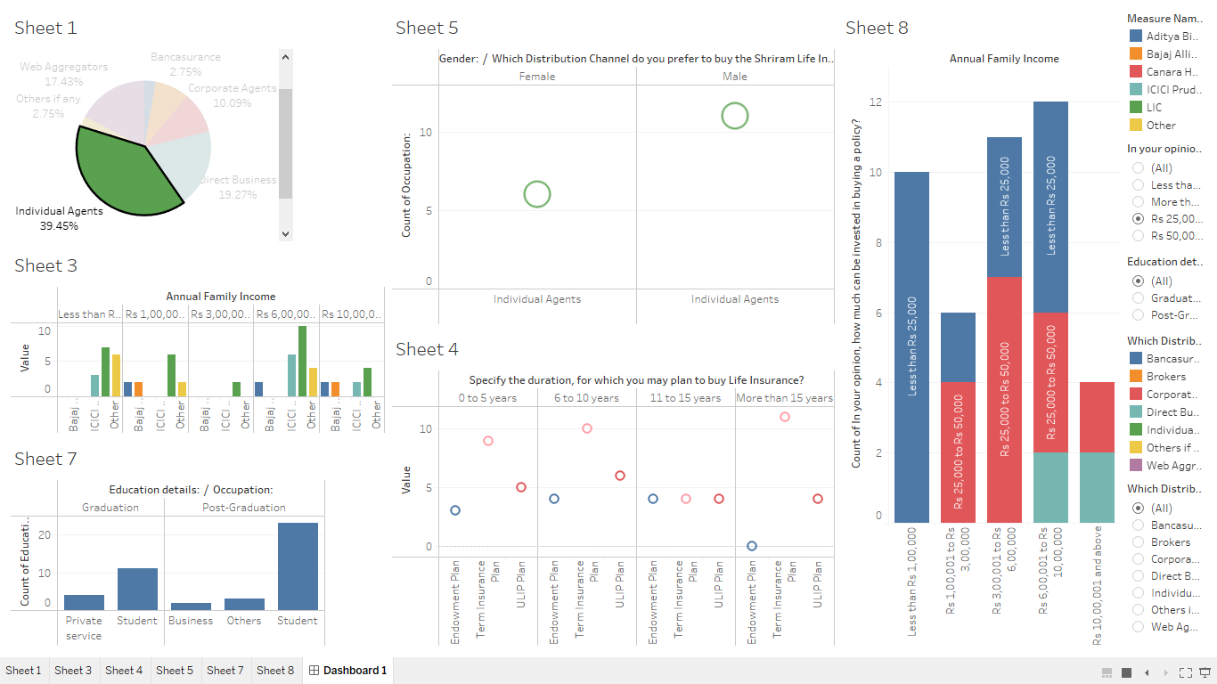
CHAPTER VIII: DATA ANALYSIS
5) Individual agents:

Slide 27
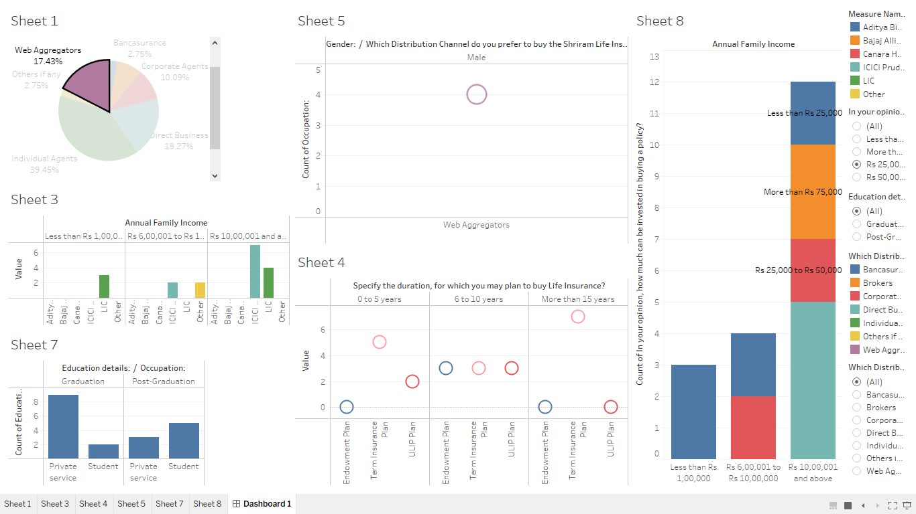
CHAPTER VIII: DATA ANALYSIS
6) Web Aggregators:

Slide 28
CHAPTER IX: FINDINGS
As discussed earlier, the respondents prefer the ‘Individual agents’ channel most to avail the Life Insurance products.
Followed by ‘Individual agents’ channel, we have ‘Direct Business’ and ‘Web Aggregators’ channels. And ‘Bancassurance’ as the least preferred.
Respondents have shown interest to buy the insurance products the most from ‘LIC’ followed by ‘ICICI Prudential’ and the least from ‘Canara HSBC Oriental Bank of Commerce Life Insurance’.
Respondents tend to purchase the ‘Term Insurance’ policy the most among the others.
We can see most of the respondents are ‘Students’ who are ‘Post-Graduates’.
Most of the respondents wish to invest ‘less than Rs 25,000’ and ‘Rs 25,000 to Rs 50,000’ in buying the Insurance Policy. Very less respondents wish to invest more than Rs 75000’

Slide 29
CHAPTER X: CONCLUSIONS & SUGGESTIONS
Conclusions:
It can be deduced from the above visualizations that ‘Individual Agents’ distribution channel is most preferred. Thus this channel helps in maximizing the sales.
Different factors/parameters can be examined in case of ‘Individual Agents’ such as:
a) Gender-wise preference is higher.
b) Preference for buying the insurance policies such as Term Insurance, Endowment plans and ULIP plans according to the duration are higher.
c) Annual Income and investment amount in this case is majority in number.
d) Preference for buying the insurance products from other insurance companies is also higher in case of ‘Individual Agents’

Slide 30
CHAPTER X: CONCLUSIONS & SUGGESTIONS (contd..)
Suggestions: (in bullet points)
Shriram Life Insurance should consider the above demographic factors and financial (income and investment) in order to increase the spread of distribution channels to reach customer demand.
Apart from ‘Individual Agents’ channel, company can focus on the next most preferred channels and formulate strategy to increase their reach based on the above mentioned factors

Slide 31
Learning form SIP
Learned about the Life Insurance and Company and its aspects.
Learned about selling of Insurance .
Learned about various Life Insurance Plans and its features.
Learned various factors to be considered (like age, income, occupation, amount to be invested in buying a policy) of customers to sell the insurance policy.

Slide 32
CHAPTER XII: Bibliography
Website addresses referred:
https://www.shriramlife.com/
https://en.wikipedia.org/wiki/HDFC_Life
https://en.wikipedia.org/wiki/Life_Insurance_Corporation
https://www.investopedia.com/terms/b/bancassurance.asp
Details of the Research papers referred :
L.Terina Grazy, 2020, ‘Life Insurance Policyholders Perception towards Insurance Distribution Channels’, South African Journal of Economic and Management Sciences 23(10)

