Slide 1


Name of Project
FOREST FIRE DETECTION SYSTEM USING DEEP LEARNING
GITHUB LINK :
https://github.com/Jay07-an

Slide 2

Learning Objectives
The primary learning objective of this project is to explore and implement deep learning techniques for the early detection of forest fires. Through this project, learners will gain a deep understanding of how artificial intelligence, particularly convolutional neural networks (CNNs), can be applied to process and analyze visual data such as satellite images and real-time video feeds. The project aims to enhance the skills required for image classification, data preprocessing, model training, and evaluation. Additionally, it seeks to foster knowledge of dataset handling, feature extraction, and the application of performance metrics such as accuracy, precision, recall, and F1-score. Learners will also be introduced to real-time detection systems and the integration of AI with alert mechanisms for quick response. By the end of the project, participants will be equipped with both theoretical knowledge and hands-on experience in developing AI solutions for environmental monitoring and disaster prevention.
GOAL
Source :
www.freepik.com/

Slide 3
Tools and Technology used
To build the forest fire detection system using deep learning, various tools and technologies were utilized throughout the project. The primary programming language used was Python, due to its extensive support for machine learning libraries and simplicity in handling data. TensorFlow and Keras were the core deep learning frameworks employed for building and training convolutional neural networks (CNNs), which are essential for image classification tasks. For handling and preprocessing images, OpenCV was used, while NumPy supported numerical computations. Visualizations of training accuracy, loss graphs, and predictions were created using Matplotlib and Seaborn. The development and testing of the model were carried out in Jupyter Notebook and Google Colab, providing an interactive and GPU-accelerated environment. The dataset used included fire and non-fire images collected from platforms like Kaggle and other open-source repositories. These tools collectively contributed to building an efficient, scalable, and accurate forest fire detection system.

Slide 4
Methodology
The methodology for forest fire detection using deep learning follows a systematic and structured approach. The process begins with data collection, where a large dataset of forest fire and non-fire images is gathered from public sources such as Kaggle, research databases, and satellite imagery repositories. This is followed by data preprocessing, which includes image resizing, normalization, and augmentation to ensure the dataset is balanced and the model is robust against overfitting. The next step involves model selection and architecture design, where Convolutional Neural Networks (CNNs) are chosen due to their effectiveness in image classification tasks. The model is then trained using labeled data, allowing it to learn distinguishing features of fire-affected areas. During the training process, performance metrics such as accuracy, loss, and validation scores are monitored. After training, the model undergoes testing and evaluation on a separate dataset to assess its real-world effectiveness. Finally, the system is optimized and can be deployed in real-time applications, such as integration with surveillance cameras or drones, to provide early fire alerts and assist in quick response measures.

Slide 5
Problem Statement:
Forest fires pose a significant threat to the environment, wildlife, human life, and property. Traditional fire detection methods, such as human patrolling, satellite monitoring, and ground-based sensors, often result in delayed detection due to limited coverage and slower response times. These delays can lead to rapid and uncontrollable spread of fires, causing devastating damage. In many cases, by the time a fire is detected and action is taken, it has already escalated beyond control. There is a critical need for a faster, more accurate, and automated system that can detect forest fires in their early stages. Leveraging deep learning and computer vision offers a promising solution, enabling real-time analysis of visual data to detect fire outbreaks with minimal human intervention. This project aims to address the limitations of existing systems by developing an intelligent, deep learning-based model capable of detecting forest fires efficiently and accurately.

Slide 6
Solution:
To address the challenges associated with traditional fire detection methods, this project proposes a deep learning-based solution using Convolutional Neural Networks (CNNs) for accurate and real-time forest fire detection. The system is trained on a diverse set of fire and non-fire images, enabling it to learn key visual features associated with fire outbreaks such as flames, smoke, and heat patterns. By automating the classification of images, the model can quickly identify potential fire incidents with high accuracy. This solution eliminates the need for constant human surveillance and reduces response time significantly. Once deployed, the model can be integrated with real-time data sources such as drone feeds, surveillance cameras, or satellite imagery to monitor forests continuously. Alerts can be generated instantly upon fire detection, allowing authorities to take timely action and prevent further damage. The system is scalable, adaptable, and can be fine-tuned for different forest environments, making it a powerful tool for proactive forest fire management.

Slide 7
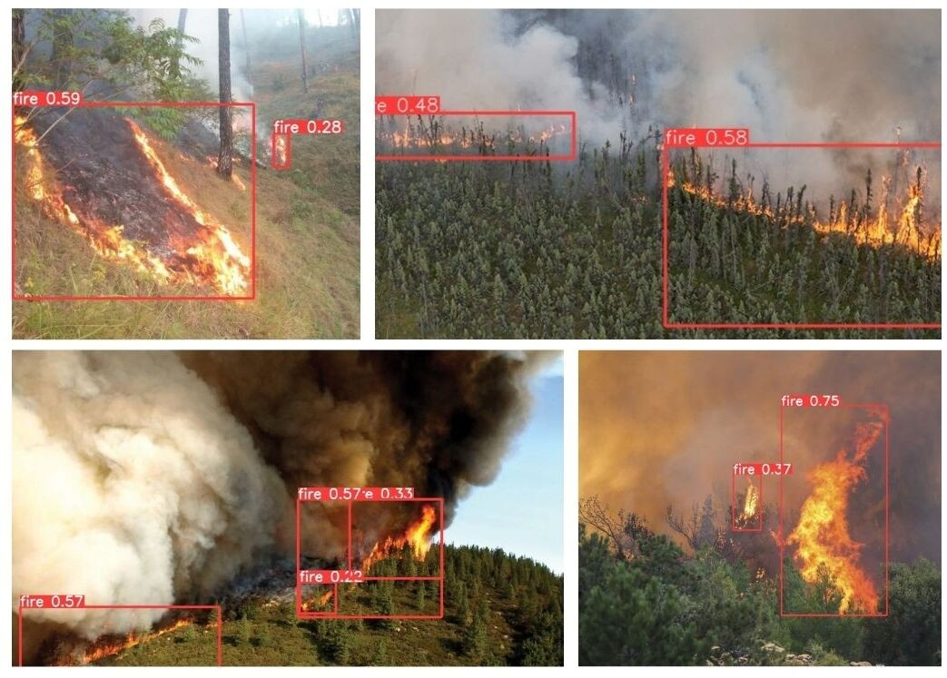
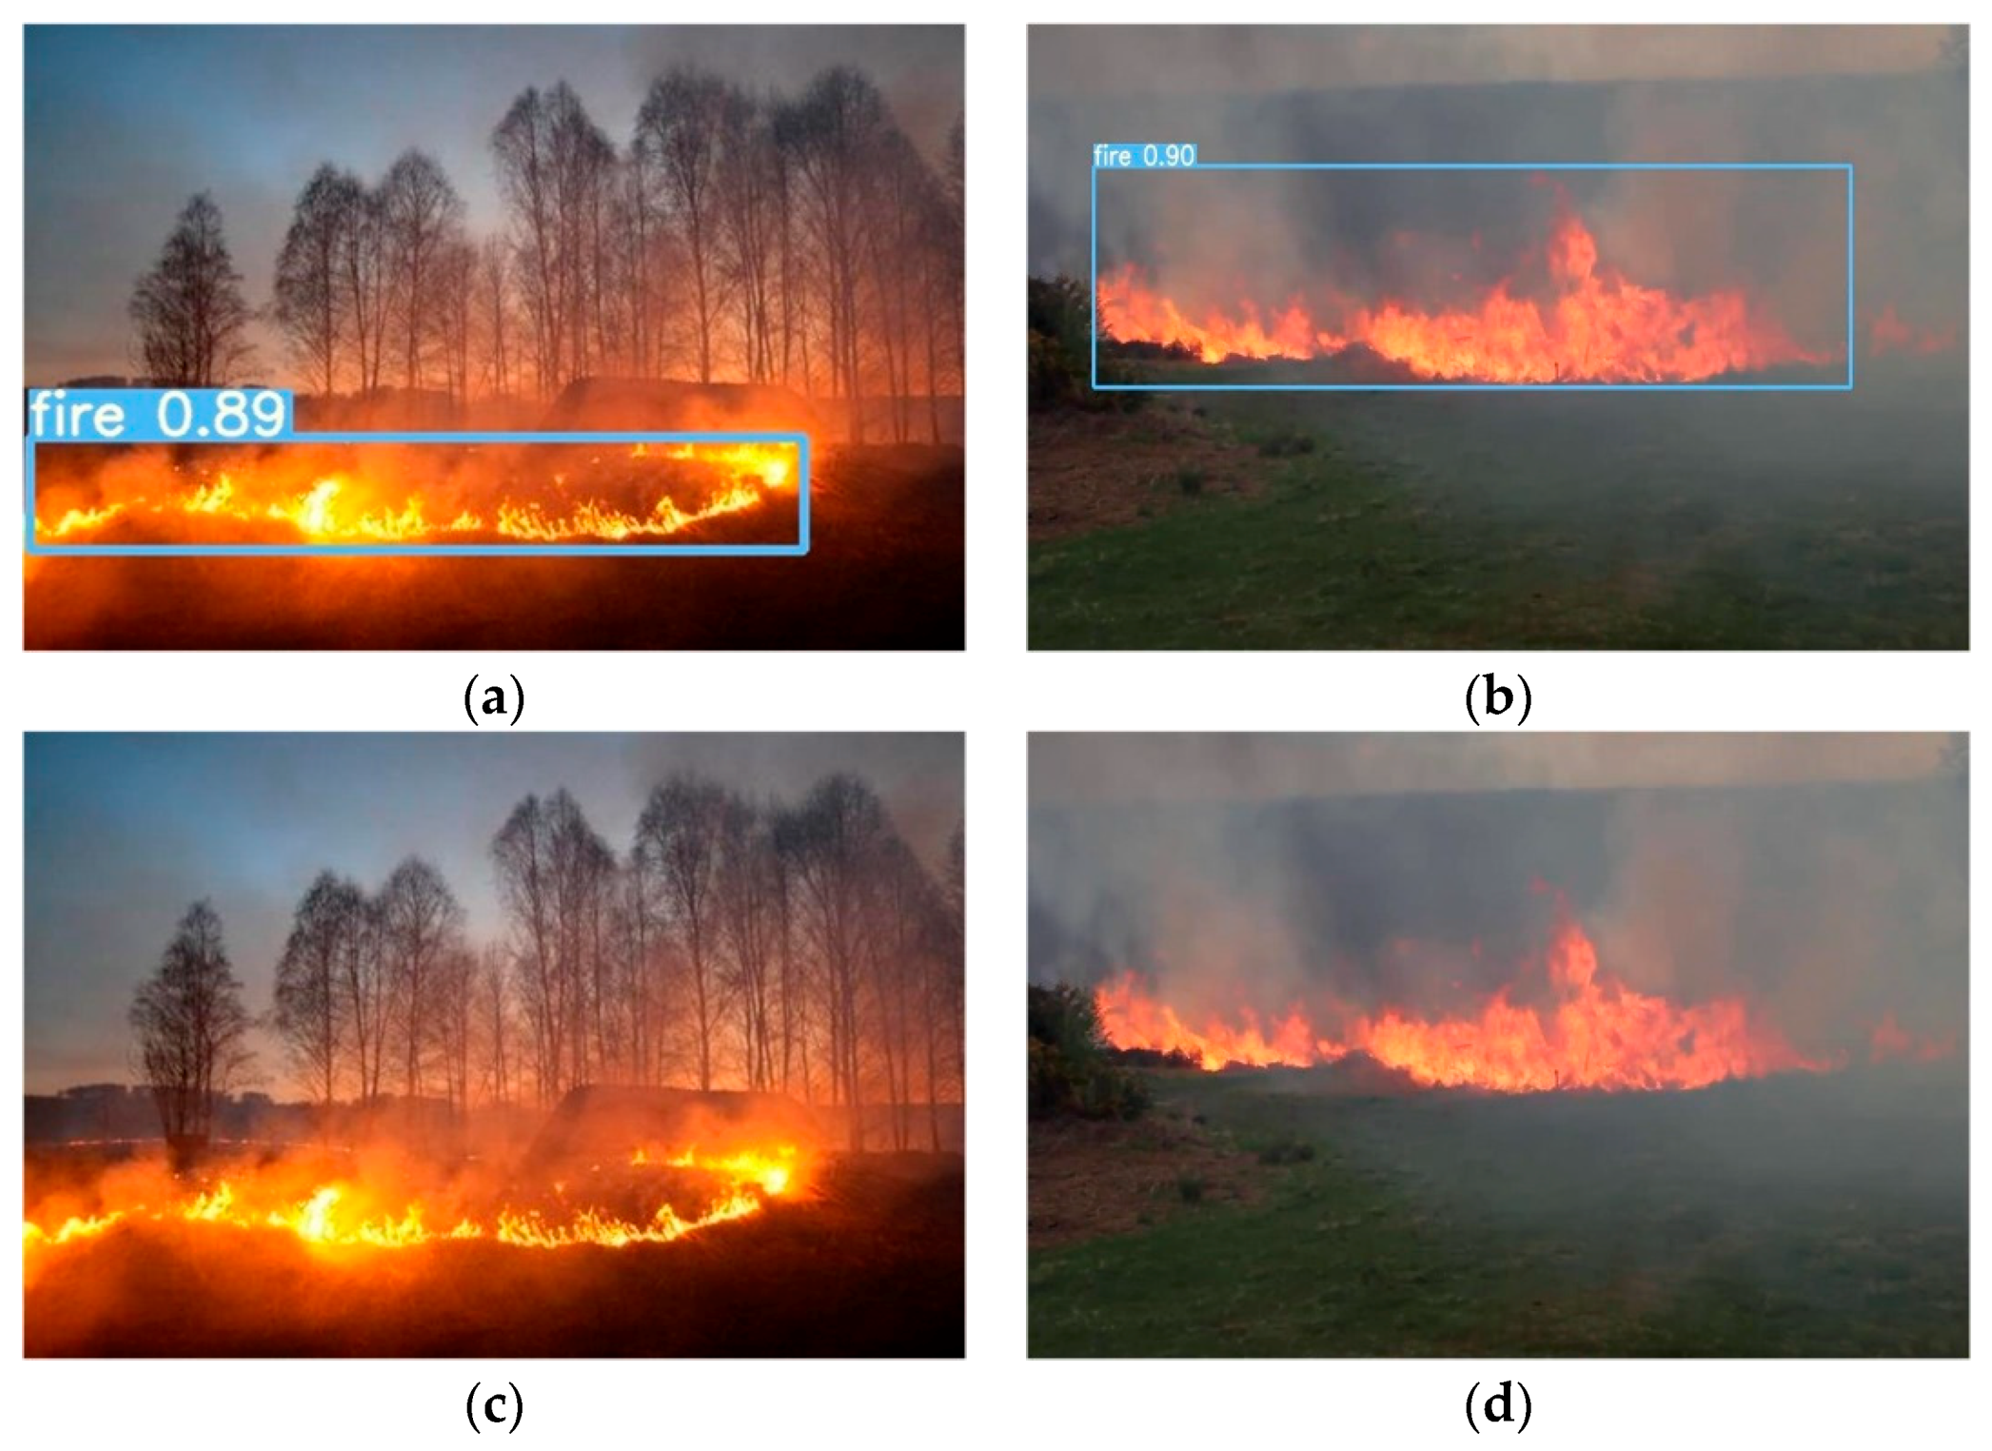
Screenshot of Output:

Slide 8
Conclusion:
Deep learning has emerged as a highly effective solution for forest fire detection, offering significant improvements in accuracy and speed compared to traditional methods. By utilizing large datasets from satellite imagery, drones, and sensors, deep learning models, especially Convolutional Neural Networks (CNNs), can automatically detect early signs of fires, smoke, and changes in vegetation, which are key indicators of wildfires. These models are capable of identifying complex patterns in the data, enabling real-time monitoring and rapid response. The scalability of deep learning allows these systems to be deployed in various geographical regions, processing data from diverse sources. However, challenges remain, such as the need for high-quality, comprehensive datasets and sufficient computational resources for training and deployment. Despite these obstacles, deep learning continues to offer promising potential for revolutionizing forest fire detection systems, improving response times, and ultimately reducing damage caused by wildfires. With ongoing advancements in technology and data access, these systems will become even more effective in safeguarding natural resources and enhancing fire management efforts.

