Slide 1
ENTERPRISE DATA MANAGEMENT

Slide 2
Foundations of Enterprise Data Management
Enterprise data management (EDM) is the process of inventorying and governing your business’s data and getting your organization onboard with the process.
Data management means making sure your people have the accurate and timely data they need, and that they follow your standards for storing quality data in a standardized, secure, and governed place.

Slide 3
Define strategy from capture to secure
You've look at how do I capture the data
How do I transform the data
How do I qualify the data
How do I store the data
How do I visualize the data
How do I analyze the data and
How do we ensure that the entire access is secure

Slide 4
Who’s in charge of enterprise data
management and what do they do?
Enterprise data managers are most often
Database administrators,
IT administrators, or
IT project managers.

Slide 5
Who’s in charge of enterprise data
management and what do they do?
They document and direct the flow of data from absorbing information, and they control the process of removing data that the business doesn’t need.
This life cycle is also referred to as a data lineage.

Slide 6
Data Lineage
Data lineage is the journey of data that takes from its creation through its transformations over time.
It describes a certain dataset’s origin,
movement, characteristics and quality.

Slide 7
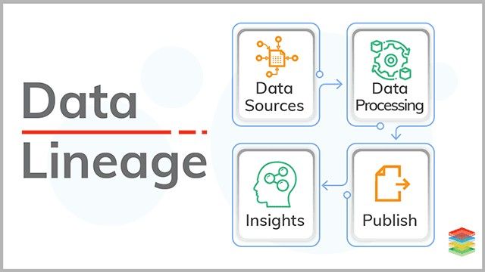
Data Lineage

Slide 8
Data Lineage
Data Lineage Use Case: From Tracing COVID-19’s Origins to
Data-Driven Business
University of California San Francisco (UCSF) study conducted a genetic analysis of COVID-19
8 different viral lineages in 29 patients in February and early March
“it’s like sparks entering California from various sources, causing multiple wildfires.”

Slide 9
Benefits of enterprise data management
Accessing high-quality data for accurate analysis
Ensuring your data is secure and compliant under regulations
Consolidating data across multiple sources for increased efficiency
Having a consistent data architecture that scales with your enterprise

Slide 10
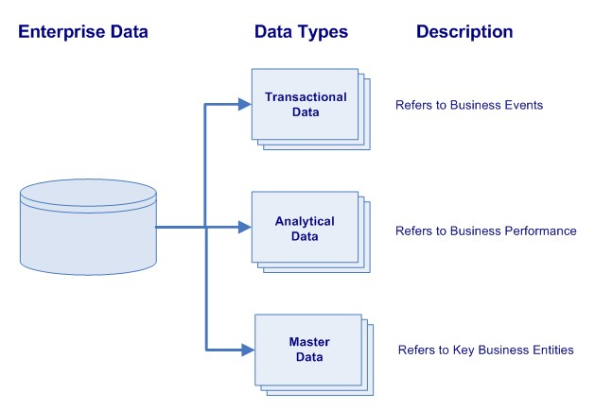
Types of Enterprise Data
Transactional
Analytical
Master

Slide 11
Types of Enterprise Data
supports the daily operations of an organization
supports decision-making, reporting, query, and analysis
supports decision-making, reporting, query, and analysis

Slide 12
Types of Enterprise Data
Transactional data
Sales
Service
Order management
Manufacturing
Purchasing
Billing
accounts receivable and accounts payable.
Commonly, transactional data refers to the data that is created and updated within the operational systems.

Slide 13
Types of Enterprise Data
Transactional data
describes business events. It is the largest volume of data in the enterprise.
Example of business events include:
buying products from suppliers,
selling products to customers,
shipping items to customer sites,
hiring employees, managing their vacations or changing their position

Slide 14
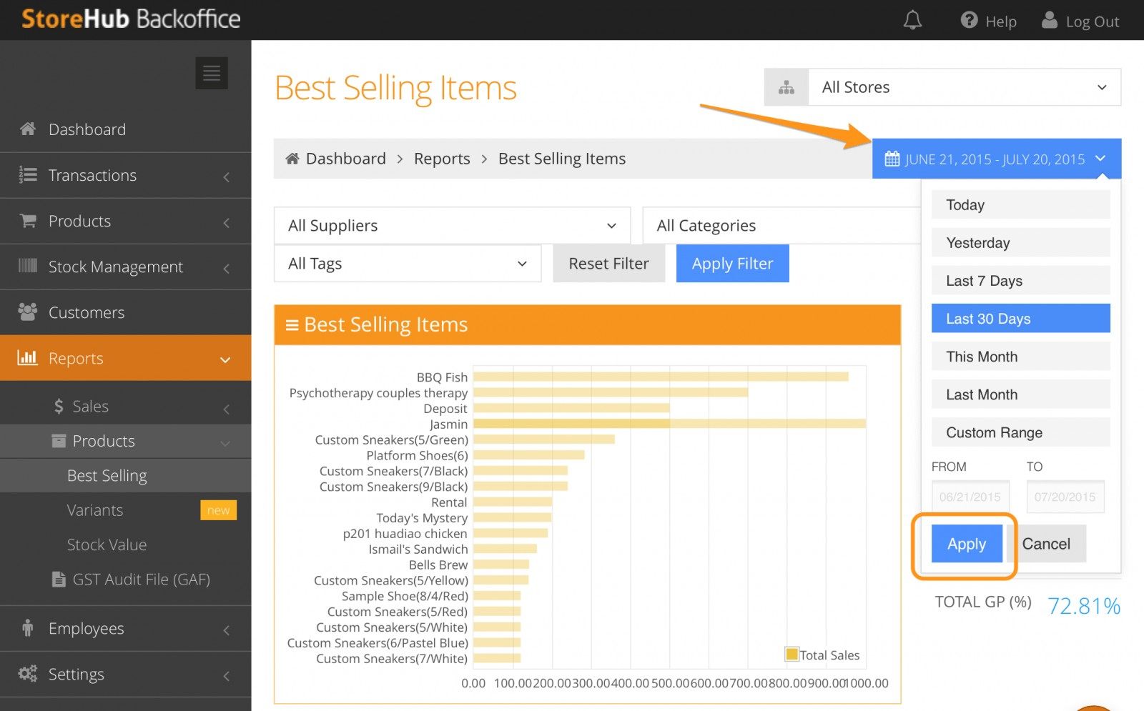

Slide 15
Types of Enterprise Data
Analytical data
These are the numerical values, metrics, and measurements that provide business intelligence and support the decision- making process.
Stored in Online Analytical Processing (OLAP) repositories, such as data warehouses and data lakes.
It is characterized as being the facts and numerical values in a dimensional model.

Slide 16
Types of Enterprise Data
Analytical data
These are the numerical values, metrics, and measurements that provide business intelligence and support the decision- making process.
Stored in Online Analytical Processing (OLAP) repositories, such as data warehouses and data lakes.
It is characterized as being the facts and numerical values in a dimensional model.

Slide 17
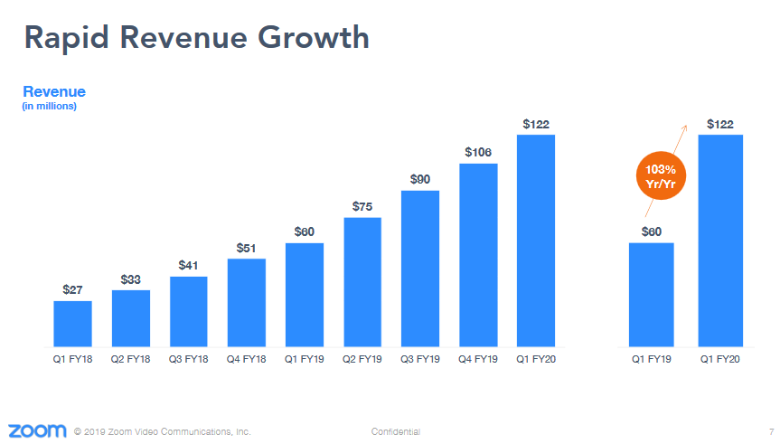
Types of Enterprise Data
ZOOM APP

Slide 18
Types of Enterprise Data
Master data
Master Data is key business information that supports the transactions.
Master Data describes the customers, products, parts, employees, materials, suppliers, sites, etc involved in the transactions. It is commonly referred to as
Places (locations, geography, sites, etc.),
Parties (persons, customers, suppliers, employees, etc.) and
Things (products, items, material, vehicles, etc.).

Slide 19
Types of Enterprise Data
Master data
Master data already exists and is used in the operational systems, with some issues. Master data in these systems is:
Not high quality data,
Scattered and duplicated;
Not truly managed.

Slide 20
