Slide 1
Where to live? A personalized neighborhood identifier for expats
Capstone project for IBM Data Science
By Bettina Vester

Slide 2
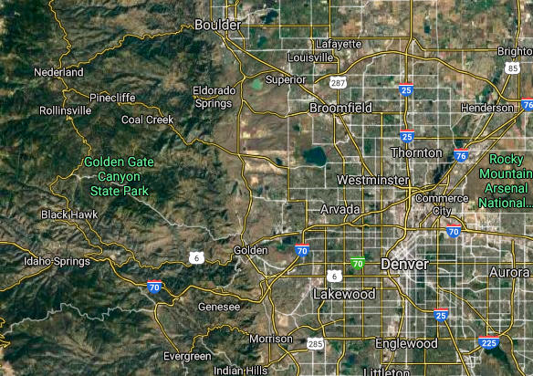
The problem of moving to a new country
It can be hard enough to choose a neighborhood or city in your own state or country, but as an expat, where to start?
My husband and I are experiencing this firsthand. We used to live in a downtown neighborhood of Copenhagen (Denmark), but my husband recently got a new job across the Atlantic ocean at the outskirts of Denver, Colorado. We know little to nothing about Denver and the nearby cities, so where do we start our search for a new home? Which city and neighborhood would we be most happy in?

Slide 3
Evaluation criteria
Constraint
Reasonable transportation time home-workplace
We have also made a list of things that we believe will make us appreciate a local neighborhood. However, we don't know how to prioritize them.
Preferences
Affordable rental prices
Nature/trails in the surrounding area
Presence of coffee shops, breweries and restaurants
Parks (dog walking opportunities)
Opportunity to do sports

Slide 4
Data sources
Potential locations:
Zip codes within a 15 miles radius from Westminster, Colorado (freemaptools.com)
US Zip codes with geolocation data (US Federal Government)
Housing
Rental prices per zip code and median home value per city (Zillow.com)
Facilities and opportunities in area
Venue information from Foursquare.com

Slide 5
Data exploration
Using the Foursquare API, I retrieved information on venues for each of the 83 zip codes using their geolocation with a radius of 1.5 kilometers (resulting in a diameter of 3 km, which is within the distance that I consider reasonable for being part of my neighborhood). This yielded a little more than 3,000 venue results, with the name and venue category for each, along with their location.
In order to be able to analyze the data, I used hot encoding to create dummy variables for each venue category and then summing them up per zip code, allowing me to see, for example how many coffee shops exist in a given zip code.

Slide 6
Personal preference groups
However, the 277 venue categories were too many to allow me to make a decision based on them. Thus, I created a function to group them into my personal preferences according to key words
cafe = 'café|coffee|tea '
restaurant = 'restaurant|pizza|food|mexican|steakhouse|burger|breakfast'
bar = 'brewery|beer|bar|pub'
grocery = 'grocery|convenience'
shopping = 'shop|store'
park = 'park'
nature = 'nature|trail|mountain|river'
sports = 'yoga|tennis|gym|bike'

Slide 7
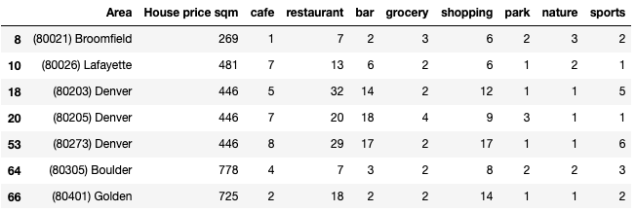
Filtering
Using my personal preference groups as a filter, I created a list of recommended zip codes based on the criteria that they have at least one venue in each of my preference groups.

Slide 8
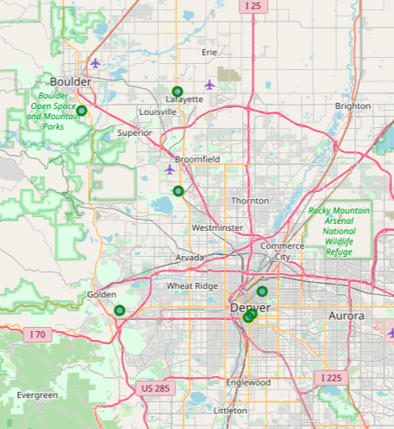
7 proposed locations
Out of the original 83 zip codes which were identified to be within the right geographical area in terms of transportation time to work , the filtering yielded seven zip codes located in five different cities.

Slide 9
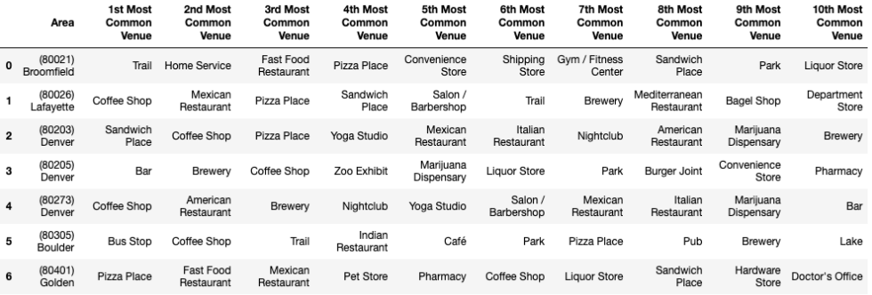
Most common venues

Slide 10
Conclusion
My husband and I are now left with a map of seven potential places to start searching for a new home, all fulfilling our preference criteria. We can use the tables to explore them in more detail, but whether we want to weigh housing prices higher or lower than the amount of coffee shops and nature areas are up to us.

