Slide 1
Social responsibility
NOVEMGER D. PASCUA

Slide 2
What is Social Responsibility?
A duty of every individual to perform as to maintain a balance between the economy and the ecosystems.
Helps individuals, organizations, and governments have a positive impact on development, business and society with a positive contribution to bottom-line results.
It pertains NOT ONLY to BUSINESS organizations but also to everyone whose any action impacts the environment.
Notes:
Bullets 1 and 2
It is the obligation of the decision makers to take actions which protect and improve the welfare of the society as a whole along with their own interest.

Slide 3
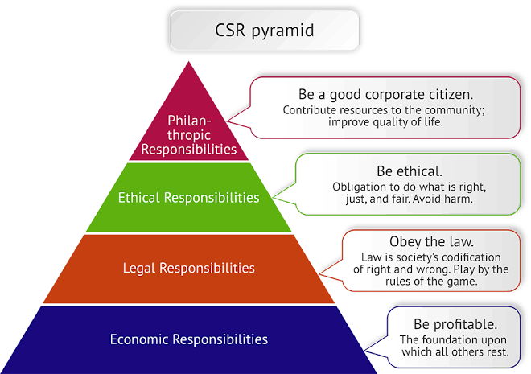
DIMENSIONS OF SR
SOCIAL RESPONSIBILITIES includes 4 Dimension:
Philanthropic
Ethical
Legal
Economic

Slide 4
Philanthropic Responsibilities
Comes from the Greek Word “Philanthropy” which means “the love of the fellow human.”
It incorporates activities that are within the corporation’s discretion to improve the quality of life of employees, loyal communities, and ultimately society at large.
It is important to note that the philanthropic activities are desires of corporations not expected by the society.
Examples of Philanthropic responsibilities
Making donations to charitable institutions
Building of recreational facilities for employees and their families
Support for educational institutions

Slide 5
Ethical Responsibilities
Refers to obligations which are right, just and fair to be met by corporations.
Going beyond law, rules and regulations what proves good for the society.
Ethical Responsibilities consist of what is generally expected by society from corporations over and above economic and legal expectations.
Notes:
Behaviors and activities that are expected or prohibited by organizational members, the community, and society (not codified into law)
Standards, norms or expectations that are reflect the concern of major stakeholders.

Slide 6
Legal Responsibilities
Refers to obeying governmental laws and regulations.
Civil law
Rights and Duties of Individuals and organizations
Criminal Law
Prohibits specific actions and imposes fines/ imprisonment as punishment for breaking the law.

Slide 7
Economic Responsibilities
How resources for the production of goods and services are distributed within the social system.
Consumers always favor socially responsible companies or they most enamored with companies that maximize profits.

Slide 8
ADVANTAGES OF SOCIAL RESPONSIBILITY

Slide 9
Advantages of Social Responsibility
1. Gives a company a competitive edge
is a top criterion when choosing a company to shop with or do business with.
Being a socially responsible company is a message you can use in your brand position and marketing.
2. Attracts strong candidates and increases retention
consistently provide a socially responsible culture for your employees and have a reputation for doing so, you can attract and retain top talent to your organization.

Slide 10
Advantages of Social Responsibility
3. Increases customer loyalty and advocacy
customer advocacy is key to attracting new customers.
As your loyal customers talk to people they know about your product and share positive reviews, they will drive more business your way.
4. Improves company reputation
If your organization is continually participating in social initiatives, it gives an impression to customers, investors and the world as a whole that your organization is financially viable. This, in turn, can attract new investors and investors alike.

Slide 11
Advantages of Social Responsibility
5. Improves profitability and value
Companies often find that when they introduce more energy-efficient methods and begin recycling, they cut operational costs and benefit the environment. Social responsibility also increases transparency with investment analysts, shareholders and community members, improving the company's reputation and increasing the overall value.

Slide 12
DISADVANTAGES OF SOCIAL RESPONSIBILITY

Slide 13
Disadvantages of Social Responsibility
1. Costs money to implement
This can be financially taxing on smaller organizations. While smaller companies can use social media to share any social responsibility policies or initiatives with customers and community members, monitoring these channels takes time and resources. It may require the company to hire extra employees to manage the process effectively, which can be challenging for small businesses.
2. Impacts profitability
A company has a fiduciary duty to its shareholders and costly social responsibility initiatives can impact this directly. This conflict can be challenging for managers, who may feel compelled to choose between socially responsible decisions or initiatives and focusing on the company's profitability.

Slide 14
Disadvantages of Social Responsibility
1. Costs money to implement
This can be financially taxing on smaller organizations. While smaller companies can use social media to share any social responsibility policies or initiatives with customers and community members, monitoring these channels takes time and resources. It may require the company to hire extra employees to manage the process effectively, which can be challenging for small businesses.
2. Impacts profitability
A company has a fiduciary duty to its shareholders and costly social responsibility initiatives can impact this directly. This conflict can be challenging for managers, who may feel compelled to choose between socially responsible decisions or initiatives and focusing on the company's profitability.

Slide 15
examples OF SOCIAL RESPONSIBILITY

Slide 16
Examples:
Charitable giving and volunteer efforts.
Changes to company policies to improve or benefit the environment
Improving labor policies and embracing fair trade
Volunteering at Homeless Shelters and Food Banks
Planting Trees to Combat Deforestation
A Shoulder to Cry on
Notes:
Charitable giving and volunteer efforts: Companies give employees time off for volunteering every year and donate portions of revenue to a charitable organization.
Changes to company policies to improve or benefit the environment: Companies are holding tree-planting events, minimizing paper waste, switching to energy-saving bulbs, setting up recycling bins and allowing remote work to reduce the negative impact of commuter traffic.
Improving labor policies and embracing fair trade: Brands are striving to improve working conditions and the well-being of employees. They are giving parents significant periods of paid leave, unlimited vacation time, more natural lighting, soft seating and plants to boost energy and morale.
Volunteering at Homeless Shelters and Food Banks: Donating time and resources to assist vulnerable populations, such as those experiencing homelessness or hunger, is a compassionate way to show social responsibility. These actions not only provide immediate assistance to those in need but also foster a sense of empathy and understanding within the community.
Planting Trees to Combat Deforestation: Deforestation is a serious matter about to reach its tipping point. Being environmentally conscious can make a person feel good about themselves because they are being socially responsible. What’s good for the environment is good for people on many levels; physically and psychologically.
A Shoulder to Cry on: Sometimes one of the best ways to be socially responsible is to just be there for a friend in their time of need. At some point in life, everyone will encounter challenges that can seem overwhelming. Even if a solution can’t be offered, just the gentle act of providing a shoulder to cry on can be exactly what is needed in that moment.

Slide 17
References:
https://www.indeed.com/career-advice/career-development/social-responsibility
https://helpfulprofessor.com/social-responsibility-norm-examples/
https://www.slideshare.net/deepbaazigar/social-responsibilities-of-business-76714999

Slide 18
THANK YOU

