Slide 1
Demand Forecasting and Managing Variability in a
Supply Chain
Notes:
SEEM 4610 Forecasting
Janny Leung

Slide 2
Learning Objectives
Role of forecasting in a supply chain
Components of a demand forecast
Demand forecasting using historical data
Analysing forecast errors
Managing demand/supply in a supply chain
Forecasting with Excel

Slide 3
Role of forecasting
Demand forecasts form the basis of all planning decisions in a supply chain
  Push: produce to anticipated demand levels
  Pull: set capacity and component availability levels
Forecast time horizons
  Short term (days, weeks): shift scheduling
  Medium Term (weeks, months): workforce planning, materials purchasing, promotions
  Long term (months, years): capacity expansion, capital/financial budget

Slide 4
Characteristics of Forecasts
Forecasts are always wrong!
  Expected value
  Error/variability from the expected value
Long-term forecasts are usually less accurate than short-term forecasts
Aggregate forecasts are usually more accurate than disaggregate forecasts
Mature products with stable demand are easier to forecast than seasonal goods or “fashion” items with short product-life

Slide 5
Influences on Customer Demand
“Predictions are usually difficult, especially about the future” – Yogi Berra
Historical patterns
  Past demand -> future demand
  Seasonality? Trend?
Externalities
  Weather
  State of the economy
Internal factors
  Planned promotional/discount campaigns
  Display position and advertising efforts
Competitors’ actions

Slide 6
Components of Observed Demand
Observed demand (O) =
Systematic component (S) + Random component (R)
Forecasting should focus on identifying the systematic component
Systematic component = Expected value of demand
Time series model:
  (Basic) demand level
  Trend, rate of growth/decline in demand per period
  Seasonality, (predictable) seasonal fluctuations

Slide 7
Forecasting Methods
Qualitative
  Subjective, human judgement and opinions
  Little historical data available, e.g. new product, .com
Time Series
  Assume past history is good indicator of future demand
  Best for stable environments
  Easy to implement
Causal
  Assume other (measurable) factors that is correlated with demand
  Models (e.g. regression) identify factors and quantifies the strength of the correlations
Simulation
  Assumes some underlying principles of customer behaviour and develop possible scenarios in the future to predict demand

Slide 8
Basic Approach to Demand Forecasting
Understand the objective of forecasting
  Forecast horizon; affected by suppliers’ lead times
Integrate demand planning and forecasting
  Co-ordination between marketing, production and suppliers
Identify major factors that influence the demand forecast
  Growth Trend? Seasonality?
  Substitutes and complementary products?
Understand and identify customer segments
  Levels of aggregation
Determine the appropriate forecasting technique
  Geographical location, product life-cycle, etc.
Establish performance and error measures for forecasts
  Assess cost impacts; consider investments in improving forecasts accuracies
No forecast is perfect; system must be flexible and have contingency plans to handle forecast errors

Slide 9
Common Time Series Patterns
Constant (stationary)
Increasing/decreasing linear trend
Seasonal variations
Non-linear (e.g. exponential) trend
Combinations
  Additive
  Multiplicative
  Mixed
Notes:
ECT 7240 Forecasting
Janny Leung
Add graphs

Slide 10
Common Time Series Patterns
Purely Random Error -
No Recognizable Pattern
Increasing
Linear Trend
Demand
Demand
Time
Time
Seasonal Pattern
Seasonal Pattern plus Linear Growth
Demand
Demand
Time
Time

Slide 11
Other Time Series Patterns
Curvilinear Trend
(quadratic, exponential)
Demand
Time
Change of variables?

Slide 12
Underlying model and definitions
Systematic component = (level + trend) x seasonal factor
L = estimate of level for period 0 (de-seasonalised demand)
T= estimate of trend (increase/decrease in demand per period)
S_{t}= Estimate of seasonal factor for period t
D_{t}= Actual demand observed for period t
F_{t}= Forecast of demand for period t
F_{t+k} = [ L+ (t+k)T ]S_{t+k}

Slide 13
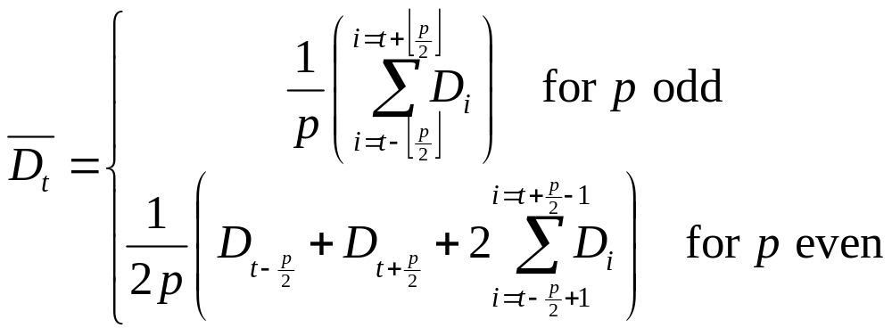
De-seasonalising Demand
De-seaonalised demand is the demand that would have been observed in the absence of seasonal fluctuations
The periodicity p is the number of periods after which the seasonal cycle repeats itself
  (e.g. if period length = 3 months, p = 4)

Slide 14
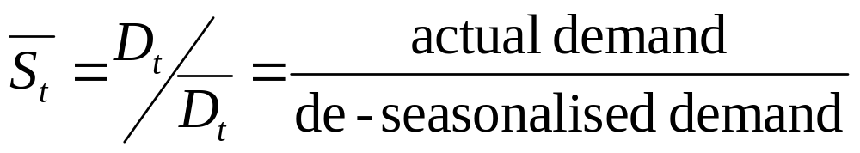
Estimating Model Parameters
Seasonal factors:
Seasonal factor for a given period (in the future) can be estimated by averaging seasonal factors of periods of corresponding seasons

Slide 15
Static Forecasting
Values of L and T estimated based on a set of data
Methods:
  Simple averaging
  Linear regression
These (static) values of L and T are used for future forecasts

Slide 16
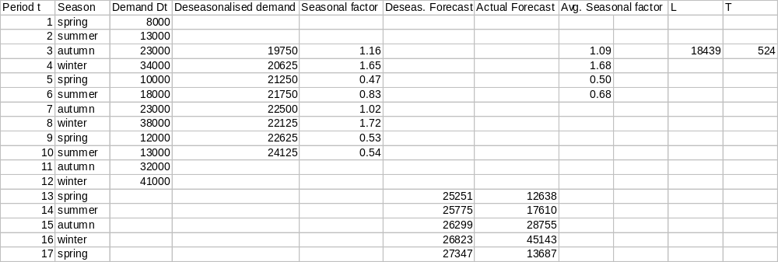
Example: Natural Gas

Slide 17
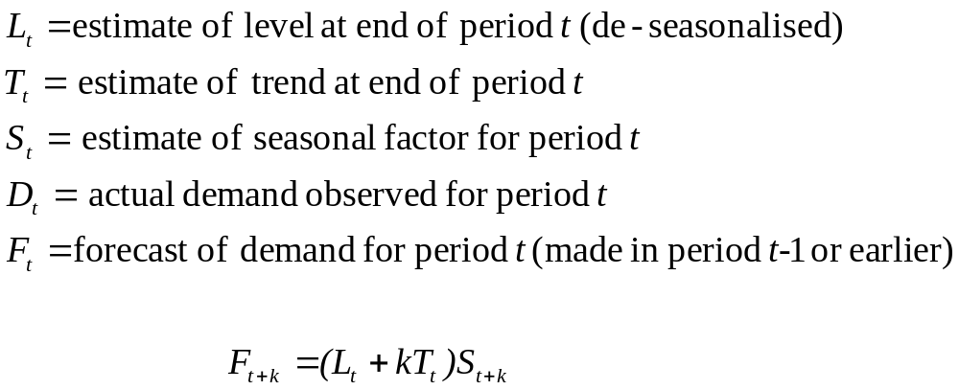
Adaptive forecasting
The estimates of level, trend and seasonality are updated after each demand observations

Slide 18
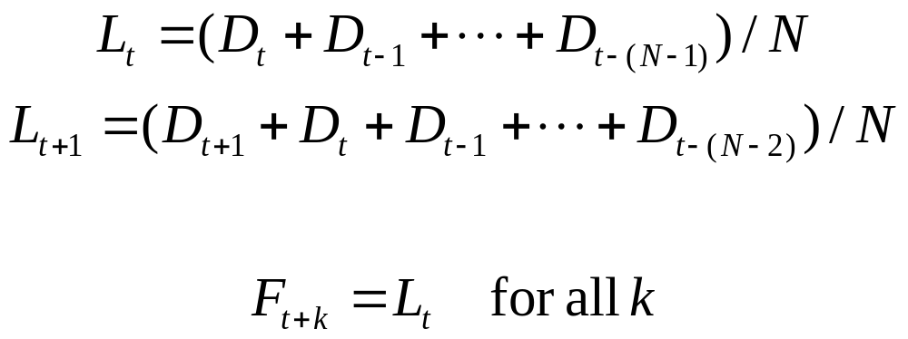
Moving Average
Assumes no trend and no seasonality
Level estimate is the average demand over most recent N periods
Update: add latest demand observation and and drop oldest
Forecast for all future periods is the same
Each period’s demand equally weighted in the forecast
How to choose the value of N?
  N large =>
  N small =>

Slide 19
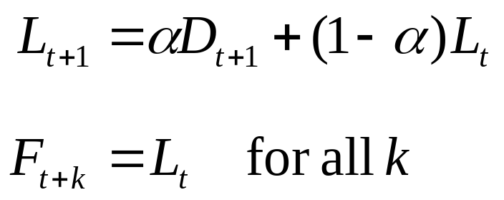
Simple Exponential Smoothing
(No trend, no seasonality)
Rationale: recent past more indicative of future demand
Update: level estimate is weighted average of latest demand observation and previous estimate
α is called the smoothing constant (0 < α < 1)
Forecast for all future periods is the same
Assume systematic component of demand is the same for all periods (L)
L_{t} is the best guess at period t of what the systematic demand level is

Slide 20
Simple Exponential Smoothing - Example
L₀= 22083 α = 0.1
F₁ = L₀
D₁=8000
E₁ = F₁ – D₁ = 22083 – 8000 = 14083
L₁ = α D₁ + (1 - α ) L₀
= (0.1)(8000) + (0.9)(22083) = 20675
F₂ = L₁= 20675, F₁₀ = L₁ = 20675

Slide 21
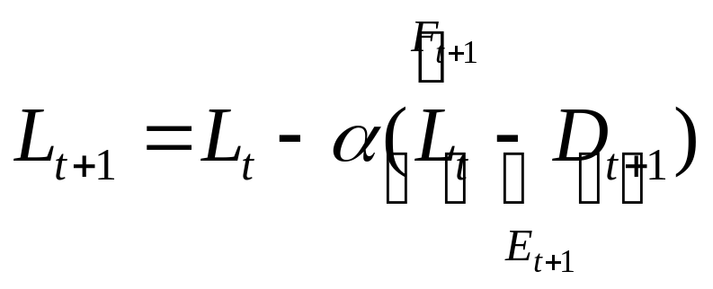
Simple Exponential Smoothing
Update: new level estimate is previous estimate adjusted by weighted forecast error
How to choose the value of the smoothing constant α?
  Large α => responsive to change, forecast subject to random fluctuations
  Small α => may lag behind demand if trend develops
Incorporates more information but keeps less data than moving averages
  Average age of data in exponential smoothing is 1/α
  Average age of data in moving average is (N+1)/2

Slide 22
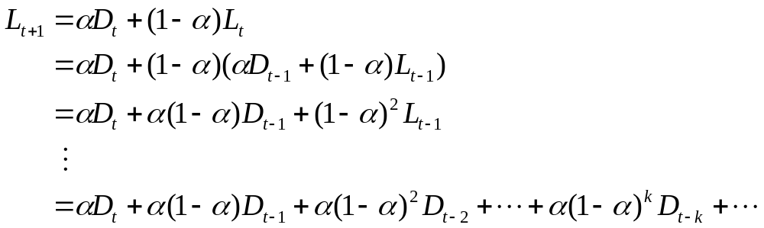

Understanding the exponential smoothing formula
Demand of k-th previous period carry a weight of hence the name exponential smoothing
Demand of more recent periods carry more weight

Slide 23
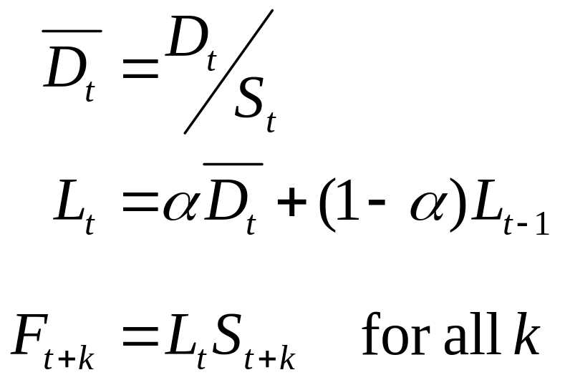
Exponential Smoothing with Seasonality (no trend)
De-seasonalise demand data
Apply exponential smoothing update
Seasonalise forecast

Slide 24
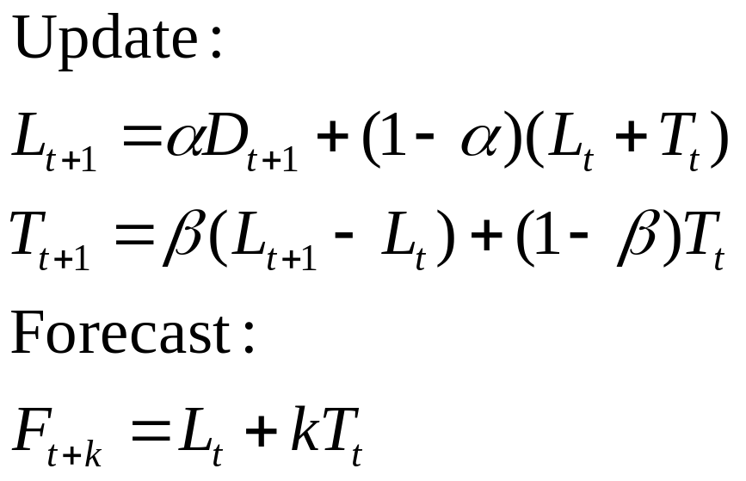
Trend corrected exponential smoothing (Holt’s model)
β is the smoothing constant for trend updating
If β is large, there is a tendency for the trend term to “flip-flop” in sign
Typical β is α²

Slide 25
Holt’s model - Example
L₀= 12015 T₀=1549 α = 0.1 β = 0.2
F₁ = L₀ + T₀ = 12015 + 1549 = 13564
D₁=8000
E₁ = F₁ – D₁ = 13564 – 8000 = 5564
L₁ = α D₁ + (1 - α )(L₀ + T₀)
= (0.1)(8000) + (0.9)(13564) = 13008
T₁ = β (L₁ − L₀) + (1 - β )T₀
= (0.2)(13008 − 12015) + (0.8)(1549) = 1438
F₂ = L₁+T₁= 13008+1438 = 14446,
F₁₀ = L₁ + 9 T₁ = 13008 + 9(1438) = 25950

Slide 26
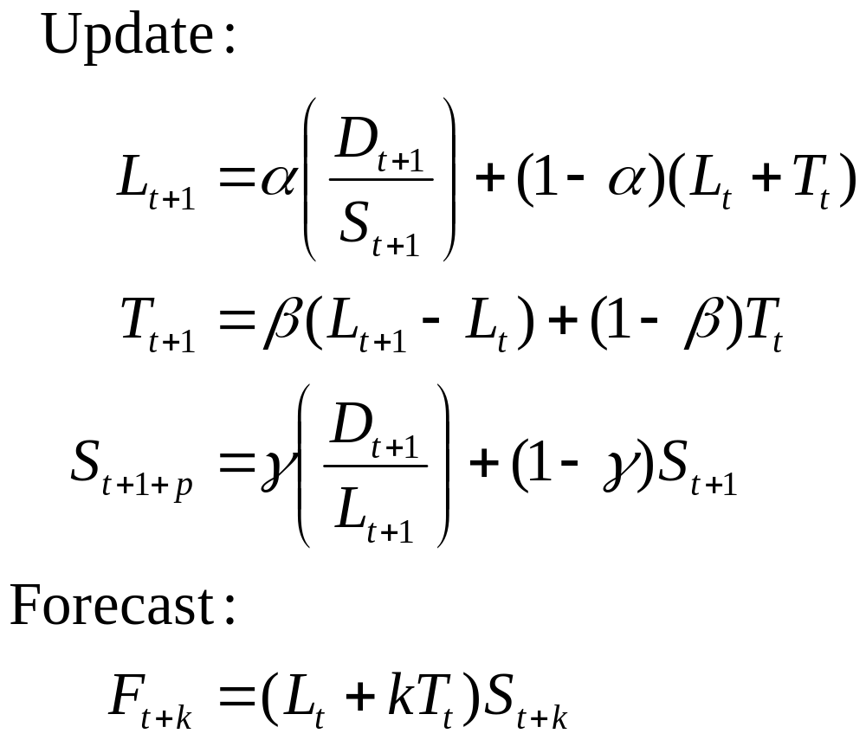
Trend and seasonality corrected exponential smoothing (Winter’s model)

Slide 27
Winter’s model - Example
L₀= 18439 T₀=524 S₁ = 0.47, S₂ =0.68, S₃ =1.17, S₄ =1.67,
α = 0.1, β = 0.2, γ = 0.1,
F₁ = (L₀ + T₀) S₁ = (18439 + 524)(0.47) = 8913
D₁=8000, E₁ = F₁ – D₁ = 8913 – 8000 = 913
L₁ = α (D₁/S₁) + (1 - α )(L₀ + T₀)
= (0.1)(8000/0.47) + (0.9)(18439+524) = 18769
T₁ = β (L₁ − L₀) + (1 - β )T₀
= (0.2)(18769 − 18439) + (0.8)(524) = 485
S₅ = γ (D₁/L₁) + (1 - γ)S₁
= (0.1)(8000/18769) + (0.9)(0.47) = 0.465
F₂ = (L₁+T₁)S₂ = (18769+485)(0.68) = 13093,
F₁₁ = (L₁ + 10 T₁)S₁₁ = (18769 + 10(485))(1.17) = 27634

Slide 28
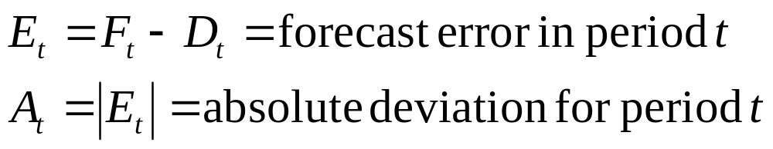
Analysing Forecast Errors
Monitor if current forecasting methods accurate
  Consistently under-predicting? Over-predicting?
  When should we adjust forecasting procedures?
Understand magnitude of forecast error
  In order to make appropriate contingency plans
Assume we have data for n historical periods
Notes:
SEEM 4610 Forecasting
Janny Leung

Slide 29
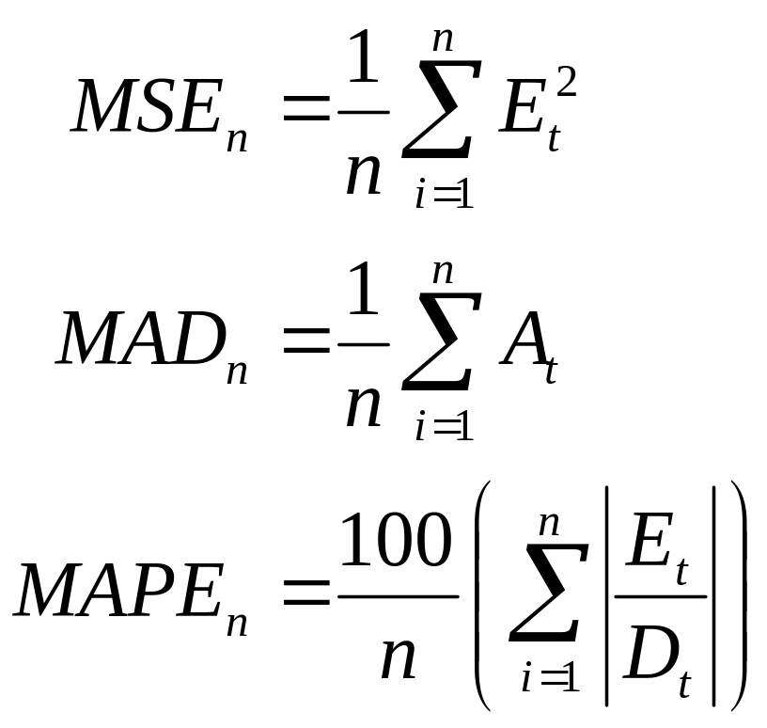
Measures of Forecast Error
Mean Square Error (MSE)
  Estimate of variance (σ²) of random component
Mean Absolute Deviation (MAD)
  If random component normally distributed, σ=1.25 MAD
Mean Absolute Percent Error (MAPE)
Notes:
ECT 7240 Forecasting
Janny Leung

Slide 30
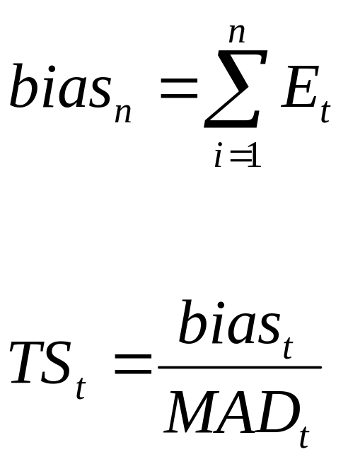
Tracking Errors
Errors due to:
  Random component
  Bias (wrong trend, shifting seasonality, etc.)
Monitor quality of forecast with a tracking signal
Alert if signal value exceeds threshold
  Indicates underlying environment changed and model becomes inappropriate
Tracking signal sometimes used as smoothing constant
  Reactive, but often unstable in practice
Notes:
ECT 7240 Forecasting
Janny Leung

Slide 31
Summary so far
Importance of forecasting in a supply chain
Forecasting models and methods
Exponential smoothing
  Stationary model
  Trend
  Seasonality
Measures of forecast errors
Tracking signals
Regression models
SEG4610
Forecasting
Notes:
SEEM 4610 Forecasting
Janny Leung

Slide 32
Regression Analysis
Statistical technique to determine the degree of association between set of variables and demand.
Given values of the predictor (independent) variables, the regression equation provides a forecast of demand.
SEG4610
Forecasting
Notes:
SEEM 4610 Forecasting
Janny Leung

Slide 33
Simple Linear Regression
Only one independent variable
Time series:
  how demand (dependent variable) changes over time (independent variable)
Scatterplots
Dependent Variable | Independent Variable
Sales of wallpaper | No. of new apartments
Hang Seng Index level | No. of times Cheng Siu Chow appears on TV
No. of patients at CUHK clinic | No. of students taking exams
SEG4610
Forecasting

Slide 34
(Pearson’s) Sample Correlation Coefficient
X = (Σ xi)/n Y = (Σ yi)/n
SX = sqrt(Σ (xi – X)^2/(n-1))
SY = sqrt(Σ (yi – Y)^2/(n-1))
SXY = Σ (xi – X) (yi – Y)/(n-1)
r = SXY / SX SY -1 < r < 1
r measures how good the linear relationship is between the variables
Watch out for induced correlation trap!
SEG4610
Forecasting
Notes:
SEG 4610 Forecasting
Janny Leung

Slide 35
Linear Regression
Find the relationship: Y = a + b X
For each data point (xi , yi), the residual error is
ei = yi – (a + b xi)
Choose a and b to minimise Σ ei^2
b = SXY / SX^2, a = Y – b X
Forecast: a new situation yields x’ and the predicted value for Y is a+bx’
SEG4610
Forecasting

Slide 36
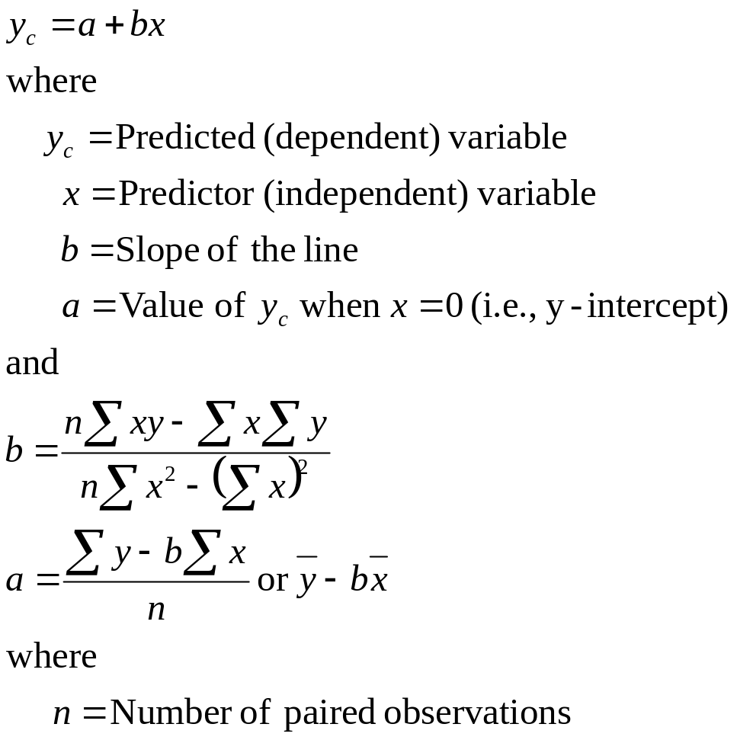
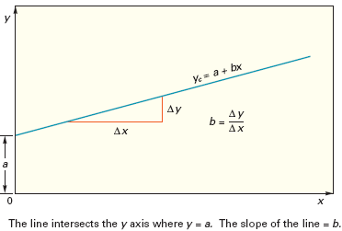
Least Squares Regression
SEG4610
Forecasting

Slide 37
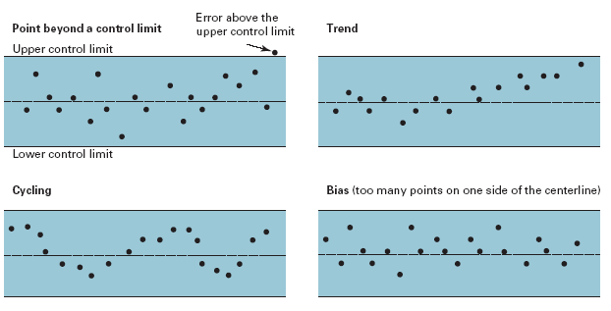
Nonrandom Errors
SEG4610
Forecasting

Slide 38
Special Forecasting Difficulties for Supply Chains
New products and service introductions
  No past history
  Use qualitative methods until sufficient data collected
  Examine correlation with similar products
  Use a large exponential smoothing constant
Lumpy derived demand
  Large but infrequent orders
  Random variations “swamps” trend and seasonality
  Identify reason for lumpiness and modify forecasts
Spatial variations in demand
  Separate forecast vs. allocation of total forecasts

Slide 39
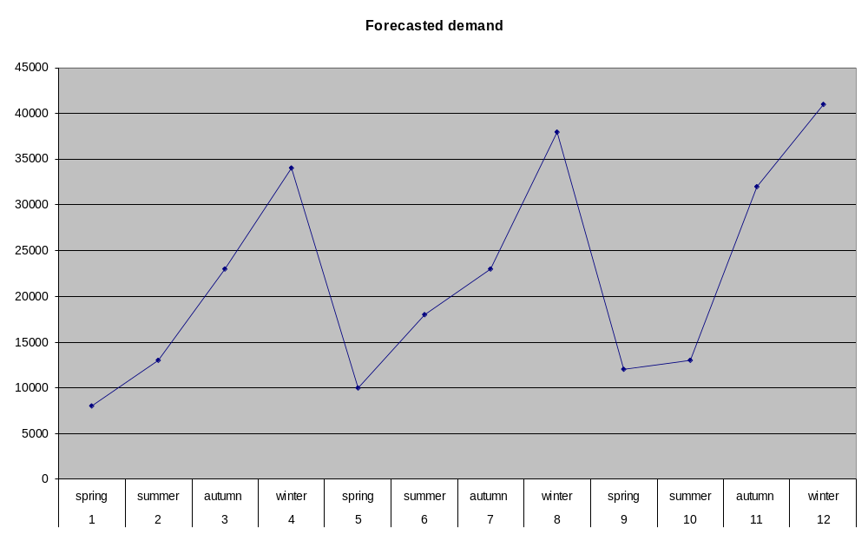
Managing (Predictable) Variability
How should we plan production to meet forecasted demand?

Slide 40
Managing Supply
Chase strategy: production matches demand
  No inventory
  Capacity under-utilised during low demand periods
Level (stable) production
  High capacity utilisation
  Personnel management/training simpler
  Inventory build up in anticipation of seasonal demand variations; obsolescence risk
  Order backlog; loss of goodwill
Capacity vs. Inventory trade-off

Slide 41
Managing Capacity
Time flexibility from workforce
  More shifts during busy season
  Overlapping shifts
  Seasonal/Temporary workforce
Subcontracting (Use of dual facilities)
  Internal or main facility: focus on efficiency (low cost), level production
  Peak demands subcontracted out or produced on more flexible facilities
Designing product flexibility into the production process
  Production lines re-configurable for different production rates
  Complementary products produced in same facility (e.g. snowblowers and lawnmowers)

Slide 42
Managing Inventory
Use common components across multiple products
  Aggregate demand more stable (forecast more accurate)
  Less obsolescence risk
Build inventory of high demand or predictable demand items
  Delay production of “fashion” items until closer to selling season

Slide 43
Managing Demand
Promotion/Discount pricing
Impact on demand
  Market growth (attract new customers)
    Increase overall demand
  Stealing market shares (attract competitors’ customers)
    Increase overall demand
  Forward buying (own customers buy earlier)
    Demand “smoothing”?
Timing of promotion: peak vs. non-peak
Change in revenue vs. change in costs

Slide 44
Factors affecting promotion timing
Factor | Favoured promotion time
High forward buying | Low demand period
High stealing market share | High demand period
High market growth | High demand period
High margin product | High demand period
High inventory holding costs | Low demand period
Low production flexibility | Low demand period

Slide 45
Demand management
Changes in demand impact production scheduling and inventory levels
  Promotion at peak demand periods increases demand variability
  Promotion at non-peak “smoothes” demand
Pricing and production planning must be done jointly
Preempt, don’t just react, to predictable variability
Actively managing predictable variability can be a strategic competitive advantage

Slide 46
Flexibility and Quick Response
No forecast is perfect …
There is no better forecast than the actual order!
If supply chain is responsive, then effect of forecast errors is minimised
Especially important when demand is unpredictable
Example: National bicycle
  Difficult to predict styles in sports bikes
  Re-engineer supply chain
  Customers design their own bike on Internet
  Bike produced in Kashiwara and delivered in 2 weeks!

Slide 47
Summary
Importance of forecasting
Exponential smoothing models
  Level, Trend, Seasonality
Measuring forecast error; tracking
Predictable variability
  Managing supply
  Managing demand
Unpredictable variability?
Co-ordinated management of supply and demand optimises profit
Forecasting with Excel

