Slide 1
TIME SERIES MODELS

Slide 2
Definitions
Forecast is a prediction of future events used for planning process.
Time Series is the repeated observations of demand for a service or product in their order of occurrence.

Slide 3

Components of a Time Series
A time series can consist of five components.
  Horizontal or Stationary – Fluctuations around a constant mean.
  Long - term trend (T).
  Cyclical effect (C).
  Seasonal effect (S).
  Random variation (R).
Quantity
Time
A trend is a long term relatively
smooth pattern or direction, that
persists usually for more than one year.

Slide 4
A cycle is a wavelike pattern describing
a long term behavior (for more than one
year).
Cycles are seldom regular, and
often appear in combination with
other components.
6/90 6/93 6/96 6/99 6/02
The seasonal component of the time series
exhibits a short term (less than one year)
calendar repetitive behavior.
6/97 12/97 6/98 12/98 6/99

Slide 5
Random variation comprises the irregular
unpredictable changes in the time series.
It tends to hide the other (more predictable)
components.
Random or Irregular Variation –classified into:
Episodic – unpredictable but identifiable
Residual – also called chance fluctuation and unidentifiable

Slide 6
Moving Average and Exponential Smoothing Methods
Consider models applicable to time series data with seasonal, trend, or both seasonal and trend component and stationary data.
Forecasting methods discussed can be classified as:
  Averaging methods.
    Equally weighted observations
  Exponential Smoothing methods.
    Unequal set of weights to past data, where the weights decay exponentially from the most recent to the most distant data points.
    All methods in this group require that certain parameters to be defined.
    These parameters (with values between 0 and 1) will determine the unequal weights to be applied to past data.

Slide 7
Moving Averages
  A n-period moving average for time period t is the arithmetic average of the time series values for the n most recent time periods.
  For example: A 3-period moving average at period (t+1) is calculated by (y_{t-2} + y_{t-1} + y_{t})/3

Slide 8
Centered Moving Average Method
The centered moving average method consists of computing an average of n periods' data and associating it with the midpoint of the periods. For example, the average for periods 5, 6, and 7 is associated with period 6.

Slide 9
Moving Averages
A large k is desirable when there are wide, infrequent fluctuations in the series.
A small k is most desirable when there are sudden shifts in the level of series.
For quarterly data, a four-quarter moving average, MA(4), eliminates or averages out seasonal effects.

Slide 10
Moving Averages
For monthly data, a 12-month moving average, MA(12), eliminate or averages out seasonal effect.
Equal weights are assigned to each observation used in the average.
Each new data point is included in the average as it becomes available, and the oldest data point is discarded.

Slide 11
Summary of Moving Averages
Advantages of Moving Average Method
  Easily understood
  Easily computed
  Provides stable forecasts
Disadvantages of Moving Average Method
  Requires saving all past n data points
  Lags behind a trend
  Ignores complex relationships in data

Slide 12
Simple Moving Average – Example (File: PPT_MA)
Period
Actual
MA3
MA5
Consider the following data,
Starting from 4th period one can start forecasting by using MA3. Same is true for MA5 after the 6th period.
Actual versus predicted(forecasted) graphs are as follows;
1
42
2
40
3
43
4
40
41.7
5
41
41.0
6
39
41.3
41.2
7
46
40.0
40.6
8
44
42.0
41.8
9
45
43.0
42
10
38
45.0
43
11
40
42.3
42.4
12
41.0
42.6

Slide 13
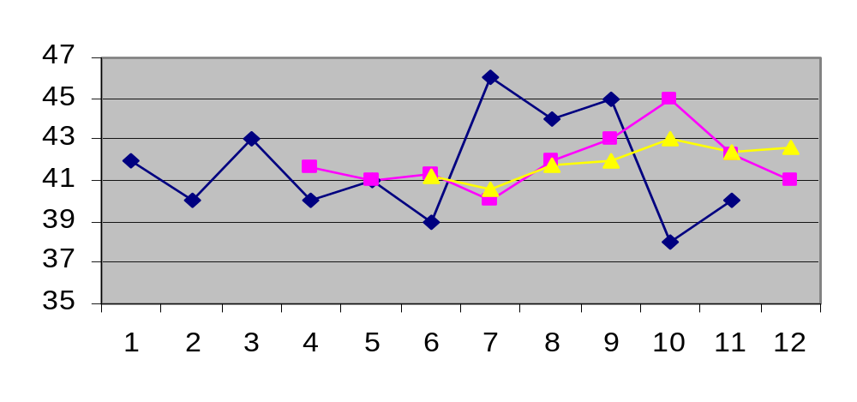
Simple Moving Average - Example
Actual
MA5
MA3

Slide 14
Sample Excel analysis for Actual, Moving Averages for 3 and 5 periods
Period | Actual | MA3 | MA5
1 | 42 | #N/A | #N/A
2 | 40 | #N/A | #N/A
3 | 43 | 41.66667 | #N/A
4 | 40 | 41 | #N/A
5 | 41 | 41.33333 | 41.2
6 | 39 | 40 | 40.6
7 | 46 | 42 | 41.8
8 | 44 | 43 | 42
9 | 45 | 45 | 43
10 | 38 | 42.33333 | 42.4
11 | 40 | 41 | 42.6

Slide 15
Sample Excel analysis for Actual, Centred Moving Averages for 2 and 4 periods
Period | Actual | Avg2 | Centered MA2 | Avg4 | Centered MA4
1 | 42 |  | NA |  | NA
 |  | 41
2 | 40 |  | 41.25 |  | NA
 |  | 41.5 |  | 41.25
3 | 43 |  | 41.5 |  | 41.125
 |  | 41.5 |  | 41
4 | 40 |  | 41 |  | 40.875
 |  | 40.5 |  | 40.75
5 | 41 |  | 40.25 |  | 41.125
 |  | 40 |  | 41.5
6 | 39 |  | 41.25 |  | 42
 |  | 42.5 |  | 42.5
7 | 46 |  | 43.75 |  | 43
 |  | 45 |  | 43.5
8 | 44 |  | 44.75 |  | 43.375
 |  | 44.5 |  | 43.25
9 | 45 |  | 43 |  | 42.5
 |  | 41.5 |  | 41.75
10 | 38 |  | 40.25 |  | NA
 |  | 39
11 | 40 |  | NA |  | NA

Slide 16
Sample SPSS analysis for Actual, Centered MA3 and Prior MA3
Period Actual MA3 Prior_MA3
1 42
2 40 41.7
3 43 41.0
4 40 41.3 41.7
5 41 40.0 41.0
6 39 42.0 41.3
7 46 43.0 40.0
8 44 45.0 42.0
9 45 42.3 43.0
10 38 41.0 45.0
11 40 42.3

Slide 17
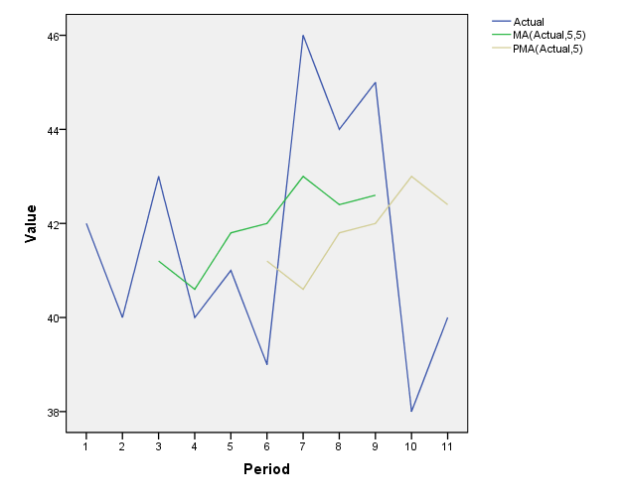
Sample SPSS graph for Actual, Centered MA5 and Prior MA5

Slide 18
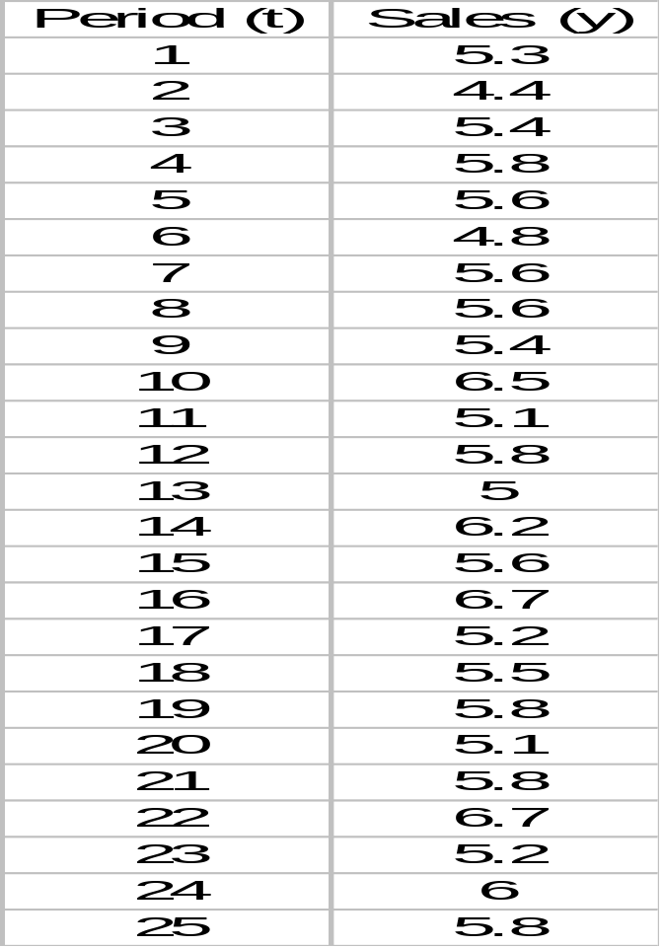
Example: Weekly Department Store Sales
The weekly sales figures (in millions of dollars) presented in the following table are used by a major department store to determine the need for temporary sales personnel.

Slide 19
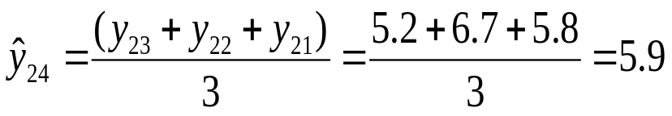
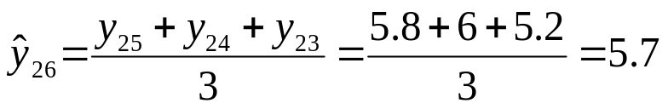
Example: Weekly Department Store Sales
Use a three-week moving average (k=3) for the department store sales to forecast for the week 24 and 26.
The forecast for the week 26 is

Slide 20
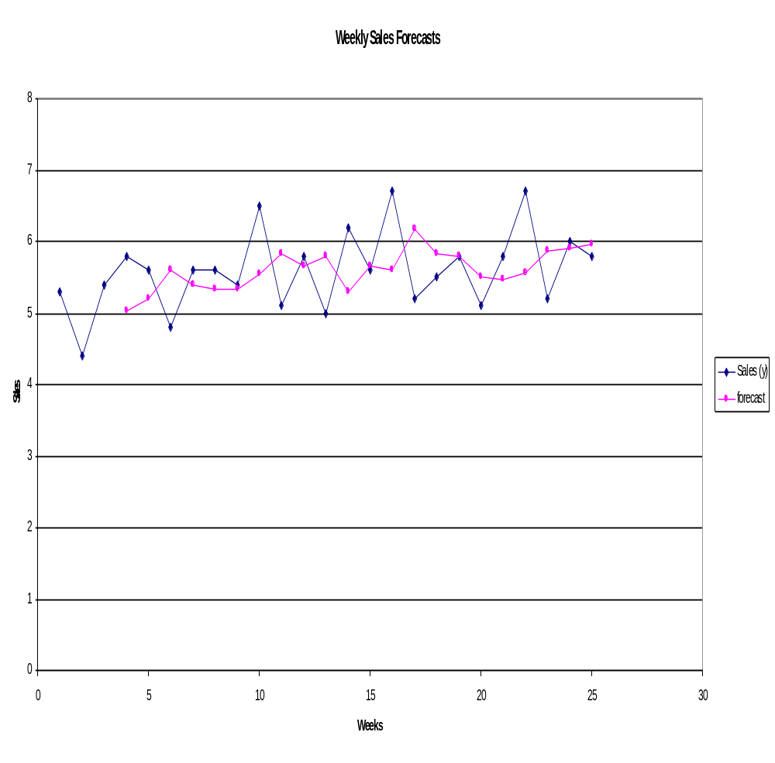
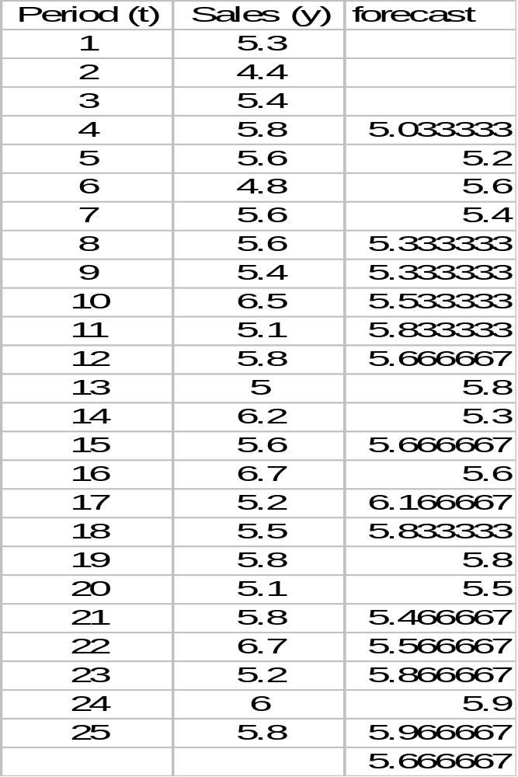
Example: Weekly Department Store Sales

Slide 21
Problem: Robert’s Drugs
During the past ten weeks, sales of cases of Comfort brand headache medicine at Robert's Drugs have been as follows:
Week Sales Week Sales
1 110 6 120
2 115 7 130
3 125 8 115
4 120 9 110
5 125 10 130
If Robert's uses a 3-period moving average to forecast sales, what is the forecast for Week 11?

Slide 22
Exponential Smoothing Methods
This method provides an exponentially weighted moving average of all previously observed values.
Appropriate for data with no predictable upward or downward trend.
The aim is to estimate the current level and use it as a forecast of future value.
Notes:
This is an obvious extension the moving average method. With simple moving average forecasts the mean of the past k observations used as a forecast have equal eights (1/k) for all k data points. With exponential smoothing the idea is that the most recent observations will usually provide the best guide as to the future, so we want a weighting scheme that has decreasing weights as the observations get older

Slide 23



Simple Exponential Smoothing Method
Formally, the exponential smoothing equation is
    forecast for the next period.
    α = smoothing constant.
    y_{t} = observed value of series in period t.
    = old forecast for period t.
  The forecast F_{t+1} is based on weighting the most recent observation y_{t} with a weight α and weighting the most recent forecast F_{t} with a weight of 1- α

Slide 24
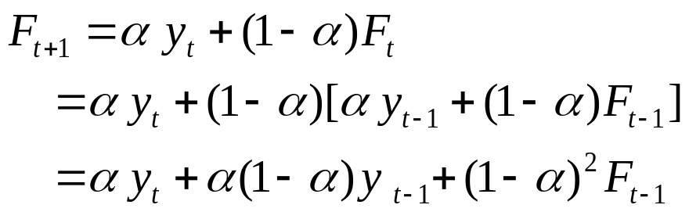
Simple Exponential Smoothing Method
The implication of exponential smoothing can be better seen if the previous equation is expanded by replacing F_{t} with its components as follows:

Slide 25
Simple Exponential Smoothing Method
If this substitution process is repeated by replacing F_{t-1} by its components, F_{t-2} by its components, and so on the result is:
Therefore, F_{t+1} is the weighted moving average of all past observations.

Slide 26

Simple Exponential Smoothing Method
The exponential smoothing equation rewritten in the following form elucidate the role of weighting factor α.
Exponential smoothing forecast is the old forecast plus an adjustment for the error that occurred in the last forecast.

Slide 27
Simple Exponential Smoothing Method
The value of smoothing constant α must be between 0 and 1
α can not be equal to 0 or 1.
If stable predictions with smoothed random variation is desired then a small value of α is desire.
If a rapid response to a real change in the pattern of observations is desired, a large value of α is appropriate.

Slide 28
Measures of Forecast Errors
Cumulative Forecast Error (CFE)
Mean Squared Error (MSE)
Standard Deviation (σ)
Mean Absolute Deviation (MAD)
Mean Absolute Percent Error (MAPE)

Slide 29
Choosing a Method
Forecast Error
Measures of Forecast Error
Et = yt – Ft
CFE = ΣEt
σ =
MSE =
MAD = MAPE =
Σ(Et – E )²
n – 1
ΣEt²
n
Σ|Et |
n
Σ[ |Et | (100) ] / yt
n
Notes:
74

Slide 30
Example
The following table shows the actual sales of upholstered chairs for a furniture manufacturer and the forecasts made for each of the last eight months. Calculate CFE, MSE, σ, MAD and MAPE for this product.

Slide 31
Choosing a Method
Forecast Error
Absolute
Error Absolute Percent
Month, Demand, Forecast, Error, Squared, Error, Error,
t yt Ft Et Et² |Et| (|Et|/yt)(100)
1 200 225 -25 625 25 12.5%
2 240 220 20 400 20 8.3
3 300 285 15 225 15 5.0
4 270 290 –20 400 20 7.4
5 230 250 –20 400 20 8.7
6 260 240 20 400 20 7.7
7 210 250 –40 1600 40 19.0
8 275 240 35 1225 35 12.7
Total –15 5275 195 81.3%
Notes:
75

Slide 32
Choosing a Method
Forecast Error
Measures of Error
Absolute
Error Absolute Percent
Month, Demand, Forecast, Error, Squared, Error, Error,
t Dt Ft Et Et² |Et| (|Et|/Dt)(100)
1 200 225 –25 625 25 12.5%
2 240 220 20 400 20 8.3
3 300 285 15 225 15 5.0
4 270 290 –20 400 20 7.4
5 230 250 –20 400 20 8.7
6 260 240 20 400 20 7.7
7 210 250 –40 1600 40 19.0
8 275 240 35 1225 35 12.7
Total –15 5275 195 81.3%
CFE = – 15
– 15
8
E = = – 1.875
5275
8
MSE = = 659.4
σ = 27.4
195
8
MAD = = 24.4
81.3%
8
MAPE = = 10.2%
Notes:
81

Slide 33
Measures of Forecast Accuracy
Choose MSE if it is important to avoid (even a few) large errors. Otherwise, use MAD / MAPE.
A useful procedure for model selection.
  Use some of the observations to develop several competing forecasting models.
  Run the models on the rest of the observations.
  Calculate the accuracy of each model.
  Select the model with the best accuracy measure.

Slide 34
Example: Robert’s Drugs
During the past ten weeks, sales of cases of Comfort brand headache medicine at Robert's Drugs have been as follows:
Week Sales Week Sales
1 110 6 120
2 115 7 130
3 125 8 115
4 120 9 110
5 125 10 130
If Robert's uses exponential smoothing to forecast sales, which value for the smoothing constant α, α = .1 or α = .8, gives better forecasts?

Slide 35
Example: Robert’s Drugs
Exponential Smoothing
To evaluate the two smoothing constants, determine how the forecasted values would compare with the actual historical values in each case.
Let: Y_{t} = actual sales in week t
F_{t} = forecasted sales in week t
F₁ = Y₁ = 110
For other weeks, F_{t+1} = .1Y_{t} + .9F_{t}

Slide 36
Example: Robert’s Drugs
Exponential Smoothing
For α = .1, 1 - α = .9
F₁ = 110
F₂ = .1Y₁ + .9F₁ = .1(110) + .9(110) = 110
F₃ = .1Y₂ + .9F₂ = .1(115) + .9(110) = 110.5
F₄ = .1Y₃ + .9F₃ = .1(125) + .9(110.5) = 111.95
F₅ = .1Y₄ + .9F₄ = .1(120) + .9(111.95) = 112.76
F₆ = .1Y₅ + .9F₅ = .1(125) + .9(112.76) = 113.98
F₇ = .1Y₆ + .9F₆ = .1(120) + .9(113.98) = 114.58
F₈ = .1Y₇ + .9F₇ = .1(130) + .9(114.58) = 116.12
F₉ = .1Y₈ + .9F₈ = .1(115) + .9(116.12) = 116.01
F₁₀= .1Y₉ + .9F₉ = .1(110) + .9(116.01) = 115.41

Slide 37
Example: Robert’s Drugs
Exponential Smoothing
For α = .8, 1 - α = .2
F₁ = 110
F₂ = .8(110) + .2(110) = 110
F₃ = .8(115) + .2(110) = 114
F₄ = .8(125) + .2(114) = 122.80
F₅ = .8(120) + .2(122.80) = 120.56
F₆ = .8(125) + .2(120.56) = 124.11
F₇ = .8(120) + .2(124.11) = 120.82
F₈ = .8(130) + .2(120.82) = 128.16
F₉ = .8(115) + .2(128.16) = 117.63
F₁₀= .8(110) + .2(117.63) = 111.53

Slide 38
Example: Robert’s Drugs
Mean Squared Error
In order to determine which smoothing constant gives the better performance, calculate, for each, the mean squared error for the nine weeks of forecasts, weeks 2 through 10 by:
[(Y₂-F₂)² + (Y₃-F₃)² + (Y₄-F₄)² + . . . + (Y₁₀-F₁₀)²]/9

Slide 39
Example: Robert’s Drugs
α = .1 α = .8
Week Y_{t} F_{t} (Y_{t} - F_{t})² F_{t} (Y_{t} - F_{t})²
1 110
2 115 110.00 25.00 110.00 25.00
3 125 110.50 210.25 114.00 121.00
4 120 111.95 64.80 122.80 7.84
5 125 112.76 149.94 120.56 19.71
6 120 113.98 36.25 124.11 16.91
7 130 114.58 237.73 120.82 84.23
8 115 116.12 1.26 128.16 173.30
9 110 116.01 36.12 117.63 58.26
10 130 115.41 212.87 111.53 341.27
Sum 974.22 Sum 847.52
MSE Sum/9 Sum/9
108.25
94.17

Slide 40
Seasonal Analysis
Seasonal variation may occur within a year or within a shorter period (month, week)
To measure the seasonal effects we construct seasonal indices.
Seasonal indexes express the degree to which the seasons differ from the average time series value across all seasons.

Slide 41

Computing Seasonal Indices
Remove the effects of the seasonal and random variations by regression analysis
= b₀ + b₁t
For each time period compute the ratio
yt/yt
which removes most of the trend variation
>
This is based on the Multiplicative Model.
>
For each season calculate the average of yt/yt
which provides the measure of seasonality.
Adjust the average above so that the sum of averages of all seasons is 1 (if necessary)

Slide 42
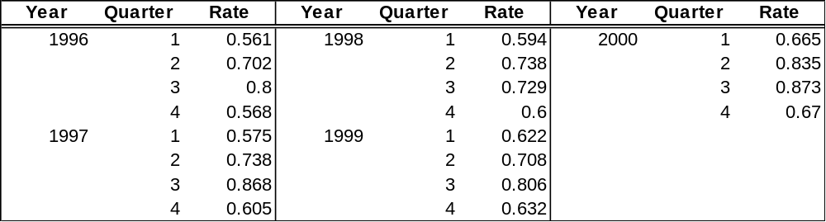
Computing Seasonal Indices
Example
  Calculate the quarterly seasonal indices for hotel occupancy rate in order to measure seasonal variation.
  Data:

Slide 43
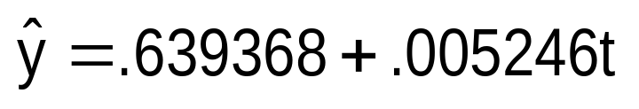
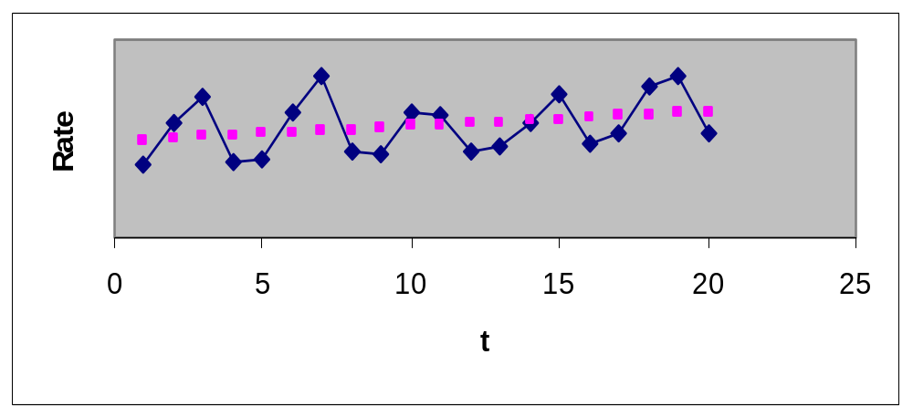
Computing Seasonal Indices
Perform regression analysis for the model
y = β₀ + β₁t + ε where t represents the time, and y represents the occupancy rate.
Time (t) Rate
1 0.561
2 0.702
3 0.800
4 0.568
5 0.575
6 0.738
7 0.868
8 0.605
. .
. .
The regression line represents trend.

Slide 44

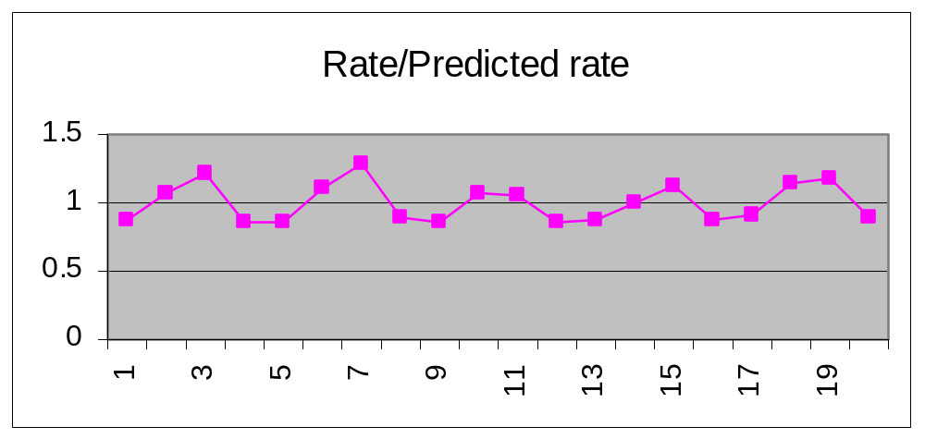

The Ratios
>
yt / yt
t yt Ratio
.561 .645 .561/.645=.870
.702 .650 .702/.650=1.08
………………………………………………….
=.639368+.005245(1)
No trend is observed, but
seasonality and randomness
still exist.

Slide 45
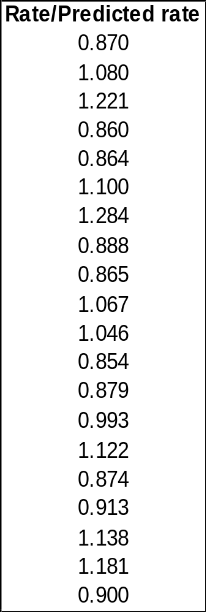
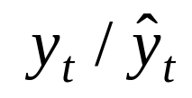
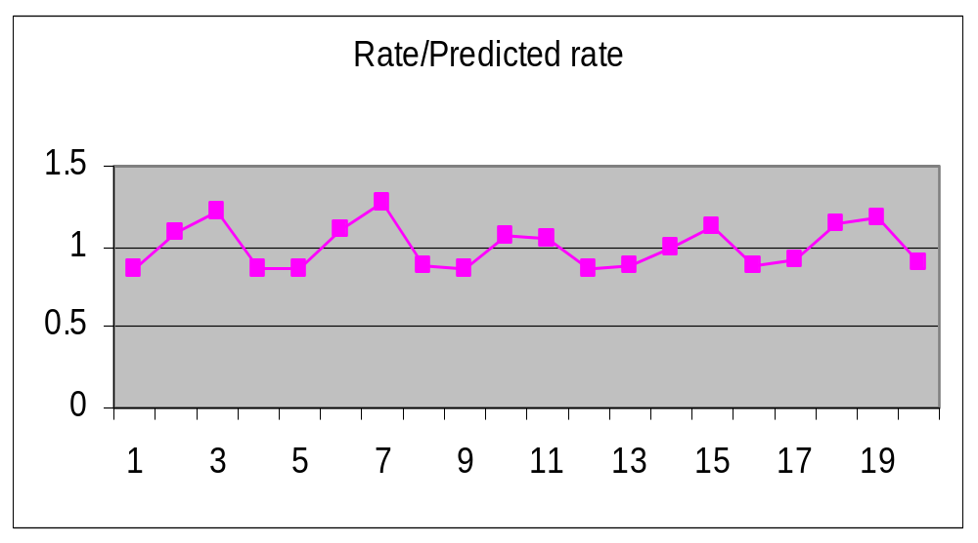
The Average Ratios by Seasons
To remove most of the random variation
but leave the seasonal effects,average
the terms for each season.
Average ratio for quarter 1:
(.870 + .864 + .865 + .879 + .913)/5 = .878
Average ratio for quarter 2: (1.080+1.100+1.067+.993+1.138)/5 = 1.076
Average ratio for quarter 3: (1.221+1.284+1.046+1.122+1.181)/5 = 1.171
Average ratio for quarter 4: (.860 +.888 + .854 + .874 + .900)/ 5 = .875

Slide 46
Adjusting the Average Ratios
In this example the sum of all the averaged ratios must be 4, such that the average ratio per season is equal to 1.
If the sum of all the ratios is not 4, we need to adjust them proportionately.
Suppose the sum of ratios is equal to 4.1. Then each
ratio will be multiplied by 4/4.1.
(Seasonal averaged ratio) (number of seasons)
Sum of averaged ratios
Seasonal index =
In our problem the sum of all the averaged ratios is equal to 4:
.878 + 1.076 + 1.171 + .875 = 4.0.
No normalization is needed. These ratios become the
seasonal indices.

Slide 47
Interpreting the Seasonal Indices
The seasonal indexes tell us what is the ratio between the time series value at a certain season, and the overall seasonal average.
In our problem:
17.1% above the
annual average
117.1%
7.6% above the
annual average
12.5% below the
annual average
Annual average
occupancy (100%)
107.6%
87.8%
87.5%
12.2% below the
annual average
Quarter 1
Quarter 2
Quarter 3
Quarter 4
Quarter 1
Quarter 2
Quarter 3
Quarter 4

Slide 48
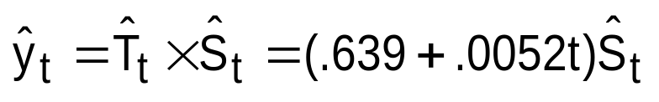
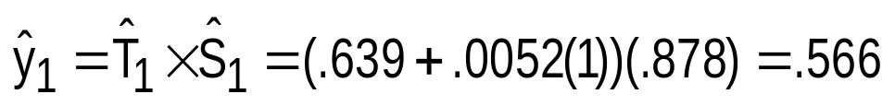
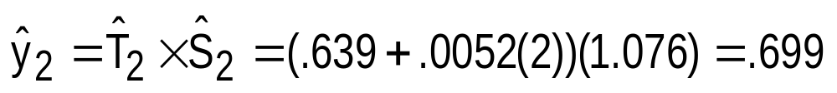
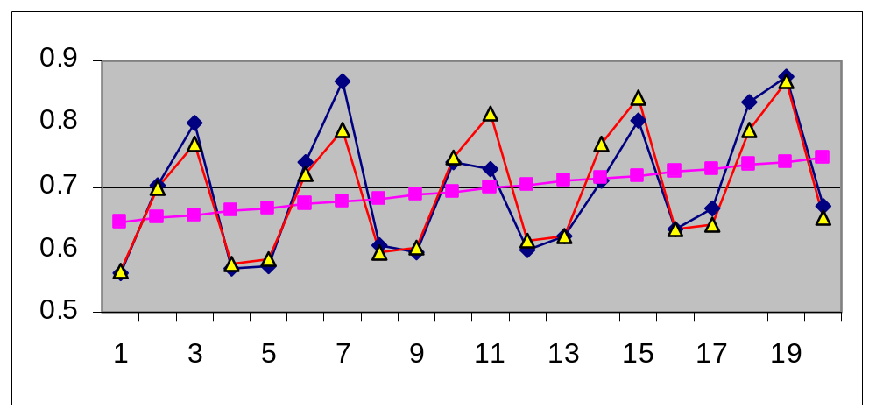
The Smoothed Time Series
The trend component and the seasonality component are recomposed using the multiplicative model.
In period #1 ( quarter 1):
In period #2 ( quarter 2):
Actual series
Smoothed series
The linear trend (regression) line

Slide 49
Deseasonalized Time Series
Actual time series
Seasonal index
Seasonally adjusted time series =
  By removing the seasonality, we can identify changes in the other components of the time series, that might have occurred over time.

Slide 50
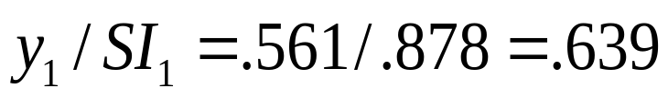
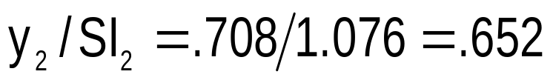
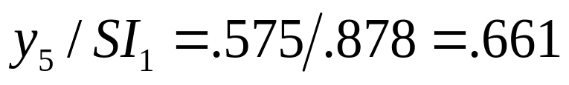
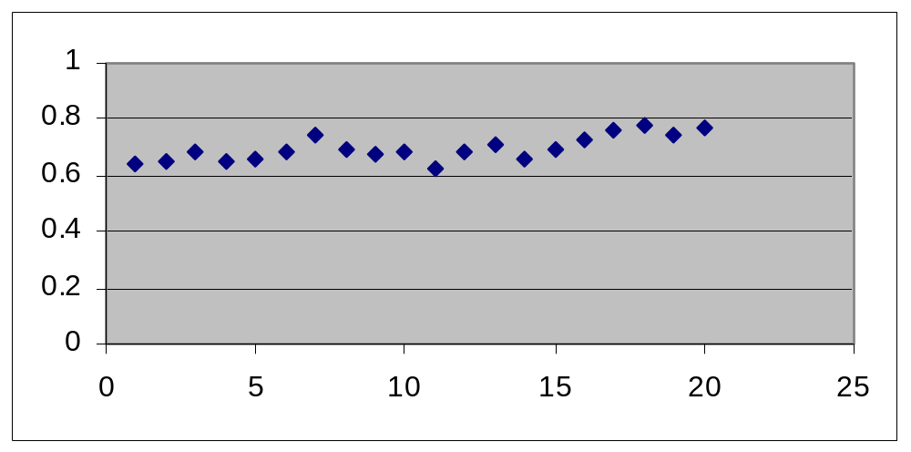
Deseasonalized Time Series
In period #1 ( quarter 1):
In period #4 ( quarter 2):
In period #5 ( quarter 1):
There was a gradual increase in occupancy rate

