Slide 1
HUMAN BEHAVIOUR ANALYSIS
Group : parakeet

Slide 2
01
04
AGENDA
02
05
03
06
RESULTS AND INTERPRETATION
INTRODUCTION
METHODOLOGY
limitations
OUTPUTS & ANALYSIS
Future scope

Slide 3

01.
INTRODUCTION

Slide 4
INTRODUCTION
CASE BACKGROUND
Mitsubishi Electric Research Laboratories (MERL), a residential and office buildings conducted an analysis with their own facility, studded with motion sensors with an intention of understanding HUMAN BEHAVIOR
The MERL sensor network is composed of passive infrared motion detectors. These sensors only detect presence and movement of heat sources.
The sensors are ceiling mounted at approximately two meter intervals along hallways and in grids covering public spaces such as lobbies and meeting rooms

Slide 5
INTRODUCTION
BUSINESS OBJECTIVE
To find the routine of employee activity in office environments over sensor network data
To find the active engagement of employees in any organisation thereby helping us to measure efficiency and effectiveness
To examine the occupancy pattern of various spaces in the building
To develop and deploy model focused on behavioral analysis thereby reducing the need of high-fidelity tracking

Slide 6
02. METHODOLOGY

Slide 7
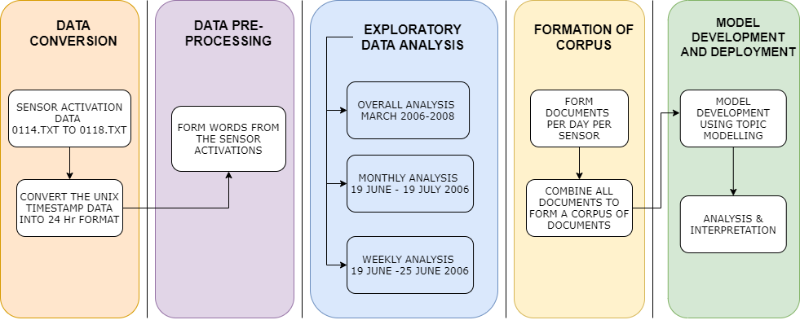
PROCESS FLOW

Slide 8




Data Preparation
Timestamp Conversion
Converting UNIX timestamp to human readable format
Generation of Corpus Creating documents from these artificial words which further form a vocabulary
STEP 01
STEP 04
DATA CONVERSION
CORPUS GENERATION
WORD FORMATION
DATA PRE-PROCESSING
Formation of Artificial Words Dividing the time frame into segments and using binary motion sensing approach
Creation of Derived variables to further compartmentalize the sensor activation data
STEP 02
STEP 03

Slide 9
TIme Segmentation and BINARY MOTION SENSING
00:00 to 06:00
1
7
17:00 to 19:00
A five minute activation pattern of one specific sensor to form a word where first 5 digits correspond to the 5 minute activation pattern.
11:00 to 14:00
06:00 to 07:00
5
2
19:00 to 21:00
8
07:00 to 09:00
14:00 to 17:00
3
6
For example - 111OO means that the sensor has been activated for 3 minutes and without being activated for 2 minutes.
Each digit corresponds to one minute information.
21:00 to 24:00
9
4
09:00 to 11:00

Slide 10
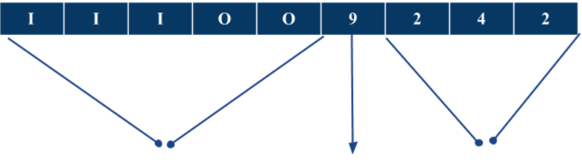
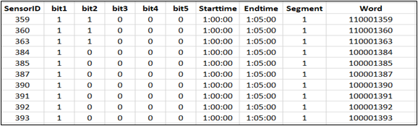
Word Formation
Structure of a word
Activation Pattern Time Segment Sensor ID
Snippet of the words formed

Slide 11
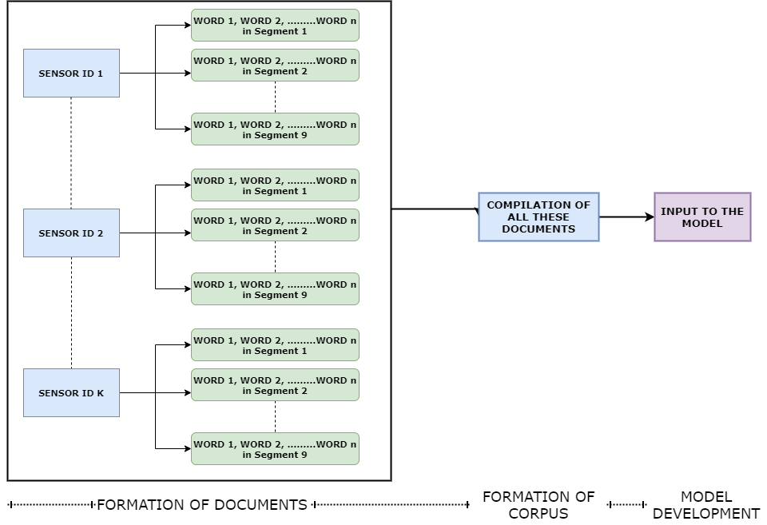
Corpus Generation

Slide 12
03.
OUTPUTS & analysis

Slide 13
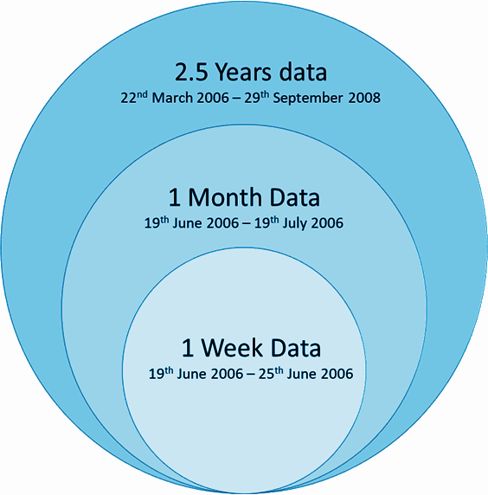
DATA CONSIDERATION
Exploratory Data analysis was done on the mentioned three segments
The results obtained for the whole data spanning over 2 years, the one month data (19th June to 19th July, 2006) as well as for the weekly data, were all presenting similar outcomes.
Finally the sample set of one month data has been chosen

Slide 14
Topic Modeling
Topic modeling is the process of identifying topics in a set of documents.
This can be useful for instances where knowing the topics of documents is important.
LDA is a one of the method of doing Topic Modeling.
Latent Dirichlet Allocation (LDA) is a form of unsupervised learning that views documents as bags of words (ie order does not matter).
LDA works by first making a key assumption: the way a document was generated was by picking a set of topics and then for each topic picking a set of words.
It reverse engineers the process to find topics.

Slide 15
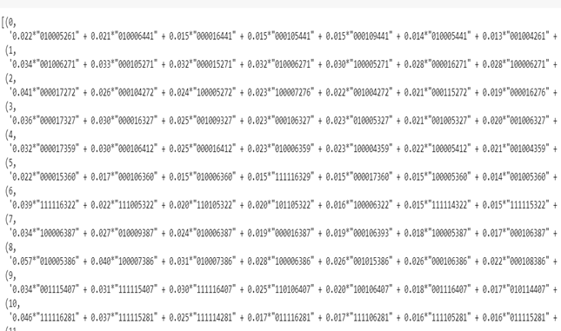
MODEL DEVELOPMENT
The documents are formed as one document for all sensor activations of a particular sensor ID in a particular day.
01-07-06 225
where 01-07-06 signifies the date and 225 signifies the sensor ID
This LDA Model has been built such that the corpus has documents of all the identifiable 211 sensors for each day for a span of one month from 19th June 2006 to 19th July 2006.

Slide 16
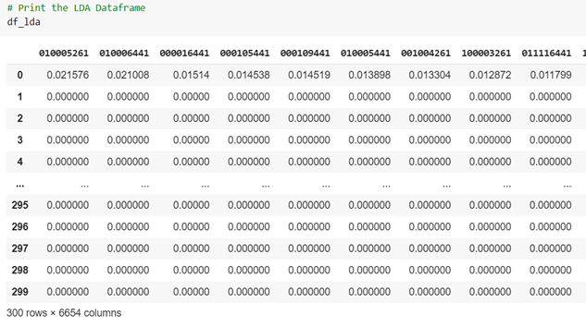
MODEL DEVELOPMENT
A data-frame of the output has been created which shows clear demarcation between different topics.
The Topics are indicative of certain behavior being exhibited in the MERL Facility
Different topics contain different proportions of words (sensor activations) which thereby amount to different behaviors

Slide 17
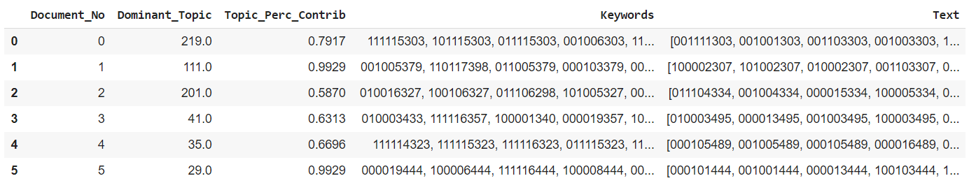
Document-Topic Distribution
WHICH TOPIC DEFINES WHICH DOCUMENT??
Here, as we can see the Document 0 has Topic 219 as the most dominant topic in it with 79% of the document being about Topic 219.
The keywords in turn tell us that topic 219 is about sensor 303 which is just at the entrance of kitchen.

Slide 18
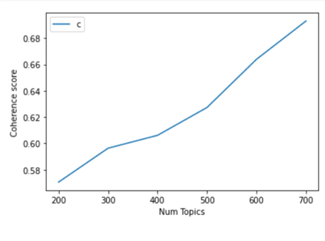
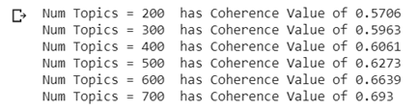
OPTIMIZATION | PERPLEXITY & COHERENCE
Perplexity is the statistical measure of how well the model predicts the unseen documents.
But it does not consider the context and associations between the documents. Hence, optimizing for perplexity may not yield human interpretable topics.
Coherence score determines how much a particular word conform to being in a particular topic.
It measures the degree of semantic similarity between co-occurring words in a document
A low value of perplexity and a constant coherence score helps in estimating the optimal number of Num Topics

Slide 19
04.
RESULTS AND INTERPRETATION

Slide 20
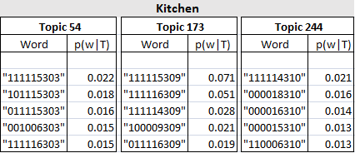
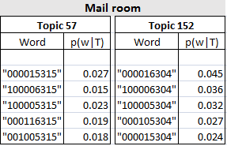
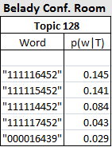
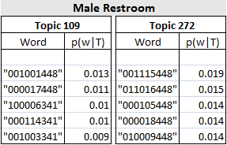
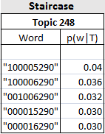
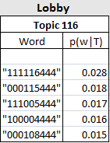
Occupancy Behaviour

Slide 21
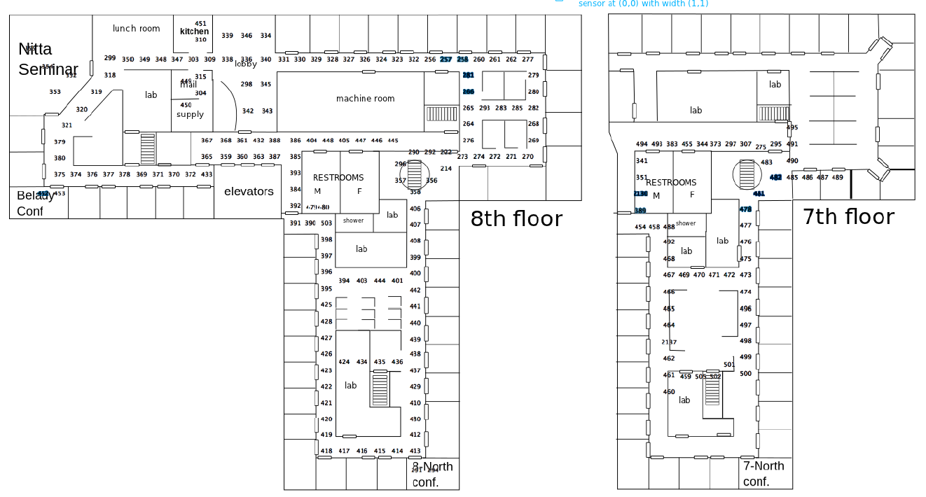





Slide 22
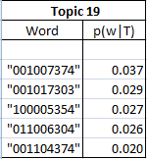
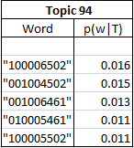
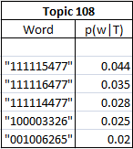
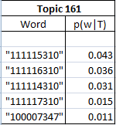
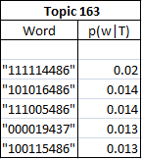
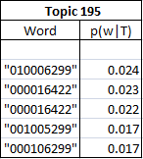
Routine Behaviour
Behaviour 1 Behaviour 2 Behaviour 3
Behaviour 4 Behaviour 5 Behaviour 6

Slide 23



Slide 24
05.
LIMITATIONS

Slide 25
Limitations
Distinguishing between the movement of the a single person and group of people passing in front og the sensor
Labelling the data : Current format of topic modelling is numeric words
Can be converted to more human understandable topics
Refining of the behavioral analysis basis the tracklet information thereby giving a sense of direction to these behaviors

Slide 26
06.
FUTURE SCOPE

Slide 27
Future scope
Real time streaming of data along with other non-privacy hindering options can help understand how different behaviors are interrelated
Optimization techniques to handle large datasets and better measures and means to decide on the parametrization of the models
Extrapolating the given business case to make use of in the current scenario of COVID-19 pandemic.
Behavioral tracking can be used to check whether the employees are following the social distancing norms
Can be further used for developing a better crowd management system

Slide 28
THANK YOU

