Slide 1
Network Vulnerability Assessment
Extion Info Tech

Slide 2
Summary
Comprehensive vulnerability assessment conducted on Metasploitable2 (a purposely vulnerable Linux VM).
Tools used: Nessus Essentials, Nmap, Enum4linux, Nikto.
Key findings:-
Multiple critical and high-severity vulnerabilities identified.
Immediate mitigation required for risks like outdated software, weak authentication, and unencrypted data transmission.

Slide 3
Testing Environment Details
Attack Platform: Kali Linux 2023.4
Target System: Metasploitable2
Primary Scanner: Nessus Essentials
Additional Tools: Nmap, Enum4linux, Nikto
Network: Isolated testing environment
Assessment Date: January 2, 2025

Slide 4
Assessment Methodology
1. Initial Reconnaissance
Tool: Nmap
Command: nmap -sV -sC -O -p- [target_ip]
Key Findings: Open Ports (21-FTP, 22-SSH, 23-Telnet, 80-HTTP, 445-SMB).

Slide 5
Assessment Methodology
2. Tool: Enum4linux
Command: enum4linux -a [target_ip]
Key Findings:
Discovered shared folders and user accounts.
Detected security misconfigurations.

Slide 6
Assessment Methodology
3. Tool: Nikto
Command: nikto -h [target_ip]
Key Findings:
Outdated server software.
Vulnerable scripts and misconfigured security headers.

Slide 7
Critical Vulnerabilities and Mitigation
1. Outdated Software and Missing Security Patches
Severity: Critical
Mitigation:
Create system inventory for updates.
Test and schedule patches.
Implement automated patch management.
Timeline: 1-2 weeks.
2. Weak Authentication Mechanisms
Severity: Critical
Mitigation:
Enable multi-factor authentication (MFA).
Enforce strong password policies.
Remove default credentials.
Timeline: 1 week.

Slide 8
Critical Vulnerabilities and Mitigation
3. Misconfigured Firewall Rules
Severity: High
Mitigation:
Audit and remove obsolete rules.
Implement least-privilege access.
Timeline: 3-4 days.
4. Unencrypted Data Transmission
Severity: High
Mitigation:
Implement TLS 1.3.
Configure proper certificate management.
Disable older SSL/TLS versions.
Timeline: 1 week.

Slide 9
Critical Vulnerabilities and Mitigation
5. Exposed Network Services
Severity: Critical
Mitigation:
Scan and close unnecessary ports.
Implement network segmentation.
Regularly monitor network traffic.
Timeline: 2-3 days

Slide 10
Implementation Schedule
Week 1:
Days 1-2: Address exposed network services.
Days 3-5: Implement firewall configurations.
Days 6-7: Begin software updates.
Week 2:
Days 8-10: Complete software updates.
Days 11-12: Implement authentication changes.
Days 13-14: Deploy encryption solutions.

Slide 11
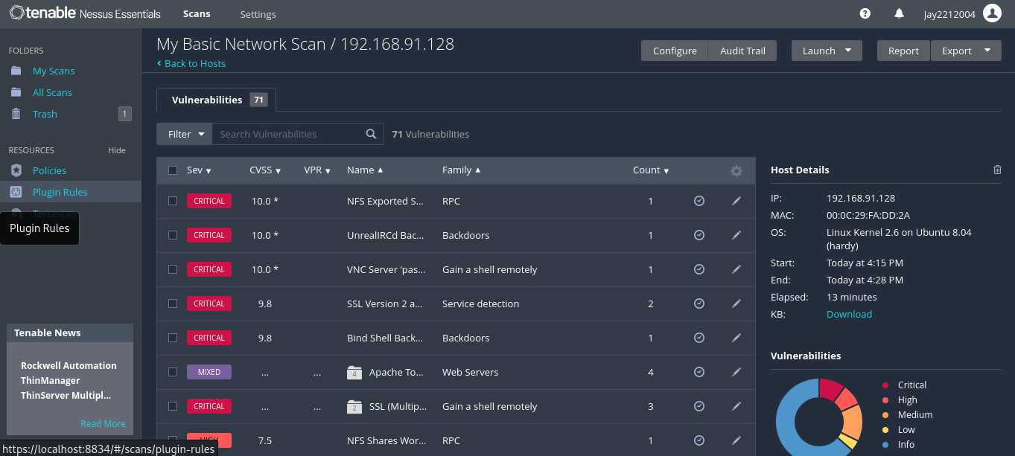
Visual Evidence and Analysis Highlights
Nessus Scan

Slide 12
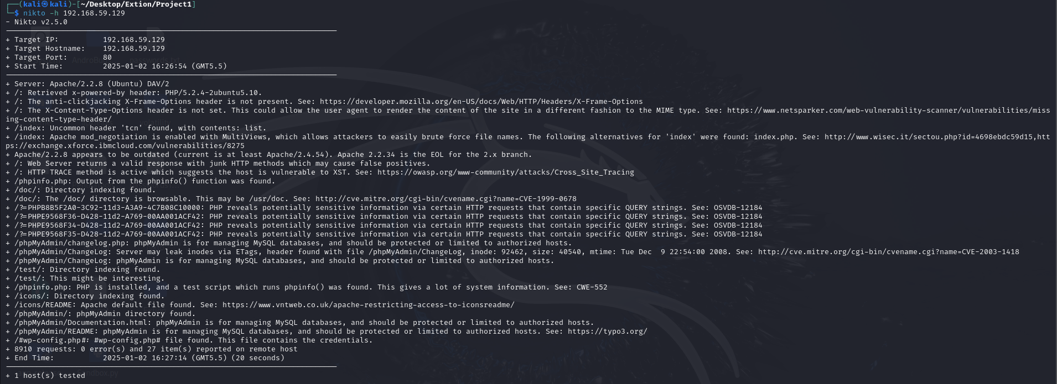
Visual Evidence and Analysis Highlights
Nikto Scan

Slide 13
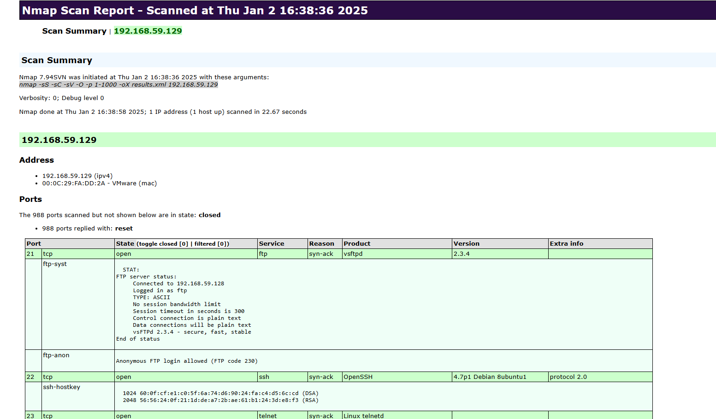
Visual Evidence and Analysis Highlights
Nmap Scan

Slide 14
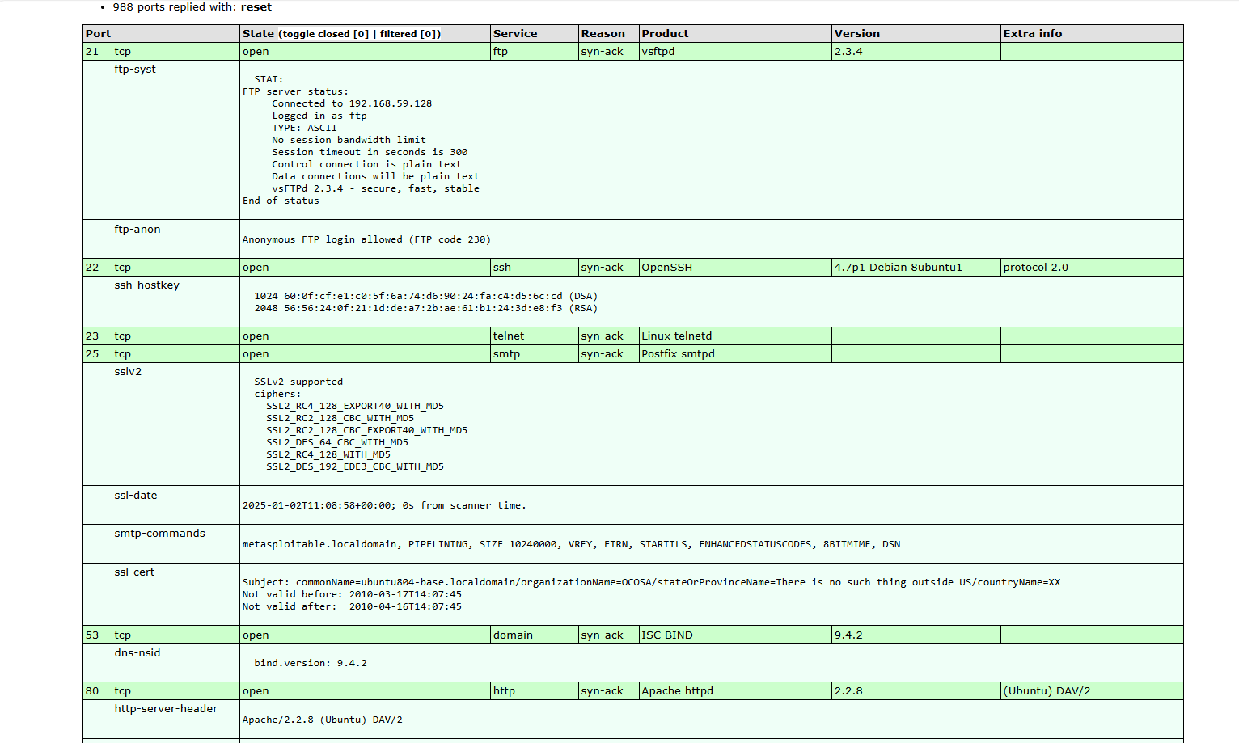
Visual Evidence and Analysis Highlights
Nmap Scan

Slide 15
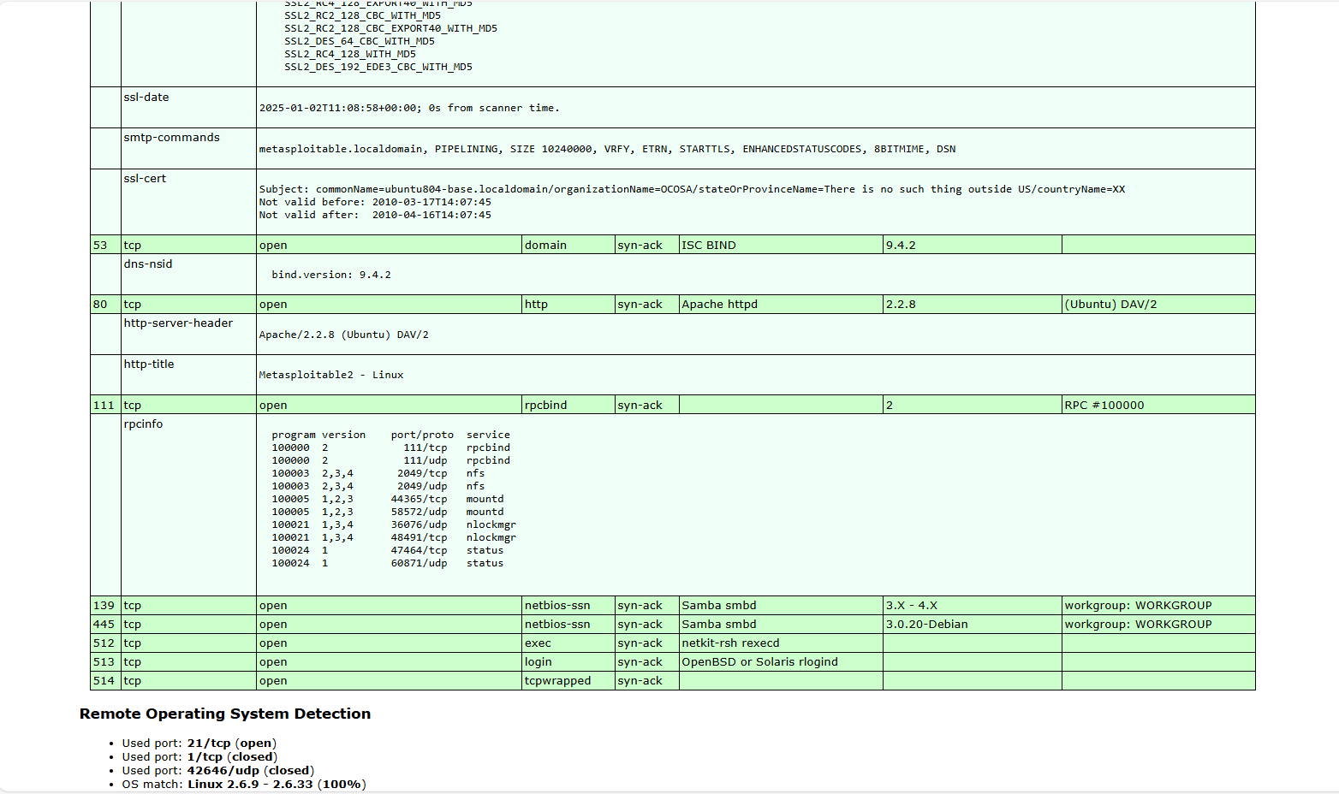
Visual Evidence and Analysis Highlights
Nmap Scan

Slide 16
Conclusion
The assessment revealed critical vulnerabilities that require immediate action.
A structured mitigation plan was proposed to address these risks while ensuring minimal disruption.
Regular reassessment using the outlined tools will verify the effectiveness of implemented solutions.

Slide 17
Contact Information
Prepared by: Jay Uchagaonkar
Position: Cyber Security Intern
Organization: Extion Infotech
Email: uchagaonkar42jay@gmail.com
Date: January 2, 2025

