Slide 1
Car Parking System
TPJ-655 Final Project Presentation
Presenters: [Rhythem Prajapati, Computer Engineering Technology(ECT) ,student]
Email: rpprajapati3@myseneca.ca Telephone: +1 647-425-3791
[Jay Shah, Computer Engineering Technology(ECT) ,student]
Email: jashah1@myseneca.ca Telephone: +1 416-277-0105
Course: Technical Project – TPJ-655
Instructor: Benjamin Shefler
Date: April 8,2022
SENECA COLLEGE OF APPLIED ARTS AND TECHNOLOGY
School of Electronics and Mechanical Engineering Technology
1750 Finch Ave East, Toronto, Ontario, M2J 2X5. Tel. 416-491-5050 Fax 416-490-9839
www.senecacollege.ca

Slide 2
Agenda
Part 1- Product Introduction
Product Specifications
Product features and functionalities
Part 2- Technical Overview
Major components and key elements
Product design and structure
Part 3- Conclusion
Viability and maintenance
Future developments and conclusion

Slide 3
Executive Summary
In response to parking concerns in a lot of areas, our team developed a car parking system.
The system uses an Arduino Uno as the main control unit, and it also has an LCD screen to display messages to the user.
A script(.ino file) will be running on the Arduino UNO that will control and monitor the signals transmitted between Arduino UNO and other components.
Because of its inexpensive cost, low power consumption, and limited maintenance requirements, this system is ideal for average people, and organizations to maintain clear parking spaces.

Slide 4

Product Introduction
In today's packed cities, finding parking is a major concern. There are too many cars on the road, yet there aren't enough parking spots. One of the most serious issues arises when we arrive at a parking lot and discover that there are no available parking spaces. It's an important time.
Another major issue is that after entering a large parking space, we are perplexed as to where to place our automobile. Perhaps we have all encountered these two issues that have squandered our valuable time. That is why we require effective parking management systems in all parking locations to provide quick and convenient parking.
But have you ever considered what happens in the parking lot when people are replaced by machines? Using Arduino UNO, we will create an automatic automobile parking system project.

Slide 5

What we offer ?
Optimized parking: Able to search parking spot easily
Reduce Traffic: decrease in traffic mess caused by unorganised parking.
Real time data and insights: A lot of data is saved and a pattern can be observed and system can be improvised
Increase in safety of vehicles and vehicle owners: less distracted in finding spot and can focus only on driving
Improved management costs: Labour cost is saved

Slide 6




Project Specifications
To plan an economical parking system to avoid chaos at parking places and manage the security of parking lots.
People will save lots of time to find the right spot in the parking lot.
To create an easy and efficient parking structure for people to use.
To develop a system which works with very few hands to save lots and lots of money of Government.
To build a parking system with the combined knowledge of hardware and software.

Slide 7
Parts Description
i) Arduino Uno: The Arduino Uno is a board with a microprocessor on it. It holds 14 digital I/O pins ,6 analog inputs, a 16 MHz quartz crystal, a USB connection, a power connector, and an ICSP header, and a reset button.
ii) IR sensor: An infrared sensor is an electrical device that emits light in order to detect an item in its surroundings by its motion.
iii) Micro Servo Motor: It is a self-contained electrical device, that rotate the parts of a machine with high efficiency and with great precision.
iv) LCD: A liquid-crystal display (LCD) is a flat-panel display or another electronically modulated optical device that makes use of the light-modulating characteristics of liquid crystals in conjunction with polarizers

Slide 8


Hardware Description
Firstly, IR sensors(x2), one of the sensors will sense the entry and the other sensor will sense the exit.
As the car passes by With which a servo motor will be connected to rotate it from 0 degrees to 90 degrees and vice-versa while exiting.
On the Arduino board, we will directly connect the LCD through jumper wires (male to male).
In nutshell, when a car arrives at the parking area's gate, the display continually displays the number of available spots. If there are any empty slots, the system uses the servo motor to open the entry gate.
When a car enters the parking area and occupies a slot, the display indicates that one of the slots is filled till it reaches the maximum. If there are no available parking spaces, the system indicates that all slots are full and does not open the gate.

Slide 9

Software Description
First off, in our code, we will initialize our motor. Then we will mention the pins attached to IR sensors, motors, LCD. Then-after we must mention total space available which has to be displayed on the screen in our case it will be 3.
Also, we will write the welcome note which will be displayed on the screen and after delay of 2s it will clear the screen.
In our case, inputs will be sensors. When Sensor 1 will be high, that is car is entering it will open the barrier, it will subtract the total space available, and it will be displayed on the LCD. And when sensor 2 will be high, that is car is exiting it will again open the barrier from other side and will add the value to total space available.
We will set total delay for to open and close barrier as 1s. In this way our code will work and then we will upload it to Arduino via USB cable.

Slide 10
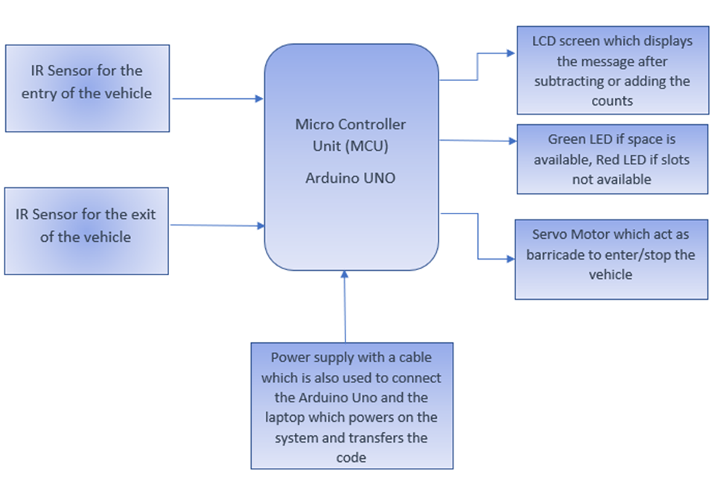
Product design and structure

Slide 11
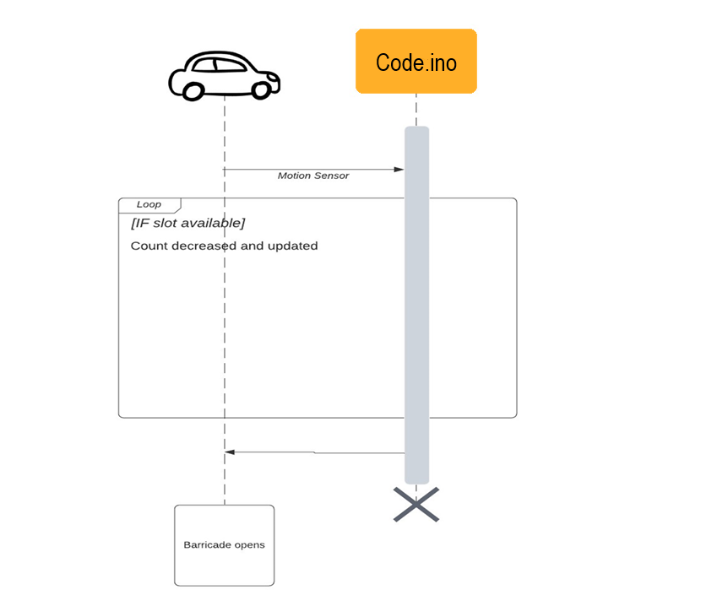
How it works ?
To power on the Arduino UNO, we need to connect it with computer via USB cable or the power adapter. Once the power is on, the user can see the slots available in the parking lot it.
The user needs to bring the car at the entry sensor. The sensor will detect the car and will open the barricade for the user so that user can go into the parking lot. Then the car will pass through the exit sensor which will reduce the count on the screen.
If the user wants to exit, then they should bring the car to exit sensor. The sensor will sense the car and the barricade will open and the user can exit. While the user is exiting the entry sensor will sense the car and will increase the count accordingly.

Slide 12
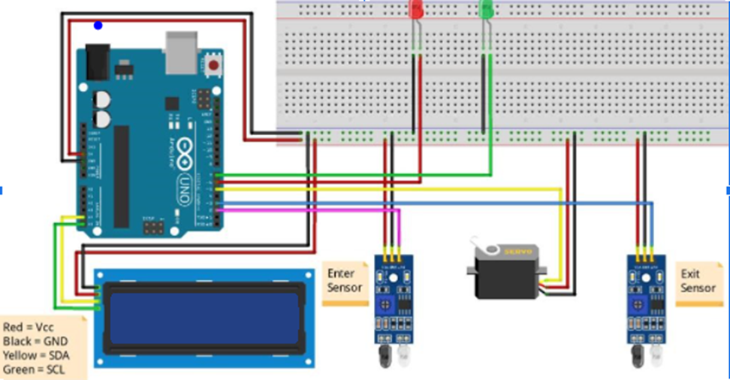
Electrical Schematics

Slide 13
Viability Of The Product
Safe and easy to use
Easy to connect to power supply
Cost efficient
Less power needed
Compact size of the setup
Physical flexibility for the smaller places
Limited maintenance

Slide 14
MAINTAINANCE REQUIREMENT
The car parking system project needs very little maintenance. But it is necessary to check several components time to time.
As the sensors and barricade are very frequently used, we need to check it frequently and should be sanitized more often.
Also, it is recommended not to upgrade Arduino UNO as it may cause disturbance in the project.

Slide 15
Future Developments
Our system can be combined with payable parking either for daily, or for weekly, or monthly rates and live video cameras to keep an eye on a time limit.
This system can also be enhanced in the future by adding a wide variety of applications, such as GSM-based internet booking, so clients can make their reservations at home or while in transit to shopping centers.
Adding a distinctive sensor can further enhance this system's ability to distinguish the question and guide the driver or client in the quickest way.
Automatic number plate recognition (ANPR) can be used for safety purposes.
The mechanical structure can be decreased and try to make it eco-friendly.

Slide 16
Conclusion
Though this kind of parking system has shown widespread usage in many developed countries, many other backward countries do not have this kind of system. At minimal cost, this could be implemented, and the problem can be easily solved.
This initiative aids automobile drivers in parking their vehicles with little time wasted by supplying precise information on the availability of parking spaces.
Furthermore, the system offers a better parking system and convenience to the consumer. This system is limited maintenance and cost-effective, making it more attractive to common parking places.
If we improve product functions, the system will become more powerful and perfect. Hopefully, it can be sold all over the world, not just in Canada.
This TPJ655 project has allowed us to put our professional talents to the test as well as show off our research abilities. This experience is indeed and will be beneficial in our future attempts

Slide 17
References
https://create.arduino.cc/projecthub/embeddedlab786/automatic-car-parking-system-95a9dc
https://www.researchgate.net/publication/318486476_Smart_Car_Parking_System_using_Arduino_UNO
https://www.waveshare.com/infrared-proximity-sensor.htm
http://store-usa.arduino.cc/products/arduino-uno-rev3
https://www.watelectronics.com/lcd-16x2/
https://www.geminiparkingsolutions.com/blog-post/advantages-of-parking-management-systems/
https://bit.ly/3IQd0lJ
https://bit.ly/3Ghsxcr
https://bit.ly/3Gf4XNx
https://www.geminiparkingsolutions.com/blog-post/advantages-of-parking-management-systems/

Slide 18

Hope you like our project presentation!!!

Slide 19
Car Parking System
CONTACT US
[Rhythem Prajapati, Computer Engineering Technology(ECT) ,student]
Email: rpprajapati3@myseneca.ca
Telephone: +1 647-425-3791
[Jay Shah, Computer Engineering Technology(ECT) ,student]
Email: jashah1@myseneca.ca
Telephone: +1 416-277-0105

