Slide 1
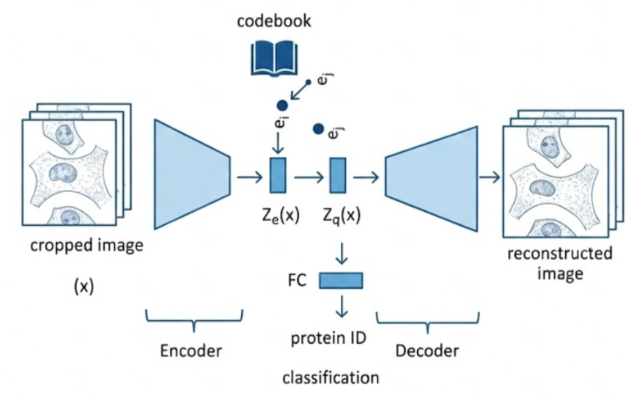



$$e_{j}$$
$$e_{i}$$
$$z_{e}\left(x\right)$$

