Slide 1

ELECTRIC Vehicle registration dataset project
Group 02 S23 3

Slide 2

Team members
1. Nikhil Santhosh Jacob
2. Jaya Chandra Kadivati
3. Shreesha Khadka
4. Monisha Panchakarla Satya

Slide 3
Abstract
The project starts off with Normalizing the data and creating the tables. Next, an empty staging table is created and the cleaning of data is done. ELT process is all about pre-processing the raw data prior to loading it to the normalized tables. Create Visualizations in Tableau to find insight into the datasets.
.
Phase 1: Normalization was done and tables were divided based on the 3rd Normal form.
Phase 2: ELT process opted and cleaning was done in tableau prep and data was inserted into normalized tables.
Phase 3: Visualization was made from the normalized tables and insights were found and presented on the tableau dashboard.

Slide 4
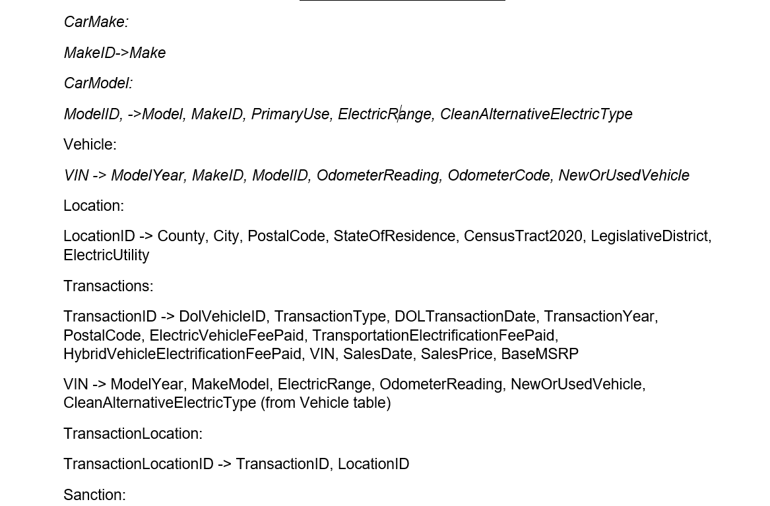
Normalization
Functional dependencies are a database theory concept that describes the relationship between characteristics in a database relation (or table).
Below are some of the functional dependencies that I created while doing phase 1.

Slide 5
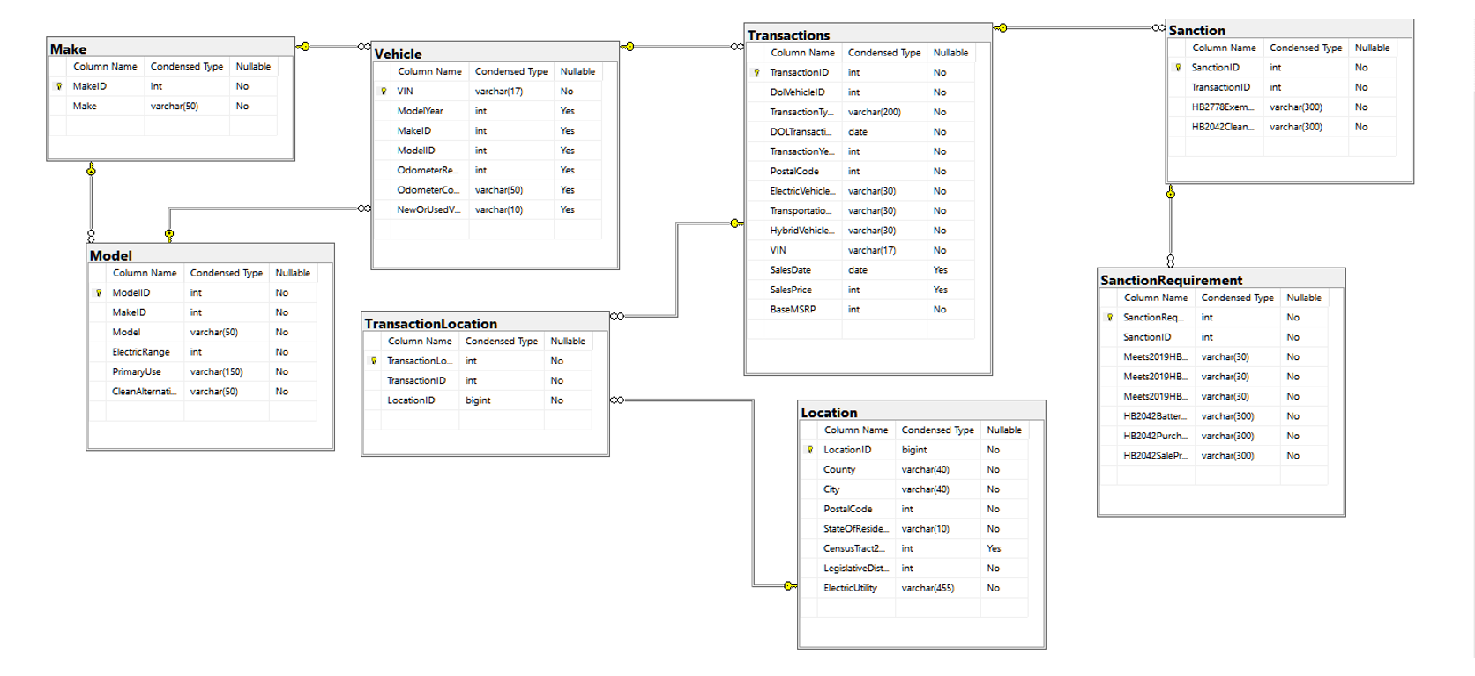
Normalized Tables
The practice of structuring data in a database to eliminate data redundancy and reliance, hence enhancing data integrity and correctness, is known as normalization. Normalization is accomplished by dividing a huge table into smaller, more manageable tables that adhere to specific standards or normal forms.

Slide 6
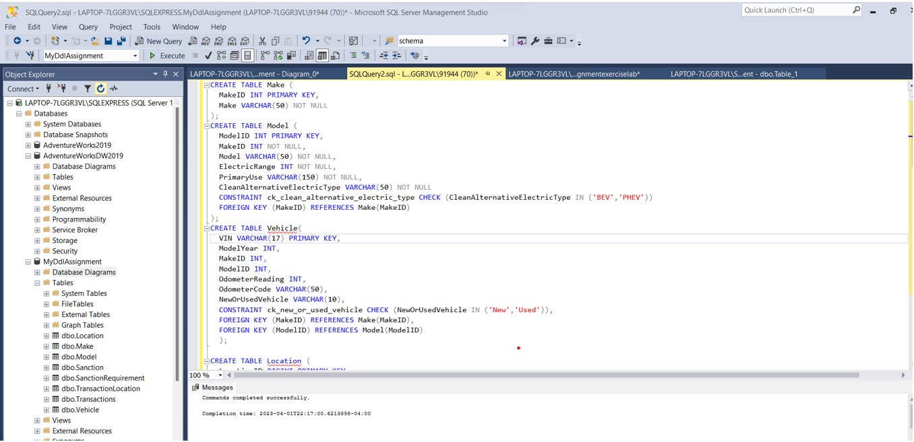
Physical Tables in SQL Database

Slide 7

Steps Involved in ELT
1. Creating the Staging Table
2. Loading the raw Data
3. Processing Data
4. Mapping Data to normalized Table

Slide 8
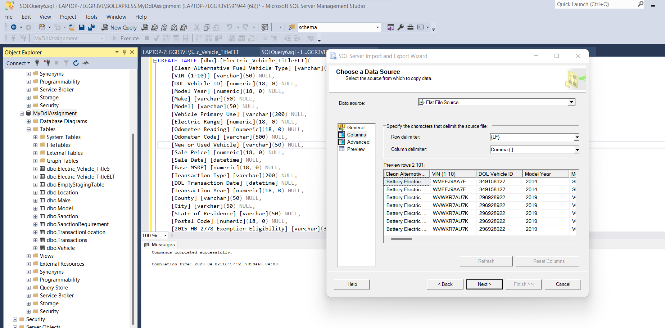
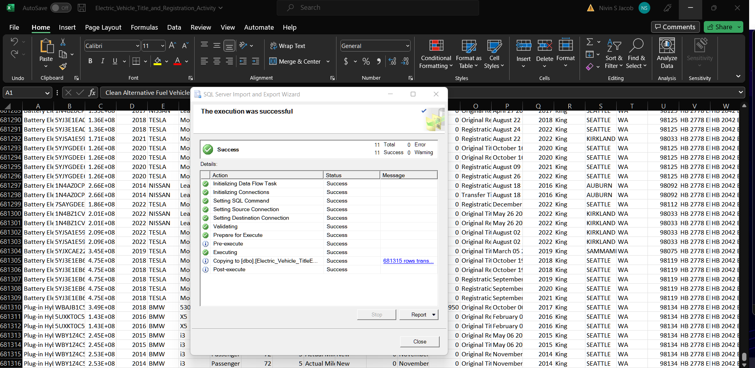
Creating the staging table and Loading the raw data
Extracting the data from the CSV file to the staging table by matching the datatypes of all the columns. We have extracted 681315 records to the Staging table.

Slide 9
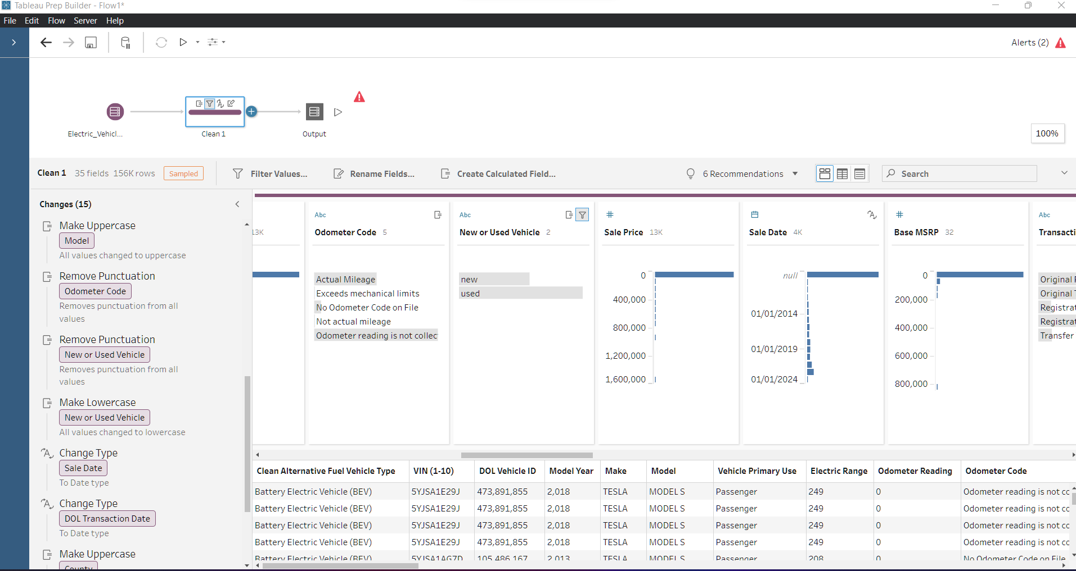
Processing Data
Processing is done by renaming some fields, filtering some unwanted data, and calculated fields was created to check if the date of the sale is after 2010 and if the condition of the car is good based on the Sanctions.

Slide 10
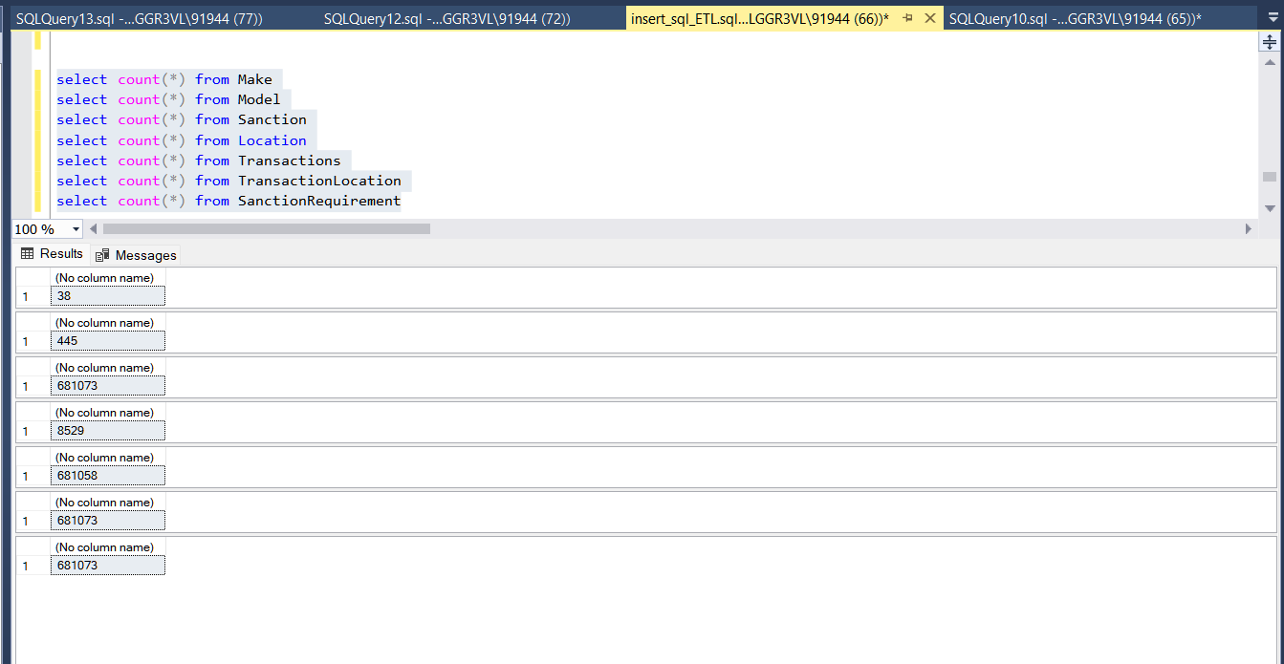
Mapping Data to normalized Table
All the records from the staging table are loaded to the normalized tables using the INSERT statement. The total number of rows inserted in every table is shown in the snapshot above.

Slide 11
Records in each stage
691315
681315
681073
Records in csv file
Records inserted to staging table
Records after processing

Slide 12

Tableau Dashboard
Tableau Desktop is data visualization software that lets you see and understand data in minutes. The use of visualization is such that the audience is able to understand the data better. The use of filters, formatting, calculated fields, and so on to bring out hidden details in the data.
By using different methods in Tableau, users are able to interact with the visualizations that provide insights and patterns in the registration of electric vehicles.

Slide 13
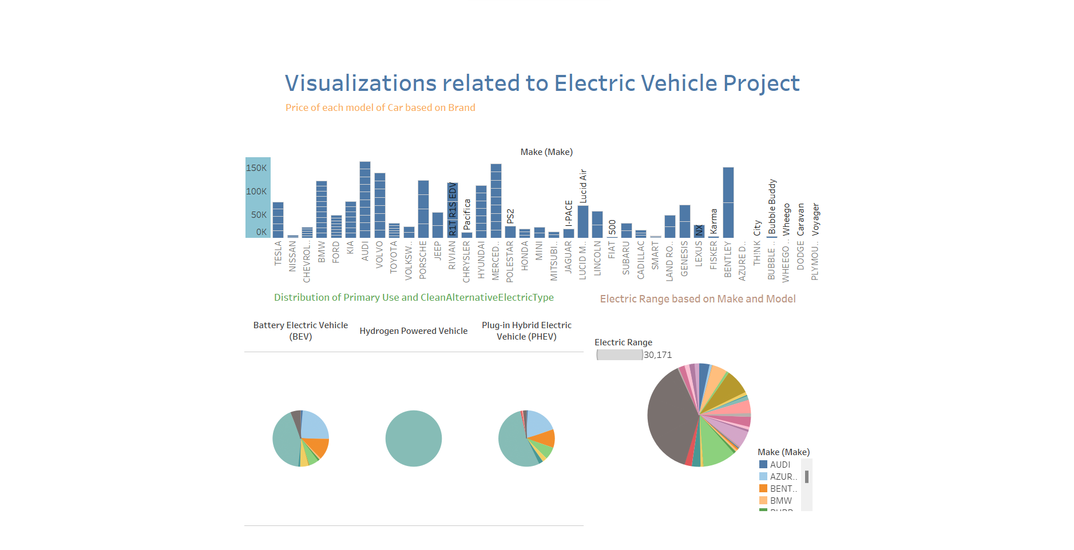
Dashboards

Slide 14
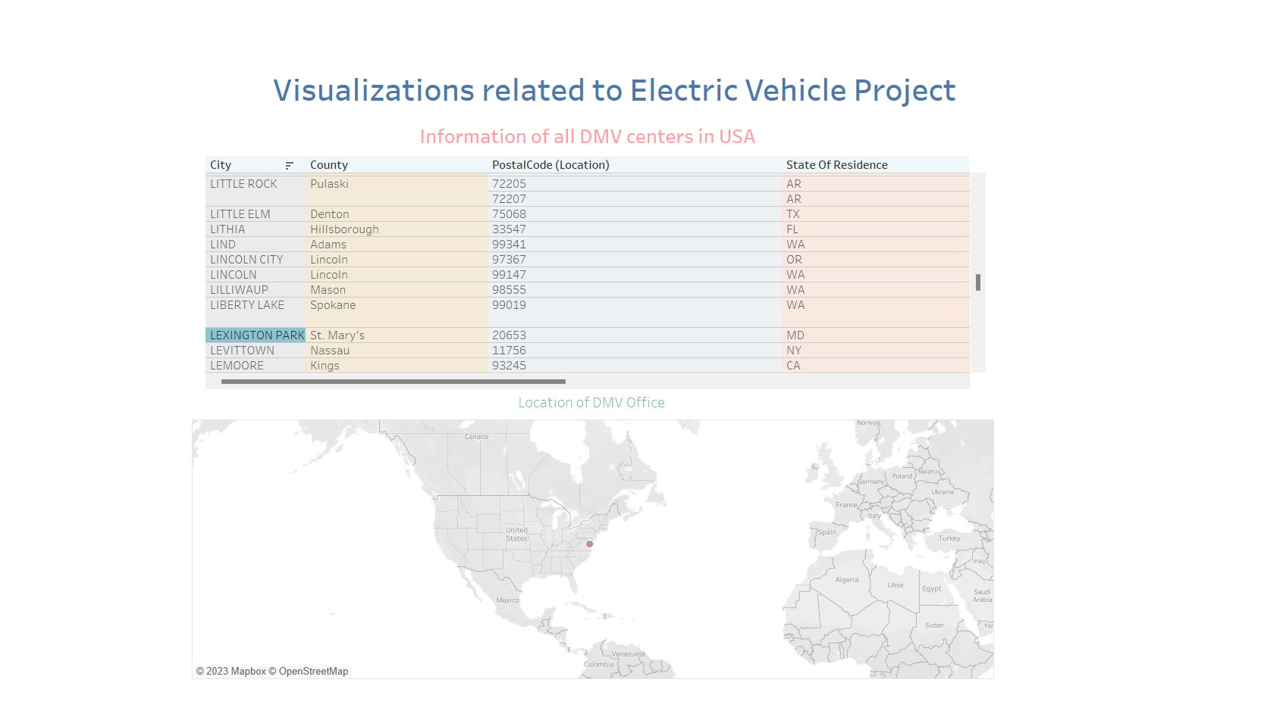

Slide 15
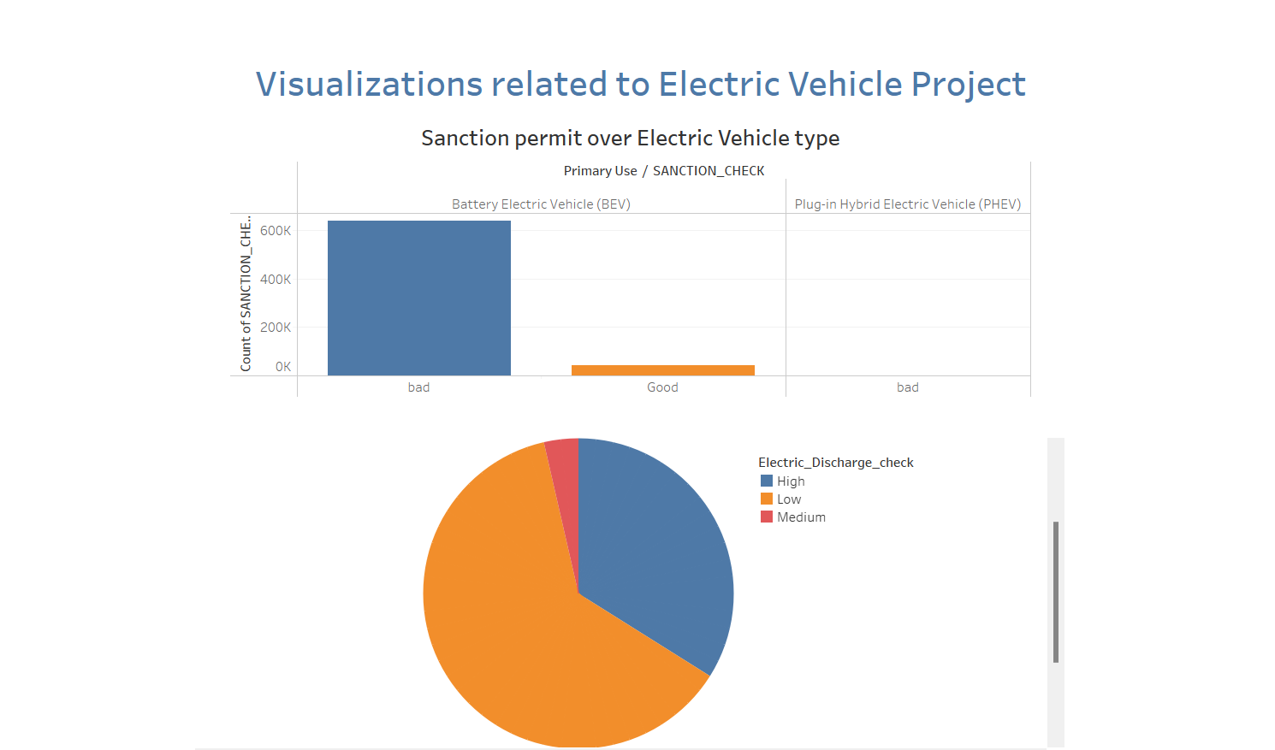

Slide 16

THANK YOU

