Slide 1
Stock Price Forecasting using ML
Jaya Chandra Kadiveti, Kruthik Reddy Theepireddy, Girish Reddy Maligireddy
ADVISOR: DR. KHALID ABOALAYON
COURSE: MSDA3999 Spring 2024

Slide 2
Table of Contents
Introduction
Problem Statement
Literature Review
Methodology
Data Collection
Exploratory Data Analysis (EDA)
Statistical/ Machine Learning Results
Results
Challenges
Lessons Learned & Future Work
Conclusion
Q&A
References

Slide 3
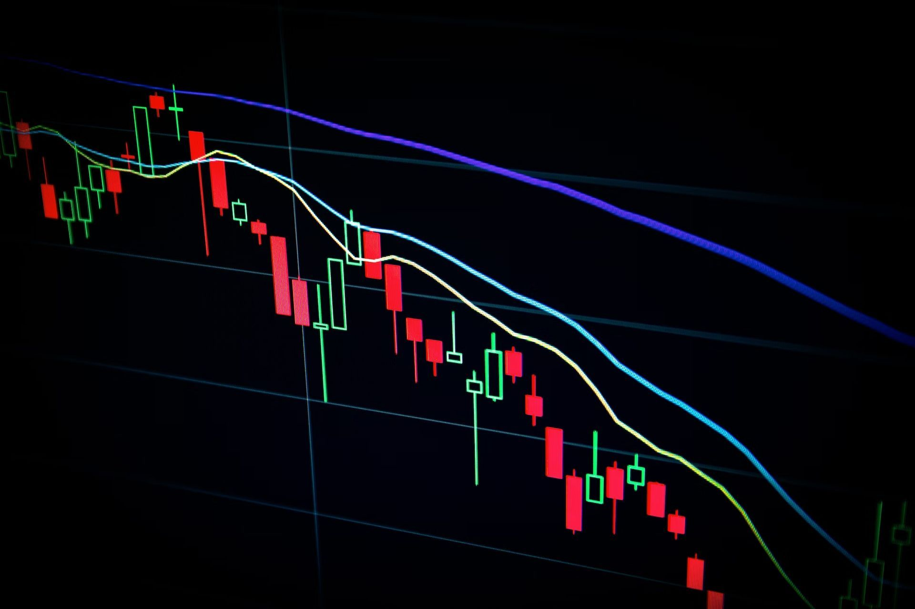
Introduction
Leveraging machine learning to forecast future stock prices.
This models help investors and trader’s to overcome challenges to Forecast stock prices.
Though there are a ton of models to forecast, this can compete with them.
Process:
Collect real time stock data.
EDA.
Implementing various models and finding the best one.
Plotting the final line chart using the best model.

Slide 4
Problem Statement
Estimating future stock prices with accuracy is a longstanding challenge.
Traditional methods can not capture the complexity of market dynamics.
They lead to unreliable forecasts.
So, A predictive stock pattern model is needed for finance professionals for strategic decision-making.

Slide 5
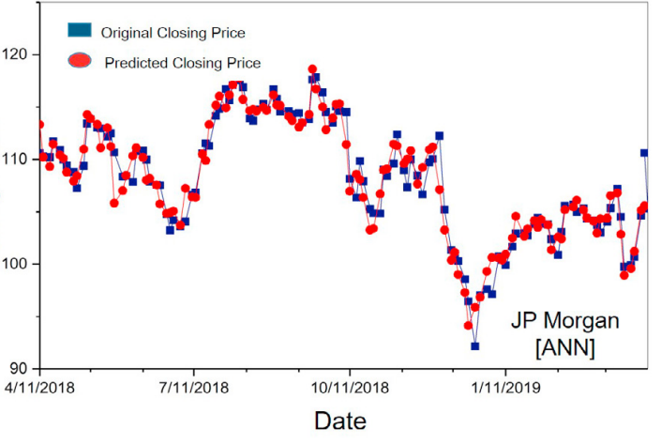
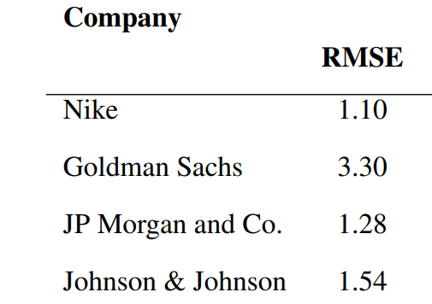
Literature Review
Stock Closing Price Prediction using Machine Learning Techniques(Mehar Vijh et al.,2020)
Used Random Forest algorithm.
Used close values for training and prediction.
RMSE varies at the range 1.10-3.30.
Windowing method for data splitting.

Slide 6
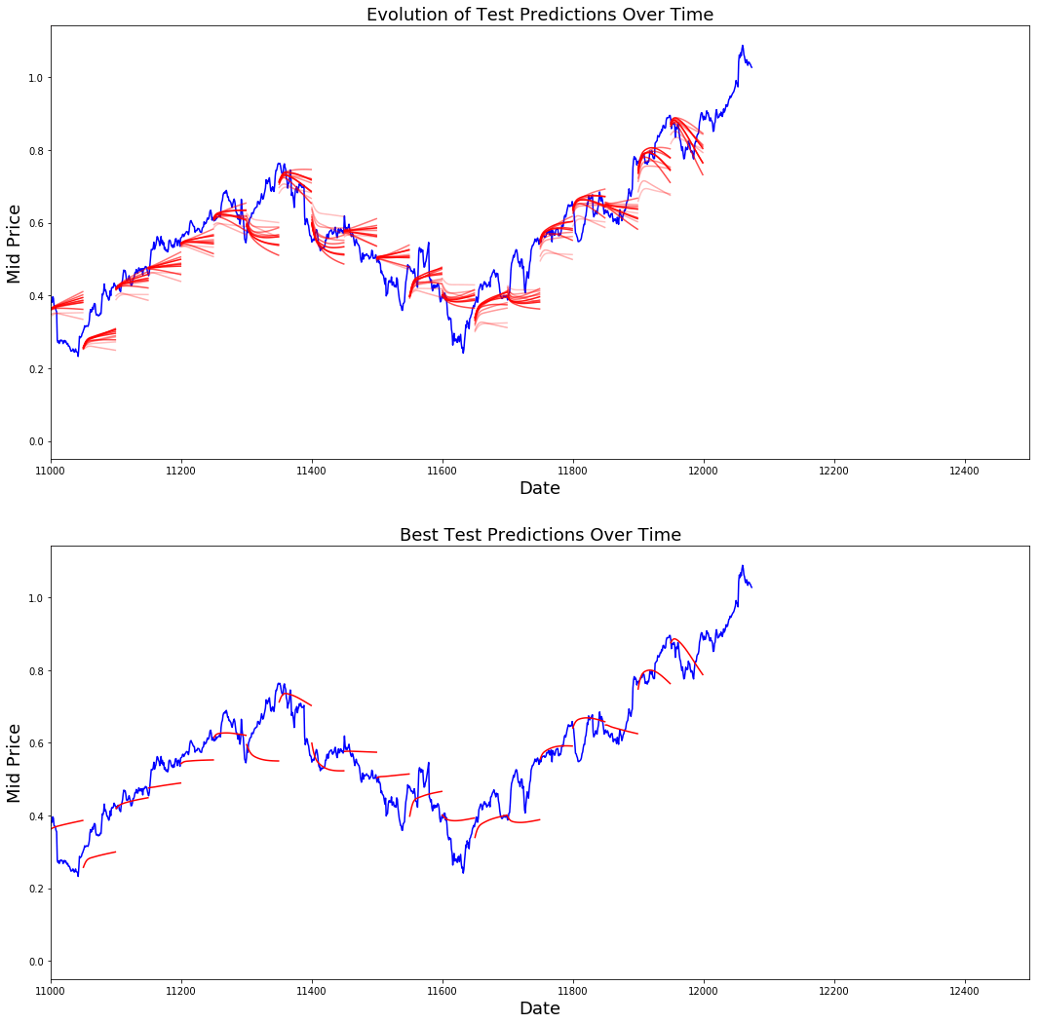
Literature Review
Stock Market Predictions with LSTM in Python. (Avijeet Bishwal, 2024)
Predicted n time frames using the past n time frames.
Used average of LOW and HIGH for the training and prediction.
RMSE ranges from 0.6-1.2.

Slide 7

Methodology: Data Collection
Yahoo! Finances
It provides financial news, data and commentary including stock quotes, and financial reports.
We install it in and import the packages from it.
Then chooses a single stock with its coordinate values from desired date till today.
So, we don’t have a particular dataset. We import it from online.

Slide 8
Methodology: Exploratory Data Analysis (EDA)

Slide 9
Methodology: Statistical/ Machine Learning
Calculated field Returns
PCA
Split Train and Test Data
Assign Independent and dependent for Training
Training Model
Extracting predictions
Plotting values

Slide 10
Methodology: Statistical/ Machine Learning
Assigning Independent and dependent for Training
X
Y
a₀ | a₁
……
a₅₉
a₆₀
……
a_{n}
X
Y
a₁ | a₂
……
a₆₀
a₆₁
……
a_{n}
……
X
Y
a₀
……
a_{n-60}
a_{n-59}
a_{n-1} | a_{n}
X = Independent variable
Y = Dependent variable
……

Slide 11
Methodology: Statistical/ Machine Learning
Comparing the models
Linear regression
ARIMA (AutoRegressive Integrated Moving Average)
LSTM (Long short-term memory)
GRU (Gated recurrent units)
Validating the models using RMSE:
RMSE | Linear regression | ARIMA | LSTM | GRU
Training set | 33.1 | 14.6 | 0.20 | 0.18
Testing set | 40.5 | 16.2 | 0.15 | 0.13

Slide 12
Methodology: Statistical/ Machine Learning
GRU (Gated recurrent units) is a type of recurrent neural network (RNN) architecture that efficiently captures and retains long-range dependencies in sequential data.
GRU and LSTM have a similar structure.
Why GRU is better than LSTM for stocks:
Less Prone to Overfitting.
Ability to Capture Short-Term Dependencies.
Simplicity and Efficiency.

Slide 13
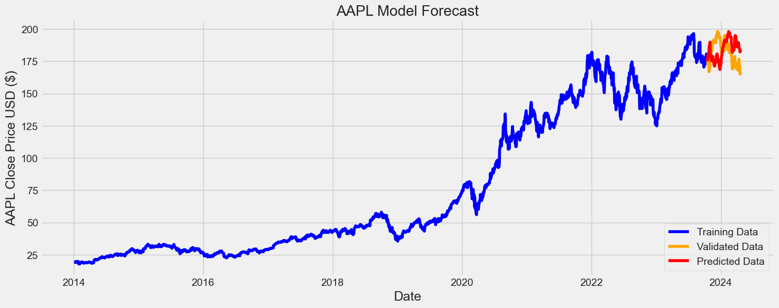
Results
Chosen 5 well known company's stocks to test the model, it goes like:
Apple

Slide 14
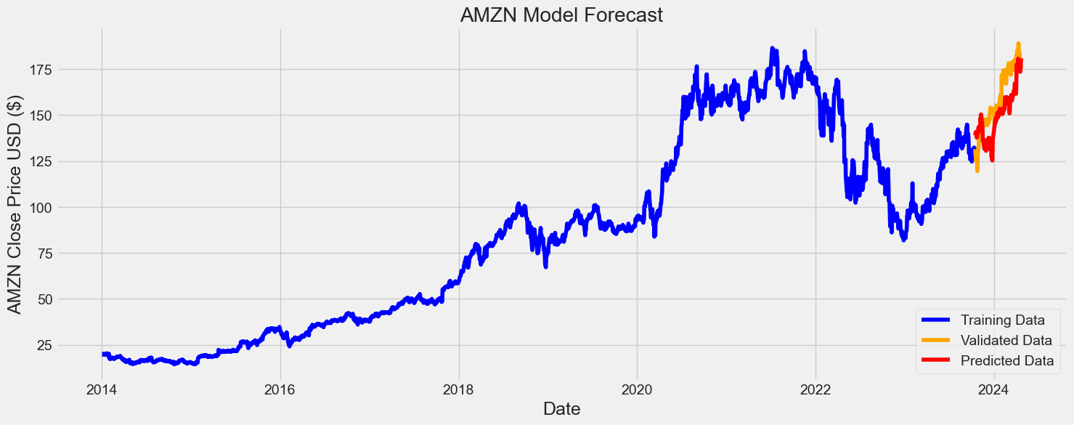
Results
Amazon

Slide 15
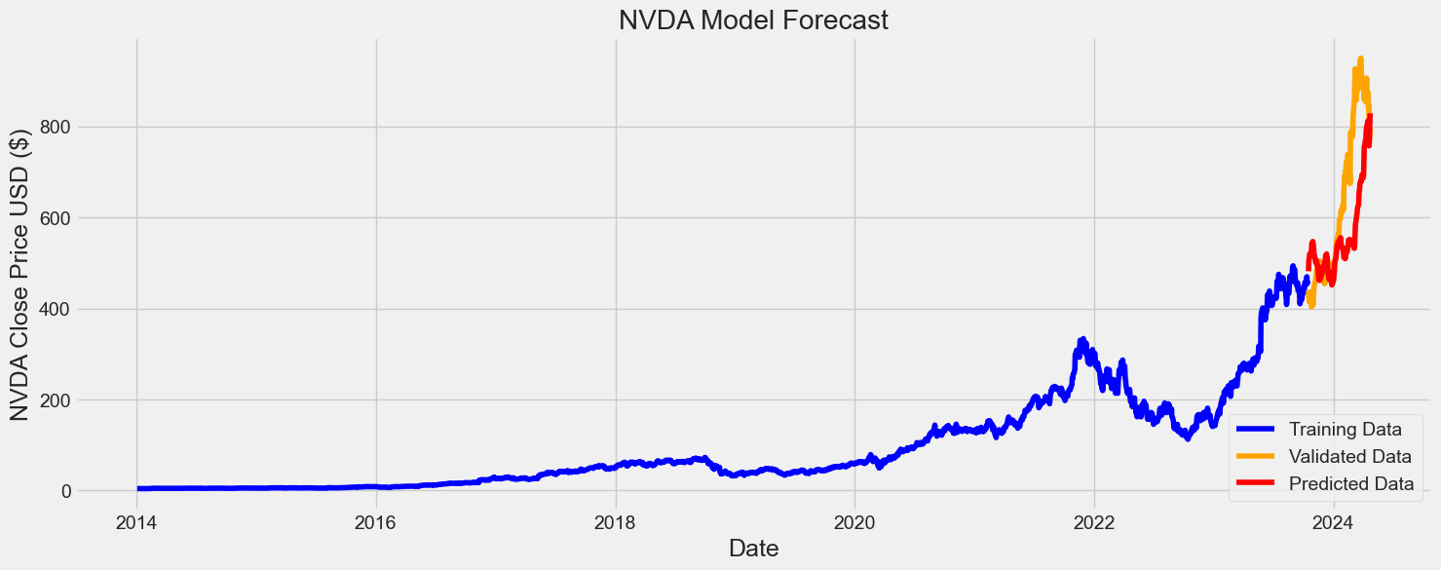
Results
Nvidia

Slide 16
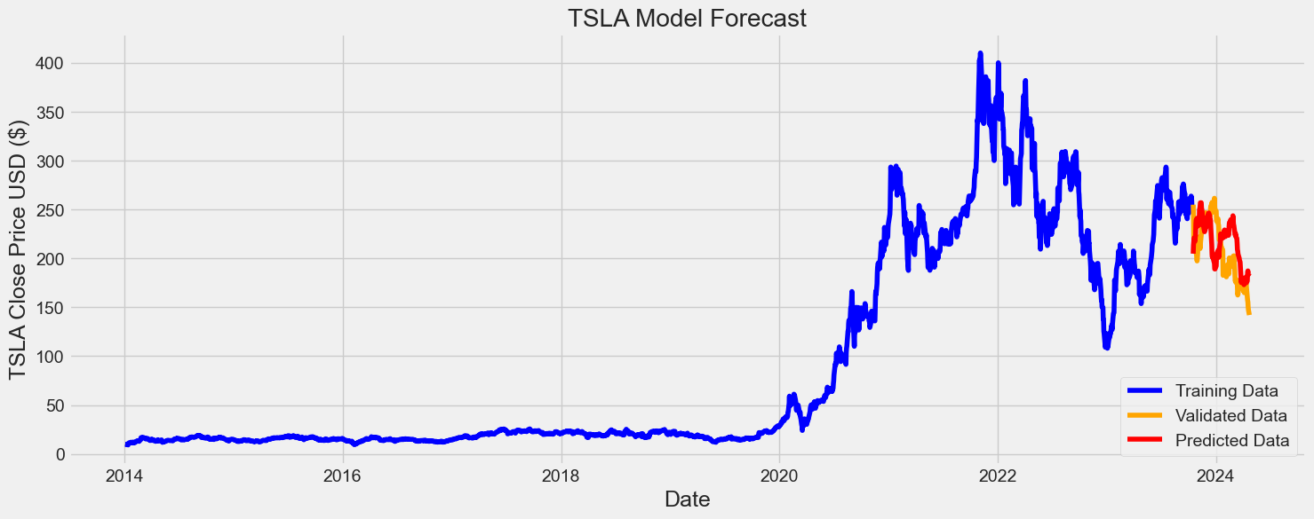
Results
Tesla

Slide 17
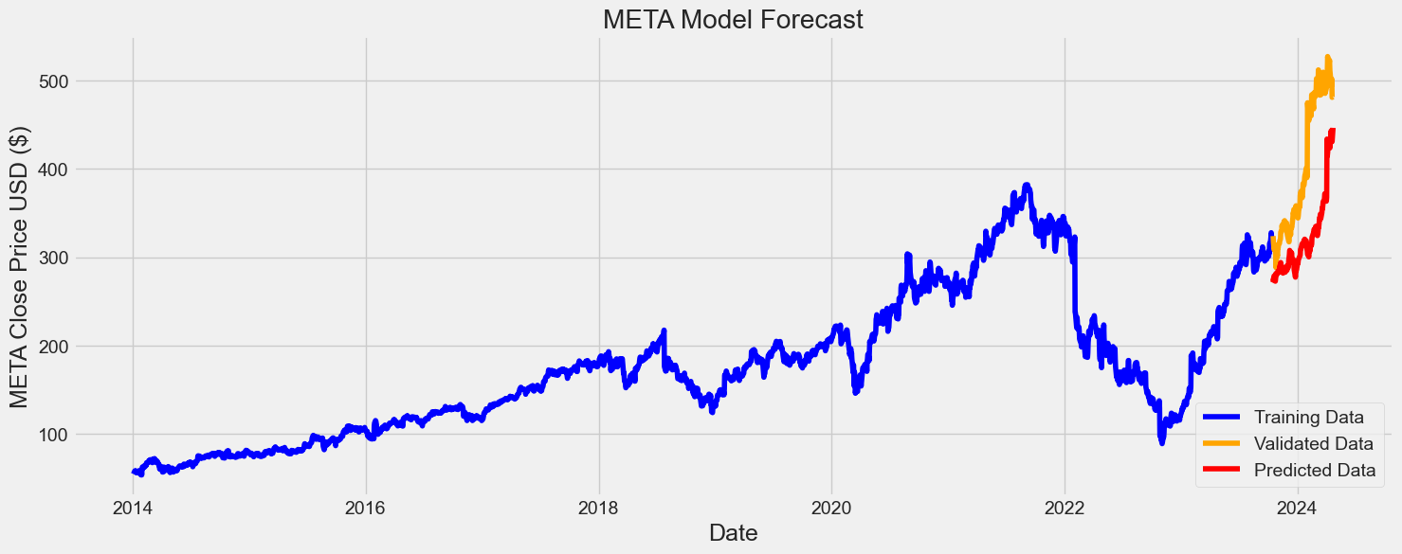
Results
Meta

Slide 18
Challenges
Discuss any challenges faced during the project
How did you overcome them?

Slide 19
Lessons Learned & Future Work
Lessons Learned:
RNN,s are the better models to Forecast the stock patterns.
Stock Forecasting Accuracy increases proportionally to the number of factors considered.
Future Work:
Data Enhancement: Using macroeconomic indicators like GDP, Inflation etc
Risk Management: Integrate risk management techniques into the forecasting framework, such as Value at Risk (VaR) analysis or stress testing.

Slide 20
Conclusion
Though any model cannot guarantee you with the exact predictions.
It can help investors and traders amplify investment strategies and better risk management practices in the financial markets.

Slide 21
Q&A
Open the floor for questions from the audience

Slide 22
References
Stock Closing Price Prediction using Machine Learning Techniques(Mehar Vijh et al.,2020)
Stock Market Predictions with LSTM in Python. (Avijeet Bishwal, 2024)

Slide 23
Thank you

