Slide 1
Game Sales
Analysis

Slide 2
Audience
Audience
Tools Used
Tools Used
Objectives
Objectives
AGENDA
Background
Background
Analyzing
Analyzing
Findings
Findings
Recommendations

Slide 3
Audience
Tools Used
Objectives
Game Developer
Background
Analysis
Findings
Recommendations

Slide 4
Tools Used
Tableau
Visualization and Dashboard Creation
Python
Data Wrangling and EDA

Slide 5
Background
What are the top-performing games of all time?
Which genres are oversaturated vs. underexplored?
Which platforms should we target?
Who are the top publishers to pitch to?
Objectives
Analysis
Findings
Recommendations

Slide 6
Background
Objectives
Mino games, a startup game publisher.
Not doing well with the sales, need a solid comeback.
They need to plan a perfect pathway by analyzing the past data
Know optimal platform-genre alignment to enhance game experience
Project the findings to Audience
Analysis
Recommendations for Audience
Findings
Recommendations

Slide 7
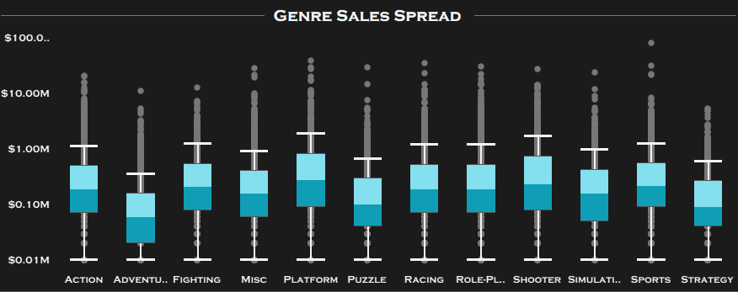
Analysis
Objectives
Genre Sales Spread
Boxplot of Global Sales per Genre (log scale)
Find the attributes that impact more on video game sales
Project the findings to Audience
Project the findings to Audience
Findings
Recommendations

Slide 8
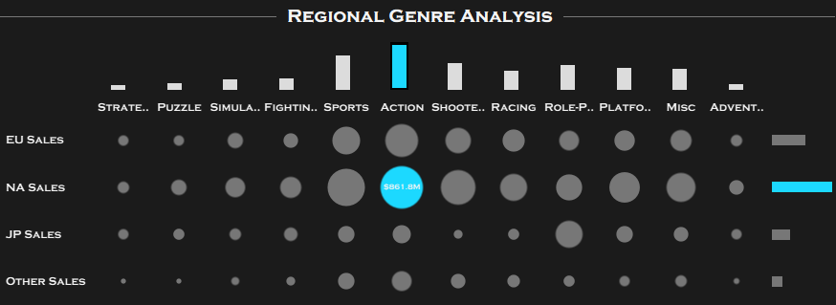
Analysis
Objectives
Regional Genre Analysis
Heatmap + Embedded dual bar charts:
o Top: Total sales per genre
o Right: Total sales per region
Find the attributes that impact more on video game sales
Project the findings to Audience
Project the findings to Audience
Findings
Recommendations

Slide 9
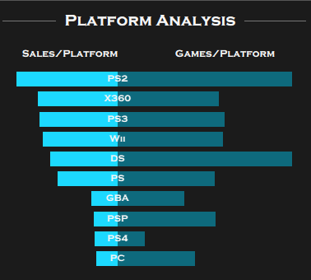
Analysis
Objectives
Platform Analysis
Find the attributes that impact more on video game sales
Tornado chart: Sales vs. Game count per platform
Project the findings to Audience
Project the findings to Audience
Findings
Recommendations

Slide 10
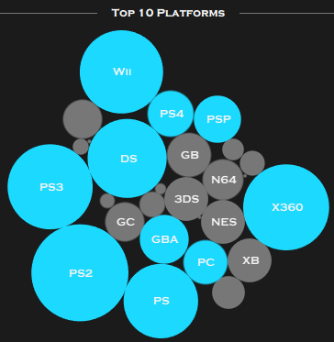
Analysis
Objectives
Platform Analysis
Find the attributes that impact more on video game sales
Bubble chart: Top 10 platforms by volume.
Project the findings to Audience
Project the findings to Audience
Findings
Recommendations

Slide 11
Findings
Top 10 Publishers globally
Action-PS2, Sports-Wii, and Shooter-X360 are the top three genre-platform combinations that are in demand.
Working on their skills in these domains can help a developer to build a secure carrier.
Recommendations

Slide 12
Findings
Recommendations
Action-PS3, Sports-Wii, and Shooter-X360 are the top three genre-platform combinations that are in demand.
Developers can pitch to Nintendo, Sony and focus on PS2/X360/Wii style markets.
Working with the top rulers in these domains can help an developer to build a good carrier.

Slide 13
Recommendations
Knowing the Top genre-platform that are in demand.
Planning to apply the publishers that are top in that genre-platform allignment.
Thank You

