Slide 1
Game Sales
Analysis

Slide 2
Audience
Audience
Tools Used
Tools Used
Objectives
Objectives
AGENDA
Background
Background
Analyzing
Analyzing
Findings
Findings
Recommendations

Slide 3
Audience
Tools Used
Objectives
Game Publisher
Background
Analysis
Findings
Recommendations

Slide 4
Tools Used
Tableau
Visualization and Dashboard Creation
Python
Data Wrangling and EDA

Slide 5
Background
Which genres make the most revenue?
Which platforms are most profitable?
What are the sales trends over time?
Which regions bring the most revenue?
Who are our top competitors?
Objectives
Analysis
Findings
Recommendations

Slide 6
Background
Objectives
Mino games, a startup game publisher.
Not doing well with the sales, need a solid comeback.
They need to plan a perfect pathway by analyzing the past data
Know optimal Genre-Platform-Region To make more sales
Project the findings to Audience
Analysis
Recommendations for Audience
Findings
Recommendations

Slide 7
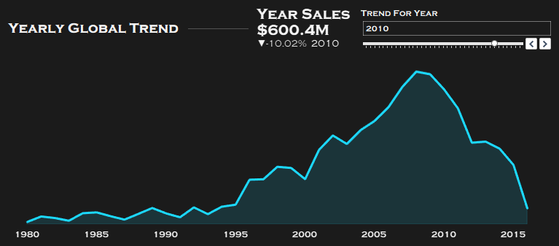
Analysis
Objectives
Yearly Sales Trend
Line chart with KPIs: Year sales, trend %, and tooltip.
Find the attributes that impact more on video game sales
Project the findings to Audience
Project the findings to Audience
Findings
Recommendations

Slide 8
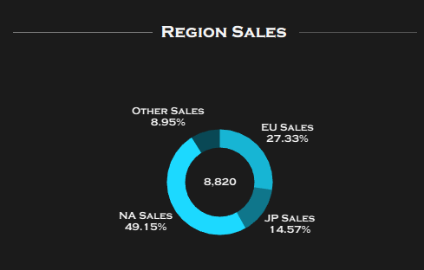
Analysis
Objectives
Find the attributes that impact more on video game sales
Region Sales Donut
Donut chart showing % share of each region and total Sales.
Project the findings to Audience
Project the findings to Audience
Findings
Recommendations

Slide 9
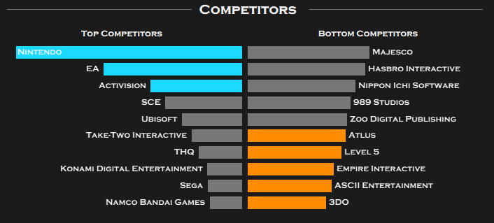
Analysis
Objectives
Competitors Analysis
Find the attributes that impact more on video game sales
• Bar charts for Top and Bottom 10 publishers.
• Highlighted publishers above average in cyan/orange.
Project the findings to Audience
Project the findings to Audience
Findings
Recommendations

Slide 10
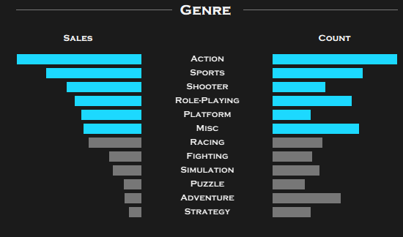
Analysis
Objectives
Genre Breakdown
Find the attributes that impact more on video game sales
Tornado chart: Genre Sales vs Game Count.
Project the findings to Audience
Project the findings to Audience
Findings
Recommendations

Slide 11
Findings
Top 10 Publishers globally
Sales peaked in 2010, followed by steady decline — possibly due to mobile gaming or platform transitions
To generate and sustain profits Action Genre and NA region is the best choise.
Recommendations

Slide 12
Recommendations
Findings
• Publishers should double down on Action,
Sports, Shooter genres
• North America and Europe dominate the global gaming market
Action-PS3, Sports-Wii, and Shooter-X360 are the top three genre-platform combinations that are in demand.
Working with the top rulers in these domains can help an developer to build a good carrier.

Slide 13
Recommendations
Knowing the Top genre-platform that are in demand.
Planning to apply the publishers that are top in that genre-platform allignment.
Thank You

