Slide 1

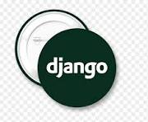

Slide 2

KRISHNA CHAITHANYA INSTITUTE OF TECHNOLOGY AND SCIENCES
(Approved by AICTE,new Delhi & Affiliated to JNTU Kakinada)
A
Seminar Report On
DJANGO
Submitted for the partial fulfilment
Of
BACHELOR OF TECHNOLOGY
In
Computer Science and Engineering
By
    22JU1A0540 JAYA SREE BANDA
    22JU1A0507 ANJALI DEVI KOPPULA
    22JU1A0505 ANITHA KASU
    22JU1A0560 MAMATHA OBURAI
Under the Guidance of
Mr.Dr.J.V.ANIL KUMAR

Slide 3
TABLE OF CONTENT
What is “Django”?
Why is “Django”?
History
Introduction
MVT and MVT Patterns
Django MVT Architecture
Work Flow
Installtion of Django
Simple Project Directory Structure
Key Features
TODO Web Application
Todo Project directory Structure
Work Flow Of TODO Application
Pros-Cons
Job Roles
Carrer path
Salaries and packages
Django Developer hiring Growth rate
Hiring Companies
Reference
Conclusion
Thank You…!

Slide 4
What Does “Django” means?
Django is named after Django Reinhardt,A jazz manouche guitarist from the 19930s to early 1950s.To this day,he’s considered one of the best guitarist of all time
Django is Pronuounced as JANG-oh ,Rhymes with FANG-oh , The “D” is silent
It was released publicly in 2008,Official website:https://www.djangoproject.com/
Django now run by international team of volunteers

Slide 5
Why “Django”?
Django provides every thing built in database connection,authentication,adminpannel,ORM,routing,security etc..
It follows MVT pattern which seperates logic,data and design.
It automatically generates an admin dashboard for user database model.
It has built In protection against common attacks like SQL injection ,XSS,CSRF.

Slide 6
HISTORY
Django was developed in the year 2003 by Adrian and Simon,two web developers who worked at a news company called Lawrence-Journal-World in Kansas,USA
They noticed that they were repeating the same co websites(like managing articles,users and comments)
To save time,they created a Resual web framework that handled common web development tasks automatically
This internal Framework was the F

Slide 7
INTRODUCTION
Django is a high-level Python web framework used for building web apllications quickly and efficiently
It is an open-source,comes with many ready-made features like: Admin-panel,Log-in and user system for Authentiction,ORM.
Django allows you to create ,read,update and delete data easily using its inbuilt Tools
It help developers create websites faster without needing to write everything from scratch
It follows the Model-View-Template(MVT) architecture for clean and organized development
It was created by ADRIAN HOLOVALTY & SIMON WILLISON in 2005
It is known as the “Framework for perfectionist with deadlines” because it saves a lot of time”

Slide 8
MCT and MVT Patterns
MCT(Model controller template)
MVT(Model view template)
It is a web application design architecture used mainly in framework like Flack.
It seperates web application into three main componets-model,controller,template.
MODEL:Handles data and database operations.
CONTROLLER:Handles user request,interacts with the model and sence data to the template.
TEMPLATE:Displays data to the user(HTML web page).
It is used in Django framework.
It is similar to the MVC patter, but in Django the framework itself acts as a controller so deloveper mainly handle model,view and template.
MODEL: Manage databases and data structure.
VIEW:Contains business logic of the application retrives data from the model and pass to template.
TEMPLATE:Displays data received from view.

Slide 9
EXAMPLE DIFFERENCE BETWEEN MVT AND MCT
MVT
MCT
# views. Py
from Django. Shortcuts import rendered home(request): # View name = "Jayasree" return render(request, 'home.html', {'name': name})
# app.py
from flask import Flask, render _ template app = Flask(_name_)@app.route('/')def home(): # Controller
name = "Jayasree" return render _ template('home.html', name=name)
# Template

Slide 10
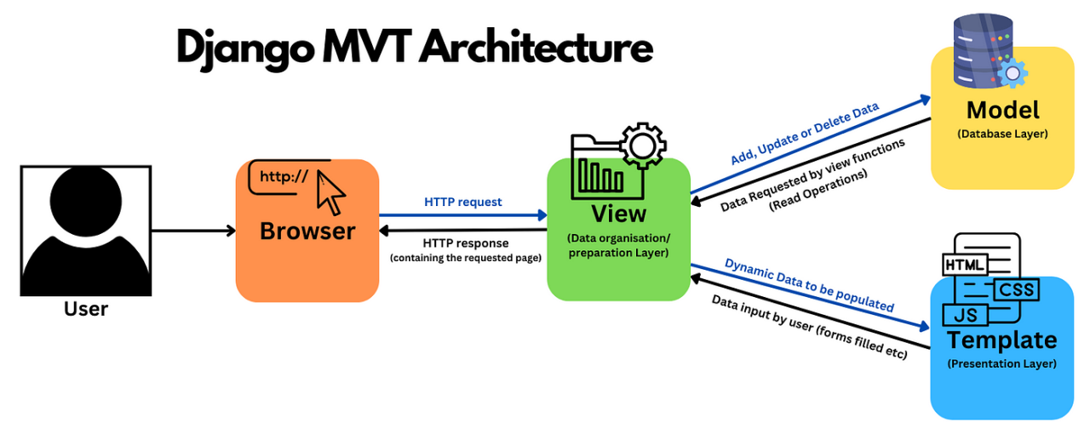

Slide 11
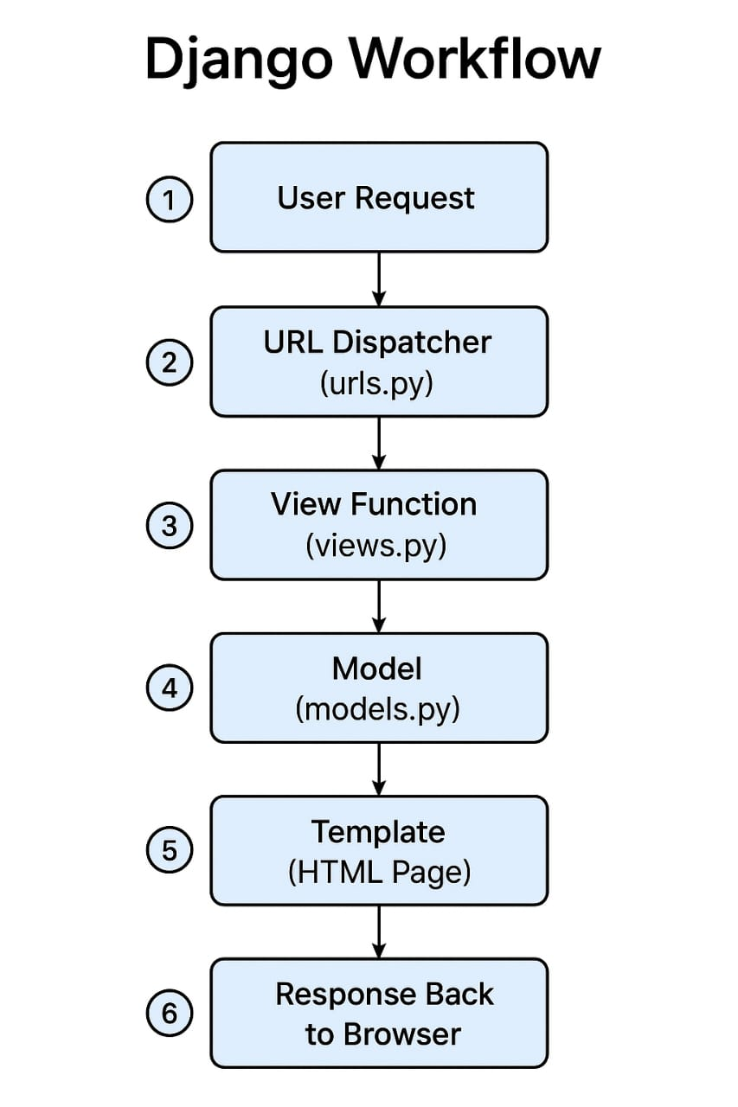
WORKFLOW
USER REQUEST URL (pattern): http//localhost:8000/admin
| | | |
V v v v
protocol Domain port number view(route)
PROTOCOL: It defines how data is trasfered between browser and server.
DOMAIN: The Adress of the server where your website is hostsed.
PORTNUMBER: A door number that tells which application or service to talk on to the server.
ROUTE(view): The specific page or end points inside your web application,it decides which view function should handle the request.

Slide 12
Installation of Django
Quick prerequisites
1.install python 3.8+
2.make sure pip is install
create a project folder and open terminal
1.mkdir project directory name
2.cd project directory name
Create and activate virtual env
1.python –m venv emn
2.\ venv\ Scripts\Activet
Install Django
1.pip install Django
Create a New Django project
1.Django-admin startproject project-name
2. cd projectname
Run the Django server
1.python manage.py runserver
Optional Commands
1.Create a New app:python manage.py startapp appname
2.Database Migrations:python manage.py migrate
3.Admin_user:python manage.py createsuperuser

Slide 13
Project Directory Structure
Directory/-----------------------Just a container for your project, Its name doesn’t matter to Django you can rename it to anything you like.
Manage.py-------------A command line utility that lets you interact with this Django Project in various ways
Project name/-------------Actual Python package for your project
__init__.py_------------A file required for python to treat Project directory as a project
Settings.py---------Congiguration for Django project
Urls.py—-----------Provided mapping to views
Wsgi.py—----------An entry point for wsgi compatible webservers to serve your project.
Templates/---------HTML files, renders based on views
Static/---------------CSS,JS files, Images etc, configurable in settings.py
Project-app/---------------A small sub package in project
  __init__.py
  Urls.py/
  Views.py-----------Responsible for users request and greturn response
  Models.py---------Definitive source of information about data generally ,each model maps to a singledatabase table
  Admin.py----------It reads a ameta data in your model
  Forms.py----------To create and manipulate form data

Slide 14
KEY FEATURES
MVT Architecture
Built in admin interface
ORM(Object relational mapper)
High security
Rapid development
Reusable and module code
Cross platform and opensource
Built on authentication system
URL routing system

Slide 15
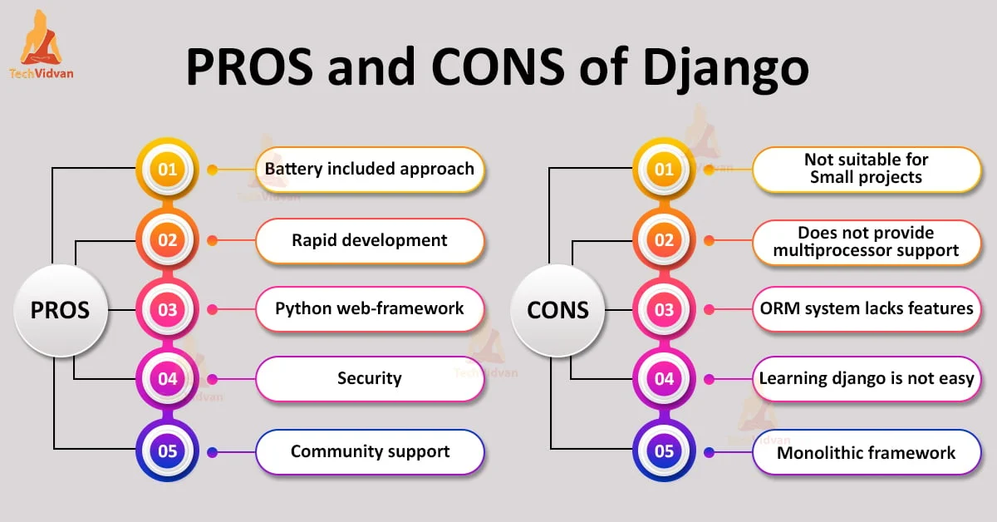

Slide 16
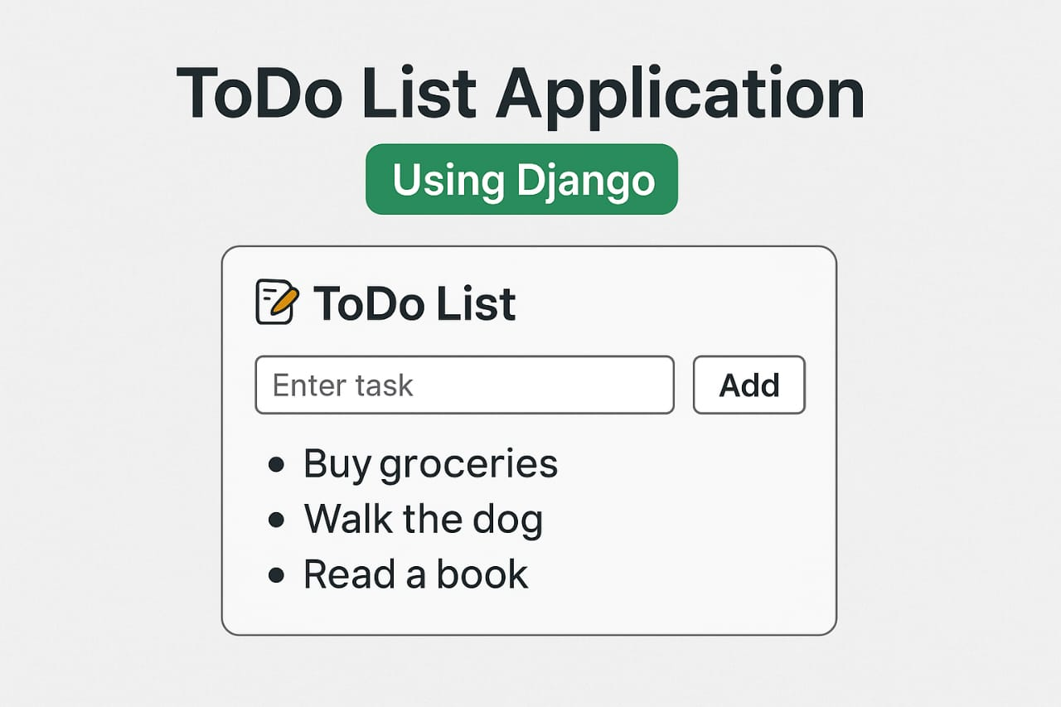
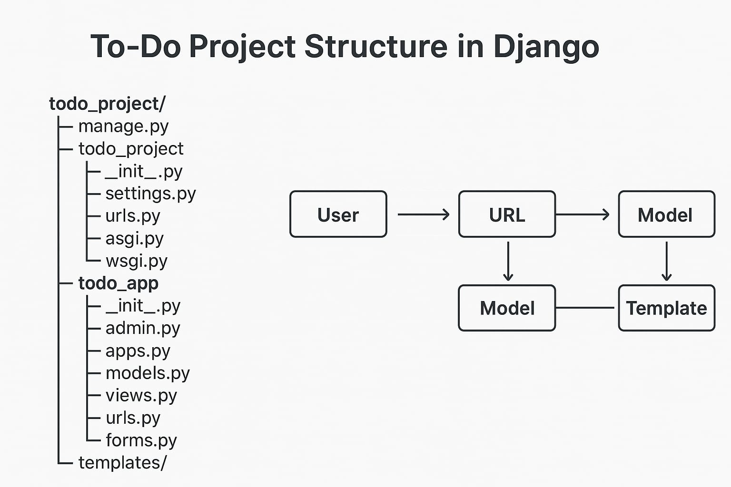
TODO WEB APPLICATION

Slide 17
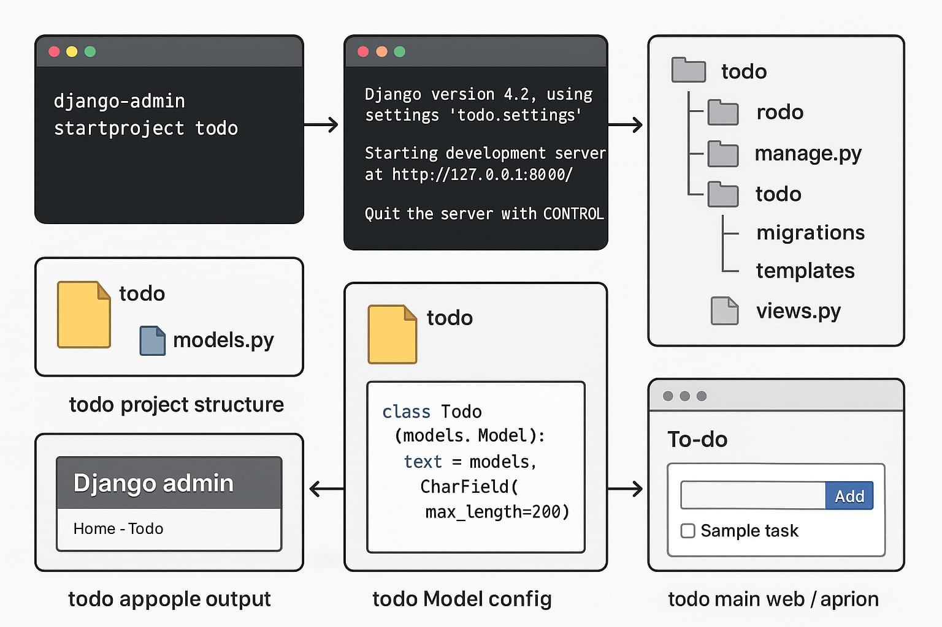
WORK FLOW
Simple TODO project Application

Slide 18
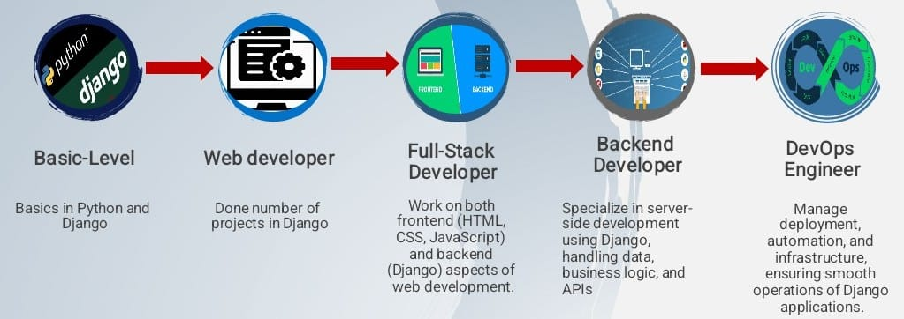
CAREER PATH

Slide 19
JOB ROLES
Python developer: As a Django- developer, Here job is to program applications for clients using the Django framework for the python programming language
Backend developer : In the case of mobile apps we would simply suggest that Django for the backend part
Full stack developer: A full stack developer with a focus on Django typically works with both frontend and backend technologies ,utilizing the Django framework for the backend.
Application developer: in the con text of Django typically focus on development of specific application or modules with in a longer web application.
Machine learning engineers:In Django web development projects they integrate with machine learning functionalities in to the Django frameworks.
Data scientist: Django is a high level python web framework that encourages rapid development and clean, pragmatic design.

Slide 20
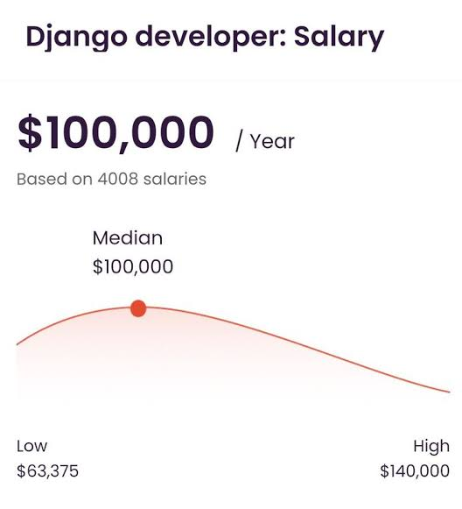
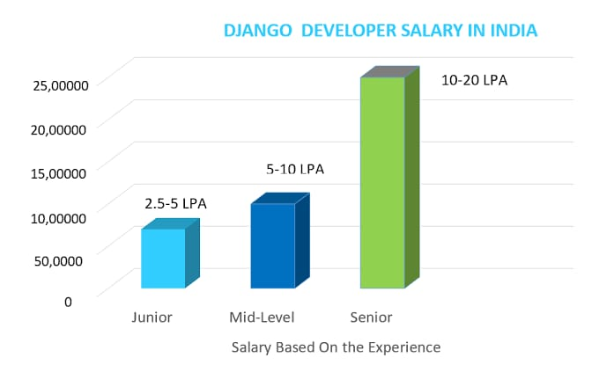
SALARIES /PACKAGES DETAILS
INDIA
ABROAD

Slide 21
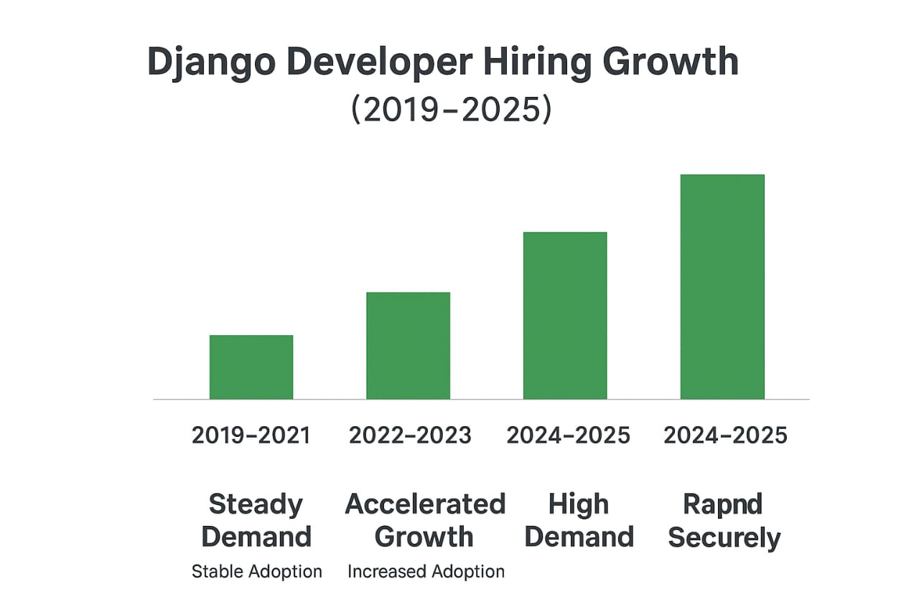
HIRING GROWTH RATE

Slide 22
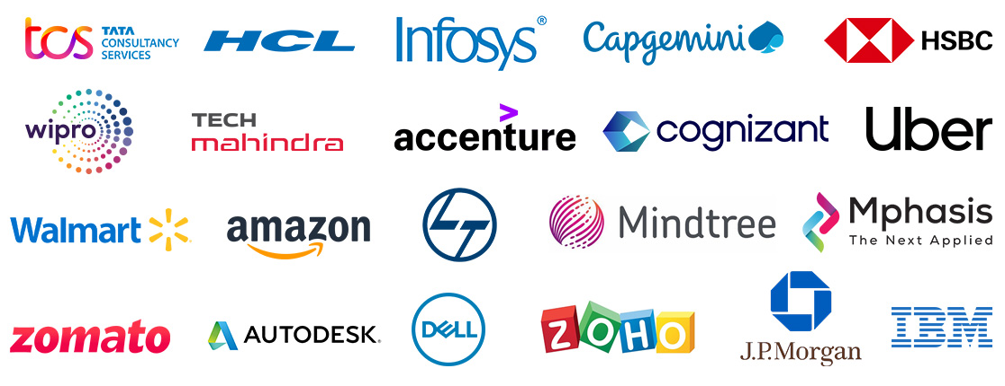
HIRING COMPANIES
The following organizing and companies use Django for high scale applications often for their backend services , internal tools and content management systems.
Instagram
YouTube
Spotify
Pinterest
Mozilla
Dropbox
Bitbucket
Udemy

Slide 23
REFERENCES
Oficial Django documentation:https://www.Djangoproject.com//start
W3school
GeeksforGeeks
YouTube channels:
Dave Gray
Programming with Mosh

Slide 24
CONCLUSION
Django is a Powerfull,Open-source web framework written in python that simplifies the process of building secure,scalable,and maintainable web apllications.it follows the MODEL,VIEW and TEMPLATE(MVT)architecture, promoting clean and reusable code. With its built-in feature like authentication, ORM, admin interface and security protection. Django allows developers to focus on application Logic rather them repetitive tasks.

Slide 25


