Slide 1


WebApp for Visualization and Analysis of Himalayan Hydro-Cryospheric Datasets
CSE402: Summer Internship - II
External Guide : Dr. Amit Kumar Dubey Scientist/Engineer 'SF’, ISRO/SAC, Ahmedabad
Internal Guide : Ms. Sachi Joshi, Assistant Professor, DEPSTAR CHARUSAT
Presented by: Jay Patel(23DCS076)
Department of Computer Science & Engineering,
Devang Patel Institute of Advance Technology and Research (DEPSTAR)
1

Slide 2
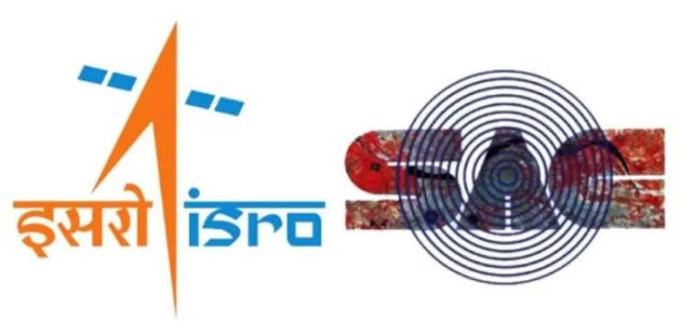
Company Overview
Organization
Indian Space Research Organisation (ISRO)
Space Applications Centre (SAC), Ahmedabad
Develops remote sensing and Earth observation applications
Supports national research in climate, hydrology and geospatial analytics
Internship Domain
Scientific Data Engineering
Remote Sensing
Geospatial Web Development
Hydro-Climatic Data Visualization
Department of Computer Science & Engineering, DEPSTAR
3

Slide 3
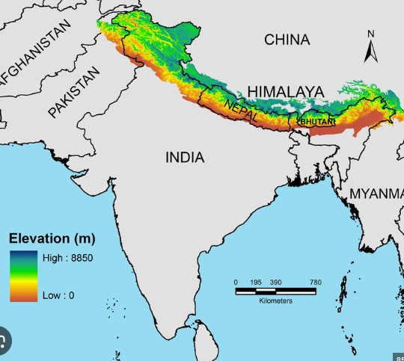
Project introduction
Introduction
The Himalayan region, known as the "Water Tower of Asia," is a highly climate-sensitive ecosystem that stores freshwater in glaciers and seasonal snow. Climate change is causing glacier retreat, changing snowfall patterns, and irregular snowmelt, impacting river flow, agriculture, hydropower, ecosystems, and water availability across South Asia.
Problem Statement
Researchers use datasets such as ERA5-Land, CMIP6, MOD10A1, SPHY, and glacier inventories, but these are large, heterogeneous, and difficult to analyze together efficiently.
Proposed Solution
A Web-Based Himalayan Basin Analytics Platform was developed to integrate these datasets into a single interactive system, enabling map-based visualization, time-series analysis, region-wise exploration, hotspot detection, and long-term environmental monitoring.
Department of Computer Science & Engineering, DEPSTAR
4

Slide 4
Objective
Build an interactive scientific visualization platform
Support ERA5-Land, CMIP6, SPHY, MOD10A1 datasets
Convert large datasets into optimized Parquet format
Develop high-performance backend APIs Enable map visualization and time-series analysis
Support glacier, basin and region-wise analysis
Prepare application for both online and offline usage for system independent
Department of Computer Science & Engineering, DEPSTAR
5

Slide 5
Data Sources
Supported datasets:
ERA5-Land
CMIP6
SPHY
MOD10A1
Glacier Boundaries
Basin Boundaries
User Uploaded NetCDF
Supported variables:
Temperature, Snowfall, Snow Depth, SWE, Wind Speed, Radiation, Precipitation, Snow Albedo, Snow Cover
Department of Computer Science & Engineering, DEPSTAR
6

Slide 6
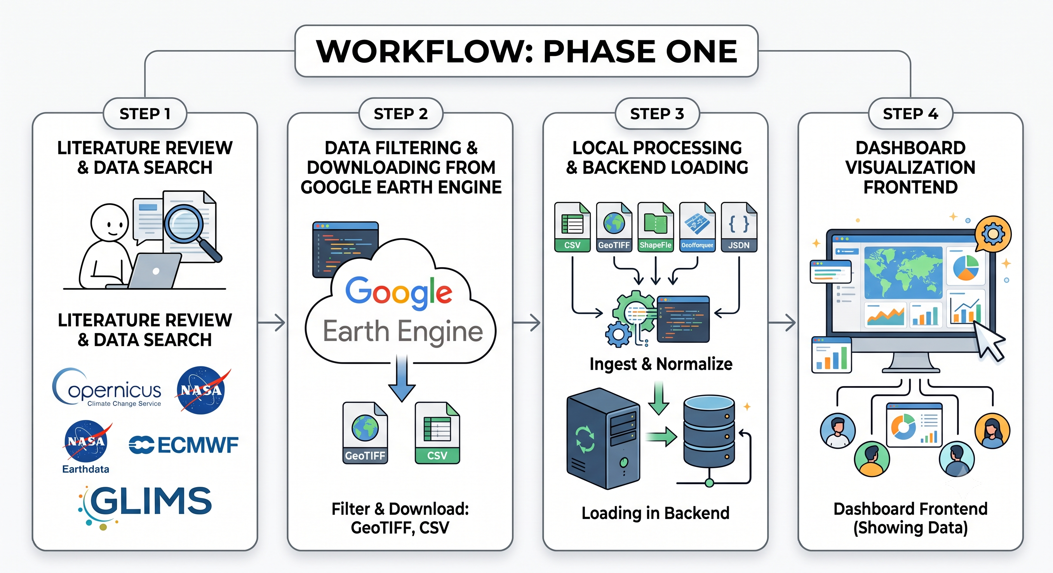

Workflow
Department of Computer Science & Engineering, DEPSTAR
10

Slide 7
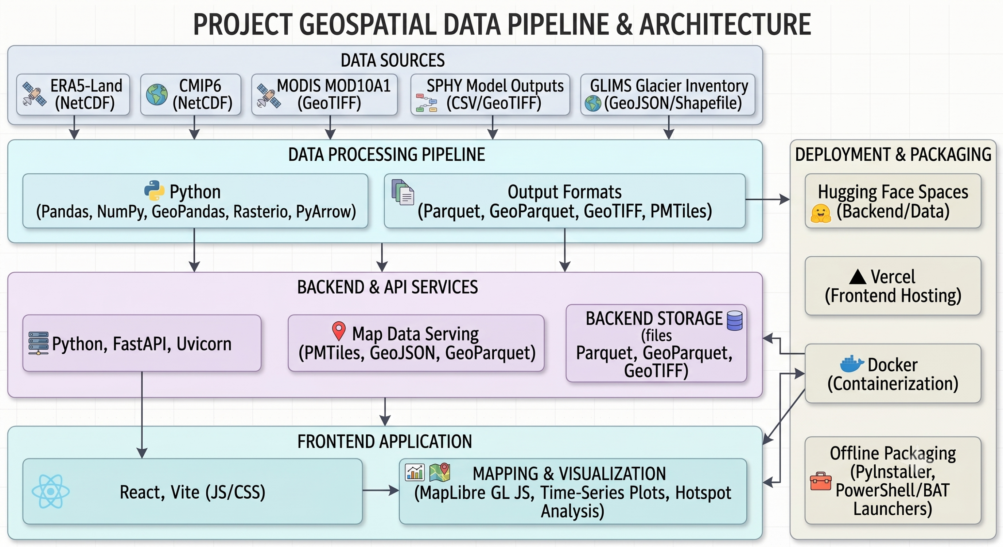
System Architecture
Department of Computer Science & Engineering, DEPSTAR
2

Slide 8
Tools and Technology
Frontend: React, Vite, JavaScript, CSS
Backend: Python, FastAPI, Uvicorn
Mapping: MapLibre GL, PMTiles, GeoJSON, GeoParquet
Data Processing: Pandas, NumPy, PyArrow, Rasterio, GeoPandas
Data Formats: Parquet, GeoParquet, GeoTIFF, NetCDF, CSV
Datasets: ERA5-Land, CMIP6, MODIS MOD10A1, SPHY model outputs, GLIMS glacier inventory
Deployment: Vercel, Hugging Face Spaces, Docker
Offline Packaging: PyInstaller, PowerShell/BAT launcher
Visualization: Interactive maps, time-series plots, hotspot analysis map
Department of Computer Science & Engineering, DEPSTAR
8

Slide 9
Major Functionalities
Region Selection: Rectangle draw, lat/lon bounds, subregion dropdown, glacier-linked selection with visible point counts
Time-Series Graphs: Basin mean and region mean plots with zoomable periods; window persists across variable changes
Hotspot Analysis: Point-wise annual trend fitting (Y = aX + b), percentile classification (P70/P85/P95), trend strength distribution
Outcome Module: Precomputed multi-decade band means (1951-1975, 1976-2000, 2001-2025) for long-term comparison
NetCDF Upload: User-uploaded gridded data with structure inspection and modular ingestion
Documentation Module: In-app scientific manual explaining project context, data sources, API design, and limitations
Department of Computer Science & Engineering, DEPSTAR
9

Slide 10
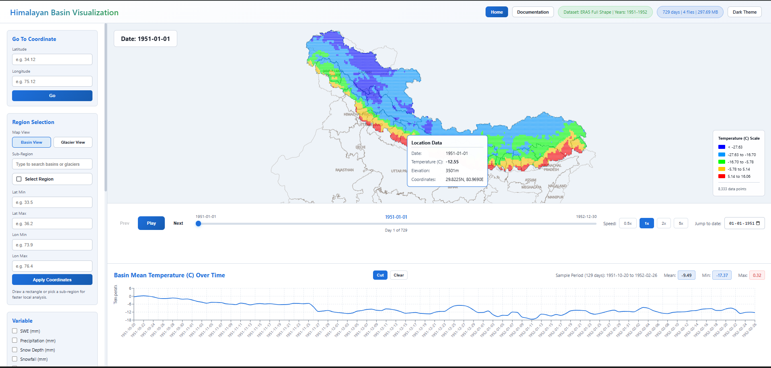
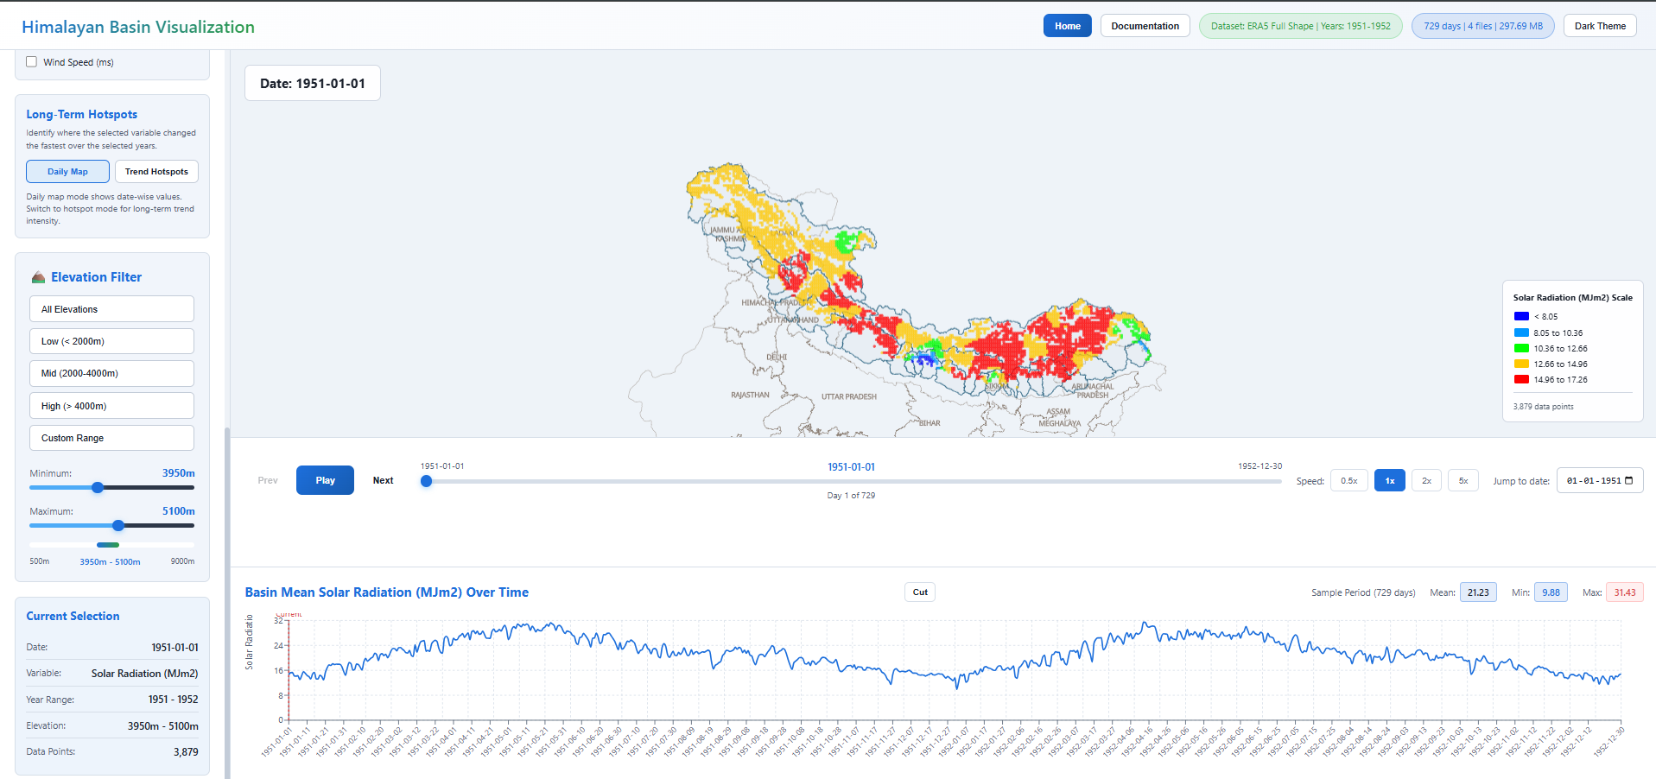
Screenshots
Dashboard
Department of Computer Science & Engineering, DEPSTAR
12

Slide 11
Challenges & Solutions
Challenge | Solution Implemented
Large climate and model datasets causing slow loading | Converted CSV/GeoTIFF data into optimized Parquet format and loaded only selected year ranges
Multiple datasets with different resolutions and variables | Standardized datasets into common latitude, longitude, date, elevation, and variable-based structure
Heavy glacier shapefiles reducing performance | Converted glacier shapefiles into GeoParquet for faster spatial loading
Need to analyze specific Himalayan sub-regions | Added rectangle selection, manual lat/lon input, and sub-region/glacier dropdown selection
Difficulty understanding long-term environmental changes | Added hotspot analysis and 25-year band comparison maps
Offline use on systems without Python/Node.js | Created portable Windows package with backend executable, built frontend, and one-click launcher
Scientist-friendly interpretation needed | Added documentation page explaining data sources, methods, formulas, and visualization logic
Deployment with large data files | Separated frontend deployment and backend/data hosting using Vercel and Hugging Face
Department of Computer Science & Engineering, DEPSTAR
14

Slide 12
Reference
[1] W. W. Immerzeel, L. P. H. van Beek, and M. F. P. Bierkens, "Climate Change Will Affect the Asian Water Towers," Science, Vol. 328, No. 5984, pp. 1382-1385, 2010.
[2] A. F. Lutz et al., "Consistent Increase in High Asia's Runoff Due to Increasing Glacier Melt and Precipitation," Nature Climate Change, Vol. 4, No. 7, July 2014.
[3] T. Bolch et al., "The State and Fate of Himalayan Glaciers," Science, Vol. 336, No. 6079, 2012.
[4] W. Terink et al., "SPHY v2.0: Spatial Processes in HYdrology," Geoscientific Model Development, Vol. 8, 2015.
[5] J. Munoz-Sabater et al., "ERA5-Land: A State-of-the-Art Global Reanalysis Dataset for Land Applications," Earth System Science Data, Vol. 13, 2021.
[6] B. Thrasher et al., "NASA Global Daily Downscaled Projections, CMIP6," Scientific Data, 2022.
Department of Computer Science & Engineering ,DEPSTAR
15

Slide 13
THANK YOU
Special thanks to Dr. Amit Kumar Dubey (ISRO/SAC),
Ms. Sachi Joshi (DEPSTAR),
and DEPSTAR CHARUSAT for their guidance and support.
Department of Computer Science & Engineering ,DEPSTAR
16

