Slide 1
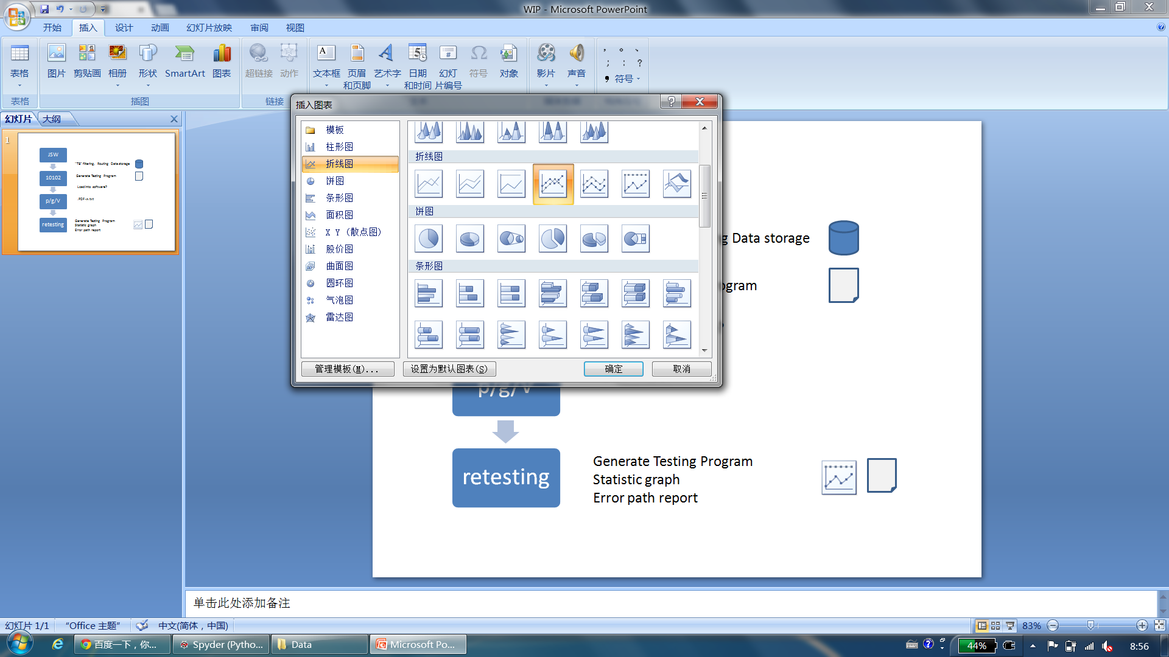

WIP workflow
JSW
10102
p/g/V
retesting
analysis
Received from process designer
“TB” filtering,
Routing Data storage
Generate Testing Program
Load into software manually?
.PDF ->.txt manually?
Submit to Splunk
Generate Testing Program
Statistic graph
Error path report
Load into equipment
Check list, and then Run program

Slide 2
System structure
Engineer
Operator
Dashboard
Routing
pool
Check list
Troubleshot
JSW
Analyzer
Testing
program
Instrument
Result report

