Slide 1
Spoileriffic (Review what you view)
Submitted To:
Baljit Kaur
Vikas Patel
Submitted By:
Team No. 4
Jay Arindam Maity
Karan Kapoor
Karanpreet Singh
Karishma Dhawan

Slide 2
Outline
Introduction
Tools
Benefits
Host Links
Overview
References

Slide 3
Introduction
At Spoileriffic, we dive deep into the cinematic experience, offering in-depth, insightful reviews that dissect every frame without ruining the surprise.
But don’t worry, we’re not just about spoilers! We celebrate the highs, analyze the lows, and provide thought-provoking discussions that ignite your passion for film. Whether you’re a die-hard cinephile or a casual moviegoer, Spoileriffic is your one-stop shop for engaging reviews and vibrant conversations about the latest blockbusters and hidden gems.

Slide 4
Tools and Languages
Here are all the tools and languages used to build Spoileriffic:
VsCode
HTML
CSS
JavaScript(ES6)
Web Browser

Slide 5
Benefits
Easily search for the review of the movie and see if it fits your take and mood according to the occasion
Quickly glance at all the trending, upcoming and high rated movies
Helps you chose the ideal movie for the night.
Minimalistic design makes it easier for people to navigate and find what they are looking for

Slide 6
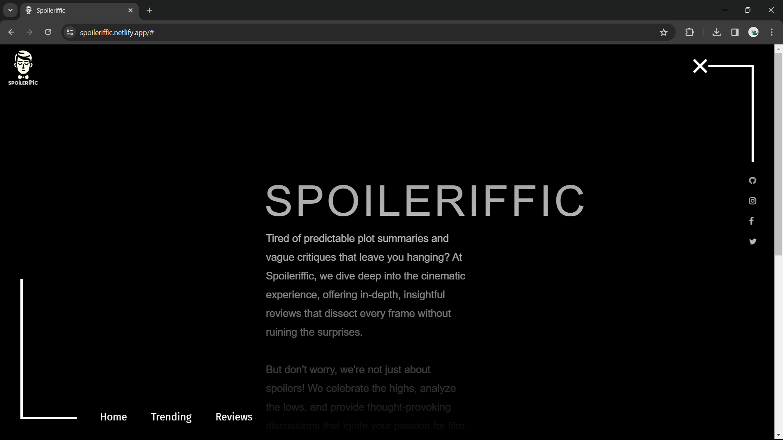
Overview
Home Page:
This page contains the basic information about the website and quick navigation links in a very responsive and unique navbar.

Slide 7
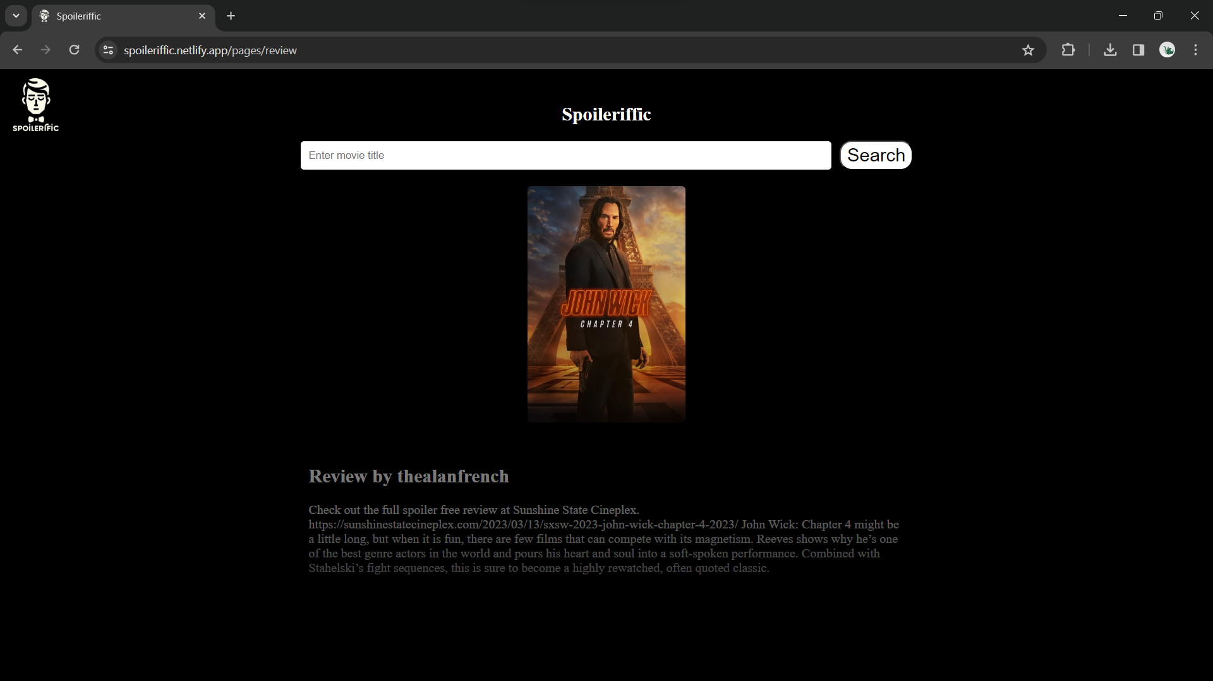
Overview
Review Page:
This page enables you to find the review of the movie you are looking for. Linked with TMBD database, this enables you to get review of wide range of movies.

Slide 8
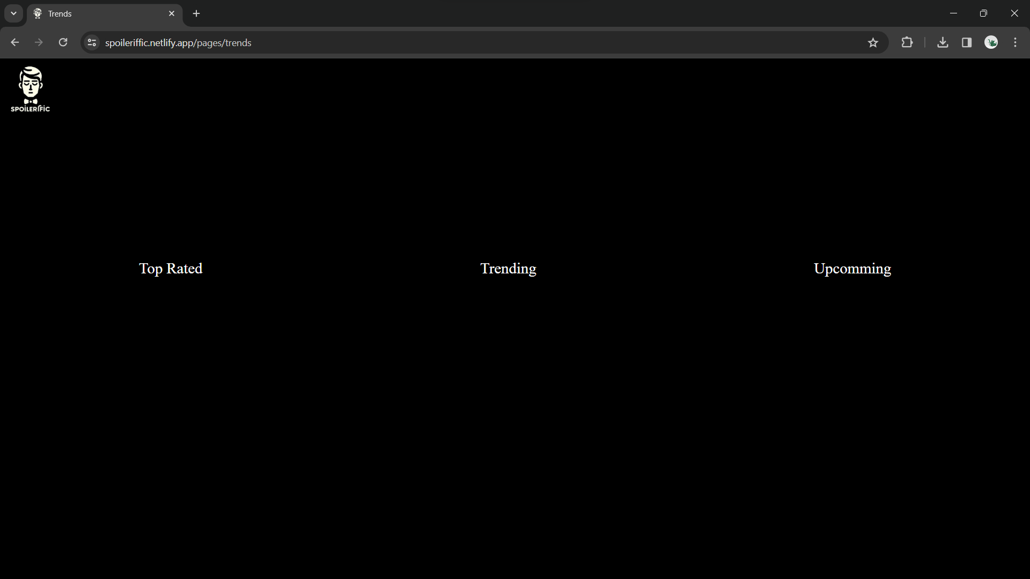
Overview
Trends Page:
This page enables you to see latest tends, top rated and upcoming movies at a glance.

Slide 9
References
W3 Schools - https://www.w3schools.com/
MDN Web Docs - https://developer.mozilla.org/en-US/
Tutorials Point - https://www.tutorialspoint.com/index.htm
css-tricks - https://css-tricks.com/
Geeksforgeeks - https://www.geeksforgeeks.org/
Deployment Link – https://www.spoileriffic.netlify.app

Slide 10
Thank You

