Slide 1
Yummybite (Food Ordering Website)
Submitted To:
Baljit Kaur
Vikas Patel
Submitted By:
Team No. 4
Jay Arindam Maity
Karan Kapoor
Karanpreet Singh
Karishma Dhawan

Slide 2
Outline
Introduction
Tools
Benefits
Host Links
Overview
References

Slide 3
Introduction
Yummy bites is a simple project made with react.js that enables people to order and various cuisines from across the world. This is a collaborative effort to showcase our development skills.

Slide 4
Tools and Languages
Here are all the tools and languages used to build Spoileriffic:
VsCode
Web Browser
React js
Node js
Javascript
Css

Slide 5
Benefits
Enables you to order various cuisines
Also calculates the total price of the food items
Cart to track your orders
Login/Signup Feature
Well defined UI/UX

Slide 6
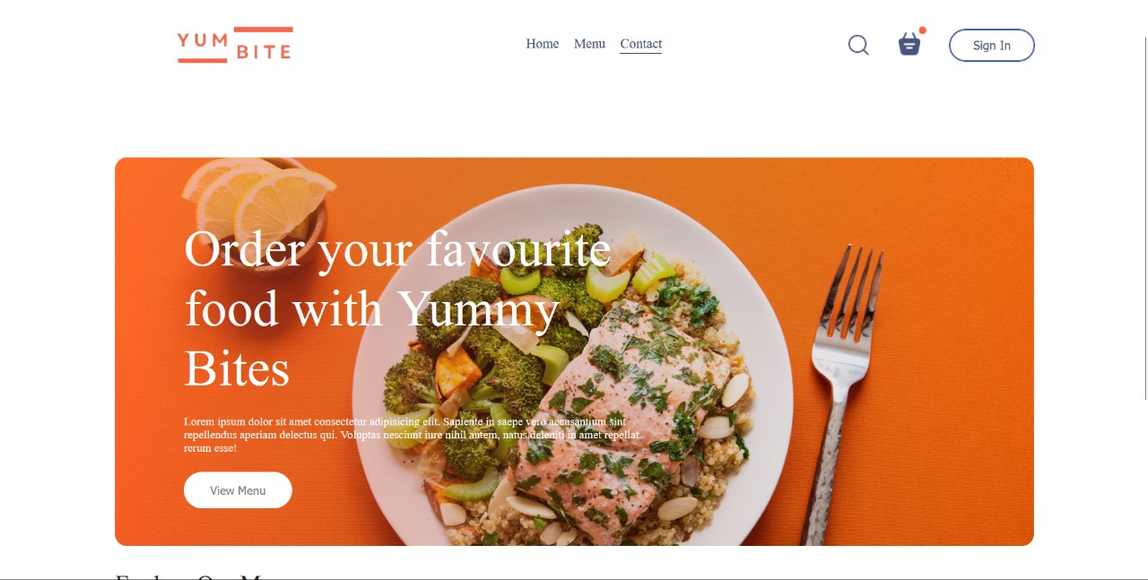
Overview
Home Page:
This page contains the basic information about the website and quick navigation links in a very responsive and unique navbar.

Slide 7
References
W3 Schools - https://www.w3schools.com/
MDN Web Docs - https://developer.mozilla.org/en-US/
Tutorials Point - https://www.tutorialspoint.com/index.htm
css-tricks - https://css-tricks.com/
Geeksforgeeks - https://www.geeksforgeeks.org/

Slide 8
Thank You

