Slide 1
YummyBites (Food Ordering Website)
Submitted To:
Ms. Baljit Kaur
Mr. Vikas Patel
Submitted By:
Team No. 4
Jay Arindam Maity
Karan Kapoor
Karanpreet Singh
Karishma Dhawan

Slide 2
Outline
Introduction
Benefits
Tools
Project Highlights
Conclusion
Host Link
References

Slide 3
Introduction
In the hustle and bustle of modern life, managing our daily tasks efficiently has become paramount. Among these tasks, the management and delivery of food stand out as areas where innovation can significantly improve our daily lives. Enter YummyBites: a groundbreaking web-based platform designed to revolutionize how we interact with food.

Slide 4
Benefits
Enables you to order various cuisines
Also calculates the total price of the food items
Cart to track your orders
Login/Signup Feature
Well defined UI/UX
Function to activate/avail discounts
Delivery charges are also calculated and included.

Slide 5
Tools and Languages
Here are all the tools and languages used to build Spoileriffic:
VsCode
Web Browser
React Js
Node Js
Javascript
Css

Slide 6
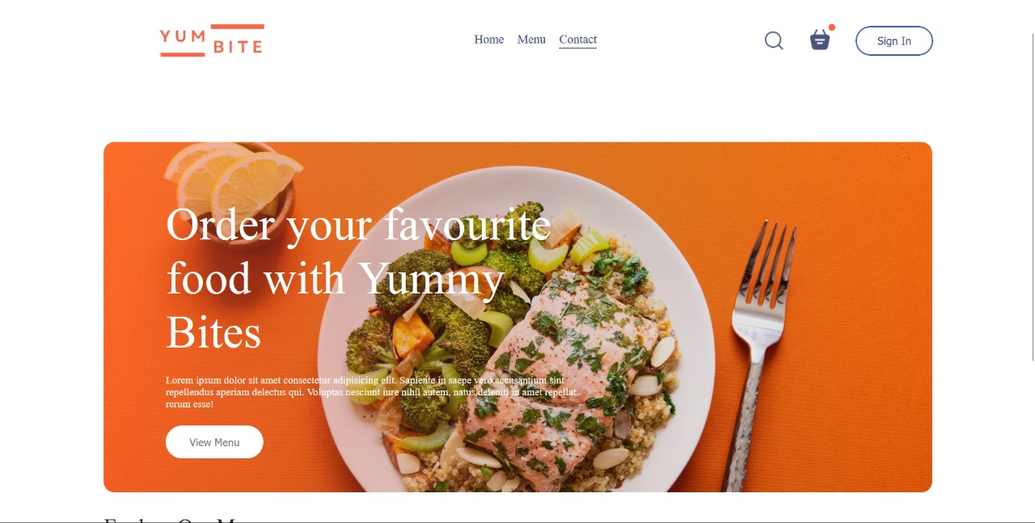
Project Highlights
Home Page:
This page contains the basic information about the website and quick navigation links in a very responsive and unique navbar.

Slide 7
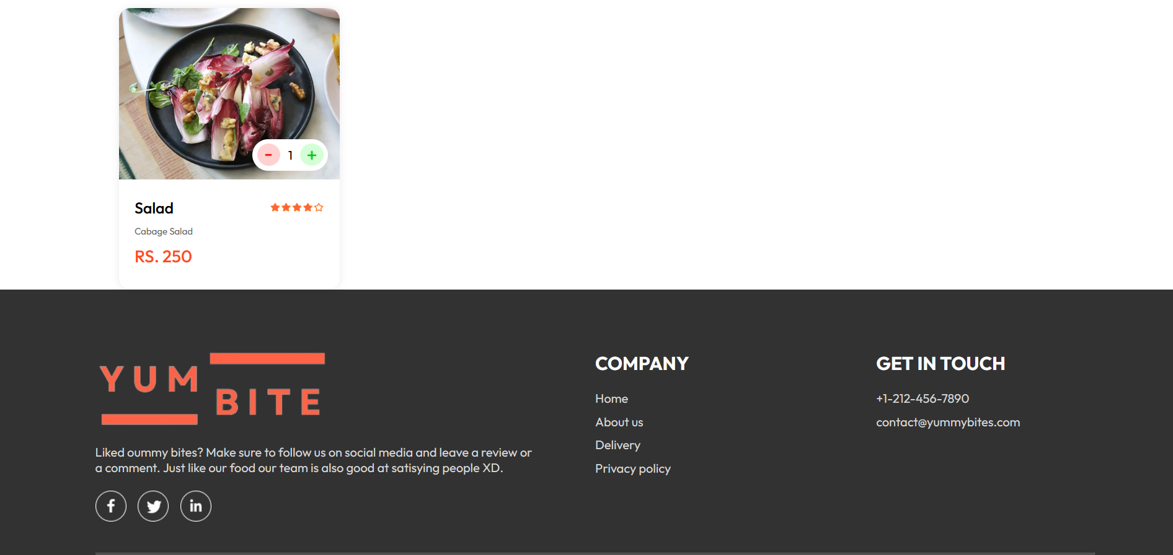
Project Highlights
Home Page (Features):
This part of the homepage features the menu from where you can place orders and also the part that gives us more details about the brand.

Slide 8
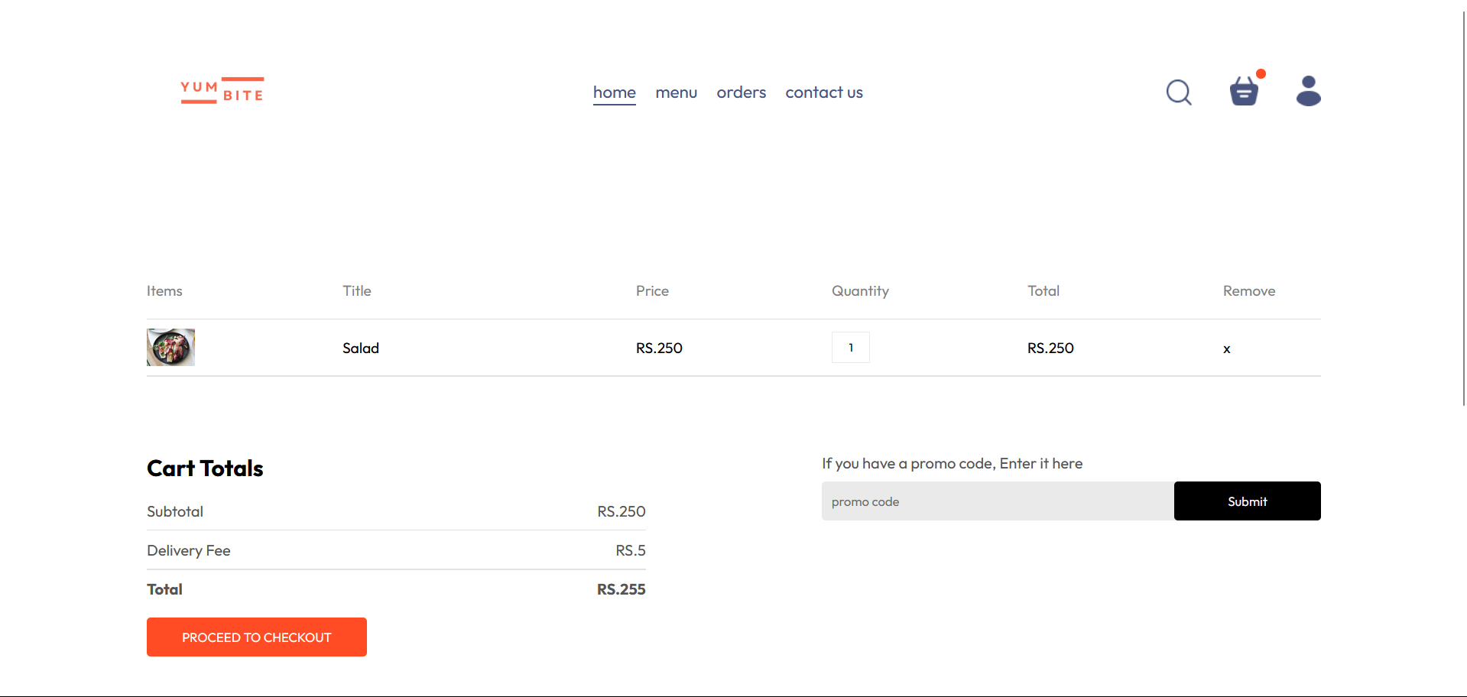
Project Highlights
Checkout Page:
This page contains all the information about the order including its price and delivery fee. You can also apply the promo code for added discounts.

Slide 9
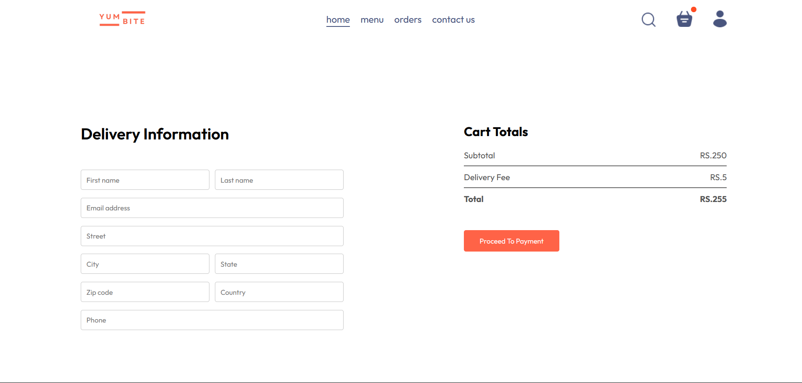
Project Highlights
Payment Page:
This page where you can finalize the order, add delivery information and then proceed to payment.

Slide 10
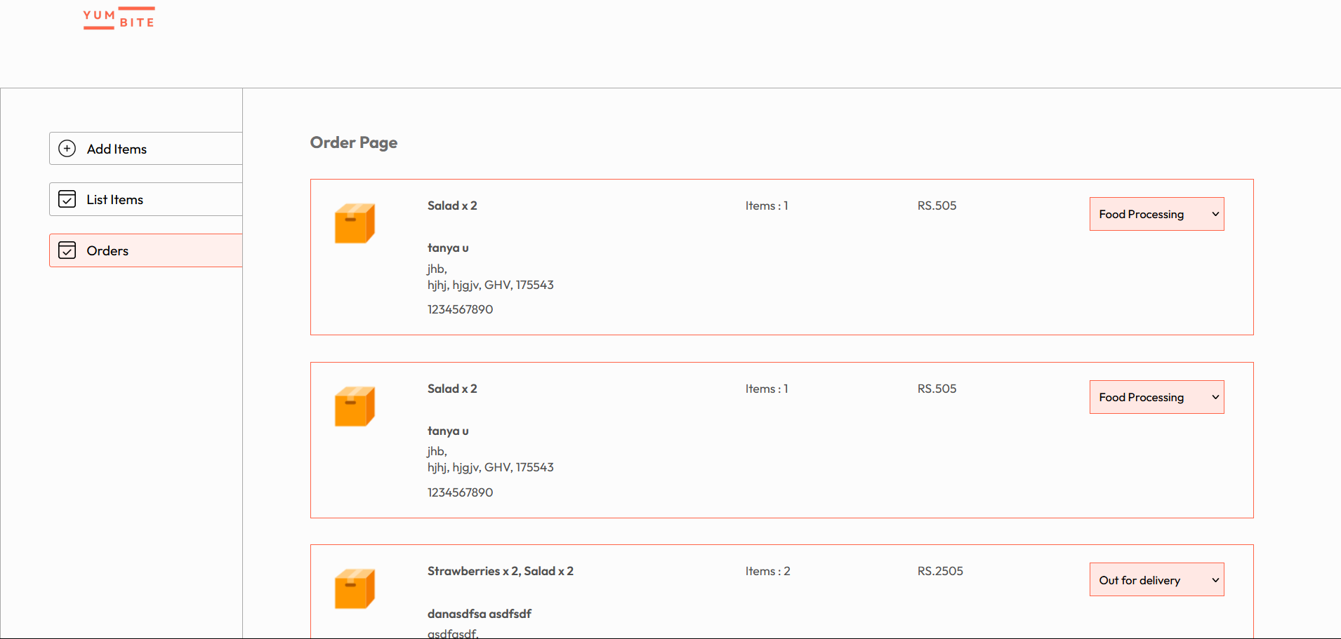
Project Highlights
Admin Panel:
This is the admin panel. From here you can add items to menu. View/remove present items and accept or decline orders.

Slide 11
Conclusion
Overall we have managed to create a powerful web based system that enables a user to order food in a organized manner. It also features an admin panel that enables the admin/manager to add, view and manage other orders. Quick speed and efficient code makes sure that that the order is accepted and processed in least amount of time as possible. Since it is also linked with MongoDB it will make sure that everyone gets more personalized experience.

Slide 12
Host Link
https://yummybites-project.vercel.app/

Slide 13
References
W3 Schools - https://www.w3schools.com/
MDN Web Docs - https://developer.mozilla.org/en-US/
Tutorials Point - https://www.tutorialspoint.com/index.html
Css-tricks - https://css-tricks.com/
Geeksforgeeks - https://www.geeksforgeeks.org/
React – https://react.org/
DevDocs – devdocs.io

Slide 14
Thank You

