Slide 1
DCF255
Lecture 4 | Data Link Layer

Slide 2
Agenda
Data Link Layer Functions
Data Link Layer: Seneca Case Study
Synchronization Problem
Asynchronous and Synchronous Communications
Data Link Layer Programming
Transmission Errors
Error Detection
Error Correction
Notes:
May require more than one slide

Slide 3
Data Link Layer
Functions

Slide 4
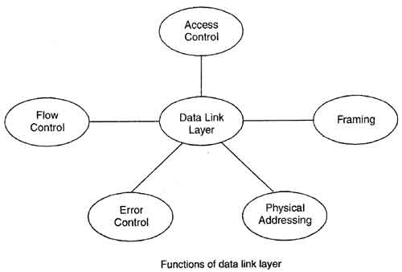
Data Link Layer Functions
Data Framing
Media Access Control (MAC) –not used with switched Ethernet
Physical Addressing.
Flow Control
Error Control
Notes:
Data Framing: The data link layer is responsible for the final encapsulation of higher-level messages into frames so it can be sent across a single switched network by the physical layer and the synchronization of machines at each end of the link.
Media Access Control (MAC): On wireless networks or older non switched Ethernet networks, the DLL is responsible for setting rules to manage devices which share a common medium.
Addressing: Each device on a network has a unique number, usually called a hardware address or MAC address. The data link layer is responsible for adding the source and destination MAC addresses to the frame header to ensure proper delivery.
Flow Control: Some devices are faster processing in others, so the data link layer can control the speed of sending frames to avoid filling the receiving devices buffer capacity and lose frames.
Error Detection and Handling: The data link layer handles errors that occur in transmission using a Frame Check Sequence which allows the receiving host to detect if the data was received correctly.

Slide 5
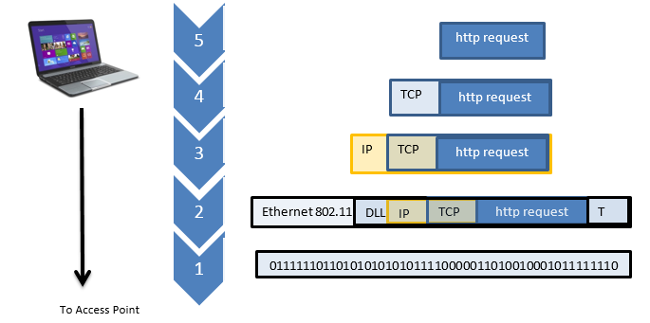
Data Link Layer: A Seneca Case Study
Notes:
Suppose you are in an open lab and want to access a web page on Microsof’s network. You open your browser and type in the URL, www.microsoft.com and press ENTER key.
Your request is formatted into an http request at the application layer by your browser.
The request is then handed down to the Transport layer which encapsulates the request inside a TCP packet. The TCP header contains protocol information, sequence number and destination and source port information.
The packet is passed to the Internet layer which adds the IP address of the host and the destination Microsoft web server. The IP header is encapsulated inside an IP datagram,
which is then passed to the data link layer. The latter adds a header and trailer to the datagram, creating a DLL frame. The header is an Ethernet 802.11n wireless frame format specifying the Media Access Control (MAC) address of the access point. The trailer is a Frame Check Sequence (FCS) to check for any errors in transmission by the Access point. The physical layer then sends the frame to the Access point

Slide 6
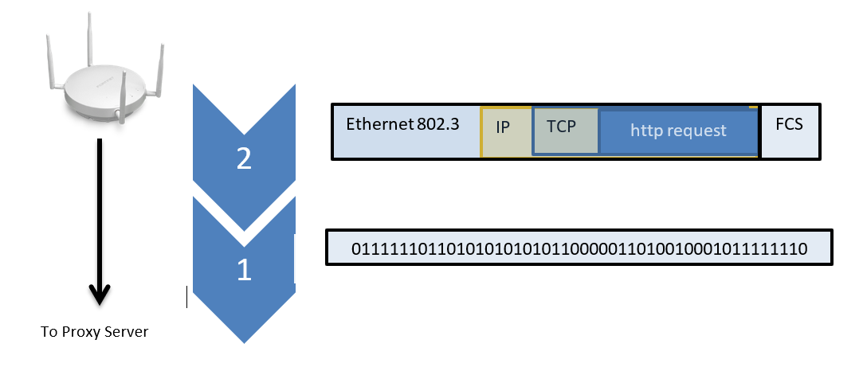
Data Link Layer: A Seneca Case Study
Notes:
At the access point the frame is checked for errors; if there were errors, the transport layer would ask for a retransmission. If no errors, the access point adds a new DLL header and trailer because, in reality, the access point is a bridge connecting to different networks, a wireless Ethernet network to a wired Ethernet network. The new frame conforms to the Ethernet 802.3 frame format, with the MAC address of the Seneca proxy server and then the FCS is recalculated. The physical layer then transmits the binary information to the proxy server which is sent using CAT 6 UTP cable.

Slide 7
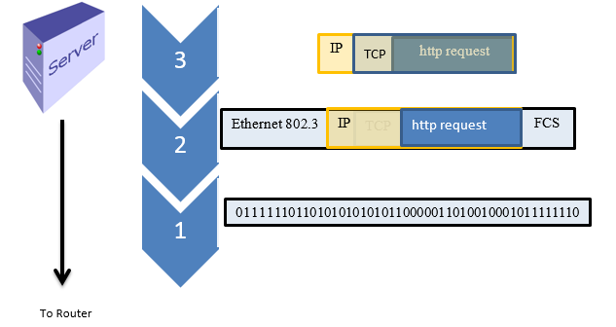
Data Link Layer: A Seneca Case Study
Notes:
The proxy server removes the Ethernet headers and trailers and creates a WAN header and trailer so the frame can travel over the Internet and be passed from router to router. The proxy server converts the private network address 10.0.0.0 to a public address 142.240.0.0 and re-encapsulates the Internet datagram. The datagram is passed to the DLL layer of the server and a new MAC address is added identifying the nearest router.

Slide 8
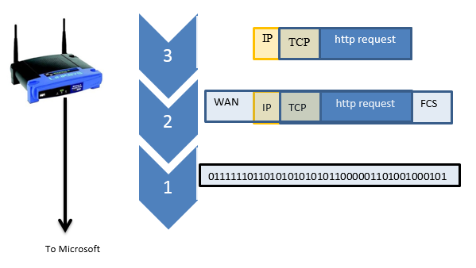
Data Link Layer: A Seneca Case Study
Notes:
At each router the http message is opened up to review the destination IP address. Based on the destination the router will review its routing table to find the best route to relay the message to the next router. The router rips off the Ethernet LAN headers and trailers because the packet is about to transverse the Internet and recreates a WAN header and trailer to conform to the next leg of the packet’s journey.
As the http message is passed from “link”to “link”, each router opens the Internet layer header to review the destination address. The router than makes a forwarding decision as to the best route to travel. If it needs to recreate new headers because the next link uses a different technology, it will replace the headers as necessary. Each routing decision gets the message one step closer to the destination.

Slide 9
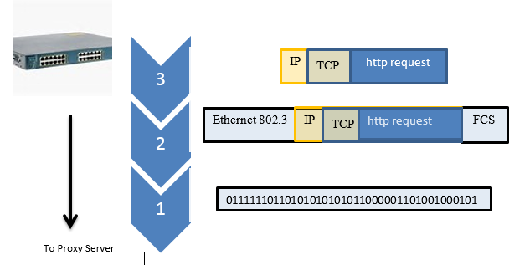
Data Link Layer: A Seneca Case Study
Notes:
When the WAN packet arrives at the Microsoft network, the border router DLL checks the FCS to ensure no errors in transmission. If no errors, the DLL layer rips off the WAN header and trailer. The frame is forwarded to the Internet layer to add the IP address of the proxy server. The datagram is passed back to the Data Link Layer which recreates LAN headers and trailers so the packet can travel on the Microsoft local area network (assume that Microsoft is using Ethernet 802.3 as well) and adds the MAC address of the proxy server to the header. It then recalculates the FCS and the frame is passed to the physical layer.(assume that Microsoft uses Ethernet 802.3).

Slide 10
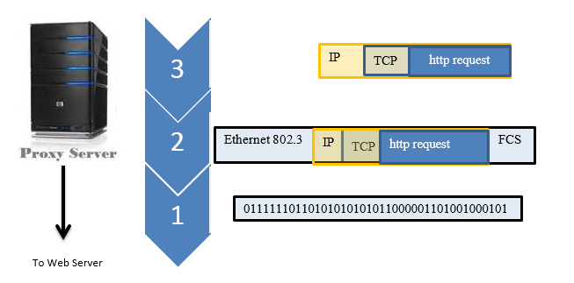
Data Link Layer: A Seneca Case Study
Notes:
The frame is forwarded by switches on the Microsoft network until it arrives at the proxy server. The proxy server acts like a firewall and ensures that only legitimate http requests are forwarded to the web server farm. The proxy server DLL checks the FCS for errors and if no errors, it passes the frame to the Internet layer. This layer reviews the destination IP address and ports, converts the public IP address to the private IP address used by Microsoft and recreates the IP header. The datagram is passed down to the DLL layer which adds the MAC address of the web server farm to the DLL header and recalculates the FCS. The physical layer then encodes the 0s and 1s and forwards the signals onto the wired network.

Slide 11
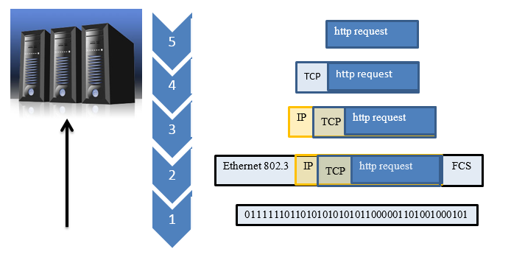
Data Link Layer: A Seneca Case Study
Notes:
The frame now passes through the switches of the Microsoft network until the web server recognizes MAC address and the physical layer then passes the frame to the DLL layer of the web server. The FCS is checked for errors and if no errors the Ethernet headers and trailers are removed and the datagram is passed to the Internet layer. The IP address is checked and then the Internet header is removed and the data is passed to the transport layer. The latter checks the sequence number to ensure that the TCP packet is a valid and checks the TCP checksum to ensure that there were no errors. The header is then removed and the data passed to the application layer which then processes the http request message. The web server then retrieves the requested web page, creates an http response message and the process now repeats as the response is forwarded back to the originating client at Seneca.

Slide 12
Data Link Layer: A Seneca Case Study
The Data Link layer is responsible for framing and creating the LAN/WAN headers and trailers so that the frame can travel across single switched networks..
We think there is a direct connection between sending and receiving host suing the IP address, but this connection is virtual or logical, the message actually moves down 5 layers of the protocol stack, across each physical link, link by link. and up 5 layers of the stack
Two addresses are required because all LAN/WAN technologies use the MAC\hardware or similar address to move across a data link. IP routing, the Internet layer, is built on top of switching to provide a globally unique address.
Notes:
From this case study three points are evident:
The Data Link layer is responsible for framing the datagram so that it can travel over a single network. For example, the data link layer keep removing the LAN or WAN headers and or trailers to ensure the packet could travel on the next leg of it’s journey.
Although we like to think that the message is sent directly from the originating host to the destination host, using the IP address, this connection is virtual; this logical. In reality, data is moved down 5 layers of the TCP/IP stack, across each network “link” by “link” (called a physical link- shown in black ) between two neighbouring devices. Then up 5 layers of the protocol stack at the receiving computer.
Two addresses are required because all of the LAN/WAN technologies use the MAC/hardware address, or similar address, to move across a data link. A data link is the means used to interconnect one location with another in order to send information. Always remember routing is built on top of switching to allow different switched networks to communicate. This is the innovation Bob Kahn and Vint Cert had to connect different switched networks with a globally unique address.

Slide 13
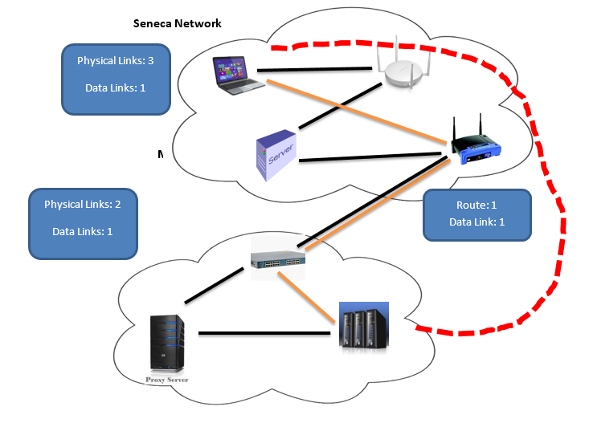
Data Link Layer: A Seneca Case Study
Total 6 physical links (black) Total 3 Data Links (orange) Total 1 Route (red)
Notes:
At the destination network, the data must be forwarded by the Microsoft switched network to the web server. LAN technologies use the 48 bit MAC or hardware address to ensure that the data gets to the right host. One a single network, using private IP addresses it is very possible that the source and destination networks may have a host with the same IP address. The MAC address, on the other hand is unique to each host. In summary, DLL is used at the beginning and at the end of the data’s journey.
Seneca Network:
Laptop to access point = 1 Access point to Server = 1 Data Link = 1 Server to border router = 1
Seneca Border Router to Microsoft Border Router = 1 Data Link = 1
Microsoft Network: Route = 1
Border Router to Proxy Server = 1 Data Link = 1 Proxy Server to Web Server = 1
Total 6 physical links Total 3 Data Links Total 1 Route

Slide 14
Synchronization Problem

Slide 15

Synchronization Problem
Remote computers have
“propagation delay”
the time for one bit to travel from sending to receiving computer.
Latency
The time to process a bit across a link
Delay caused by congestion
How can we keep remote computers in synch?
Notes:
Computers work on clock cycles. When a computer is sending information internally, from RAM to the console, there is no synchronization problem because all parts of the computer are working in phase with each other. Data is sent on one clock cycle, the binary data is sampled in the middle of the next clock cycle. However, when computers are separated by distance it is difficult for computers to stay in time with each other. For example, to send 1 bit across Canada on a fiber optic cable takes 30 ms. This delay is called “propagation delay” and can’t be eliminated. In addition, each device has to process the data, read it into memory, execute instructions and send it out one of its ports. This process takes a few milliseconds for each device. As the data travels from link to link, this delay can build up, called “latency”, which refers to the delay as the data travels from source to destination. In addition, routers can get congested and develop a backlog of packets which further adds to the latency. If the variance in time is too great when packets are received, jitter can occur. We experience jitter when our TV screen flickers during a show, or when we lost part of a conversation when using VoIP. How to keep remote computers in synch with each other has been a major goal of data communications.
Three methods have been developed to keep remote computers in time - even if they are in different parts of the world.

Slide 16

Three Solutions to Solve Synchronization Problem
Run a separate clocking wire to join all the computers and synchronize them.
Expensive and impractical when there are great distances
Use a “self-clocking” encoding system like Manchester forcing the sending and receiving computer to reset its clock 2 times for every bit.
Impractical with speeds above 10 Mbps
NRZI more efficient when 1 followed by a 0 2 bits are sent per clock cycle
Send data asynchronously so that timing is less of an issue. Used internally in PC
Notes:
1. The best and most expensive way to keep computers in synch is to run a separate clocking wire to between them. If the sender and receiver are both working in time to the same clock source, then transmission can take place forever with the assurance that signal sampling at the receiver will always be in perfect synchronization with the transmitter. Some MAN (Metropolitan Area Network) such as SONET or FDDI work this way, but a separate clocking wire is impractical when the source and destination are separated by great distances.
2 The second method is to develop an encoding system which is “self-clocking”. If the receiving computer can sample the signal in phase with the sending computer they will always be in synch. Manchester encoding does this by forcing the receiving computer to reset its clock two times per bit. For example, a transition from low to high indicates a one and a transition from high to low indicates a zero. This ensures synchronization, but is inefficient and can’t be used for Gigabit Ethernet. NRZI is more efficient because at change in voltage at the beginning of a clock cycle is a one and no change is a zero. When a one is following by a zero, 2 bits are being sent per clock cycle. However, long strings of zeros, when the voltage is kept constant, can cause jitter.
3 The third method is to transmit data asynchronously so that timing is less of an issue. This is the most common method used internally for a PC.

Slide 17
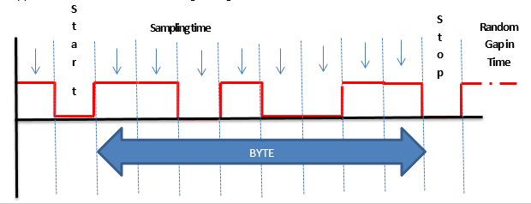
Asynchronous Transmission
Drop in voltage indicates the start bit of a transmission.
Followed by 8 bits of data. With only 8 bits being sent. Jitter is minimized
A stop bit signals the end of the transmission
Sending computer waits a random gap in time and then repeats process
Problem: Sending 2 bits for every 8 bits is 25% overhead which does not provide enough throughput for large applications, like databases
Notes:
The sending computer starts a transmission by a drop in signal level. This indicates the “start bit” and the beginning of a transmission. After the start bit comes 8 bits of data followed by a “stop bit”. The sending computer waits a random amount of time and the process repeats. The receiver tries to sample the signal in the middle of each bit time and with only 8 bits being sent jitter is minimized. Tests have shown that the sender and receiver can be out of synch by as much as 5% and the bit will still be interpreted correctly. The problem with this approach is that for every 8 bits sent you have 2 bits or 25% of overhead. Also, sending one byte at a time does not provide enough throughout for processor intensive applications like databases.

Slide 18

Synchronous Transmission
Large block of data – Ethernet 1500 bytes. -- No shown is 7 byes of zeros and ones which is used to synchronize the devices before the start flag
Followed by a start of transmission flag of 01111110 (126 or 0x 7E) . The same flag is used for end of transmission
The address field is the MAC address of the sending and receiving hosts
The control field is one or more bytes and contains information about the frame
The Payload is the data carried and is much bigger than shown here
The CRC is a 2 byte field that shows if any errors occurred in transmission
Notes:
The better approach is to create a synchronous transmission which is a large data block (for Ethernet the block is 1500 bytes – Payload is much larger than indicated in the diagram).
To keep the computers in synch a periodic pulse of voltage is sent on a separate wire called a “Clock” or “Strobe” which tells the receiver "the current data bit is 'valid' at this moment in time". Synchronous transmission is used internally by your PC for parallel communication. For example, when the computer retrieves a system address or read/write data using the control bus.
The address field holds the MAC address of the sending and receiving devices. The Control field is one or more bytes and contains information about the type of frame. For example, if the frame is user data or supervisory information needed by the data link devices. The Payload of the frame is the data field sent from the higher layer and is completely transparent to the DLL. The CRC refers to the “Cyclical Redundancy Check” which is a two byte field. The value of these bytes is the result of polynomial arithmetic based on every bit of data between the flags. When the frame is received, the calculation is repeated and compared with the sending computer’s CRC value. If the values match then the receiving computer knows that there were no errors in transmission. Otherwise the frame is discarded. CRC is effective in detecting 99.9% of all network errors and has less than 1% of overhead making it very efficient. Finally, a flag of “01111110” (value 126 in decimal or 7E in hexadecimal) is added as delimiters of the frame.

Slide 19
Summary Table
Notes:
When constructing frames, the DLL layer can create an Asynchronous or Synchronous frame. Today, almost all communication is synchronous. However, if the line noise is high, the DLL layer will default to asynchronous to ensure proper transmission. There is also a WAN technology called Asynchronous Transfer Mode (ATM) which uses asynchronous transmissions( the frame size is based on 53 bytes). ATM networks are the core technology of the public switched telephone network (PSTN), DSL, multiplexing where fast, low latency ideal for content such as voice and video. ATM networks, however, have been in decline which the growth of IP based technologies and increasing speeds of Ethernet.

Slide 20
Data Link Layer Programming
Synchronous transmissions are the norm for the data link layer
Start and Ending flag of decimal value 126 or 7E in hexadecimal “01111110”
The flags are essential to synchronous transmissions telling the receving computer when a transmission starts and ends.
What happens if this value of 7E appears in the payload or address portion of the transmission? The receiving computer could mistakenly interpret the value as the ending flag.
To avoid this probability (57%) DLL has a built in subroutine called “bit stuffing”
Notes:
Synchronous transmissions are the norm of network traffic. Each synchronous transmission has a flag of 126 in decimal or 7E in hexadecimal at the beginning and at the end of the frame. The flags are essential because they tell the receiving computer when a transmission starts and ends. The problem is if this value appears in anywhere else in the frame, the receiving computer could mistakenly interpret the value as the end of the frame – studies have shown that this can happen 57% of the time. To avoid this program, the DLL layer has a build in programming routine called “bit stuffing”.
The routine is relatively simple, but highly effective. Before the DLL adds, the flags, it scans the data stream. If it detects five consecutive “1s”’s , it adds or “stuffs” a “0” into the outgoing data stream. Then the DLL adds the flags. When the frame arrives at the DLL of the receiving host, it deletes the two flags, and scans the data stream for five consecutive “1s”, followed by a “0”; when it finds these combination it “unstuffs” the “0” bit, before sending the data stream to the network layer.

Slide 21
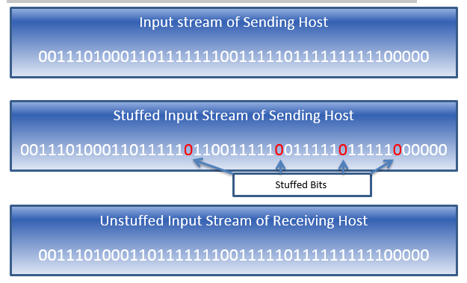
Bit Stuffing
Notes:
The routine is relatively simple, but highly effective. Before the DLL adds, the flags, it scans the data stream. If it detects five consecutive “1s”’s , it adds or “stuffs” a “0” into the outgoing data stream. Then the DLL adds the flags. When the frame arrives at the DLL of the receiving host, it deletes the two flags, and scans the data stream for five consecutive “1s”, followed by a “0”; when it finds these combination it “unstuffs” the “0” bit, before sending the data stream to the network layer.
The bit stuffing routine ensures that the flags are in fact the delimiters of the frame, avoiding any errors in the interpretation of the frame.

Slide 22
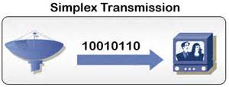
Simplex Half Duplex Full Duplex
One Way Communication only
Two Way Communication, but not at the same time
Two Way Communication, at the same time
Notes:
The outgoing data stream can be sent in one of three ways: simplex, half-duplex and full-duplex. For example, simplex means that the data can only travel in one direction. For example, internally, your keyboard can only send information to the CPU, the keyboard can never receive information from the CPU. Light travels in fiber optic cable in only one direction which makes fiber optic cable simplex. If you had only one wire, you could receive information, only if you stopped sending information. This is an example of half-duplex, you can send and receive, but not at the same time. The best form of communication is full duplex which means you can send and receive at the same. Using fiber optic cable, you need to bundle 2 wires, one for sending and the other for receiving to make the cable full duplex. Coaxial cable can send full duplex communication by dividing the copper core into multiple channels using technology. One channel can send and the other could receive. Ethernet cables are all full duplex.

Slide 23
Transmission Errors
Noise EMI CrossTalk Jitter

Slide 24

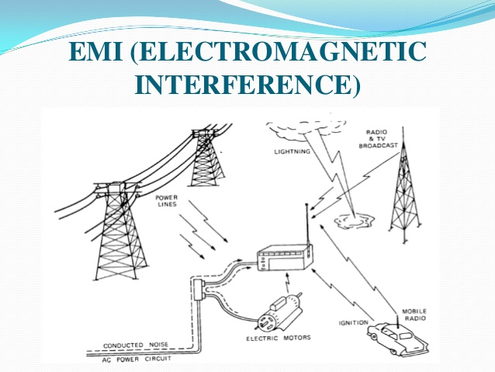
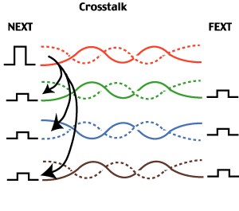
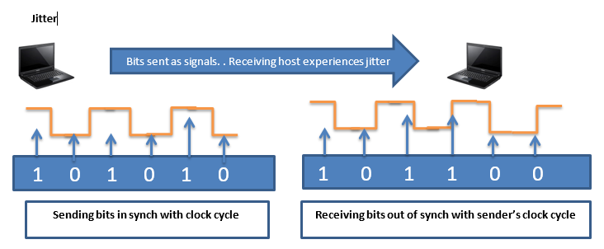
Common Transmission Errors
Notes:
There are four common causes for transmission errors: noise, electromagnetic interference (EMI), crosstalk and jitter. Network noise is generated as electrons move down a cable, and can’t be eliminated in copper cabling. This type of noise is called “thermal noise. It can’t be eliminated which is why EIA/TIA has streak limits to the distance a signal can travel without regeneration. Noise can also be introduced from an external source, such as when lightning strikes, or random increases in line voltage, called “spikes”, are conducted along the cable. EMI causes errors when cabling is located too close to noise sources which generate their own electromagnetic field, such as lights, elevator motors or other heavy machinery. We have experienced EMI when you are listening to the AM radio and you drive under high voltage lines, the music is disrupted with loud “SHSHSH” sound coming from the car speakers. Crosstalk is a special type of electromagnetic interference. Cables with electrons travelling in opposite directions can pull electrons off of one cable, and they travel on the other cable, in the opposite direction. We have all experienced crosstalk on the telephone when you are talking to a friend, but you hear the echo of another conversation in the background. To avoid crosstalk, the wires are twisted so that the electromagnetic fields cancel each other. However, the ends of the cable which are straightened to connect to the RJ-45 connector can result in crosstalk (NEXT – Nearend Crosstalk), FEXT – Farend Crosstalk) if the ends are untwisted more than a ½”. Jitter occurs when two computers “drift” out of synch with each other. This can happen if the receiving computer begins to sample the voltage too near the end of a clock cycle, it can misinterpret the value.

Slide 25
Error Control
Detection and Correction

Slide 26

Error Detection
Parity
Even or Odd (Even most common)
Checksum
CRC – Cyclical Redundancy Check
Based on Polynomial arithmetic
Notes:
The Data Link Layer is the first layer that detects and corrects errors. Errors are a fact of life in network communications. The most common type of error is called “burst errors where multiple bits are lost or miss interpreted by the receiving host.
To detect errors two common procedures are used by the data link layer:
parity check – can be odd or even – even is the most common
Cyclic Redundancy Check (CRC).- used polynomial arithmetic
In both cases the data link layer adds redundant bits so the receiving computer can check for errors.

Slide 27

Parity
Even parity
Count the number of “1”
If count is ODD add a one to make the count even
If 2 bits are flipped the parity bit will not detect the error . This is why there are additional check points at the transport and application layers
Notes:
One extra bit is sent along with the original bits to make the number of 1s either even, in case of even parity, or odd, in case of odd parity. The sender counts the number of 1s and if the number of 1a is odd, the layer adds a bit to keep the parity even, if even parity is used(even parity is more common than odd parity)
The receiver simply counts the number of 1s in a frame if the number matches the parity bit used the frame is accepted. However, if 2 bits are flipped, this error will not be detected by parity because the parity bit is correct, but the message is lost. For this reason, there are multiple error checking, at the transport and application layers.

Slide 28
Checksum
This technique is widely used in Internet for checking error.
In this technique, all the bits are considered as integers.
These integers are then summed up.
1’s complement is then taken for the summed up bits.
Sum of Original and 1’s Complement is then checked at the receiver.
If all are 1’s, no error.
If there is any 0, there is error.
Notes:
One extra bit is sent along with the original bits to make the number of 1s either even, in case of even parity, or odd, in case of odd parity. The sender counts the number of 1s and if the number of 1a is odd, the layer adds a bit to keep the parity even, if even parity is used(even parity is more common than odd parity)
The receiver simply counts the number of 1s in a frame if the number matches the parity bit used the frame is accepted. However, if 2 bits are flipped, this error will not be detected by parity because the parity bit is correct, but the message is lost. For this reason, there are multiple error checking, at the transport and application layers.

Slide 29
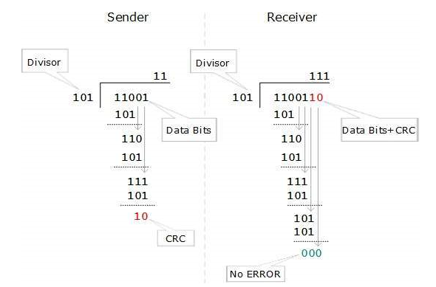
CRC – Cyclical Redundancy Check
Uses Binary Division combined with Polynomials
Sender performs a division on the bits being sent and calculates the remainder
The CRC check bits are added to the end of the data bits
The receiver performs a division operation using the same CRC divisor
The remainder should be “0”
CRC – very fast built into the hardware, overhead is very low and detects 99.99% of all errors
Notes:
CRC uses binary division combined with polynomial arithmetic to detect if the received frame contains valid data. The divisor is generated using polynomials. The sender performs a division operation on the bits being sent and calculates the remainder. Before sending the actual bits, the sender adds the remainder at the end of the actual bits.
The receiver performs a division operation using the same CRC divisor. If the remainder contains all zeros the data bits are accepted, otherwise it is considered as there some data corruption occurred in transit.
CRC is very fast because it is built into the hardware. Using 16 bits for error detection on a 1500 byte transmission is less than 1% overhead and stops 99.99% of all errors.

Slide 30
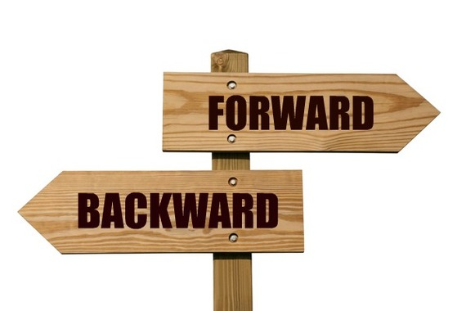
Error Correction
Backward Correction
Send a message to the sender to retransmit the corrupted data
Forward Correction
Includes parity bits and redundant bits so the receiver can not only detect the error but fix the error “on the fly”
Notes:
In the digital world, error correction can be done in two ways:
Backward Error Correction: When the receiver detects an error in the data received, it sends a requests back to the sender to retransmit the data unit.
Forward Error Correction: When the receiver detects some error in the data received, it executes error-correcting code, which helps it to auto-recover and to correct some kinds of errors.
Backward Error Correction is simple and can only be efficiently used where retransmitting is not expensive. For example, fiber optics uses this approach. But in case of wireless transmission, or real-time streaming retransmitting is not practical. (Nobody wants to see a blank screen on the TV while a retransmission is in progress)

Slide 31

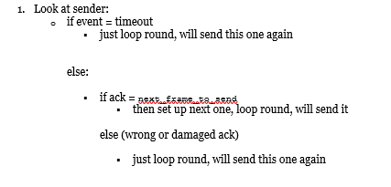
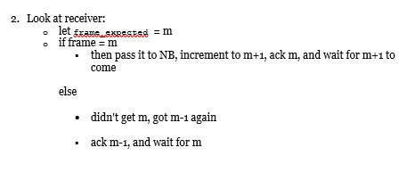
Backward Correction
Data
ACK – next packet expected
Notes:
Backward Error Correction is simple and can only be efficiently used where retransmitting is not expensive. For example, fiber optics uses this approach. But in case of wireless transmission, or real-time streaming retransmitting is not practical. (Nobody wants to see a blank screen on the TV while a retransmission is in progress)
For backward correction is based on the receiver sending an ack with the number of the next expected packet to be received.
The pseudocode of the backward correction protocol shows the following:
Machine A sends to B.
NA = Network layer on A. DA = Data Link layer on A.
NB = Network layer on B. DB = Data Link layer on B.
If error, assume detected via CRC.
For example if the sender sends packets 1,2,3,4 it sets a time, if the time expires before receiving an ACK packet it resends the packets.
If packets 1-4 were received without errors by the receiving host the receiving host would send an ACK packet indicating that it is expecting packet 5. This tells the sender that the transmission of packets 1-4 was successfully received. And it then transmits packets 6,7,8,9
If the sender does not receive an ACK or it was damaged then it resends the packets 1-4 again
Receiver sets a timer to receive a response and sends ack packet indicating the next packet to receive. If no ack, sender re-sends.
If the receiving computer received packets 1,2,3,4 and packet 3 had errors. Then the ACK packet would indicate it is expecting to receive packet 3

Slide 32
Forward Correction
Used in real time content VoIP, IPTv where it is not practical to send an ACK packet and wait for a retransmission
Hamming codes are redundant bits added to the data stream combined with parity so that the receive can not only detect errors, but can correct the bad bits on the fly
To learn more about how hamming codes work – click on the button to the right.
YouTube Hamming Codes
Notes:
Forward correction is based on hamming codes and the use of parity bits. A parity bit is added as previously discussed based on the number of 1s in the frame. In addition, redundant bits are added by the data link layer for error correction which in turn have a parity bit. This block of error correction bits with parity are called “Hamming codes” and allow the receiving computer to detect which bits in the data stream have errors and fix them on the fly. For this course, you do not need to learn how hamming codes work. If you are interested there is an excellent explanation at:
https://www.youtube.com/watch?v=JAMLuxdHH8o

Slide 33
Summary
The Data Link layer is responsible for framing data by adding and removing LAN/WAN headers required for the next link. Data is sent link by link across single switched networks. Routing is built on top of switching so that there is a logical connection between the IP address of the sender and receiver hosts
Synchronization is a problem in data transmission. Each computer’s clock cycle must be closely aligned to avoid errors. The best method is to connect all devices with a clocking wire, but this is expensive and impractical if devices are separated by great distance.
Data communications uses asynchronous and synchronous types of transmissions to correct the synchronization problem. Asynchronous communications use a start and stop bit and only transmit 1 byte at a time. While effective, it is too slow for processor intensive applications. Synchronous transmissions are best but require bit stuffing sub routines as well as low noise and reliable networks to be effective
Error detection is done using parity and CRC. Error correction is based on backward correction, such as sending a request to retransmit bad packets and forward correction which uses parity and hamming codes to correct the bad bits at the receiving host.

