Slide 1

California House Price Prediction
A machine-learning study of median house values across 20,640 California districts
Best model: XGBoost | R² = 0.83
Jay Badekar
09/11/2026
Notes:
Introduce the project: predicting California median house value from location and demographic features. Headline result: XGBoost reaches R² of 0.83 on the held-out test set.

Slide 2
The Problem
Can we predict a district’s median house value from where it is and who lives there?
20,640
districts (rows) in the dataset
9
predictor features
Regression task with a continuous target
Inputs: location, housing and demographic features
Goal: find the model with the lowest error on unseen data
6
models compared
Notes:
The task is supervised regression. The dataset has 20,640 rows and 10 columns: 9 predictors plus the target median_house_value. We compared six models.

Slide 3




The Dataset
Location
Housing
longitude, latitude, ocean_proximity (5 categories)
housing_median_age, total_rooms, total_bedrooms
Demographics
Target
population, households, median_income
median_house_value, the price we predict
Notes:
Nine input features fall into three groups: location, housing stock and demographics. ocean_proximity is the only categorical column.

Slide 4
Data Preparation
1
2
3
4
Check
Impute
Encode
Split
207 missing values found in total_bedrooms
Filled with the column mean (about 538)
One-hot encoded ocean_proximity
80/20 split: 16,512 train, 4,128 test
Encoding sits inside a scikit-learn Pipeline, so train and test data get identical treatment (random_state = 42).
Notes:
Only total_bedrooms had missing values (207 of 20,640 rows). Mean imputation was used. ocean_proximity was one-hot encoded inside a ColumnTransformer within a Pipeline. The split is 80/20 with random_state 42.

Slide 5
Exploring House Prices
$179,700
median house value
$206,856
mean value, pulled up by pricey districts
$500,001
maximum, so prices look capped
Notes:
Most districts are within an hour of the ocean or inland; only 5 are on an island. The mean price exceeds the median, which indicates right skew, and the maximum of 500,001 suggests the target is capped. The notebook also explored a price histogram, an income vs price scatter plot and a correlation heatmap.

Slide 6
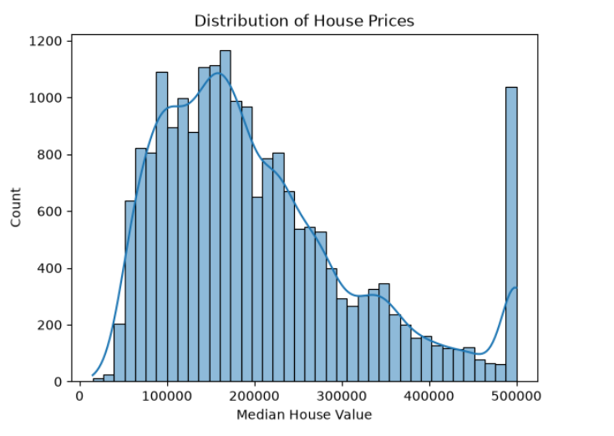
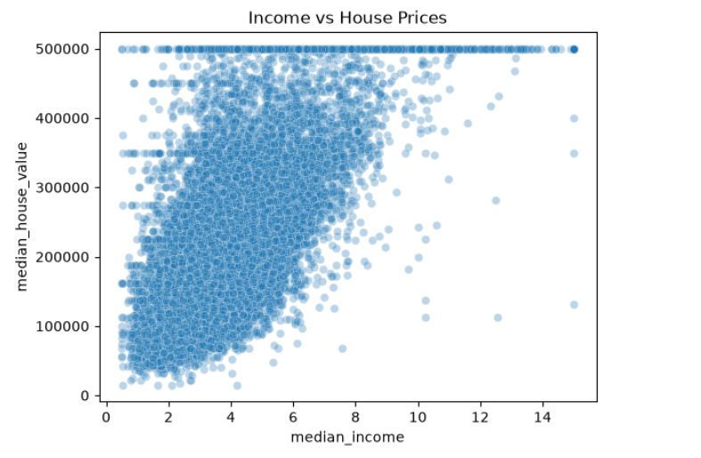
Prices and Income
Right-skewed prices, with a spike at $500,000 where values are capped.
Price rises with income (correlation 0.69). The cap shows as a flat line at $500K.
Notes:
Left: histogram of median_house_value. Prices are right-skewed and there is a pile-up of over 1,000 districts at the 500,000 cap. Right: income vs price. A clear upward trend with a horizontal band at 500,000 where prices were capped.

Slide 7
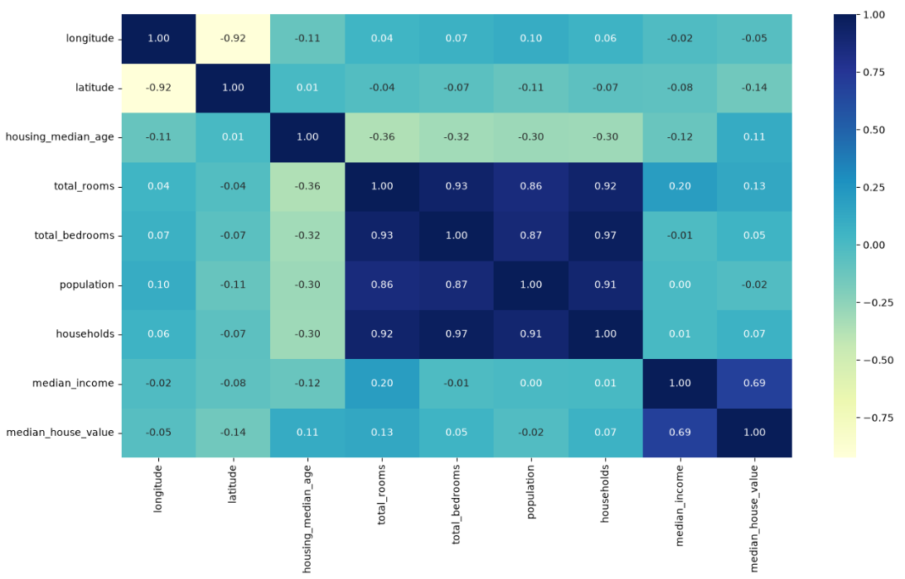
Correlation Heatmap
0.69
median_income vs price, the strongest link
0.97
total_bedrooms vs households: overlapping features
-0.92
longitude vs latitude
Notes:
Median income has by far the strongest correlation with price (0.69). Room, bedroom, population and household counts are highly correlated with each other (0.86 to 0.97), and latitude and longitude are strongly negatively correlated (-0.92).

Slide 8
Six Models Compared
LINEAR
LINEAR
LINEAR
Linear Regression
Ridge
Lasso
Baseline
L2 penalty, alpha = 1
L1 penalty, alpha = 100
TREE
TREE
TREE
Decision Tree
Random Forest
XGBoost
Single tree, default depth
100 trees
300 trees, lr 0.05, depth 6
All models scored on MAE, RMSE and R² using the same 20% hold-out set.
Notes:
Three linear models and three tree-based models. All were evaluated on identical test data using MAE, RMSE and R².

Slide 9
Tree Models Win Clearly
≈ 0.63
R² for linear models and a single tree
0.83
R² for XGBoost, the best model
Regularisation (Ridge, Lasso) gave no gain. Ensembles captured non-linear patterns.
Notes:
Linear, Ridge and Lasso all land near R² 0.63, so regularisation did not help. The single decision tree edges ahead on MAE but is only 0.64 on R². Random Forest (0.817) and XGBoost (0.831) show a big jump.

Slide 10
Best Model: XGBoost
0.831
$31,269
$47,072
R² score
mean absolute error
root mean squared error
vs. linear baseline
MAE down 38%
RMSE down 33%
R² up from 0.63 to 0.83
300 trees, depth 6, lr 0.05
Notes:
XGBoost: MAE about $31.3K, RMSE about $47.1K, R² 0.831. Against the linear baseline, MAE falls 38% (50,702 to 31,269) and RMSE falls 33% (70,031 to 47,072).

Slide 11
What Drives Price?
57%
from the ocean_proximity categories combined
26%
from median_income
7%
from latitude and longitude together
Notes:
The ocean_proximity dummies together account for about 57% of importance (0.492 + 0.029 + 0.019 + 0.018 + 0.014), with INLAND alone near 49%. Median income adds about 26%. Longitude and latitude add about 7%. Location and income dominate price.

Slide 12
Conclusions and Next Steps
Key takeaways
Suggested next steps
XGBoost is best: R² 0.83, MAE about $31K
Location (ocean proximity, lat/long) drives about 64% of importance; income about 26%
Non-linear models beat linear ones by about 0.2 R²
Tune hyperparameters with cross-validation
Engineer ratios such as rooms per household
Handle the capped $500K target and outliers
Try LightGBM or model stacking
Notes:
Close with the three takeaways. The next steps are recommendations beyond the current notebook: they are not yet implemented.

Slide 13
Appendix: Full Metrics
Model | MAE ($) | RMSE ($) | R²
Linear Regression | 50,702 | 70,031 | 0.626
Ridge (alpha 1) | 50,710 | 70,041 | 0.626
Lasso (alpha 100) | 50,738 | 70,102 | 0.625
Decision Tree | 43,438 | 68,834 | 0.638
Random Forest | 31,710 | 49,030 | 0.817
XGBoost | 31,269 | 47,072 | 0.831
Notes:
Full test-set results for all six models.

