Slide 1

Netflix Movie Data Analysis
Genres, ratings, popularity and release trends across 9,827 movies
9,827 movies | 19 genres
Jay Badekar
07/11/2026
Notes:
Introduce the project: an exploratory data analysis of a movie dataset with 9,827 titles, answering five questions about genre, ratings, popularity and release years.

Slide 2
Project Overview
Which genres, ratings and release periods dominate this movie catalogue?
9,827
movies in the raw data
19
distinct genres
Clean and reshape a raw movie dataset
Answer five questions with visuals
Surface patterns in genre, rating, popularity and year
5
questions answered
Notes:
The goal is to explore the catalogue: which genres appear most, how ratings are distributed, which titles are most and least popular, and how release years are spread.

Slide 3
The Dataset
Kept for analysis (6 columns)
Dropped (3 columns)
Release_Date
release date, reduced to the year
Overview
Original_Language
Poster_Url
Title
movie name
Popularity
popularity score
Vote_Count
number of votes received
Little value for the questions asked here.
Vote_Average
average rating, later grouped
Genre
comma-separated genre list
Notes:
The raw file has nine columns. Six are kept. Overview, Original_Language and Poster_Url were dropped because they add little to the five questions.

Slide 4




What Exploration Showed
Tidy data
Popularity outliers
No missing values and no duplicate rows
Median 21.2, mean 40.3, max 5,084
Ratings too granular
Packed genres
Vote_Average runs 0 to 10; needs grouping
Several genres in one cell; needs splitting
Notes:
df.info, df.duplicated and df.describe showed a tidy dataset. Popularity has a long right tail (mean 40.3 vs median 21.2, max 5,083.95). Vote_Average needs to be grouped and Genre needs splitting.

Slide 5
Data Preprocessing
1
2
3
4
Dates
Drop
Group
Explode
Release_Date converted to the year only
Removed 3 columns that add little value
Ratings split into 4 classes; 100 movies outside the bins dropped
Genres split so each row holds one genre
Result: 25,552 rows x 6 columns, 19 genre categories, no missing values.
Notes:
Steps: convert Release_Date to datetime then keep the year; drop three columns; cut Vote_Average into four classes with quartile edges; the 100 rows that fell outside the bins (the minimum rating of 0 is excluded by pd.cut) became NaN and were dropped, leaving 9,727 movies; then split Genre into a list and explode so each row has one genre, giving 25,552 rows.

Slide 6
Grouping the Ratings
9,727
movies left after dropping 100 that fell outside the bins
~25% each
cutoffs are quartiles, so classes are near-equal by design
Notes:
Vote_Average was cut using its min, 25%, 50%, 75% and max as edges (5.9, 6.5 and 7.1 are the inner cutoffs). Because the edges are quartiles, each class holds about a quarter of the movies. That is by construction, not a finding.

Slide 7
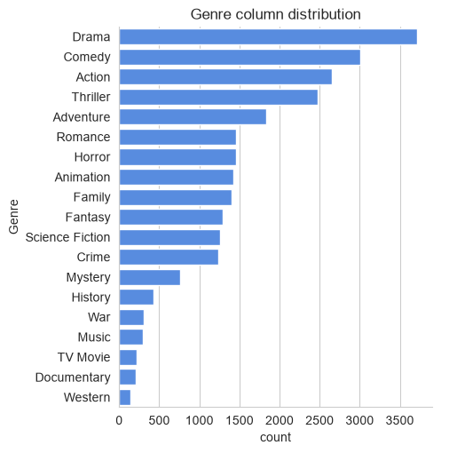
Q1: Top Genre
Drama: 3,715
genre entries, the most of any genre
14.5%
Drama's share of all 25,552 genre entries across 19 genres
Comedy, Action and Thriller follow. Western, Documentary and TV Movie are the rarest.
Notes:
Drama is the most frequent genre with 3,715 entries, over 14% of the 25,552 genre rows. Counts are genre tags, so a movie with three genres is counted three times.

Slide 8
Q2: Rating Classes
25.5%
of rows are in the Popular class (6,520)
Drama
leads the Popular class at over 18.5%, per the notebook
Classes are close in size because the cutoffs are quartiles.
Notes:
After the genre split, Average is the largest class (6,613 rows) and Popular is second (6,520 rows, 25.5%). The notebook conclusion adds that Drama has the largest share of the Popular class, over 18.5%. The classes are similar in size because quartile cutoffs were used.

Slide 9
Q3: Most Popular Movie
Spider-Man: No Way Home
~240x
2021
the median popularity score of 21.2
5,083.95
8,940
votes received
popularity score, the highest in the dataset
Popular
Action
Adventure
Science Fiction
rating class (top quartile)
Notes:
Spider-Man: No Way Home has the maximum popularity of 5,083.954, about 240 times the dataset median of 21.2. Genres: Action, Adventure, Science Fiction. 8,940 votes, rating class Popular.

Slide 10
Q4: Least Popular Movies
The United States vs. Billie Holiday
Threads
2021 | Music, Drama, History
1984 | War, Drama, Science Fiction
13.354
13.354
popularity score, the dataset minimum
popularity score, the dataset minimum
152 votes | Average rating class
186 votes | Popular rating class
Both share the lowest popularity score, yet Threads still falls in the Popular rating class: popularity and rating measure different things.
Notes:
Two movies tie at the minimum popularity of 13.354. Threads (1984) is nonetheless in the Popular rating class, which shows that popularity and rating are different signals.

Slide 11
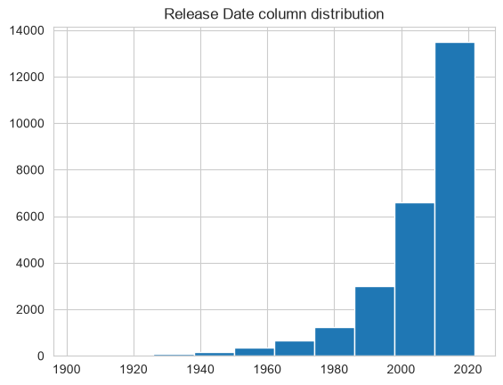
Q5: Release Years
~13,500
rows in the newest bin (about 2010 to 2022)
Before 1960
very few releases per bin
The notebook names 2020 as the peak year and 1930 as the lowest. Counts are genre-split rows.
Notes:
The histogram shows releases rising steeply after 2000, with the newest bin (roughly 2010 to 2022) holding about 13,500 rows. The notebook conclusion identifies 2020 as the peak year and 1930 as the lowest. Note the histogram uses 10 wide bins and counts rows after the genre split.

Slide 12
Key Insights
Question | Answer
Q1 Most frequent genre | Drama: 3,715 entries (14.5%)
Q2 Largest rating class | Average (6,613 rows); Popular is 25.5%
Q3 Most popular movie | Spider-Man: No Way Home (5,084)
Q4 Least popular movies | Billie Holiday film and Threads (13.354)
Q5 Release trend | Sharp rise in recent years; 2020 peak per notebook
Notes:
Summary of the five answers from the analysis.

Slide 13
Limits and Next Steps
Things to keep in mind
Suggested next steps
Genre counts are tags, so multi-genre movies count repeatedly
Rating classes use quartiles, so they are equal by design
Popularity outliers pull averages upward
100 movies were dropped during grouping
Compare popularity and ratings by genre
Track how genre mix changes over the years
Test how vote count relates to popularity
Bring back Original_Language to compare markets
Notes:
The limitations are inherent to how the data was reshaped. The next steps are suggestions beyond the current notebook.

