Slide 1
PHOTOVOLTAIC POWER PREDICTION
Photovoltaic (Solar) Power Prediction on
Large-Scale Spatiotemporal Data
Five Machine Learning Paradigms, One Dataset, One Honest Investigation
[YOUR NAME]
ECE571 Machine Learning
Instructor: [PROFESSOR NAME]
[DATE]
Notes:
WHAT TO SAY: Hi, I'm [your name], and this is my ECE571 project — predicting solar power output using five different machine learning approaches on the same dataset. Rather than five separate assignments, I tried to tell one coherent story about what actually helps when forecasting photovoltaic power, and just as importantly, what doesn't.
IMPORTANT POINT: Frame this immediately as ONE investigation, not five disconnected exercises — that's the whole narrative thread for the next 10 minutes.
TRANSITION: Let's start with why this problem matters in the first place.
APPROX TIME: 0:30

Slide 2
MOTIVATION
Why Solar Power Forecasting?
Solar power output is not something you can turn up on demand — it is set entirely by the weather.
Why it matters operationally
Grid operators need to schedule other generation and reserves around expected solar output
Battery storage systems need forecasts to decide when to charge and discharge
Utilities planning a new site with little or no history need some way to estimate output
Output depends on:
Irradiance (GHI / DNI / DHI)
Cloud cover & cloud type
Temperature
Time of day & season
All three are, at their core, the same ML problem: relate weather and irradiance to electrical output — sometimes with plenty of historical data, sometimes with very little.
2
Notes:
WHAT TO SAY: Solar power is different from a fossil-fuel plant because you can't just turn it up when you need more — the sun decides. That creates real problems: grid operators need to know how much power is coming so they can plan other generation, storage systems need forecasts to know when to charge or discharge, and utilities planning a brand-new site often have little or no historical data.
IMPORTANT POINT: This is called 'intermittency' — a generation source you can forecast but not control. That's the reason PV forecasting is its own research area.
TRANSITION: Let's look at the actual dataset I used.
APPROX TIME: 0:45

Slide 3
THE DATA
The Dataset
Davis, CA
Amherst, MA
Huron, SD
Santa Barbara, CA
La Jolla, CA
2011–2016
2018–2020
2011–2016
2011–2016
2011–2016
164.0 kW avg
60.9 kW avg
50.1 kW avg
49.1 kW avg
47.3 kW avg
22
30 min
~24,000
3.5×
columns: irradiance, weather, Cloud Type, Output Power
measurement interval, 10:00–15:00 daily window
rows for each 6-year city (Amherst: 12,056)
Davis's output scale vs. the smallest city
“The dataset is spatiotemporal” — why that matters:
Data varies across both SPACE (5 different cities, different climates and plant sizes) and TIME (30-minute readings across multiple years) — that's exactly what makes cross-city comparison (Problems 2 & 5) and time-based forecasting (Problem 2's sequence model) possible in the first place.
3
Notes:
WHAT TO SAY: This is the dataset — five cities, mostly six years of data at 30-minute intervals, 22 columns covering irradiance, weather, cloud type, and Output Power. The big number on the right — Davis's plant produces roughly three and a half times the average output of the smallest city. That's not a data quality issue, it's just different plant sizes, but it matters enormously later.
IMPORTANT POINT: 'Spatiotemporal' just means the data varies across both space — five different cities — and time — years of 30-minute readings. That combination is exactly what makes cross-city comparison and time-based forecasting possible.
TRANSITION: Now let's look at how I actually structured the experiments around this data.
APPROX TIME: 1:00

Slide 4
METHODOLOGY
Experimental Design — Five ML Paradigms
1
2
3
4
5
Classification
Regression
Dimension Reduction
Semi-Supervised
Transfer Learning
Sky-condition & generation-regime
Output Power — the core task
PCA & autoencoder compression
Learning from partly-labeled data
Davis → Amherst knowledge transfer
Same-city
vs.
Cross-city
(used throughout Problems 2 & 5 — train on one city, test on the same city vs. a different one)
Chronological splitting — used everywhere:
Earliest 80% of a city's timestamps train, latest 20% test — never shuffled. Random shuffling would let a model trained on next Tuesday's readings predict last Monday's, which would make every metric meaningless for real forecasting.
4
Notes:
WHAT TO SAY: I tested five ML paradigms on this dataset, each with its own fair baseline: classification, regression — the core task — dimension reduction, semi-supervised learning, and transfer learning. Two and five specifically compare same-city versus cross-city performance. And every single experiment uses chronological splitting: earliest eighty percent of a city's data trains, most recent twenty percent tests, never shuffled.
IMPORTANT POINT: Why chronological and not random? Because this is time-series data — random shuffling would let the model see the future relative to what it's being tested on, which would make every reported number meaningless.
TRANSITION: Before the results, let me quickly show the preprocessing pipeline that feeds all five problems.
APPROX TIME: 1:00

Slide 5
METHODOLOGY
Preprocessing Pipeline
Raw
Data
→
Missing-Value
Handling
→
Feature
Engineering
→
Categorical
Encoding
→
Scaling
→
Chronological
Split
→
ML
Models
Clear-Sky Index:
GHI ÷ Clearsky GHI — measures how close actual irradiance is to the clear-sky maximum; defines Problem 1's sky-condition label
Cyclical time features:
Hour/month/day-of-year → sine/cosine pairs, so 23:00 and 00:00 are numerically close, not maximally far apart
Categorical encoding:
Cloud Type is one-hot encoded everywhere — it's a category code, not an ordered number
Lag / sequence windows:
Problem 2's forecasting sub-task uses the previous 12 readings (~6 hours) to predict the next one
Every scaler and encoder is fit on training data only, then applied unchanged to test data — never the reverse.
5
Notes:
WHAT TO SAY: All five problems share one preprocessing pipeline: clean the raw data, engineer features like the Clear-Sky Index and cyclical time encodings, one-hot encode Cloud Type, scale everything, split chronologically, then train. A few specific decisions worth mentioning: the Clear-Sky Index — GHI divided by the theoretical clear-sky maximum — is what defines Problem 1's label. Time features use sine and cosine pairs so that, say, 11pm and midnight end up close together numerically instead of far apart. And Problem 2's forecasting sub-task uses the past 12 readings, about six hours, to predict the next one.
IMPORTANT POINT: Every scaler is fit on TRAINING data only, then applied unchanged to test data — this is the core leakage-prevention rule that holds everywhere in the project.
TRANSITION: Let's get into the actual results, starting with classification.
APPROX TIME: 1:00

Slide 6
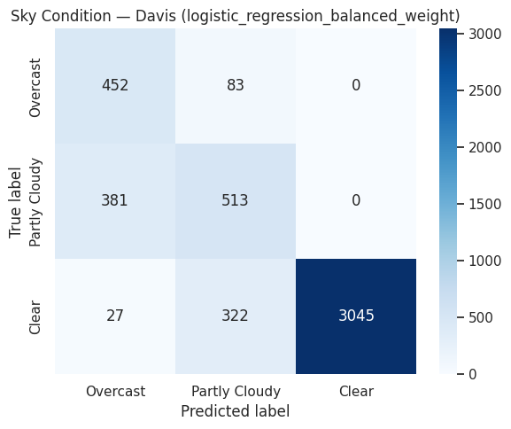
PROBLEM 1
Classification
Predict sky-condition (Clear / Partly Cloudy / Overcast) from weather features — GHI excluded, since it defines the label itself.
0.772
Log. Reg.
Balanced Accuracy — Best Model (Davis)
Best model (balanced weight) — not an ensemble!
Hardest class: Partly Cloudy (F1 = 0.566)
Sits between Clear and Overcast on the Clear-Sky Index scale — confused with both neighbors
Clear conditions were easiest (F1 = 0.946) — also the majority class (72% of data)
Class imbalance is why balanced accuracy, not raw accuracy, is the headline metric
Confusion matrix, best Davis sky-condition model
6
Notes:
WHAT TO SAY: First result: classification. Predict whether the sky is Clear, Partly Cloudy, or Overcast, from weather features. I excluded GHI and related irradiance columns, because the label itself is defined by GHI divided by clear-sky GHI — including them would just leak the answer. The best model, at 0.772 balanced accuracy, was plain logistic regression with class weighting — not a random forest or neural network. Looking at the confusion matrix, Clear is easy, but Partly Cloudy is the hardest class, because it sits on the boundary between the other two.
IMPORTANT POINT: Balanced accuracy averages each class's recall equally, so a model that always guessed 'Clear' — the majority class at 72% of the data — can't fake a good score.
TRANSITION: Now, the core task of the whole project — regression.
APPROX TIME: 1:00

Slide 7
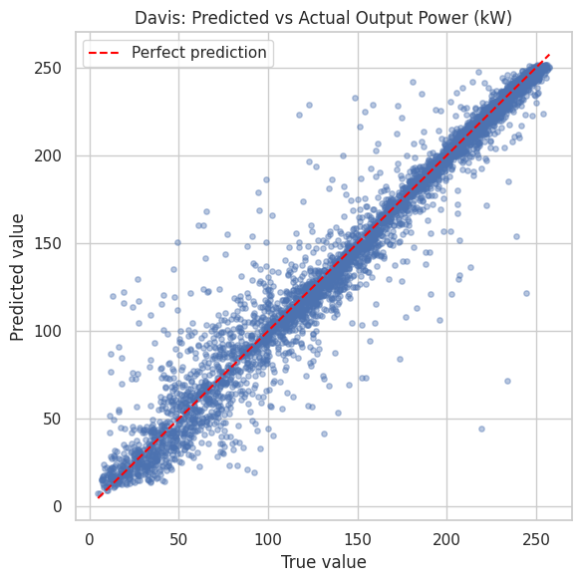
PROBLEM 2 — CORE TASK
Regression
Predict continuous Output Power (kW). Compared same-city (train & test on Davis) vs. cross-city (Davis model applied directly to 3 other cities, no retraining).
15.17
8.31
0.953
RMSE (kW), Davis
MAE (kW), Davis
R², Davis
Best model: Gradient Boosting (Davis, same-city)
Strongest result in the whole project — explains 95.3% of Output Power's variance from weather alone
Cross-city (same model → Huron/Santa Barbara/La Jolla): RMSE ≈ 125 kW — ~8× worse
Why: scale mismatch, not a modeling failure — Davis averages 164 kW, others 47–50 kW. Rescaling by the target city's mean recovers R²=0.55–0.84
Predicted vs. actual Output Power, Davis
7
Notes:
WHAT TO SAY: This is the project's core task — predict actual Output Power in kilowatts. Gradient boosting on Davis's own data was the strongest result in the whole project: fifteen kilowatts of RMSE, an R-squared of point nine five three — it explains ninety-five percent of the variance using just weather. Applying that same Davis model directly to other cities without any adaptation failed badly — RMSE around 125 kilowatts. But that's mostly a scale problem, not a failure to learn weather patterns: rescaling the predictions by the target city's own average recovers R-squared of point five five to point eight four.
IMPORTANT POINT: RMSE penalizes big misses more heavily than MAE does, since it squares errors before averaging — that's why I report both. And nRMSE, normalized by the target's range, is what lets me compare error across cities with very different power scales.
TRANSITION: Next — did compressing the feature space help or hurt?
APPROX TIME: 1:15

Slide 8
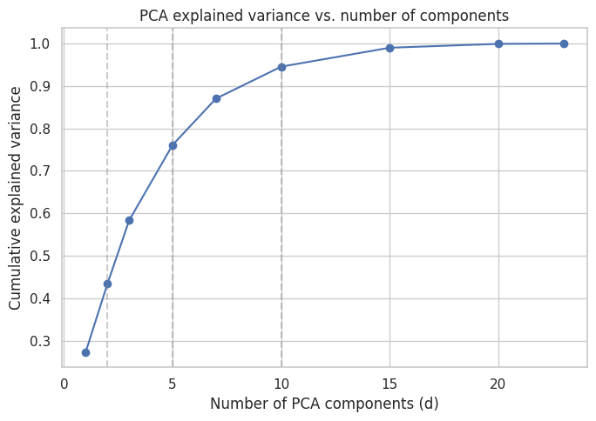
PROBLEM 3
Dimension Reduction
Compress 23 features to d = 2, 5, or 10 with PCA (linear) and an autoencoder (nonlinear) — fit with zero label access — then test whether Problems 1 & 2 still work as well.
Did reducing the feature space help prediction?
No.
Raw features beat every PCA/autoencoder version, at every dimension, on both classification and regression
Raw: 0.743 balanced accuracy vs. best reduced (Autoencoder, d=10): 0.661
Traced to a cause: Cloud Type (highly predictive) compresses poorly into a few continuous dimensions
PCA explained variance by dimension
8
Notes:
WHAT TO SAY: Problem three asks: can I compress this feature space without hurting the tasks that depend on it? I tried PCA — the classical, linear method — and a small autoencoder — the deep, nonlinear method — at three sizes, fit with zero access to any label. The honest answer is no: raw, uncompressed features beat every reduced version, at every dimension, on both downstream tasks. That surprised me going in. I traced part of this to Cloud Type — a feature that turns out to be highly useful but doesn't compress well into a handful of continuous numbers.
IMPORTANT POINT: Explained variance tells you how much of the INPUT features' spread you kept — it says nothing about whether that spread includes the specific information needed to predict a label. That's exactly the gap this result exposes.
TRANSITION: Next — what if you barely have any labels at all?
APPROX TIME: 1:00

Slide 9
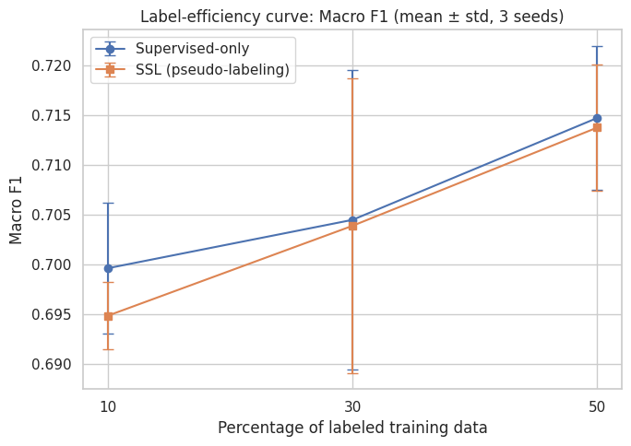
PROBLEM 4
Semi-Supervised Learning
Only 10%, 30%, or 50% of Davis's sky-condition labels are available. Can pseudo-labeling — using the model's own confident predictions on unlabeled data — beat training on the labeled subset alone?
Did unlabeled data help — even at 10% labels? NO.
SSL gain was slightly negative at every fraction tested (10%, 30%, 50%) — an honest, reported finding
Diagnosis: pseudo-labels were 100% accurate (checked after training only) — but 98% of the first round were the easy “Clear” class
Correct, but redundant — reinforced what the model already knew instead of helping with the hard Partly Cloudy / Overcast boundary
Label-efficiency curve: supervised-only vs. SSL
9
Notes:
WHAT TO SAY: For semi-supervised learning, I hid most of Davis's sky-condition labels — down to as few as ten percent — and tested whether pseudo-labeling, where the model labels the unlabeled data itself when confident enough, could beat just training on the small labeled set alone. The honest answer is no, especially interesting at the ten percent case — the gap is slightly negative at every label fraction. I checked why, using the hidden true labels purely as a diagnostic after training was already finished. The pseudo-labels were completely accurate — a hundred percent — but ninety-eight percent of the first batch were all the same, easy 'Clear' class.
IMPORTANT POINT: This means the method wasn't adding WRONG information — it was adding REDUNDANT information. That's a more precise, more useful finding than just 'SSL didn't work.'
TRANSITION: Now, the last paradigm, and the most interesting result in the project — what if a whole different city could help?
APPROX TIME: 1:00

Slide 10
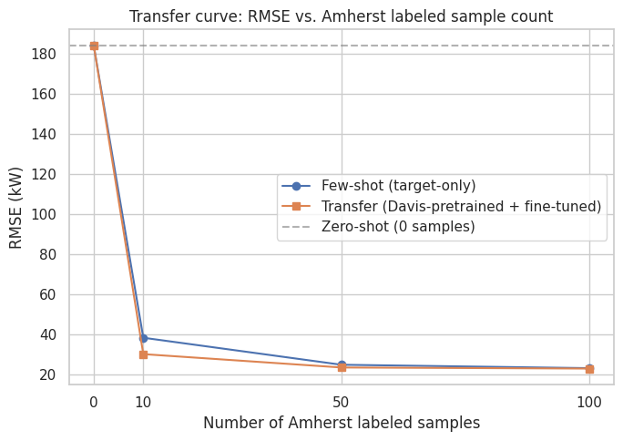
PROBLEM 5 — MOST INTERESTING RESULT
Transfer Learning
Davis
(data-rich)
→
Pretrain
→
Fine-Tune
on k samples
→
Amherst
(data-poor)
+21.4%
30.03
184.17
Transfer gain at k=10 samples
Transfer RMSE (kW), k=10
Zero-shot RMSE (kW)
Transfer (fine-tuned) beat few-shot (fresh model) at every k tested — most at k=10
Negative transfer DID occur — and was fixed
An early version, with too small a fine-tuning learning rate (the assignment's own suggested strategy), scored 140.9 kW at k=10 — WORSE than few-shot's 38.2 kW. Diagnosed: output stuck near Davis's scale. Fixed by matching the pretraining learning rate.
RMSE vs. Amherst labeled sample count
10
Notes:
WHAT TO SAY: The last paradigm, and the most interesting result in the whole project. Can Davis, with six years of data, help Amherst, which only has three? I compared zero-shot — no Amherst training at all — few-shot — a fresh model trained only on a handful of Amherst samples — and transfer — the Davis-pretrained model fine-tuned on that same handful. Zero-shot failed badly, same scale problem as before. Transfer clearly beat training from scratch at every sample count, most at just ten samples — a twenty-one percent improvement.
IMPORTANT POINT — the real story: my very first version of this experiment made things WORSE, not better, because I used too small a learning rate during fine-tuning — actually what the assignment itself suggested. I dug into what the model was predicting, found its output was stuck near Davis's scale, and fixed it by matching the pretraining learning rate instead. One hyperparameter was the entire difference between failure and success.
TRANSITION: Let's zoom out and see all five problems side by side.
APPROX TIME: 1:15

Slide 11
THE WHOLE PROJECT, AT A GLANCE
Overall Results
Problem | Best Method | Main Result | Main Finding
P1 — Classification | Logistic Regression | 0.772 Bal. Acc. (Davis) | A simple linear model beat every ensemble and neural net
P2 — Regression | Gradient Boosting | RMSE 15.17 kW (R²=0.953) | Strongest result in the entire project
P3 — Dimension Reduction | Raw features (no reduction) | 0.743 Bal. Acc. / RMSE 23.86 kW | Compression hurt at every dimension tested
P4 — Semi-Supervised | Pseudo-labeling | Macro F1 ≈ 0.70 (all fractions) | SSL gain ≈ 0 — labels correct, but redundant
P5 — Transfer Learning | Transfer (k=10) | RMSE 30.03 kW (+21.4%) | Transfer clearly helped, most when data was scarce
Metrics are NOT combined into one fake overall score — balanced accuracy and RMSE aren't comparable quantities.
11
Notes:
WHAT TO SAY: This table is the whole project in one place. Two paradigms clearly helped — supervised learning was strong throughout, and transfer learning gave a real boost when Amherst data was scarce. Two did NOT help, and I want to be upfront about that rather than bury it — dimension reduction hurt performance at every size I tried, and semi-supervised learning's gain was essentially zero.
IMPORTANT POINT: I deliberately did not combine these into one overall score — a balanced accuracy number and an RMSE in kilowatts simply aren't the same kind of quantity, so a fake combined ranking would be misleading, not helpful.
TRANSITION: Let's pull out the handful of findings that matter most.
APPROX TIME: 1:00

Slide 12
PULLING IT TOGETHER
Most Important Findings
1
Same-city prediction was far easier than cross-city prediction
15–20 kW vs. ~125–184 kW RMSE — driven mainly by output-scale mismatch, not a failure to learn weather patterns
2
A simple linear model beat every ensemble and neural net
Logistic regression won Problem 1's classification task at 0.772 balanced accuracy — added complexity didn't help here
3
Semi-supervised learning did NOT help, even at 10% labels
Pseudo-labels were 100% accurate but redundant — reinforced the easy class instead of the hard one
4
Transfer learning clearly helped — but only after fixing a real bug
A learning-rate issue caused negative transfer during development; fixing it turned failure into a +21.4% win
12
Notes:
WHAT TO SAY: Four findings I'd want you to remember. First, same-city prediction was far easier than cross-city — mostly a scale problem, not a weather-learning problem. Second, a simple linear model beat every more complex model on classification — a genuinely useful, somewhat counterintuitive result. Third, semi-supervised learning didn't help even with just ten percent labels — the pseudo-labels were accurate but redundant. And fourth, transfer learning clearly helped, but only after I found and fixed a real negative-transfer bug during development.
IMPORTANT POINT: Notice these are genuinely mixed — two positive, two negative. That honesty is intentional; I didn't force every technique to look good.
TRANSITION: Let's talk about what this project doesn't cover.
APPROX TIME: 0:45

Slide 13
SCOPE
Limitations & Future Work
Limitations
Future Work (not yet completed)
Mid-day-only data (10:00–15:00) — no nighttime behavior covered
Only 5 cities, and only one transfer-learning source/target pair tested
City-specific PV plant scale is a recurring complication, not a solved problem
Amherst has only 3 years of data vs. 6 for the other cities
Deliberately small hyperparameter searches (3–5 options) throughout
No GPU during development — all models trained on CPU
Additional cities for transfer learning (Huron, Santa Barbara, La Jolla — currently zero-shot only)
A larger hyperparameter search now that working baselines exist
Longer forecasting horizons and real weather-forecast inputs, not just historical readings
More sophisticated temporal models for the sequence-forecasting sub-task
Better domain adaptation for cross-city scale differences
Uncertainty estimation alongside point predictions
13
Notes:
WHAT TO SAY: Quick, honest limitations: every reading falls in a ten-to-three daytime window, so nothing here describes nighttime behavior. Only five cities, and only one source-target pair tested for transfer learning. Plant-scale differences kept showing up as something I had to work around, not fully solve. And I kept hyperparameter searches small throughout, on purpose.
IMPORTANT POINT: The future-work items on the right are explicitly things I have NOT done — a larger search, more cities, longer horizons, real forecast inputs, better domain adaptation, uncertainty estimation. I want to be clear these are proposals, not completed work.
TRANSITION: Let's wrap up.
APPROX TIME: 0:45

Slide 14
CONCLUSION
“Machine learning can predict PV output effectively within a city, but cross-city domain shift remains a major challenge — one that fine-tuning can address, but naive transfer cannot.”
Strongest result:
Davis same-city regression — RMSE = 15.17 kW, R² = 0.953
Most interesting finding:
The Problem 5 learning-rate story — one hyperparameter separated failure from a +21.4% win
Biggest limitation:
Deliberately small hyperparameter searches throughout — never confirmed against a larger search
Whether an advanced ML technique helps has to be tested directly, not assumed — and that's the real finding of this project.
14
Notes:
WHAT TO SAY: So — machine learning predicts PV output very effectively within a city, but cross-city domain shift remains a major challenge — one that fine-tuning can address, but naive transfer cannot. My strongest result was Davis same-city regression, RMSE of fifteen point one seven kilowatts, R-squared of point nine five three. The most interesting finding was that single learning-rate story in Problem five. And the biggest limitation is that I kept every hyperparameter search deliberately small, so I can't say for certain there isn't more headroom out there.
IMPORTANT POINT: The real thread connecting all five problems — supervised learning and transfer learning clearly helped, dimension reduction and semi-supervised learning didn't, and understanding WHY in each case mattered as much as the numbers themselves.
TRANSITION: Thanks — happy to take questions.
APPROX TIME: 0:45

