Slide 1
PHOTOVOLTAIC POWER PREDICTION
Photovoltaic Power Prediction on
Large-Scale Spatiotemporal Data
Five Machine Learning Paradigms, One Dataset, One Honest Investigation
ECE571 — Machine Learning Course Project
[Your Name]
Instructor: Prof. Puchovsky
[Presentation Date]
Notes:
Hi everyone, I'm going to walk you through my ECE571 project: predicting solar power output using five different machine learning approaches on the same dataset. Rather than treating this as five separate assignments, I tried to tell one coherent story about what actually helps when you're trying to forecast photovoltaic power — and, just as importantly, what doesn't. Let's start with why this problem matters in the first place.

Slide 2
MOTIVATION
Why PV Forecasting Matters
Solar power output is not something you can turn up on demand — it is set entirely by the weather.
Why it matters operationally
Grid operators need to schedule other generation and reserves around expected solar output
Battery storage systems need forecasts to decide when to charge and discharge
Utilities planning a new site with little or no history need some way to estimate output
Output depends on:
Irradiance (GHI / DNI / DHI)
Cloud cover & cloud type
Temperature
Time of day & season
All three are, at their core, the same ML problem: relate weather and irradiance to electrical output — sometimes with plenty of historical data, sometimes with very little.
2
Notes:
Solar power is different from a fossil-fuel plant because you can't just turn it up when you need more — the sun decides. That intermittency creates real problems: grid operators need to know how much power is coming so they can plan other generation, storage systems need forecasts to know when to charge or discharge, and utilities planning a brand-new site often have little or no historical data to work with. All three of those are fundamentally the same machine learning problem — relate weather to power output — just with different amounts of data available. That's the thread connecting all five parts of this project. Next, let's look at the actual dataset I used.

Slide 3
THE DATA
Dataset & Experimental Challenge
Davis, CA
Amherst, MA
Huron, SD
Santa Barbara, CA
La Jolla, CA
2011–2016
2018–2020
2011–2016
2011–2016
2011–2016
164.0 kW avg
60.9 kW avg
50.1 kW avg
49.1 kW avg
47.3 kW avg
22
30 min
~24,000
3.5×
columns per row: irradiance, weather, Cloud Type, Output Power
measurement interval, 10:00–15:00 daily window
rows for each 6-year city (Amherst: 12,056)
Davis's output scale vs. the smallest city
The central challenge running through this project:
Output Power has a different physical scale in every city, and the data is a time series — so every train/test split in this project is chronological (earliest 80% train, latest 20% test), never randomly shuffled. Shuffling first would let a model trained on next Tuesday predict last Monday.
3
Notes:
This is the dataset: five cities, mostly six years of data at 30-minute intervals, 22 columns covering irradiance, weather, cloud type, and Output Power. The big number on the right — Davis's plant produces roughly three and a half times the average output of the smallest city. That's not a data quality issue, just different plant sizes, but it matters enormously later when I compare or transfer between cities. And because this is time-series data, every experiment splits chronologically — train on the earliest eighty percent, test on the most recent twenty — never a random shuffle, since that would let the model peek into the future. Now, the overall pipeline I built to run all five ML problems consistently.

Slide 4
METHODOLOGY
One Shared Experimental Framework
Raw Excel
Data
→
Cleaning
→
Feature
Engineering
→
Chronological
Split
→
Scaling /
Encoding
→
Model
Training
→
Evaluation
Every scaler and encoder is fit on training data only, then applied unchanged to test data — never the reverse.
This one pipeline feeds five ML paradigms:
1
2
3
4
5
Classification
Regression
Dimension Reduction
Semi-Supervised
Transfer Learning
Sky-condition & generation-regime
Output Power — the core task
PCA & autoencoder compression
Learning from partly-labeled data
Davis → Amherst knowledge transfer
4
Notes:
Rather than build five separate one-off pipelines, I built one shared framework: load the raw Excel data, clean it, engineer features like the clear-sky index and cyclical time encodings, split chronologically, scale and encode — fitting only on training data — then train and evaluate. That one pipeline feeds all five ML paradigms you see at the bottom: classification, regression — the core task — dimension reduction, semi-supervised learning, and transfer learning. Building it this way meant every paradigm was tested under the exact same leakage-prevention rules, so comparisons between them are fair. Let's go through each one, starting with classification.

Slide 5
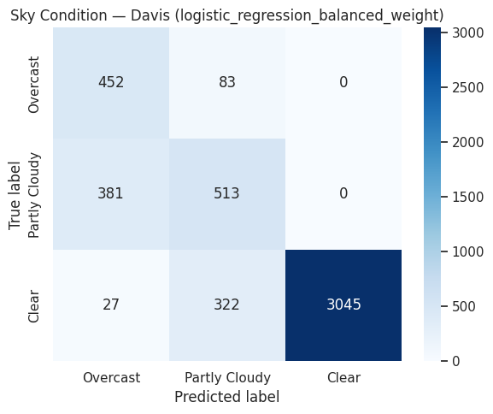
PROBLEM 1
Supervised Classification
Predict sky-condition (Clear / Partly Cloudy / Overcast) from weather features — with GHI and irradiance columns deliberately excluded, since they define the label itself.
0.772
0.720
Balanced Accuracy (Davis)
Macro F1 (Davis)
Best model: Logistic Regression (balanced weight)
Notably not an ensemble or neural network — a well-regularized linear model, since the remaining features relate to sky-condition fairly directly
Clear conditions: F1 = 0.946 (easiest, majority class)
Partly Cloudy: F1 = 0.566 (hardest — sits between both other classes)
Confusion matrix, best Davis sky-condition model
5
Notes:
The first problem is classification: predict whether the sky is Clear, Partly Cloudy, or Overcast, using weather features. Important detail — I deliberately excluded GHI and related irradiance columns, because the label itself is DEFINED by GHI divided by clear-sky GHI, so including them would just be leaking the answer. The best model here, at 0.772 balanced accuracy, was actually plain logistic regression with class weighting — not a random forest or neural network. Looking at the confusion matrix on the right, Clear conditions are easy to identify, but Partly Cloudy is the hardest class, because it sits on the boundary between the other two — it gets confused with both neighbors instead of having one dominant failure mode. That's a pattern that shows up again later. Next, the core task of the project: regression.

Slide 6
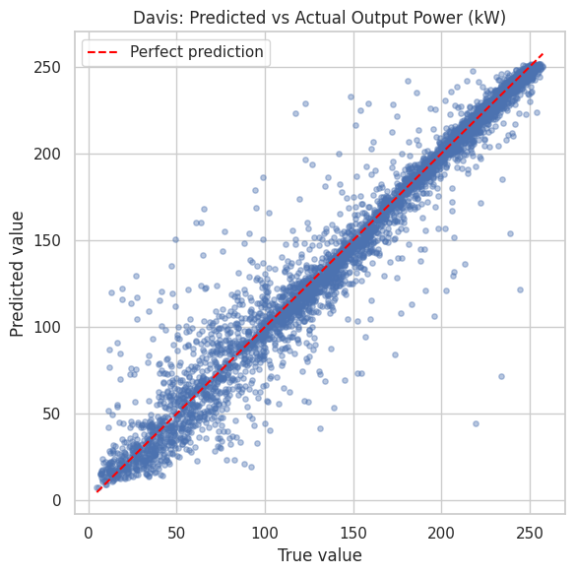
PROBLEM 2 — CORE TASK
Supervised Regression
Predict continuous Output Power (kW) from weather + irradiance features — same-city, cross-city, and as a short-term sequence forecast.
15.17
8.31
0.953
RMSE (kW)
MAE (kW)
R² (Davis)
Best model: Gradient Boosting (Davis, same-city)
Cross-city zero-shot (Davis → Huron/Santa Barbara/La Jolla) failed severely (RMSE ≈ 125 kW) — almost entirely a scale-mismatch problem, not a modeling failure
K=12 sequence GRU (17.58 kW) clearly beat a persistence baseline (21.97 kW) — genuine temporal structure, though a harder task than same-timestep regression
Predicted vs. actual Output Power, Davis
6
Notes:
This is the project's core task: predict actual Output Power in kilowatts. Gradient boosting on Davis's own data was the strongest result in the whole project — fifteen kilowatts of RMSE, an R-squared of point nine five three, meaning it explains ninety-five percent of the variance using just weather and irradiance. You can see that in the scatter plot on the right — points cluster tightly around the perfect-prediction line. Two other things worth mentioning quickly: applying the Davis model directly to other cities without any adaptation failed badly, RMSE around 125 kilowatts — but that's mostly a scale problem I'll come back to in problem five. And a GRU sequence model, predicting the next reading from the previous twelve, clearly beat a naive persistence baseline, so it's learning real temporal structure. Now — did compressing the feature space help or hurt?

Slide 7
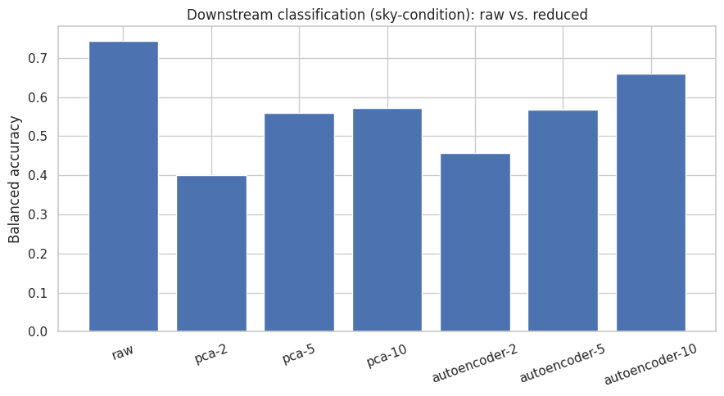
PROBLEM 3
Dimension Reduction
Compress 23 features to d = 2, 5, or 10 dimensions with PCA (linear) and an autoencoder (nonlinear) — fit with zero label access — then test whether Problems 1 & 2 still work as well.
The key question: did compression help or hurt?
Raw features beat every PCA/autoencoder representation, at every tested dimension, on both classification and regression
Raw: 0.743 balanced accuracy vs. best reduced (Autoencoder, d=10): 0.661
Autoencoder consistently beat PCA — it can learn nonlinear compressions PCA cannot
Traced to a cause: Cloud Type (highly predictive) compresses poorly into a few continuous dimensions
Downstream classification accuracy: raw vs. every reduced representation
7
Notes:
Problem three asks: can I compress this feature space without hurting the tasks that depend on it? I tried PCA — the classical, linear method — and a small autoencoder — the deep, nonlinear method — at three latent sizes, fit with zero access to any label. The chart on the left is the honest answer: raw, uncompressed features beat every reduced version, at every dimension, on both tasks. That surprised me going in. The autoencoder did consistently beat PCA, since it can learn curved compressions instead of just straight lines — but neither closed the gap with using everything. I traced part of this to Cloud Type, one of the most useful individual predictors, which doesn't compress well into a handful of continuous numbers. Next: what if you barely have any labels at all?

Slide 8
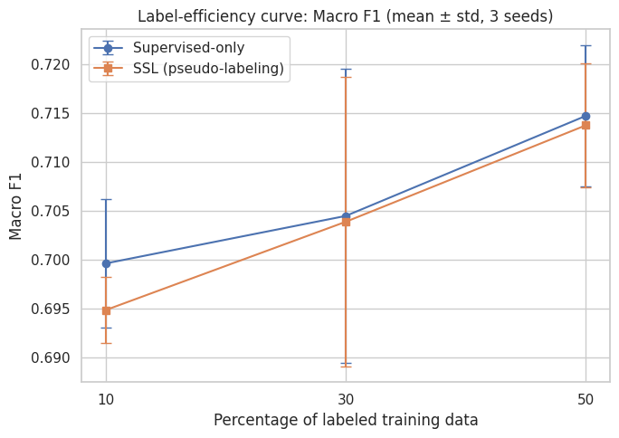
PROBLEM 4
Semi-Supervised Learning
Only 10%, 30%, or 50% of Davis's sky-condition labels are available. Can pseudo-labeling — using the model's own confident predictions on unlabeled data — beat training on the labeled subset alone?
Did SSL beat supervised-only at 10% labels? NO.
SSL gain was slightly negative at every fraction tested (10%, 30%, 50%) — an honest, reported finding
Diagnosis: pseudo-labels were 100% accurate (checked after training only) — but 98% of the first round were the easy “Clear” class
Correct, but redundant — reinforced what the model already knew instead of helping with the hard Partly Cloudy / Overcast boundary
Label-efficiency curve: supervised-only vs. SSL
8
Notes:
For semi-supervised learning, I hid most of Davis's sky-condition labels — down to as few as ten percent — and tested whether pseudo-labeling, where the model labels the unlabeled data itself when confident enough, could beat just training on the small labeled set alone. The honest answer, shown in that curve, is no — the two lines are essentially on top of each other, slightly negative at every label fraction, not just the smallest. I checked WHY, using the hidden true labels purely as a diagnostic after training was already finished. The pseudo-labels were completely accurate, a hundred percent — but ninety-eight percent of the first batch were the same, easy "Clear" class. So the method wasn't adding wrong information, it was adding redundant information. Now, the last paradigm: what if a whole different city could help?

Slide 9
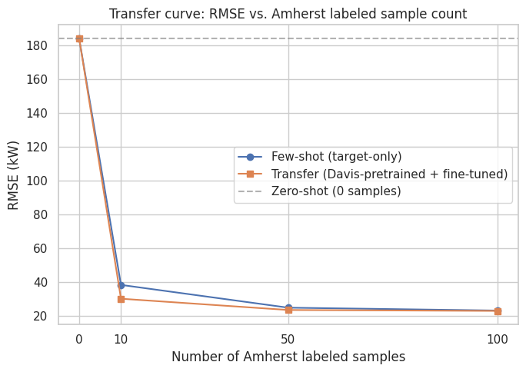
PROBLEM 5
Transfer Learning
Davis
6 years
→
Source
Model
→
Fine-Tune
→
Amherst
3 years
+21.4%
30.03
184.17
Transfer gain at k=10 samples
Transfer RMSE (kW), k=10
Zero-shot RMSE (kW) — no adaptation
Zero-shot (no Amherst training) fails badly — same scale mismatch as Problem 2
Transfer (Davis-pretrained + fine-tuned) beats training from scratch on the same k samples, at every k — most when data is scarcest
An early version, with too-small a fine-tuning learning rate, caused negative transfer (worse than from-scratch) — found and fixed
RMSE vs. Amherst labeled sample count
9
Notes:
The last paradigm: can Davis, with six years of data, help Amherst, which only has three? I tested three approaches on Amherst's held-out test set: zero-shot, the Davis model applied directly with no Amherst training at all; few-shot, a fresh model trained only on a handful of Amherst samples; and transfer, the Davis-pretrained model fine-tuned on that same handful. Zero-shot failed badly, same scale problem as before. But transfer clearly beat training from scratch at every sample count, and the gain was biggest exactly where it matters most — just ten samples, a twenty-one percent improvement in RMSE. I'll be upfront: my first version of this experiment actually made things worse, because I used too small a learning rate during fine-tuning — I'll explain exactly what happened on the next slide, since it's the most interesting finding in the whole project.

Slide 10
THE WHOLE PROJECT, AT A GLANCE
Cross-Problem Results
Problem | Best Method | Best Result | Main Finding
P1 — Classification | Logistic Regression | 0.772 Bal. Acc. (Davis) | A simple linear model beat every ensemble and neural net
P2 — Regression | Gradient Boosting | RMSE 15.17 kW (R²=0.953) | Strongest result in the entire project
P3 — Dimension Reduction | Raw features (no reduction) | 0.743 Bal. Acc. / RMSE 23.86 kW | Compression hurt at every dimension tested
P4 — Semi-Supervised | Pseudo-labeling | Macro F1 ≈ 0.70 (all fractions) | SSL gain ≈ 0 — labels correct, but redundant
P5 — Transfer Learning | Transfer (k=10) | RMSE 30.03 kW (+21.4%) | Transfer clearly helped, most when data was scarce
Two paradigms clearly helped (supervised learning, transfer learning); two produced genuinely negative results (dimension reduction, semi-supervised learning) — all reported honestly.
10
Notes:
This table is the whole project in one place. Two paradigms clearly helped — plain supervised learning was strong throughout, and transfer learning gave a real, meaningful boost when Amherst data was scarce. Two paradigms did NOT help, and I want to be upfront about that rather than bury it — dimension reduction hurt performance at every size I tried, and semi-supervised learning's gain was essentially zero. I think that mix is actually the most honest and most useful outcome a project like this can produce — it tells you which techniques are worth reaching for on this kind of problem, and which aren't, based on real evidence instead of assuming every advanced technique automatically helps. Let's dig into the single most interesting result — one that almost didn't turn out this way.

Slide 11
MOST INTERESTING FINDING
One Learning Rate, Two Opposite Outcomes
The exact same transfer setup — same cities, same 10 Amherst samples — produced either a severe failure or a clear win, depending only on the fine-tuning learning rate.
Too small a fine-tuning learning rate (following the assignment's own suggested strategy) couldn't shift the model's output from Davis's ~164 kW scale to Amherst's ~64 kW scale in time
Matching the pretraining learning rate instead let it adapt — RMSE dropped from 140.9 to 27.2 kW
This is why the final, reported result (30.03 kW, mean of 3 seeds) clearly beats few-shot, not loses to it
11
Notes:
Here's the single most interesting thing I found in this project. My very first version of transfer learning used a smaller learning rate for fine-tuning than for pretraining — actually what the assignment itself suggested as a reasonable strategy. With that setup, transfer learning was WORSE than training from scratch on the same ten samples — 140.9 kilowatts of RMSE versus 38.2. That's negative transfer. Instead of accepting that number, I checked what the model was actually predicting, and found its average output was stuck near Davis's scale — about 164 kilowatts — because the learning rate was too small to shift it down to Amherst's roughly 64 kilowatt scale in time. Matching the fine-tuning learning rate to the pretraining rate instead dropped RMSE to 27.2, and transfer clearly won. That one hyperparameter was the entire difference between failure and success. Now, a real failure I want to walk through the same way.

Slide 12
BEING HONEST ABOUT WHAT DIDN'T WORK
Failure Analysis
Main failure: Dimension reduction hurt every task, at every dimension tested
Even at d=10 (using most of the original information, 94.6% explained variance for PCA), compressed features still lost real predictive power on both classification and regression.
Why?
What did I learn from it?
Cloud Type is categorical and highly predictive, but doesn't compress well into a few continuous dimensions
Verified directly: removing Cloud Type raised explained variance but lowered both reconstruction quality and downstream accuracy
“Unsupervised compression should be harmless” is an assumption, not a guarantee — it has to be tested for each dataset
A secondary failure (Problem 4): SSL's pseudo-labels were 100% accurate but redundant — a different, subtler kind of failure than being simply wrong
12
Notes:
I want to spend a slide specifically on what didn't work, because that's just as important as the successes. The clearest failure is dimension reduction — compressing the feature space hurt performance on both classification and regression, at every size I tried, even when keeping ninety-five percent of the variance. I traced it to Cloud Type specifically: categorical, and one of the most useful individual features I have, but it doesn't survive being squeezed into a handful of continuous numbers. I proved this by removing it from the compression step and watching both reconstruction quality and downstream accuracy get worse, even though explained variance technically went UP. The bigger lesson: "compression is basically free" is an assumption you have to test, not assume. Problem four's SSL result is a different flavor of failure — redundant, not wrong — worth distinguishing. Let's talk about the project's limitations more broadly.

Slide 13
SCOPE
Limitations & Future Work
Limitations
Future Work
5 cities, mostly 6 years — enough to demonstrate methods, not to generalize broadly
Different PV plant scales across cities are a recurring complication, not a solved problem
Deliberately small hyperparameter searches (3-5 options) throughout
No GPU in development — all models trained on CPU (will use CUDA automatically)
No real-time weather forecast input, no live deployment testing
A larger hyperparameter search, now that a working baseline exists for each paradigm
Investigate the Wind Speed domain-shift anomaly flagged in Problem 5
Extend transfer learning to Huron, Santa Barbara, and La Jolla (currently zero-shot only)
Longer forecasting horizons and real weather-forecast inputs, not just historical readings
Uncertainty estimation alongside point predictions
13
Notes:
Quickly, the honest limitations: five cities and mostly six years of data is enough to demonstrate these methods, but not enough to claim they generalize broadly. The different plant scales across cities kept showing up as a complication I had to work around, not something I fully solved. I kept hyperparameter searches deliberately small throughout, and there was no GPU available during development, though the code will use one automatically if run on GPU hardware. For future work, the most natural next steps are a larger hyperparameter search now that I have working baselines, digging into that Wind Speed anomaly I flagged rather than just noting it, and extending the transfer-learning approach to the other data-scarce cities that were only tested zero-shot in problem two. Let's wrap up with the big-picture takeaways.

Slide 14
CONCLUSION
Five Takeaways
1
PV output can be predicted very effectively from weather and irradiance alone
R² = 0.953 for same-city Davis regression
2
Different ML paradigms provide genuinely different, non-interchangeable benefits
Supervised learning, transfer learning, dimension reduction, and SSL all behaved differently
3
Cross-city transfer is possible, but output-scale mismatch has to be handled explicitly
Raw zero-shot transfer failed everywhere it was tried
4
Transfer learning helped substantially; semi-supervised learning did not, here
+21.4% RMSE at k=10 vs. an SSL gain of essentially zero
5
Understanding WHY a technique fails is as valuable as the number itself
Every negative result in this project was traced to a specific, explainable cause
14
Notes:
So, five takeaways. First, PV output can be predicted very effectively from weather and irradiance alone — an R-squared of point nine five three is strong by any standard. Second, the five ML paradigms genuinely behaved differently — there's no single technique that's universally best. Third, cross-city transfer is possible, but only once you handle the output-scale mismatch explicitly — raw zero-shot transfer failed everywhere I tried it. Fourth, transfer learning helped substantially here, while semi-supervised learning essentially didn't — two techniques that sound similar in spirit but produced opposite results. And fifth, maybe the most important lesson: understanding WHY something failed — a learning rate, a categorical feature, a redundant pseudo-label — was at least as valuable as the headline numbers themselves. That's the project. Happy to take questions.

Slide 15
Questions?
Photovoltaic Power Prediction on Large-Scale Spatiotemporal Data
Notes:
Thanks — I'm glad to answer questions about any of the five problems, the dataset, the leakage-prevention setup, or the reproducibility checks I ran.

