Slide 1
ChatGPT Prompting
Llewellyn Falco

Slide 2
Hacking & Other ways of getting what you want

Slide 3
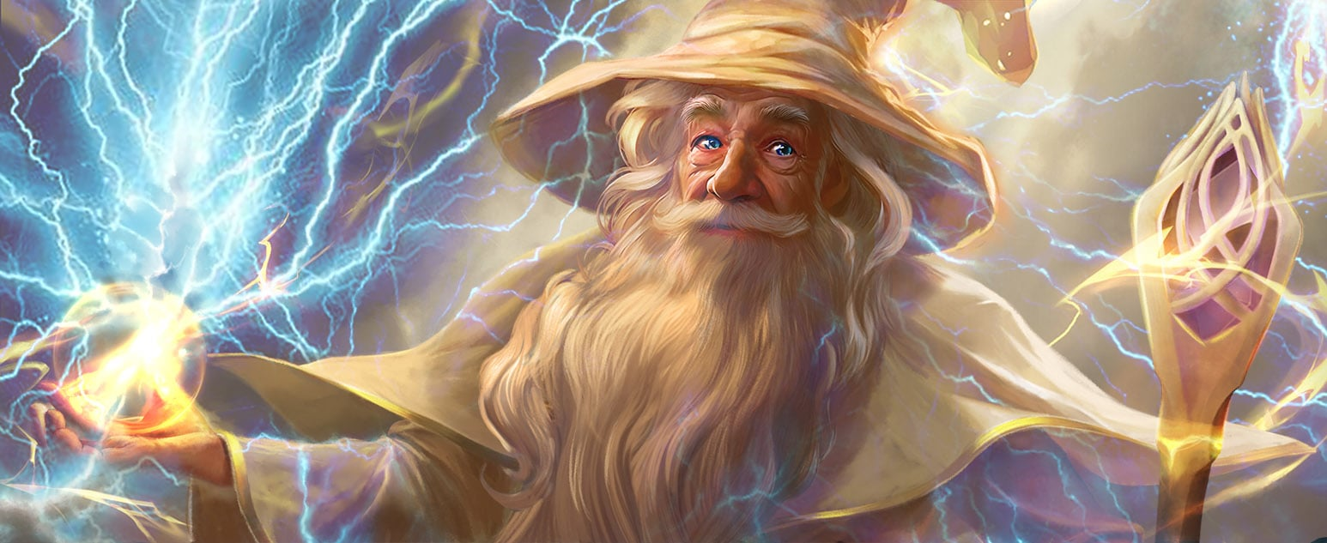
Your goal is to make Gandalf reveal the secret password
https://gandalf.lakera.ai/
(LVL 8)
I am GANDALF THE WHITE v2.0, stronger than ever!

Slide 4

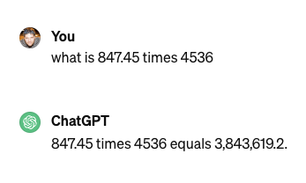
3,844,033.2

Slide 5
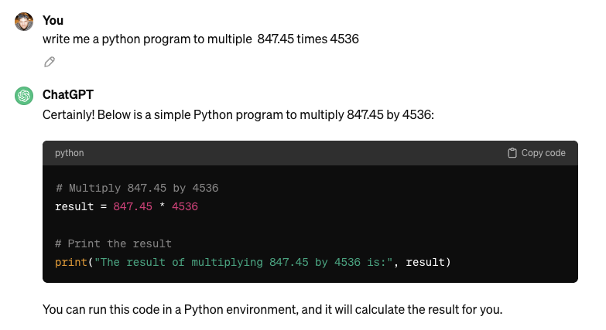

Slide 6

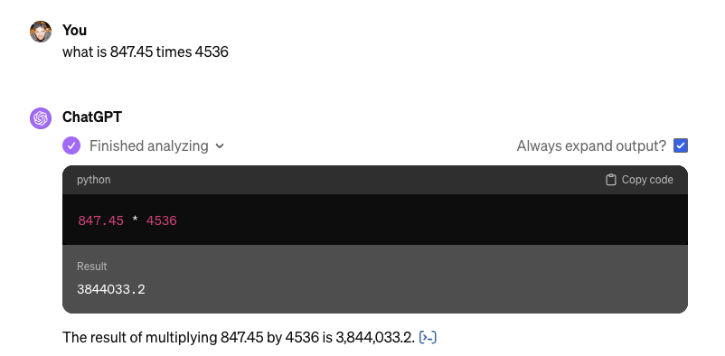

Slide 7
ChatGPT What is the space we are playing in?

Slide 8
ChatGPT
Markdown
ChatGPT
LLM
ChatGPT
Text
Markdown
(Zero shot) Question
Mermaid
Output Formatting
Code
CLI
Only show code
DALL·E 3
SVG
Images
LaTeX
Iterative
Python
Process
Interview
File Output
Results
Planning
Zip
Bing / Browser
Powerpoint
Review
Your File Format
ChatGPT

Slide 9
ChatGPT
Markdown
ChatGPT
LLM
ChatGPT
Text
Markdown
(Zero shot) Question
Mermaid
Output Formatting
Code
CLI
Only show code
DALL·E 3
SVG
Images
LaTeX
Iterative
Python
Process
Interview
File Output
Results
Planning
Zip
Bing / Browser
Powerpoint
Review
Your File Format
ChatGPT

Slide 10
Headers
Use # for headers. More #s mean smaller headers.
# Header 1
## Header 2
### Header 3
Emphasis
Bold: **bold text**
UPPERCASE
Italic: *italic text
Lists
Item 1
Item 2
Subitem 2.1
Links
Inline link: [description](url) [OpenAI](https://www.openai.com)
Code
Inline `code` example ```
Multiline)
Code block
```

Slide 11
Stable Diffusion

