Slide 1
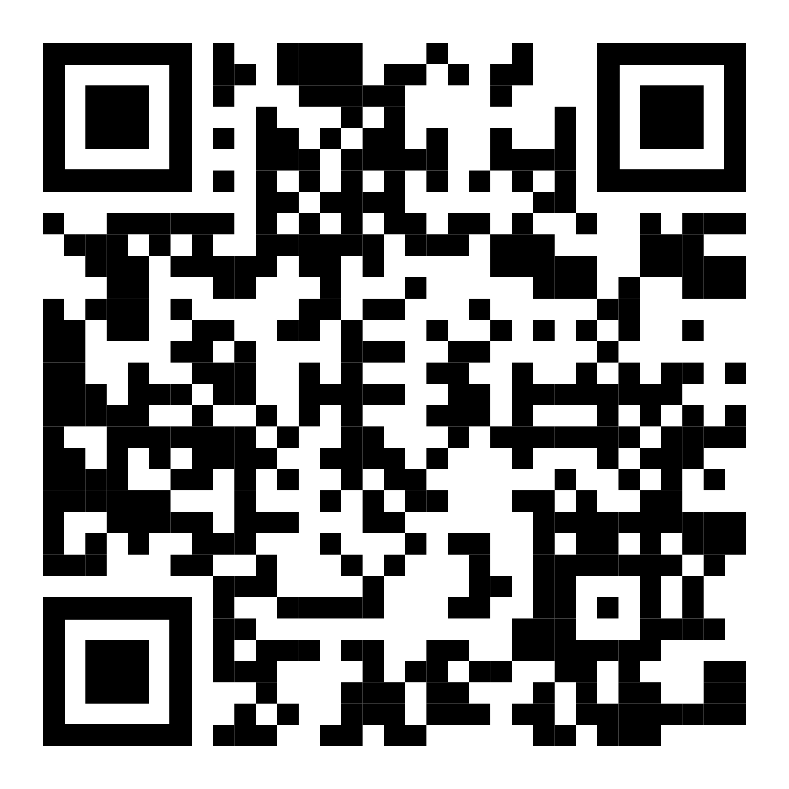

Pattern: Many of One

Slide 2
https://github.com/isidore/Talks/blob/master/Many_Of_One.md

Slide 3
var team = new[] {"Sulley"};
// Many of one
var team = "Sulley"; // 1

Slide 4
Easier, Smaller Refactoring
Backward Compatible APIs
Inch by inch, it’s a cinch
Yard by yard, makes it hard
Moving forward without leaving others behind

Slide 5
Patterns
Let’s start with the first set of slides

Slide 6


Slide 7
People/Statues Holding Footballs?
How many
www.menti.com code: 28 19 68 6

Slide 8


Slide 10
People/Statues Holding Footballs?
How many
www.menti.com code: 28 19 68 6

Slide 11
0, 1, Many
printVariables(); // 0 parameters
printMonster("Sulley"); // 1 parameter String name = "Sulley"; // 1 value
String[] team = new[] {"Sulley", "Mike", "Boo"}; // Many values

Slide 12
Pattern: Many of One

Slide 13
Many of One: The smallest step between 1 and 2
var teamMember = "Sulley"; // 1
var teamMembers = new[] {"Sulley", "Mike"}; // 2

Slide 14
Many of One: The smallest step between 1 and 2
var teamMember = "Sulley"; // 1
var teamMembers = new[] {"Sulley"}; // Many of one
var teamMembers = new[] {"Sulley", "Mike"}; // 2

Slide 15
Exercise 1: Refactoring

Slide 16
The Value of Small Steps

Slide 17
The Value of Small Steps

Slide 18
Failures in Refactoring

Slide 19
Variable
var output = ""; var number1 = 1; output += number1 + ",";
var output = ""; var number1 = new [] {1}; output += number1[0] + ",";

Slide 20
Loop
var output = ""; var number1 = 1; output += number1 + ",";
var number1 = 1; for (int i = 0; i < 1; i++) { output += number1 + ","; }

Slide 21
Exercise 2: Var Args

Slide 22
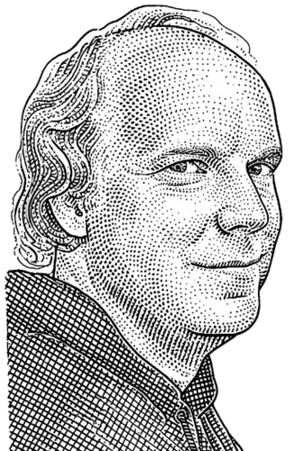
Make the change easy, then make the easy change
(warning: the first part might be hard)
- Kent Beck

Slide 23
Variable Parameter Array
string Merge(string prefix, int number)
string Merge(string prefix)
string Merge(string prefix, params int[] number)

Slide 24
Exercise 3: Container Parameter

Slide 25
Container Parameter
var a = ["<li>", "</li>"];
var a = {
prefix: "<li>",
suffix: "</li>"
};

Slide 26
Container Parameter with default value
string Format(int number)
string Format(int number, string prefix)
?
string Format(int number, Options options = default)

Slide 27
Container Parameter with default value
string Format(int number, string prefix)
string Format(int number, string prefix) { return Format(number, Options.withPrefix(prefix)); }
string Format(int number, Options options = null)

Slide 28
Exercise 4: ApprovalTests

Slide 29
ApprovalTests
var result = MethodUnderTest(1); Approvals.Verify(result);
var forValues = new[] {1}; Approvals.VerifyAll("MethodUnderTest", forValues, n => $"{n} => {MethodUnderTest(n)}");

Slide 30
ApprovalTests
var forValues = new[] {1}; Approvals.VerifyAll("MethodUnderTest", forValues, n => $"{n} => {MethodUnderTest(n)}");
var forValues = new[] {1,2,3,10,99,-1}; Approvals.VerifyAll("MethodUnderTest", forValues, n => $"{n} => {MethodUnderTest(n)}");

Slide 31
First, make the space.
Then fill the space

Slide 32
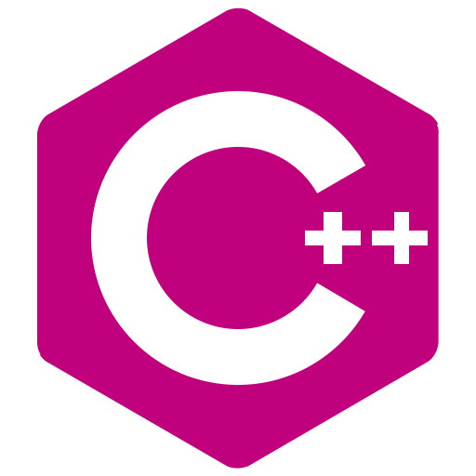
2 Hours a week for 4 weeks: Tuesdays 8-10am pst
Testing Legacy Code Effectively with Approval Tests
Online Workshop
£350 / $450
Sept 08 Sept 15 Sept 22
Sept 29
Testing existing code Testing w/ApprovalTests Testing Globals & Services Testing inconsistent dates and hard to invoke code
+ (optional) 1–on-1 consults with the instructors on your code

Slide 33
https://github.com/isidore/Talks/blob/master/Many_Of_One.md

Slide 34

Thanks!
Presentation template by SlidesCarnival
(please connect via LinkedIn & Twitter)
@LlewellynFalco
youtube.com/isidoreus
LlewellynFalco.Blogspot.com
approvaltests.com

Slide 35
Extra resources · Build your own monsters

