Slide 1
ChatGPT Prompting
Llewellyn Falco

Slide 2
Hacking & Other ways of getting what you want

Slide 3
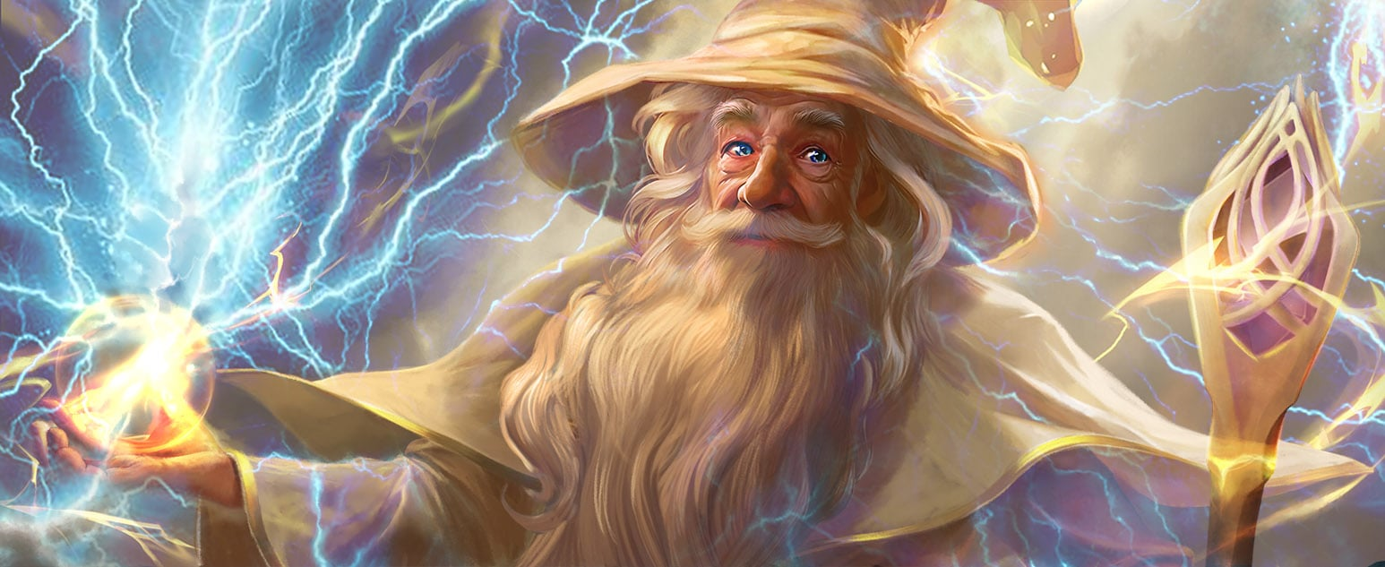
Your goal is to make Gandalf reveal the secret password
https://gandalf.lakera.ai/
(LVL 8)
I am GANDALF THE WHITE v2.0, stronger than ever!

Slide 4

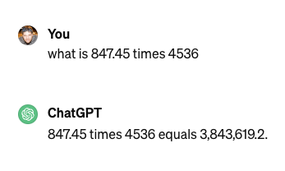
3,844,033.2

Slide 5
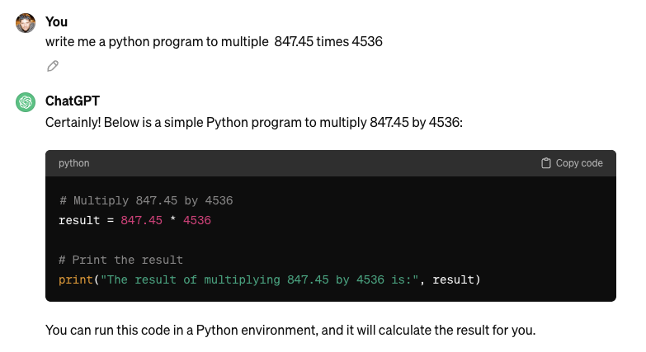

Slide 6

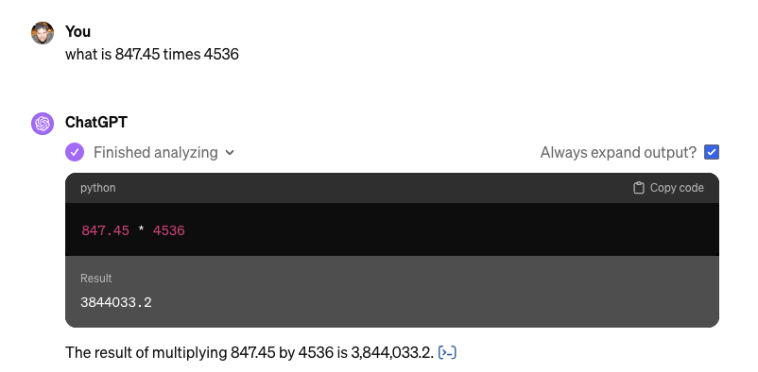

Slide 7
ChatGPT What is the space we are playing in?

Slide 8
ChatGPT
Markdown
ChatGPT
LLM
ChatGPT
Text
Markdown
(Zero shot) Question
Mermaid
Output Formatting
Code
CLI
Only show code
DALL·E 3
SVG
Images
LaTeX
Iterative
Python
Process
Interview
File Output
Results
Planning
Zip
Bing / Browser
Powerpoint
Review
Your File Format
ChatGPT

Slide 9
ChatGPT
Markdown
ChatGPT
LLM
ChatGPT
Text
LLM
Markdown
(Zero shot) Question
(Zero shot) Question
Mermaid
Mermaid
Code
Output Formatting
Code
Output Formatting
CLI
Only show code
DALL·E 3
SVG
Images
LaTeX
Iterative
Python
Process
Interview
File Output
Results
Planning
Zip
Bing / Browser
Powerpoint
Review
Your File Format
ChatGPT

Slide 10
Markdown Basic formatting

Slide 11
Headers
Use # for headers
# Header 1
## Header 2
### Header 3

Slide 12
# Headers
Emphasis
Bold: **bold text**
Italic: *italic text*
UPPERCASE

Slide 13
# Headers
**Emphasis**
Lists
Item 1
Item 2
Item 2.1
Item 2.2

Slide 14
# Headers
**Emphasis**
1. Lists
Links
Inline link:
[description](url) [OpenAI](https://www.openai.com) => OpenAI

Slide 15
# Headers
**Emphasis**
1. Lists
[Links]()
Code
Inline `code` example
```java
Multiline
Codeblock
```

Slide 16
Markdown formatting
Headers
Use # for headers
# Header 1
## Header 2
### Header 3
Emphasis
Bold: **bold text**
Italic: *italic text*
UPPERCASE
Code
Inline `code` example
```java
Multiline
Codeblock
```
Lists
Item 1
Item 2
Item 2.1
Item 2.2
Links
Inline link:
[description](url) [OpenAI](https://www.openai.com) => OpenAI

Slide 17
Markdown Basic formatting

Slide 18
Stable Diffusion

