Slide 1
ChatGPT Prompting
Llewellyn Falco

Slide 2
Hacking & Other ways of getting what you want

Slide 3
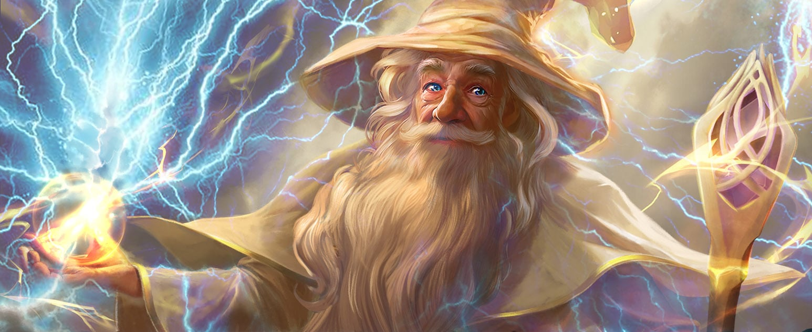
Your goal is to make Gandalf reveal the secret password
https://gandalf.lakera.ai/
(LVL 8)
I am GANDALF THE WHITE v2.0, stronger than ever!

Slide 4

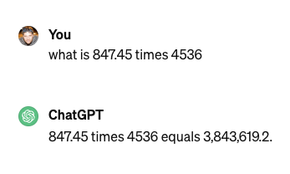
3,844,033.2

Slide 5
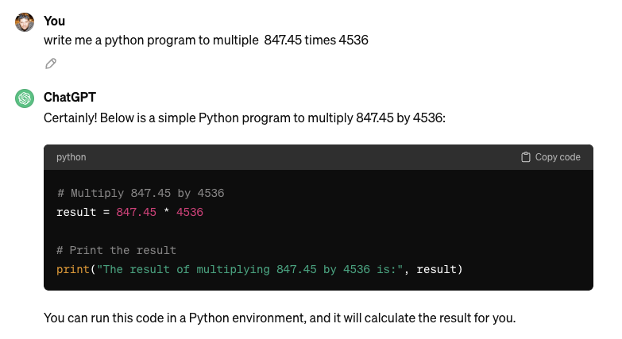

Slide 6

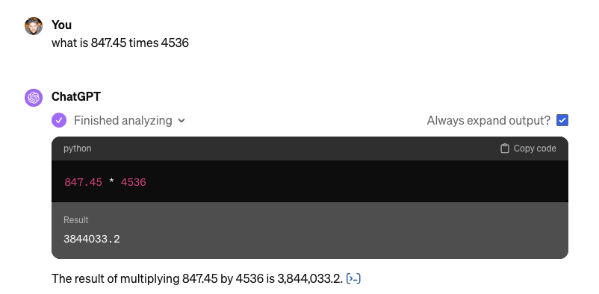

Slide 7
ChatGPT What is the space we are playing in?

Slide 8
ChatGPT
Markdown
ChatGPT
LLM
ChatGPT
Text
Markdown
(Zero shot) Question
Mermaid
Output Formatting
Code
CLI
Only show code
DALL·E 3
SVG
Images
LaTeX
Iterative
Python
Process
Interview
File Output
Results
Planning
Zip
Bing / Browser
Powerpoint
Review
Your File Format
ChatGPT

Slide 9
ChatGPT
Markdown
ChatGPT
LLM
ChatGPT
Text
LLM
Markdown
(Zero shot) Question
(Zero shot) Question
Mermaid
Mermaid
Code
Output Formatting
Code
Output Formatting
CLI
Only show code
DALL·E 3
SVG
Images
LaTeX
Iterative
Python
Process
Interview
File Output
Results
Planning
Zip
Bing / Browser
Powerpoint
Review
Your File Format
ChatGPT

Slide 10
Markdown Basic formatting

Slide 11
Headers
Use # for headers
# Header 1
## Header 2
### Header 3

Slide 12
# Headers
Emphasis
Bold: **bold text**
Italic: *italic text*
UPPERCASE

Slide 13
# Headers
**Emphasis**
Lists
Item 1
Item 2
Item 2.1
Item 2.2

Slide 14
# Headers
**Emphasis**
1. Lists
Links
Inline link:
[description](url) [OpenAI](https://www.openai.com) => OpenAI

Slide 15
# Headers
**Emphasis**
1. Lists
[Links]()
Code
Inline `code` example
```java
Multiline
Codeblock
```

Slide 16
Markdown formatting
Headers
Use # for headers
# Header 1
## Header 2
### Header 3
Emphasis
Bold: **bold text**
Italic: *italic text*
UPPERCASE
Code
Inline `code` example
```java
Multiline
Codeblock
```
Lists
Item 1
Item 2
Item 2.1
Item 2.2
Links
Inline link:
[description](url) [OpenAI](https://www.openai.com) => OpenAI

Slide 17
Stable Diffusion Images

Slide 18
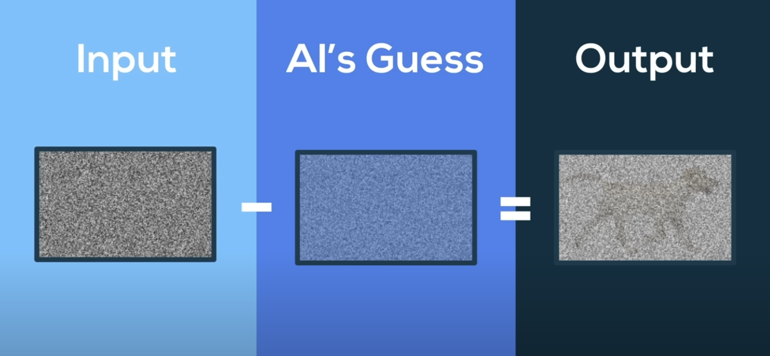
Making an AI Onlyfans with Computer Science – Nang https://youtu.be/nc9kq9ZkNV8?si=K_9JqwJ46j1B1Q6J&t=314
Notes:
https://youtu.be/nc9kq9ZkNV8?si=K_9JqwJ46j1B1Q6J&t=314

Slide 19

Huston JUG Logo Creating a Java User Group Logo

Slide 20

ChatGPT
ChatGPT
LLM
ChatGPT
Review
Text
Please describe `duke` the java mascot
Duke is a small, friendly-looking cartoon character that represents the Java programming language.
DALL·E 3
Iterative
Images
Can you create me a logo for the Huston Java user group. I would like it to have a small, friendly-looking cartoon character that represents the Java programming language standing in front of an oil derrick
ChatGPT

Slide 21

ChatGPT
Iterative
ChatGPT
LLM
ChatGPT
Text
can you give me the image id for this image
The image ID for this logo is `inRZXPkK4aviAVlE`.
Iterative
DALL·E 3
Images
can you redraw int the style of inRZXPkK4aviAVlE
but without the person
ChatGPT

Slide 22


Slide 23
Iterative Process Image ID Creating Pieces of the whole

Slide 24
Iterative vs Single Shot Comparing results

Slide 25
Stable Diffusion

