Slide 1
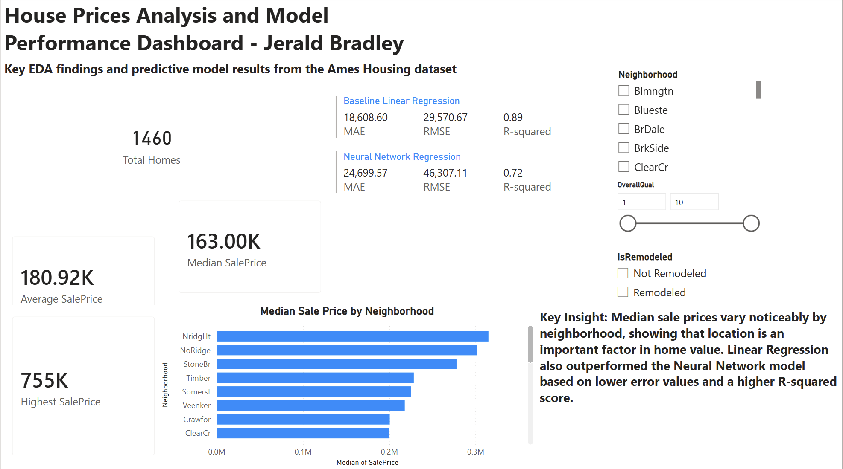
Bradley J. Software Development: ECPI University SDC486L: AI/ML and Advanced Data Analytics Lab Dr. Kingsley Iyinbor June 13, 2026
House Prices Analysis
Model Performance & Scenario Dashboard
Ames Housing Dataset • Final Course Project
1,460
$163K
0.89
Homes analyzed
Median sale price
Best model R²
Key takeaway: model performance favored a simpler Linear Regression baseline, while scenario analysis showed the largest predicted gain from property-size expansion.
House Prices Analysis | 1
Notes:
Opening: This presentation summarizes the full housing-price analytics project. The work moved from dataset selection and EDA through preprocessing, model building, dashboard development, and scenario analysis. The goal was to understand what factors drive SalePrice and how models perform when predicting sale prices.

Slide 2
Project Focus
Three analytical issues guided the end-to-end workflow.
Location impact
Model sensitivity
Age & renovations
Do neighborhoods show meaningful differences in typical home value?
How do unusual or larger properties affect prediction behavior?
How do home age and remodel timing relate to sale price?
EDA
Preprocessing
Models
Scenarios
Dashboard
Final deliverables
Jupyter notebooks for EDA, modeling, and scenario analysis
Power BI dashboard with interactive slicers
Final report, appendix, GitHub repository, and this presentation
House Prices Analysis | 2
Notes:
The three analytical issues kept the project focused. Location was handled through neighborhood comparisons. Outlier and model sensitivity were handled through EDA and scenario testing. Home age and renovations were handled with engineered features such as HomeAgeAtSale and YearsSinceRemodel.

Slide 3
Dataset & Preprocessing
The training data were used because the Kaggle test file did not include SalePrice.
1,460
24
88
Training records
Selected predictors
Processed inputs
Engineered features
HomeAgeAtSale
Age of home when sold
Preprocessing decisions
YearsSinceRemodel
Time since latest remodel
Handled missing values based on feature meaning, not just a blanket median fill
One-hot encoded categorical features such as Neighborhood and Condition
Standardized numerical features for neural network training
Log-transformed SalePrice to reduce skew before model training
IsRemodeled
Remodeled vs. not remodeled
Neighborhood price patterns
Location impact analysis
House Prices Analysis | 3
Notes:
The data preparation stage mattered because the housing dataset has mixed data types and meaningful missing values. For example, some missing values indicate that a feature does not exist, such as no pool or no alley access. The final model dataset used selected original and engineered variables related to the project questions.

Slide 4
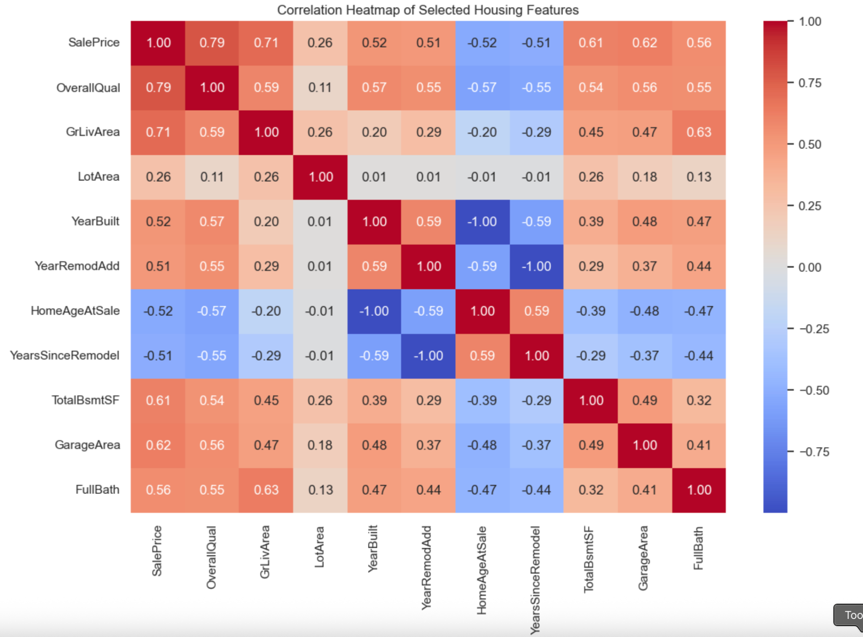
EDA Findings: What Drove SalePrice?
Correlation and distribution results pointed to quality, size, age, renovation, and location.
Key EDA takeaways
SalePrice was right-skewed; mean was higher than median
Potential outliers appeared in SalePrice, GrLivArea, and LotArea
Newer homes and recently remodeled homes tended to perform better
Neighborhood showed clear median price differences
Correlation heatmap excerpt
House Prices Analysis | 4
Notes:
The strongest selected relationship was OverallQual, with a correlation near 0.79. GrLivArea was also strongly positive, which means larger above-ground living areas were usually associated with higher prices. Age-related variables were negative when measuring age or years since remodeling, meaning older or less recently updated homes tended to show lower prices.

Slide 5
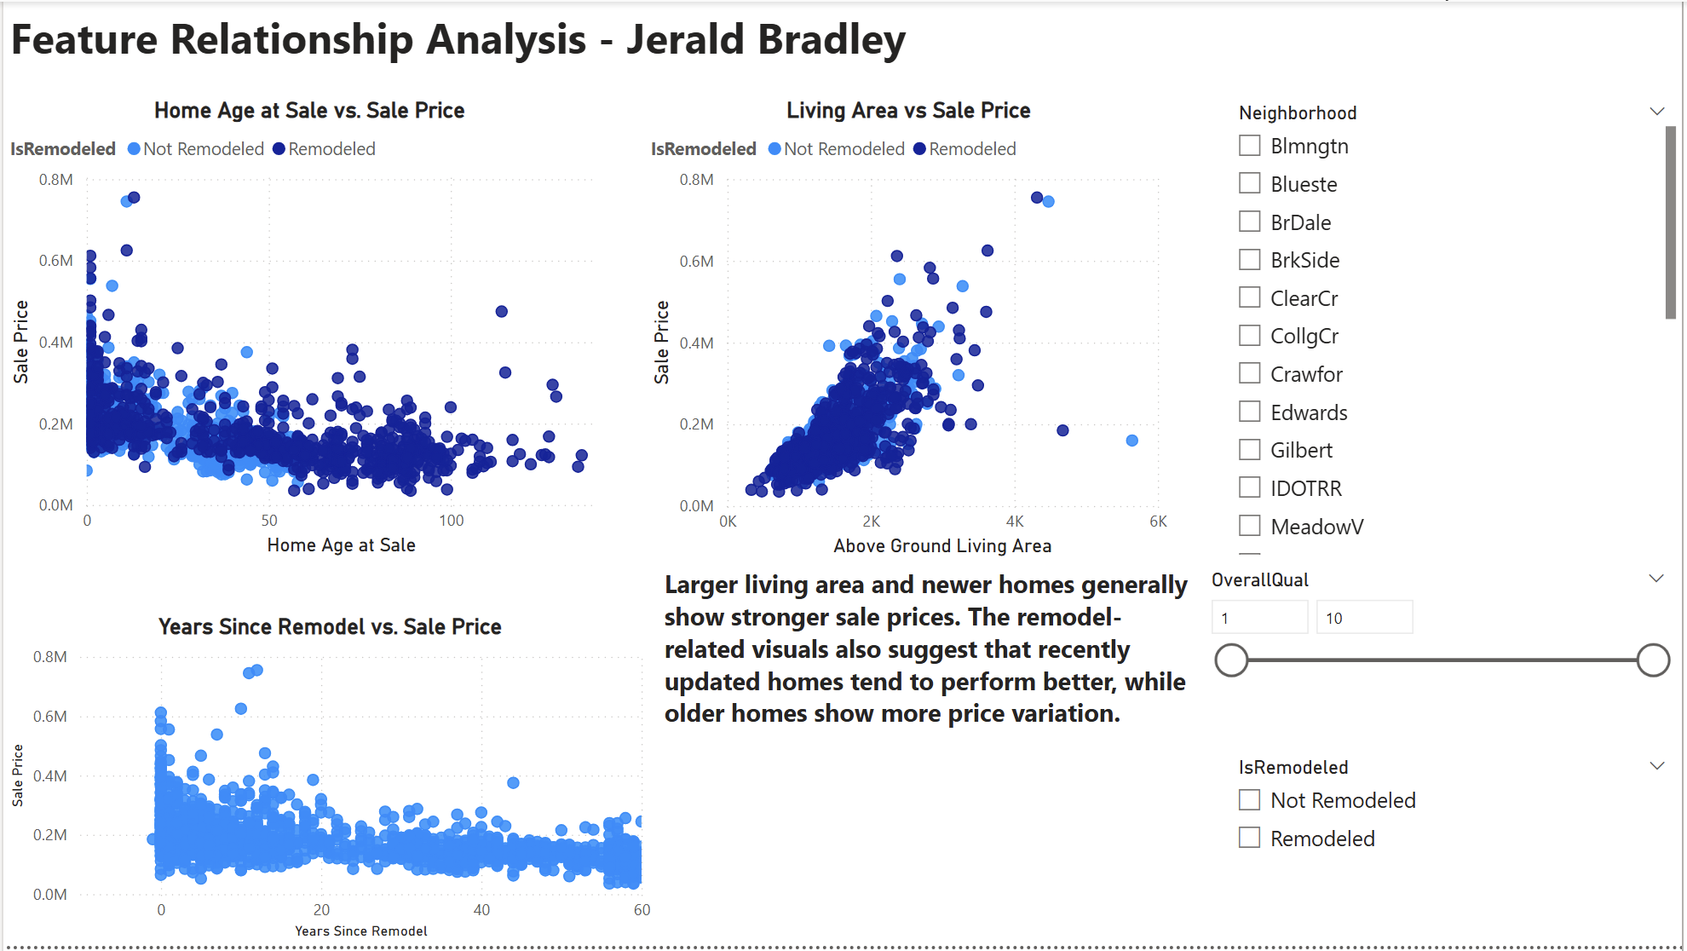
Feature Relationships
Power BI visuals connected home age, living area, and remodeling patterns to SalePrice.
What the visuals showed
Living area had the clearest positive pattern with SalePrice
Newer homes generally showed stronger sale prices
Recent remodel indicators supported stronger predicted values
Slicers allowed users to explore neighborhood, quality, and remodel status
Strongest visual pattern: Living Area
House Prices Analysis | 5
Notes:
This dashboard page was designed to show the feature relationships visually rather than just as numbers. The living-area plot showed the clearest upward relationship. The age and remodel visuals supported the idea that newer or recently updated properties generally performed better.

Slide 6
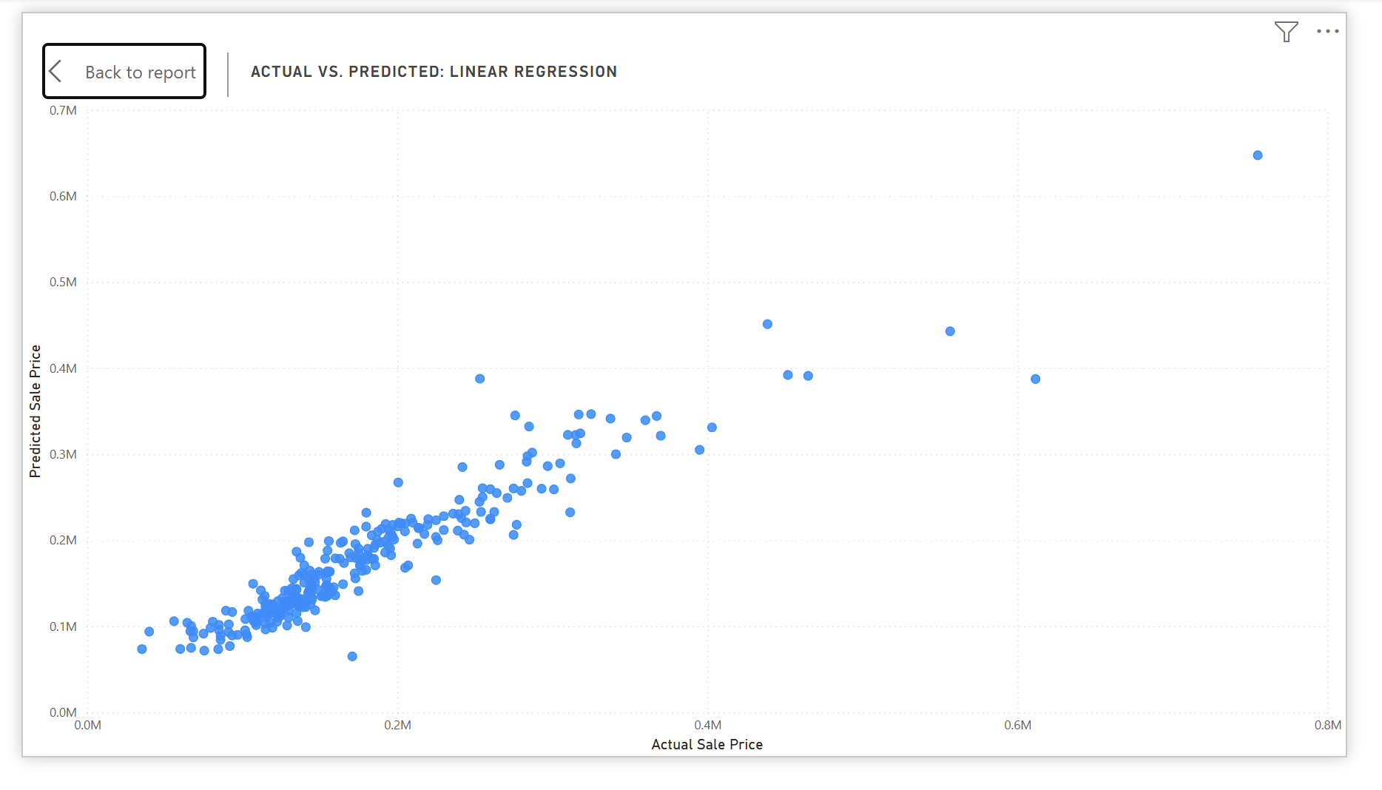
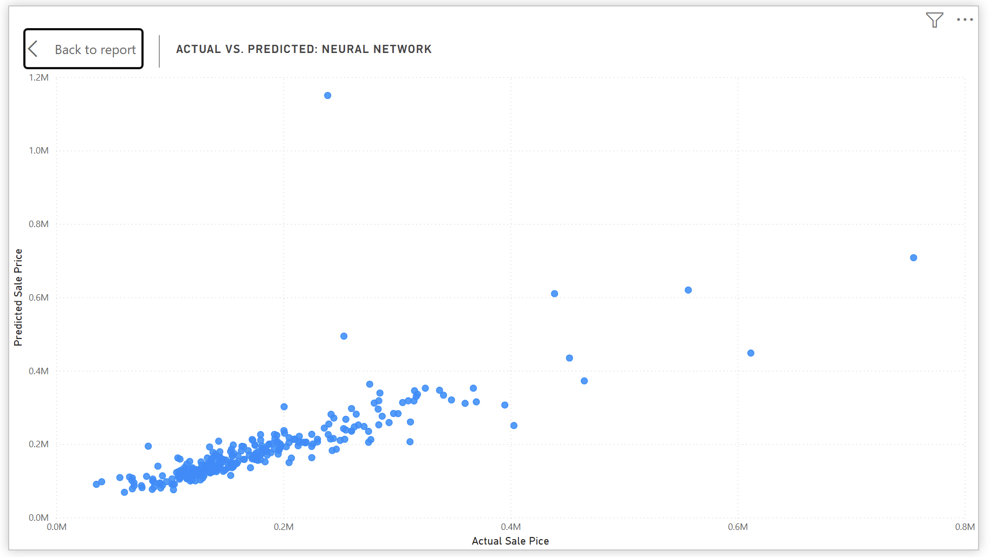
Model Performance
Linear Regression outperformed the optimized Neural Network model.
Actual vs. predicted plots
Interpretation
The neural network improved after architecture changes, but the baseline Linear Regression model produced lower errors and a higher R².
0.886
0.720
Linear Regression R²
Neural Network R²
House Prices Analysis | 6
Notes:
The baseline Linear Regression model had a lower MAE and RMSE than the neural network. The Linear Regression model also explained more variation in the test set with an R-squared value around 0.886. The neural network did improve after adjustments, but it was still less consistent, especially for some higher-priced properties.

Slide 7
Scenario Analysis
Three what-if scenarios tested how the neural network responded to controlled input changes.
Average predicted price changes
Scenario
$ Change
% Change
Premium Neighborhood
$4,398
2.41%
Recent Renovation
$10,695
5.85%
Expanded Property
$20,574
11.26%
Expanded Property produced the largest modeled impact. It increased most predictions while staying mostly inside the training feature ranges.
House Prices Analysis | 7
Notes:
The scenario analysis used the trained neural network without retraining it. Inputs were modified, then passed through the same preprocessing pipeline and converted back from log predictions into dollars. Expanded Property had the strongest modeled effect, followed by Recent Renovation and Premium Neighborhood.

Slide 8
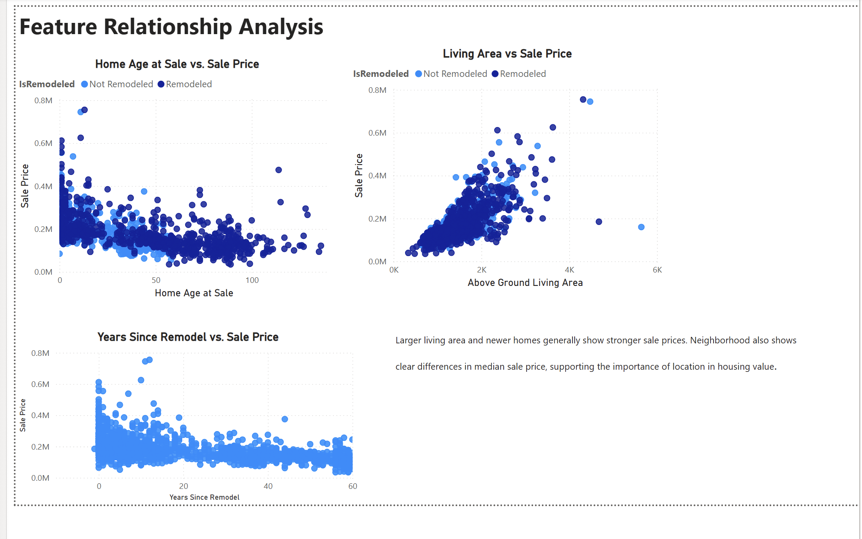
Dashboard & Interactivity
The Power BI report connected EDA, model results, and scenario outcomes.
Executive Overview
Feature Relationship Analysis
Interactive elements: neighborhood, overall quality, remodel status, and scenario slicers allow the user to filter the story dynamically.
House Prices Analysis | 8
Notes:
The dashboard is not just a static report. It lets the viewer interact with filters and slicers. The Executive page summarizes the big picture. The feature page explores the relationships. The model page compares prediction performance. The scenario page adds what-if analysis results. This is why the dashboard supports the final report instead of duplicating it exactly.

Slide 9
Recommendations & Conclusion
Use the model and dashboard as decision-support tools, not as standalone price guarantees.
Actionable recommendations
Final conclusion
Use neighborhood with size, quality, age, and renovation features—not by itself
Keep Linear Regression as the preferred model for this dataset
Use scenario results to explore sensitivity, not to promise returns
Flag unusual high-value or large properties for additional review
Housing prices were most strongly shaped by quality, living area, location, age, and renovation history. Linear Regression produced the strongest predictive performance, while scenario analysis showed the model was most sensitive to property-size increases.
Bottom line
The project provides a practical workflow for explaining home values and comparing predictive approaches.
House Prices Analysis | 9
Notes:
The final recommendation is to use the Linear Regression model as the stronger current model because it was more accurate and easier to interpret. The scenario analysis adds business value by showing how predictions change under hypothetical conditions. However, the results are model-based estimates. Real-world decisions would also need cost, market, and inspection information.

Slide 10
References
Key sources used for dataset context and modeling tools.
De Cock, D. (2011). Ames, Iowa: Alternative to the Boston housing data as an end of semester regression project. Journal of Statistics Education, 19(3), 1–15.
https://doi.org/10.1080/10691898.2011.11889627
Kaggle. (n.d.). House prices: Advanced regression techniques.
https://www.kaggle.com/competitions/house-prices-advanced-regression-techniques/data
Pedregosa, F., Varoquaux, G., Gramfort, A., Michel, V., Thirion, B., Grisel, O., et al. (2011). Scikit-learn: Machine learning in Python. Journal of Machine Learning Research, 12, 2825–2830.
https://www.jmlr.org/papers/volume12/pedregosa11a/pedregosa11a.pdf?ref=https:/
TensorFlow. (2025). The Sequential model. TensorFlow Core.
https://www.tensorflow.org/guide/keras/sequential_model
House Prices Analysis | 10
Notes:
Close by noting that the presentation summarizes the same work documented in the final report, appendix, notebooks, and dashboard. This slide lists the main sources used for the dataset, modeling workflow, and neural network implementation.

