Slide 1
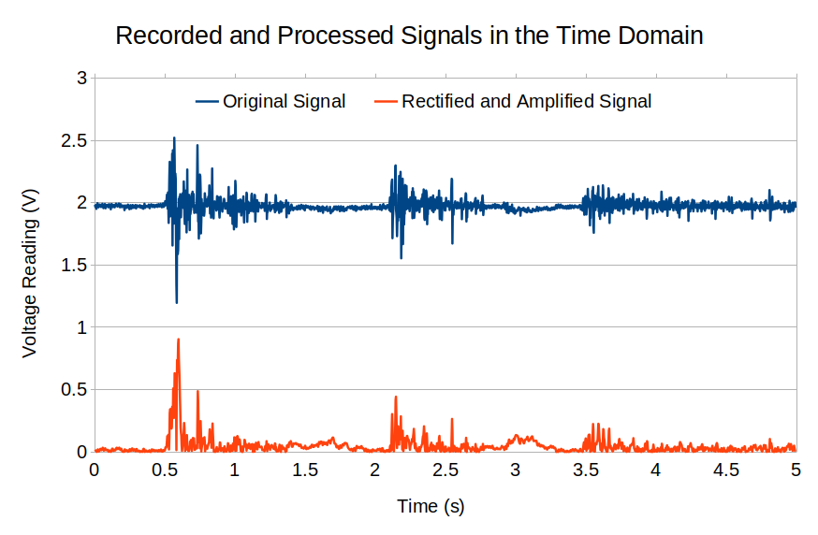
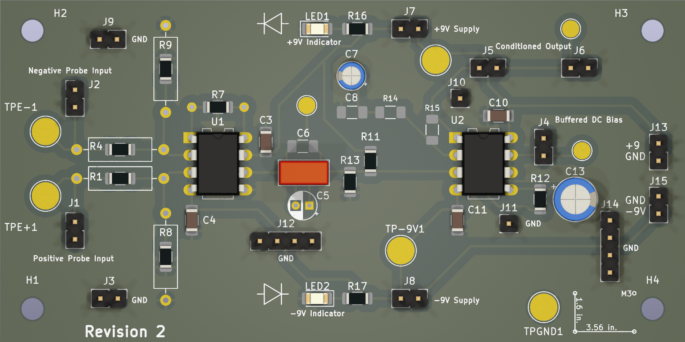
Motorized Robotic Hand Controlled by Surface Electromyography (sEMG)
Jay E. Bernstein, David J. Mora, Juan R. Ortiz
Advised by Dr. Norali Pernalete
6mm 8mm 10mm 20mm 30mm

