Slide 1
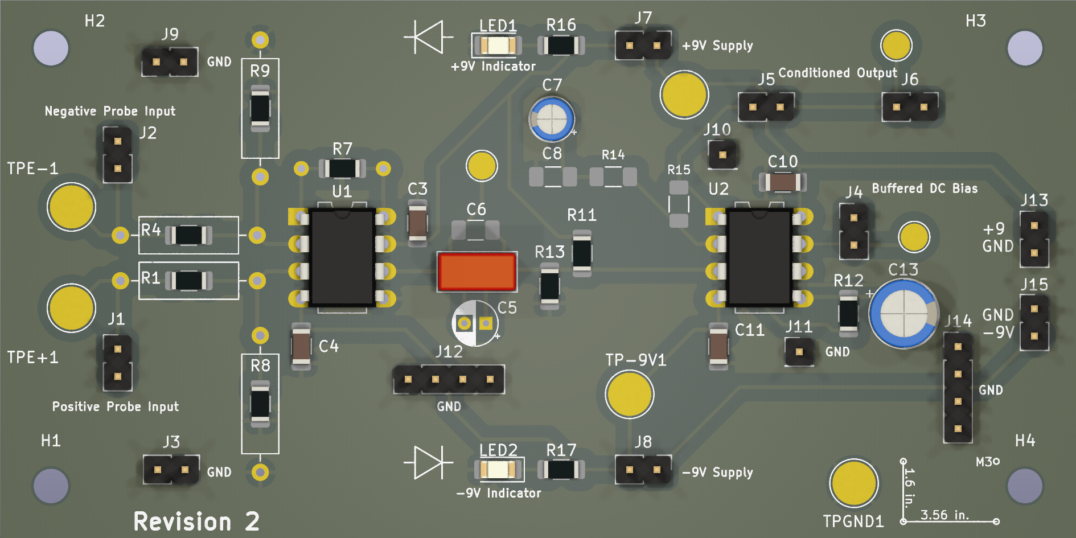
Motorized Robotic Hand Controlled by Surface Electromyography (sEMG)
Jay E. Bernstein, David J. Mora, Juan R. Ortiz
Advised by Dr. Norali Pernalete
Signal Processing Chain here
Abstract:
Embedded controllers and analog acquisition ICs have. The objective of this project was to discover the fundamentals of signal acquisition and processing, in a situation requiring extremely precise hardware requirements in order to achieve both common mode signal rejection and extremely high gain. Because this is a medical device, considerations of safety had to be made as well. The final product is a printed circuit board designed around the Texas Instruments INA82x that handles differential gain, with input resistance to limit the shock hazard were a fault to occur. The amplified input signal is processed so that a microcontroller is able to determine what command the signal is closest to.
Picture Showing Conductive Paths through Human tissue, juxtaposed with LTSPICE model
6mm 8mm 10mm 20mm 30mm. 32Point = 0.5 inch High
Picture of Complete Project Here

