Slide 1
SERVLET
Servlet technology is used to create a web application (resides at server side and generates a dynamic web page)..
Servlet is a class that extends the capabilities of the servers and responds to the incoming requests. It can respond to any requests.
Servlet is a web component that is deployed on the server to create a dynamic web page.

Slide 2
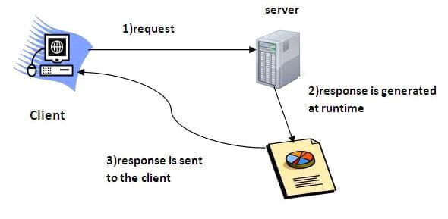

Slide 3
Execution of Servlets basically involves six basic steps:
(1) The clients send the request to the webserver.
(2) The web server receives the request.
(3) The web server passes the request to the corresponding servlet.
(4) The servlet processes the request and generates the response in the form of output.
(5) The servlet sends the response back to the webserver.
(6) The web server sends the response back to the client and the client browser displays it on the screen.

Slide 4
Servlet life cycle
Start
LOADING AND INSTANTIATION
init()
INITIALIZED AND READY
FOR SERVICE
service()
HANDLING REQUEST
END OF
LIFE CYCLE
Destroy()
END

Slide 5
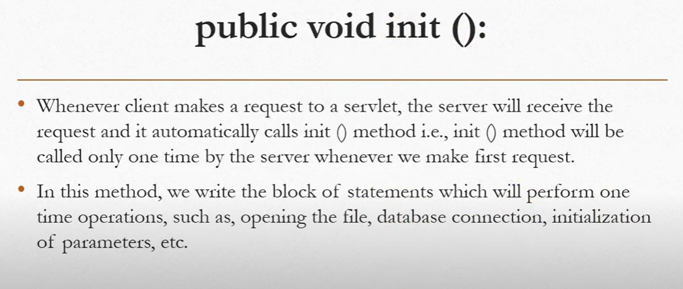

Slide 6
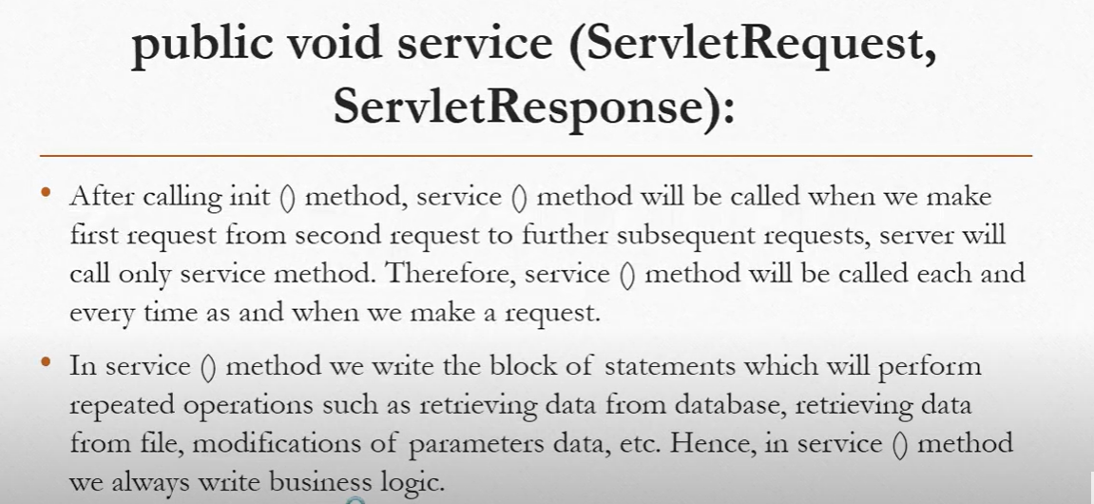

Slide 7
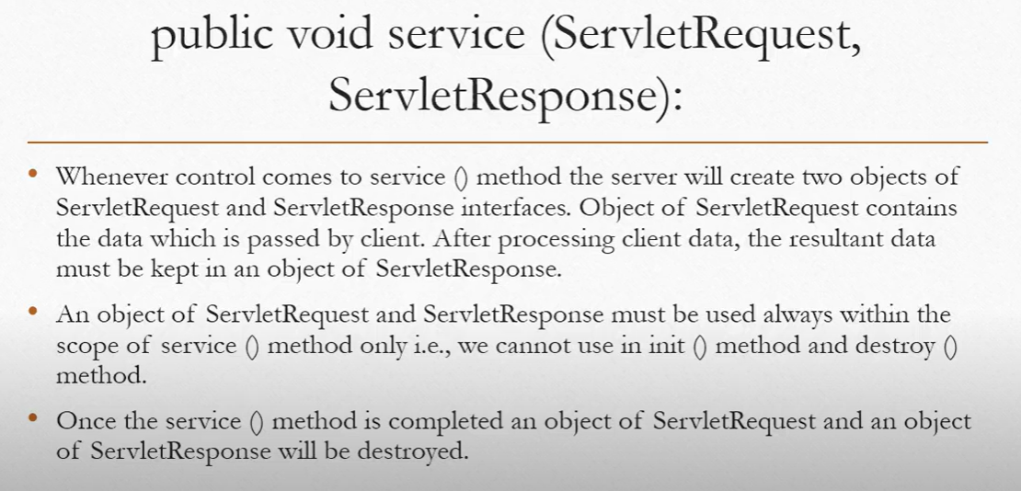

Slide 8
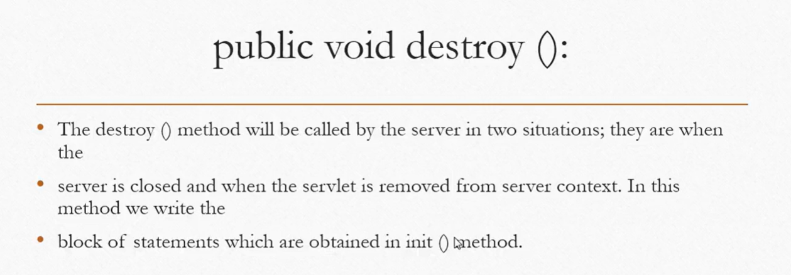
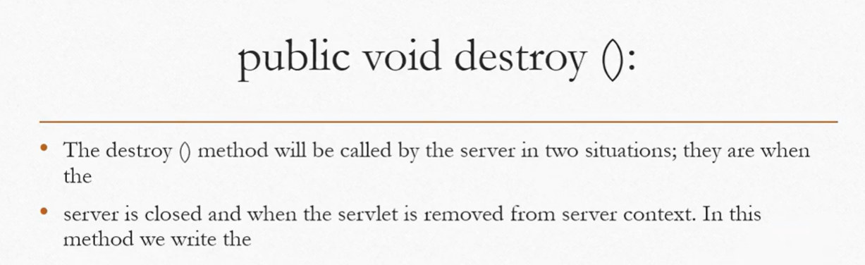

Slide 9
RequestDispatcher in Servlet
The RequestDispatcher interface provides the facility of dispatching the request to another resource it may be html, servlet or jsp. This interface can also be used to include the content of another resource also.
Two methods:
(1) forward()
(2) include()

Slide 10
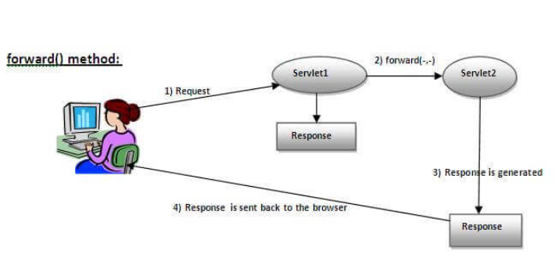
Forward Method

Slide 11
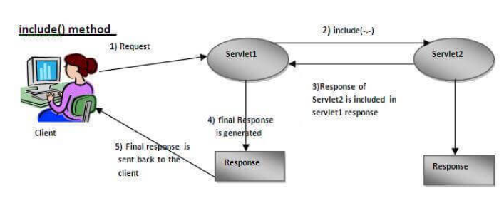
Include Method

Slide 12
SendRedirect in servlet
The sendRedirect() method of HttpServletResponse interface can be used to redirect response to another resource, it may be servlet, jsp or html file.
It accepts relative as well as absolute URL.

Slide 13
JSP
JSP technology is used to create web application just like Servlet technology. It can be thought of as an extension to Servlet because it provides more functionality than servlet such as expression language, JSTL, etc.
JSP is similar to HTML pages, but they also contain Java code executed on the server side.
A JSP page is a file with a ".jsp" extension that can contain a combination of HTML Tags and JSP codes.

Slide 14
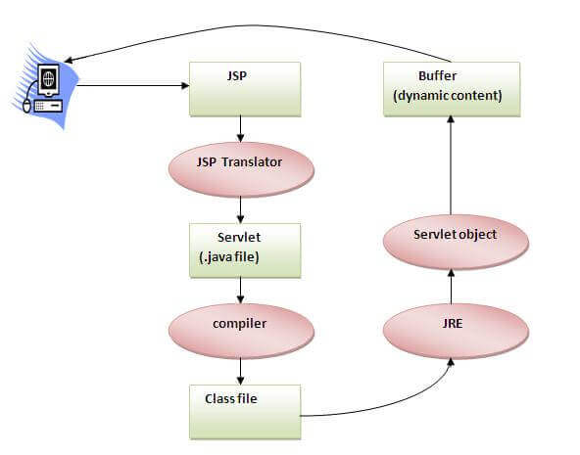
The Lifecycle of a JSP Page

Slide 15
JSP Scripting elements
The scripting elements provides the ability to insert java code inside the jsp. There are three types of scripting elements:
scriptlet tag
expression tag
declaration tag
(1) scriptlet tag
<html>
<body>
<% out.print("welcome to jsp"); %>
</body>
</html>
(3) declaration tag
<html>
<body>
<%! int data=50; %>
<%= "Value of the variable is:"+data %>
</body>
</html>
(2) expression tag
<html>
<body>
<%= "welcome to jsp" %>
</body>
</html>

Slide 16
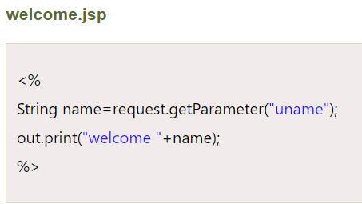
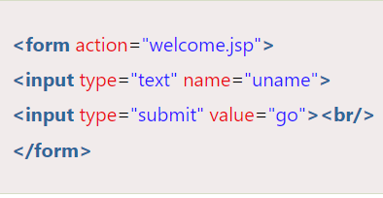
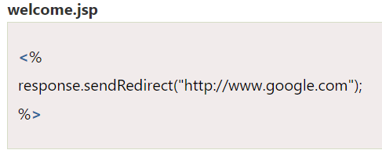
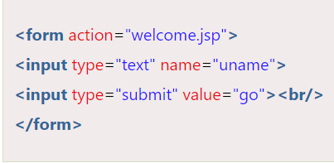
JSP Implicit Objects
(1) Request implicit object
(2)response implicit object

Slide 17

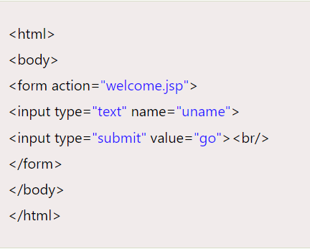
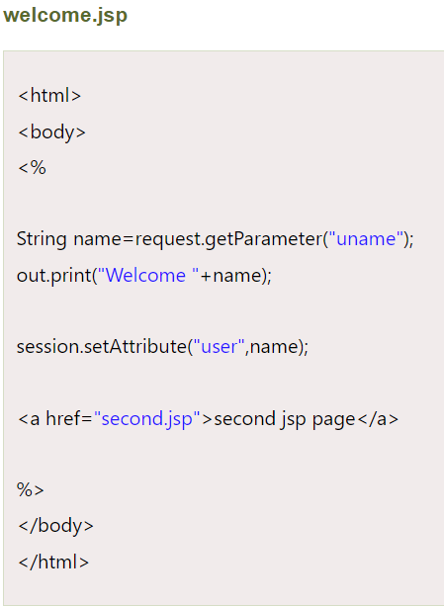
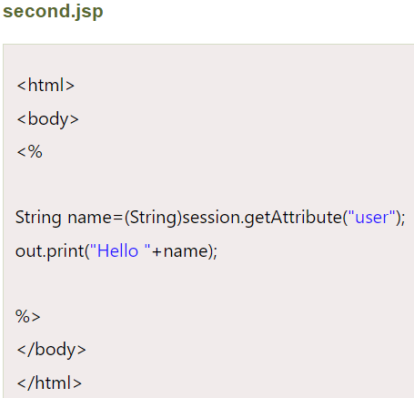

(3)Session implicit object

Slide 18
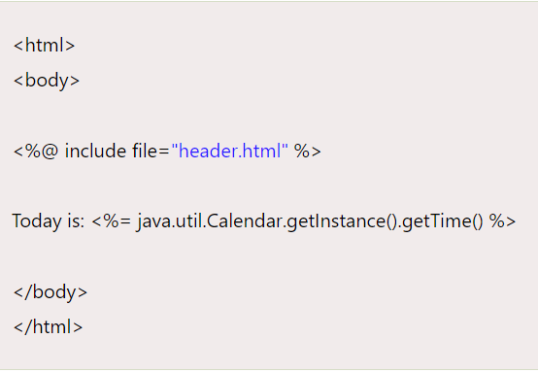
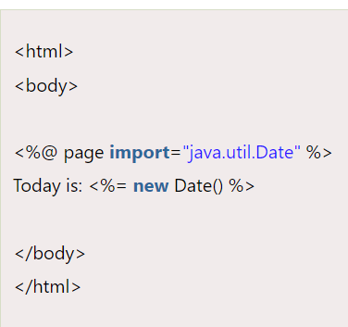
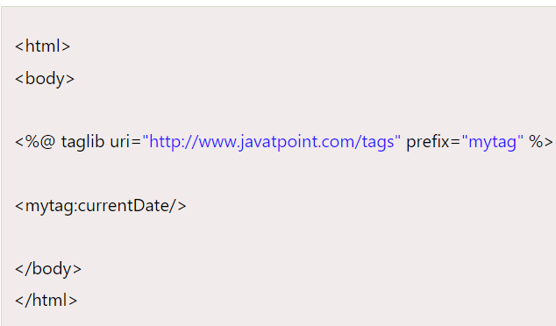
JSP directives(The jsp directives are messages that tells the web container how to translate a JSP page into the corresponding servlet.)
(1) Include Directive
(3)Page directive
(2) Taglib directive

Slide 19
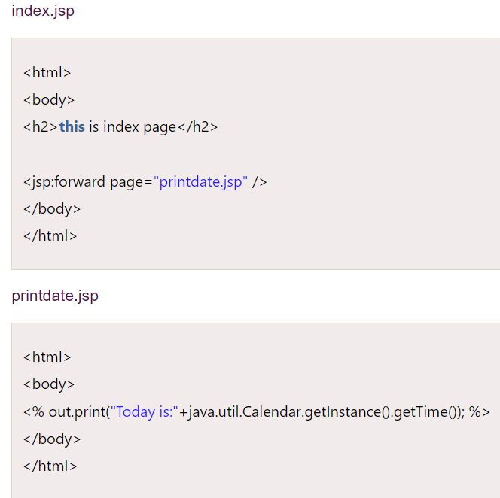
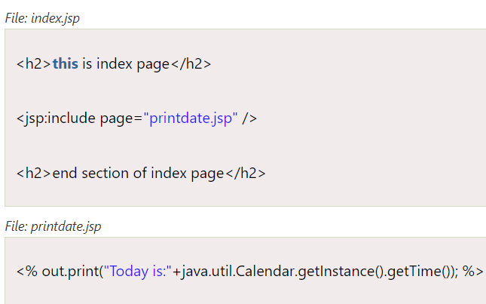
JSP Action Tags(There are many JSP action tags or elements. Each JSP action tag is used to perform some specific tasks)
Forward Action
Include Action

Slide 20
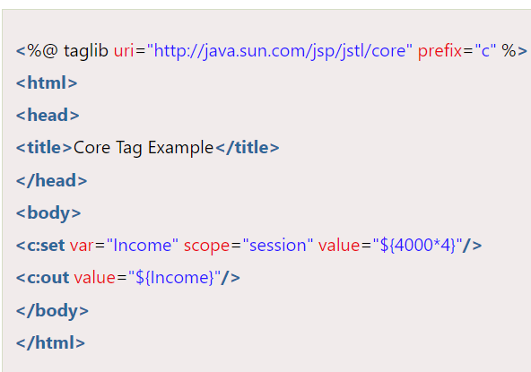
JSTL
JSTL provides many tags that simplify the JSP,It avoids the use of scriptlet tag.
<c:set> Tag

Slide 21
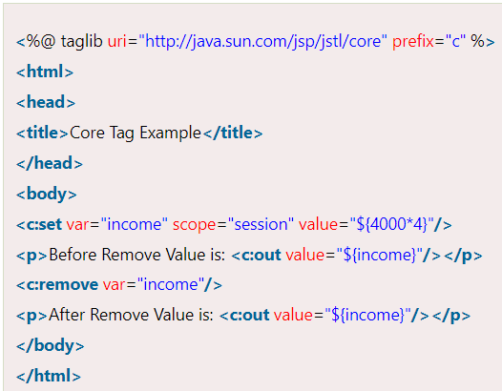
<c:remove> Tag

Slide 22
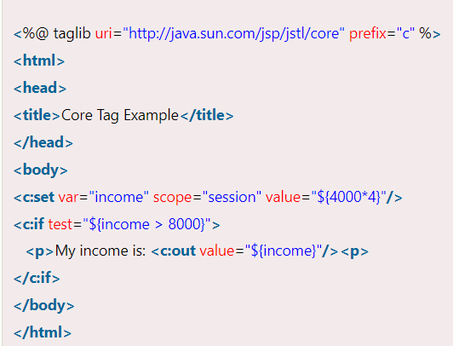
<c:if> Tag

Slide 23
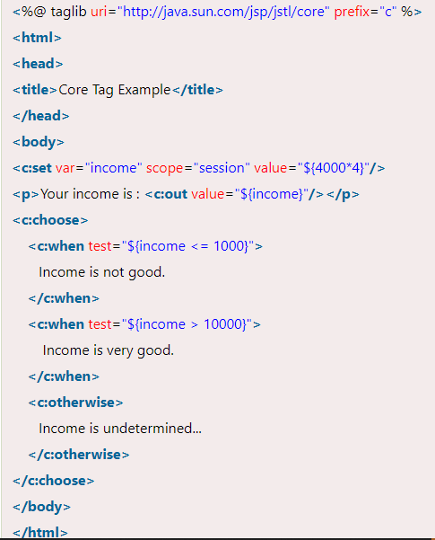
<c:choose>, <c:when>, <c:otherwise> tag

Slide 24
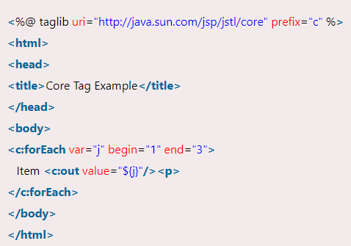
<c:forEach> Tag

Slide 25
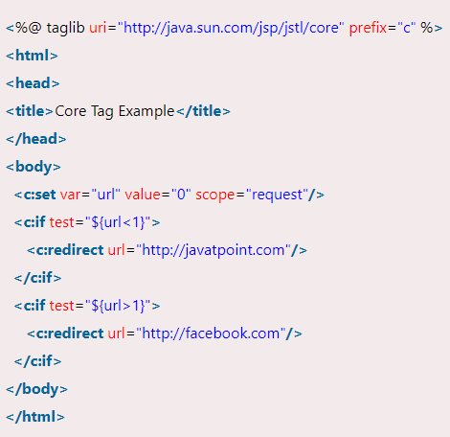
<c:redirect> Tag

Slide 26
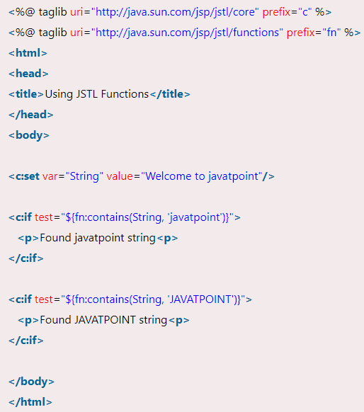
JSTL(The JSTL function provides a number of standard functions, most of these functions are common string manipulation functions.)
fn:contains()
Function

Slide 27
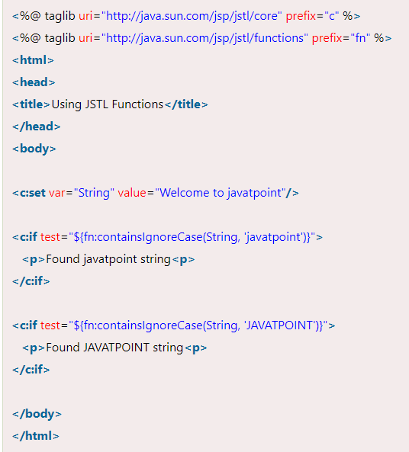
fn:containsIgnoreCase() Function

Slide 28
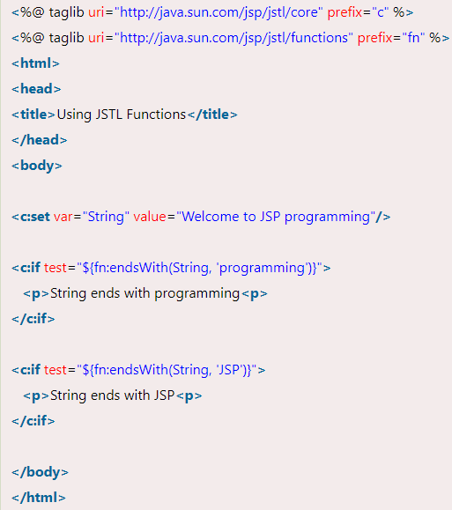
fn:endsWith() Function

Slide 29
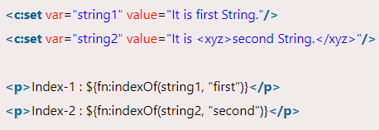
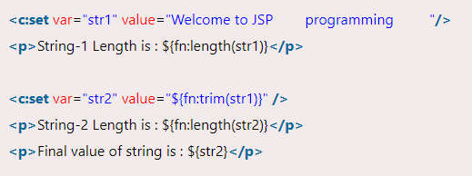
fn:indexOf() Function
fn:trim() Function

Slide 30
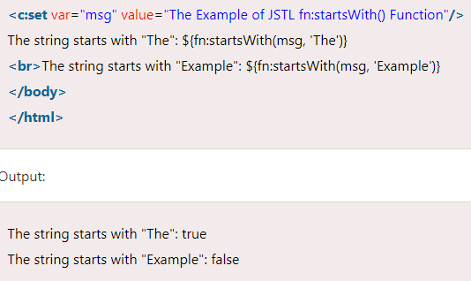

fn:startsWith() Function
fn:split() Function

Slide 31
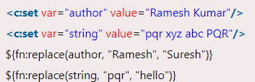

fn:replace() Function
fn:substringAfter() Function

Slide 32

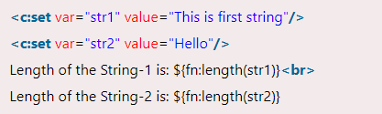
fn:substringBefore() Function
fn:length() Function

Slide 33


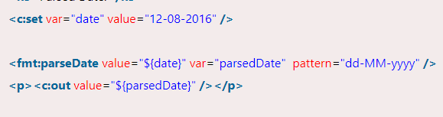
JSTL Formatting tags(The formatting tags provide support for message formatting, number and date formatting etc.)
<fmt:formatNumber> Tag
<fmt:parseDate> Tag

