Slide 1
Cosc 5/4735
Android Wear 2.0
By: Brant Dolling, Kegan McIlwaine, Jay Bishop

Slide 2
What is covered
Custom Cards
Action Confirmations
Dynamic Watch Faces
Battery Life
Color Changing
Weather

Slide 3
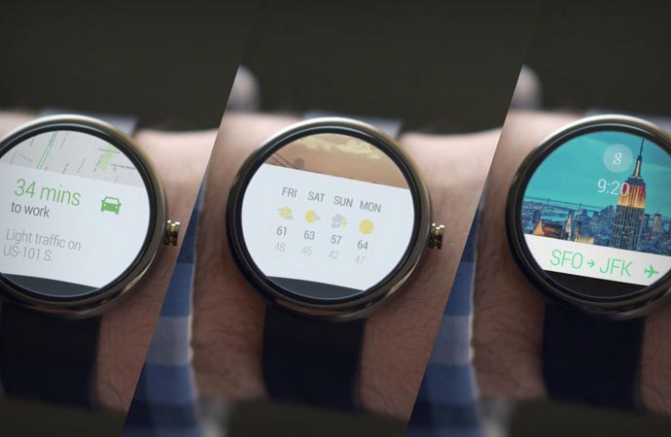
Custom Cards
A way of presenting simple information to a wearable user
Uses a CardFrame class to wrap views into card-styled frame
Two Ways to make a Custom Card
Extending the CardFragment class
Adding a card directly to a layout

Slide 4
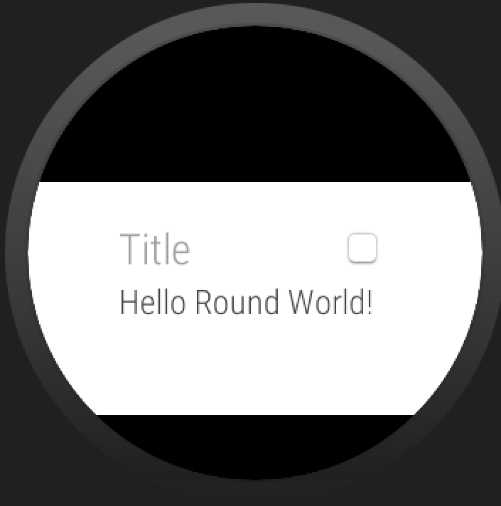
Card Fragment
The Card Fragment class provides a default card layout that includes a title, description, and an icon
A Card Fragment is created as follows
CardFragment name = CardFragment.create(
String title, String description, Icon icon);
You may then add this CardFragment to a
fragmentTransaction and display it

Slide 5

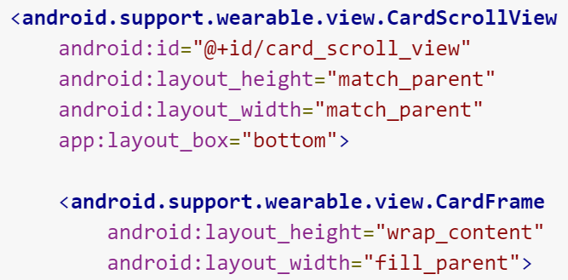
Adding Cards to a Layout
Cards may also be added to an xml layout
Done by creating a CardFrame and then adding subsequent elements to that frame, such as a textView for a title
Can also use a CardScrollView to detect which type of watch face is being used and display the frame appropriately

Slide 6
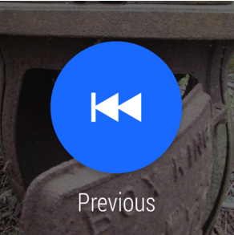
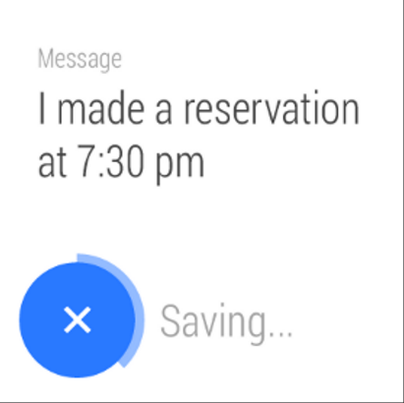
Action Buttons and Confirmations
Action Buttons are when a user is prompted to take action on a notification: Causes a specific action to be executed
See original Android Wear lecture for more information
Action confirmations allow the user to act upon an action that is about to be executed by an Action button.
The picture on the right shows off a confirmation that
allows the user to cancel the action before it begins

Slide 7
Auto Confirmation Timers
Lets users cancel an action that they just performed
When an action is performed, an app shows a button to cancel the action with a timer animation, and begins the timer
App is notified if thee action is cancelled and when the timer expires
Done by adding a <DelayedConfirmationView> to a layout and implementing the DelayedConfirmationListener interface in your activity
Contains methods onTimerSelected for when the user cancels the action, and onTimerFinished for when the timer runs out

Slide 8
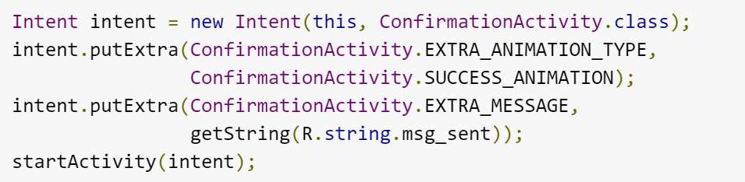
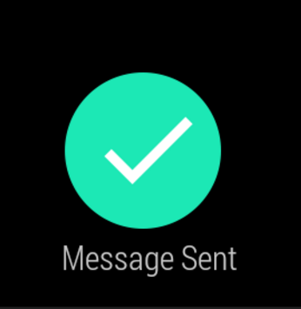
Confirmation Animations
An animation that shows once a user completes an action in your application
Done by creating an intent in your activity that starts ConfirmationActivity
You may also add an intent extra, EXTRA_ANIMATION_TYPE to have the animation be a specific one, such as a SUCCESS_ANIMATION etc.

Slide 9
References
Android’s training site
http://developer.android.com/training/building-wearables.html
http://developer.android.com/training/wearables/ui/confirm.html
http://developer.android.com/training/wearables/ui/cards.html
http://developer.android.com/training/wearables/watch-faces/configuration.html#Listener http://developer.android.com/training/wearables/apps/always-on.html http://developer.android.com/samples/WatchFace/index.html http://developer.android.com/training/wearables/data-layer/events.html http://stackoverflow.com/questions/27538742/adding-a-simple-toggle-configuration-for-watch-face-android-wear http://developer.android.com/training/wearables/data-layer/data-items.html

Slide 10
Q
A
&

