Slide 1
Cosc 5/4735
Android Wear 2.0
By: Brant Dolling, Kegan McIlwaine, Jay Bishop

Slide 2
What is covered
Custom Cards
Action Confirmations
Dynamic Watch Faces
Battery Life
Gestures
Configuration Activity

Slide 3
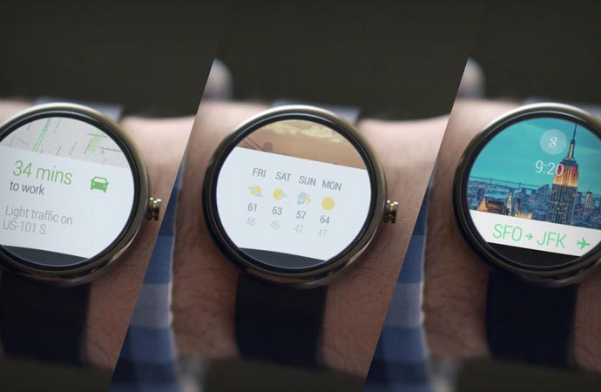
Custom Cards
A way of presenting simple information to a wearable user
Uses a CardFrame class to wrap views into card-styled frame
Two Ways to make a Custom Card
Extending the CardFragment class
Adding a card directly to a layout

Slide 4
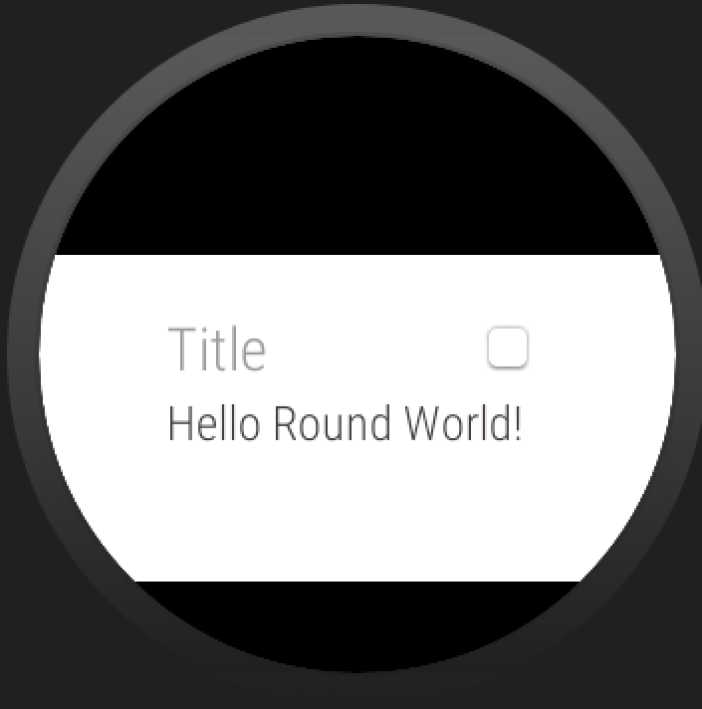
Card Fragment
The Card Fragment class provides a default card layout that includes a title, description, and an icon
A Card Fragment is created as follows
CardFragment name = CardFragment.create(
String title, String description, Icon icon);
You may then add this CardFragment to a
fragmentTransaction and display it

Slide 5
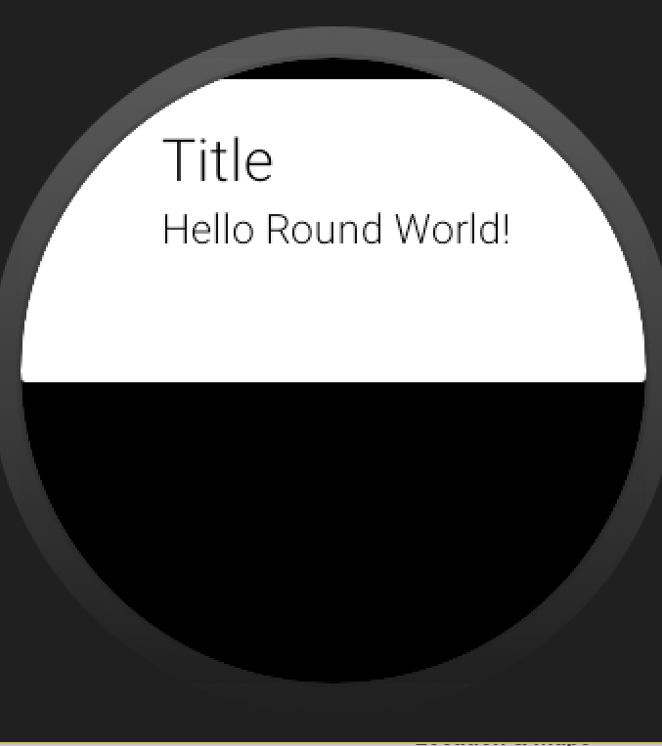
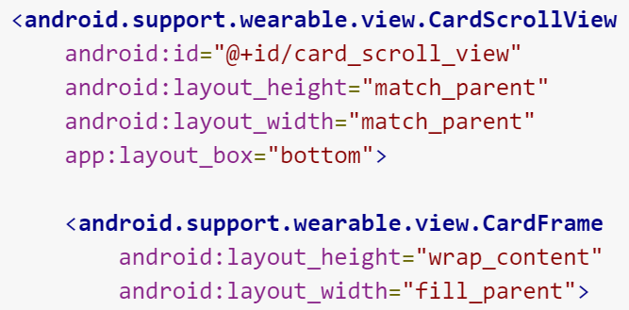
Adding Cards to a Layout
Cards may also be added to an xml layout
Done by creating a CardFrame and then adding subsequent elements to that frame, such as a textView for a title
Can also use a CardScrollView to detect which type of watch face is being used and display the frame appropriately

Slide 6
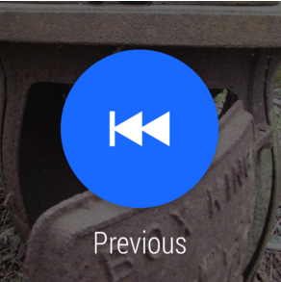
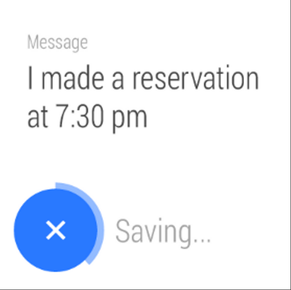
Action Buttons and Confirmations
Action Buttons are when a user is prompted to take action on a notification: Causes a specific action to be executed
See original Android Wear lecture for more information
Action confirmations allow the user to act upon an action that is about to be executed by an Action button.
The picture on the right shows off a confirmation that
allows the user to cancel the action before it begins

Slide 7
Auto Confirmation Timers
Lets users cancel an action that they just performed
When an action is performed, an app shows a button to cancel the action with a timer animation, and begins the timer
App is notified if thee action is cancelled and when the timer expires
Done by adding a <DelayedConfirmationView> to a layout and implementing the DelayedConfirmationListener interface in your activity
Contains methods onTimerSelected for when the user cancels the action, and onTimerFinished for when the timer runs out

Slide 8
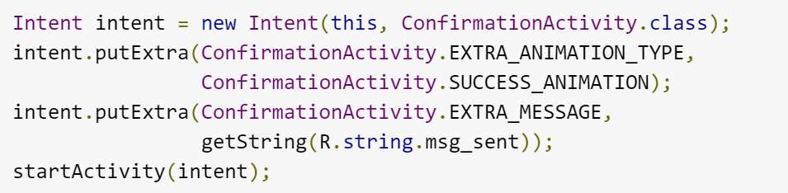
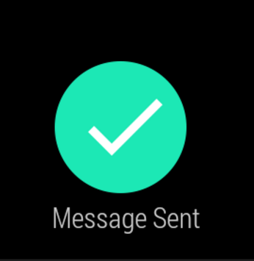
Confirmation Animations
An animation that shows once a user completes an action in your application
Done by creating an intent in your activity that starts ConfirmationActivity
You may also add an intent extra, EXTRA_ANIMATION_TYPE to have the animation be a specific one, such as a SUCCESS_ANIMATION etc.

Slide 9
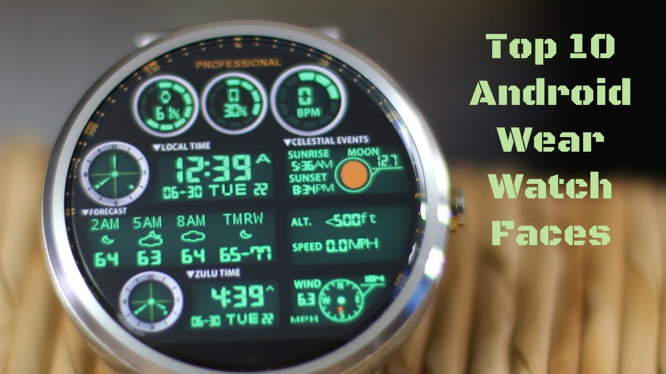
Dynamic Displays
A lot of information can be displayed on the watch face.
Such as:
Battery Percentage of the watch
Battery Percentage of the phone
Local Weather
The time the sun sets
Google Fit steps
I chose to display the battery
percentage of the watch.

Slide 10
Displaying Information
To display information in real time you have to use a AsyncTask.
AsyncTask allows the watch face to perform background operations and publish results on the UI thread without having multiple threads or handlers.
After it gets done calculating the info in the background, it then calls onPostExecute and that is how it updates the screen.
This makes it easy to get and update the battery percentage.

Slide 11
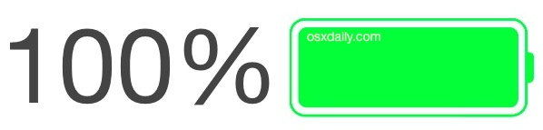
Displaying Information
Intents are used to get the information of the battery, specifically when the battery changes its percentages.
First declaring the Intent Filter to tell what information you want.
Second making the actual Intent with the filter for just the battery.
Once you have declared your intent you can get what the actually battery percentage is on the watch.

Slide 12
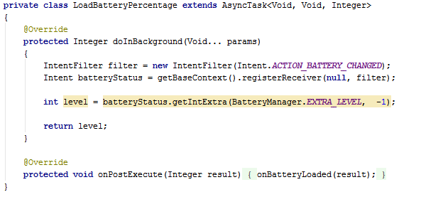
Example

Slide 13
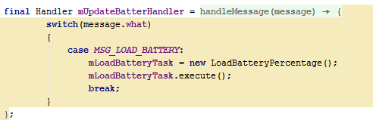
Handlers
Handlers are needed to send messages between threads.
Handlers are called every time the time is updated on the watch face.

Slide 14
Same Concepts Different Information
You can basically do the same thing to get all the other types of information.
There are just slight changes to get the battery of your phone or to get calendar events to display on the watch

Slide 15
Making a Configurable Watch Face
Allowing the user to interact with the watch face
Can be done with gestures or configuration activities

Slide 16
Gestures
When creating the watch face, allow tap events
setWatchFaceStyle(new WatchFaceStyle.Builder(mService)
.setAcceptsTapEvents(true)
// other style customizations
.build());
Then override the onTapCommand method

Slide 17
Handling Taps
The only specific gesture recognized is a single tap
Any other gesture from the user is sent as a cancelled tap

Slide 18
Example
@Override
public void onTapCommand(int tapType, int x, int y, long eventTime) {
switch (tapType) {
case WatchFaceService.TAP_TYPE_TAP:
// An actual tap was received
break;
case WatchFaceService.TAP_TYPE_TOUCH:
// Indicates a touch event has started
break;
case WatchFaceService.TAP_TYPE_TOUCH_CANCEL:
// A previous TAP_TYPE_TOUCH has been cancelled
break;
default:
super.onTapCommand(tapType, x, y, eventTime);
break;
}
}

Slide 19
Configuration Activity
Change look and behavior
Should be simple to run on the watch

Slide 20
Configuration Activity
Register the activity in the wear manifest in the watch face service
<meta-data
android:name=
"com.google.android.wearable.watchface.wearableConfigurationAction"
android:value=
"com.example.android.wearable.watchface.CONFIG_WATCH" />

Slide 21
Configuration Activity
Then add the intent filter in the manifest file
<intent-filter>
<action android:name=
"com.example.android.wearable.watchface.CONFIG_WATCH" />
<category android:name=
"com.google.android.wearable.watchface.category.WEARABLE_CONFIGURATION" />
<category android:name="android.intent.category.DEFAULT" />
</intent-filter>

Slide 22
Manifest.xml Snippet
<!-- The watch face service -->
<service
android:name=".MyWatchFace"
android:label="@string/my_analog_name"
android:permission="android.permission.BIND_WALLPAPER">
<meta-data
android:name="android.service.wallpaper"
android:resource="@xml/watch_face" />
<meta-data
android:name="com.google.android.wearable.watchface.preview"
android:resource="@drawable/preview_analog" />
<meta-data
android:name="com.google.android.wearable.watchface.preview_circular"
android:resource="@drawable/preview_analog" />
<!-- wearable configuration activity -->
<meta-data
android:name=
"com.google.android.wearable.watchface.wearableConfigurationAction"
android:value=
"edu.uwyo.bdolling.mobilepresentation.CONFIG_WATCH"/>
<intent-filter>
<action android:name="android.service.wallpaper.WallpaperService" />
<category android:name="com.google.android.wearable.watchface.category.WATCH_FACE" />
</intent-filter>
</service>
<!-- The configuration activity -->
<activity
android:name=".ConfigActivity"
android:label="Config Watch Face">
<intent-filter>
<action android:name=
"edu.uwyo.bdolling.mobilepresentation.CONFIG_WATCH"/>
<category android:name= "com.google.android.wearable.watchface.category.WEARABLE_CONFIGURATION"/>
<category android:name="android.intent.category.DEFAULT"/>
</intent-filter>
</activity>

Slide 23
References
Android’s training site
http://developer.android.com/training/building-wearables.html
http://developer.android.com/training/wearables/ui/confirm.html
http://developer.android.com/training/wearables/ui/cards.html
http://developer.android.com/training/wearables/watch-faces/interacting.html
http://developer.android.com/training/wearables/watch-faces/configuration.html
http://developer.android.com/training/wearables/apps/always-on.html
http://developer.android.com/samples/WatchFace/index.html
http://developer.android.com/training/wearables/data-layer/events.html

Slide 24
Q
A
&

