Slide 1
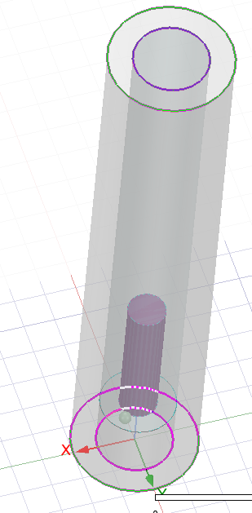
¼ cavity

Slide 2
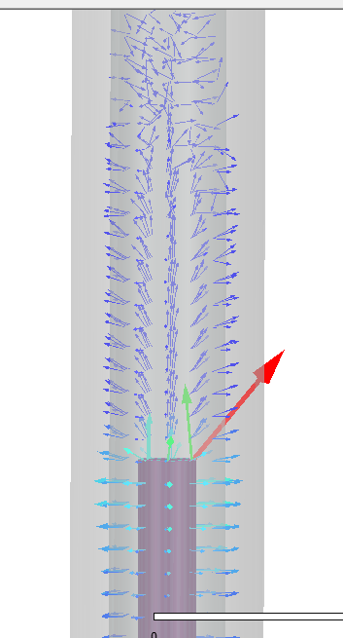
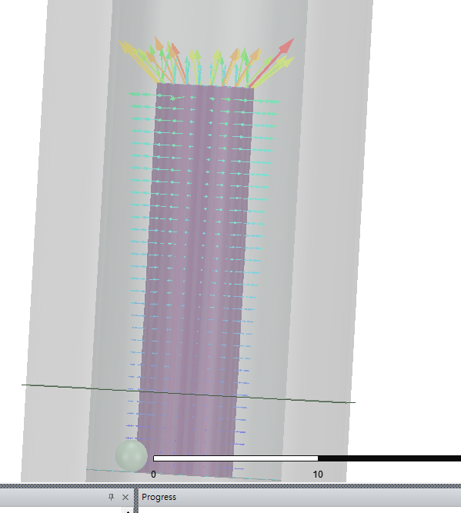

Field decay

Slide 3
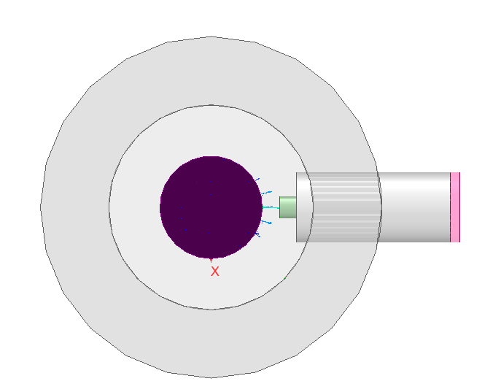
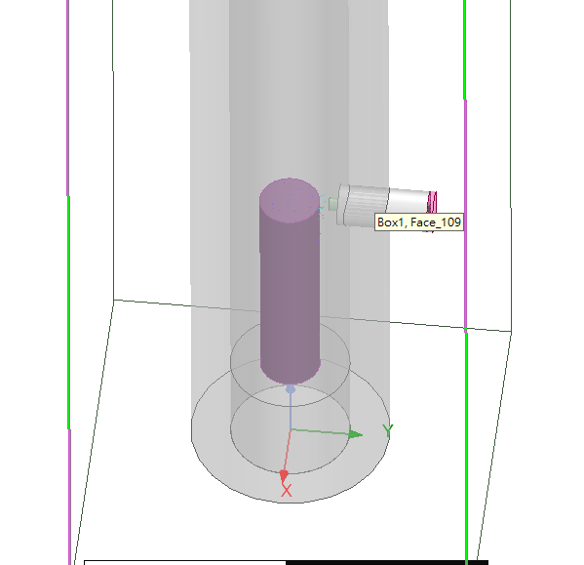

Slide 4
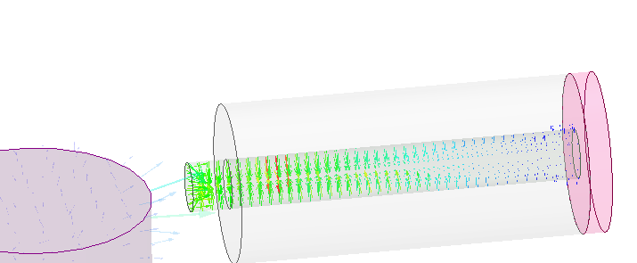
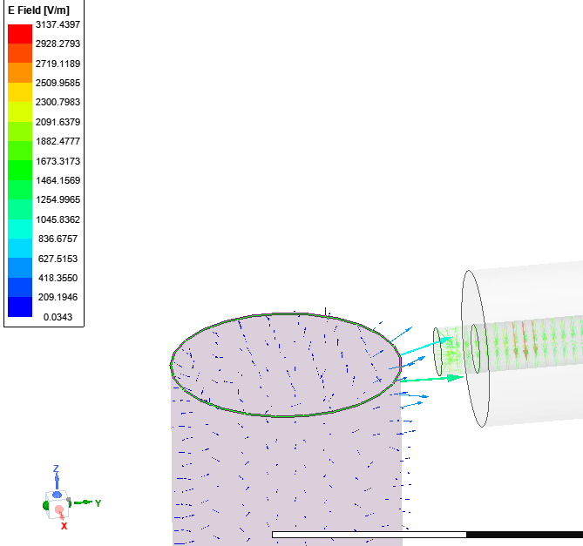

Slide 5
Relative weak couple to driving
Relative strong couple
Easily to readout

Slide 6
5*5*5mm
3mm
100mm
10mm
23mm
15mm

Slide 7
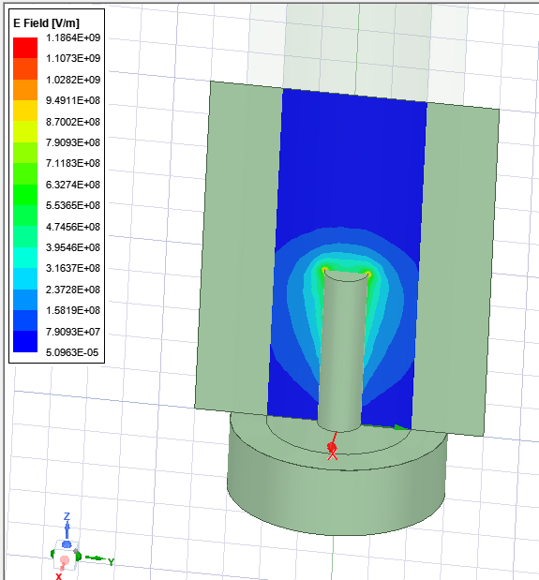
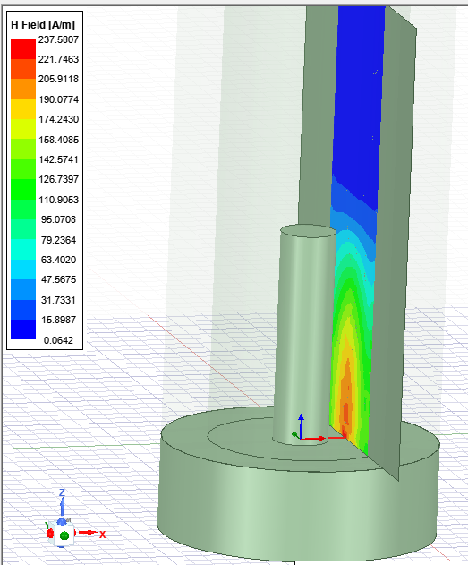

Slide 8
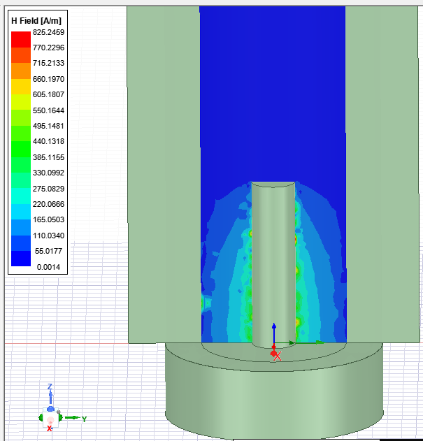
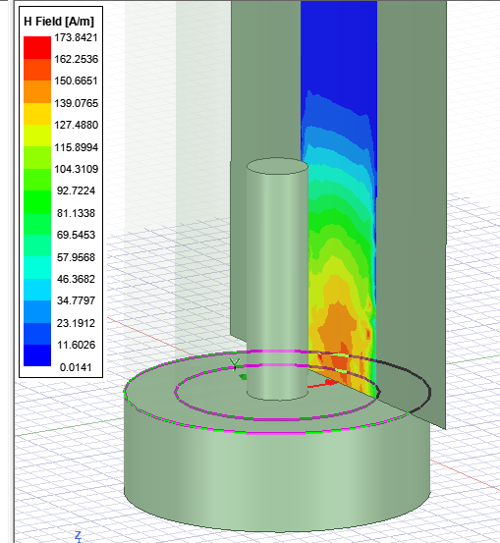
0mm away
7mm away

Slide 9
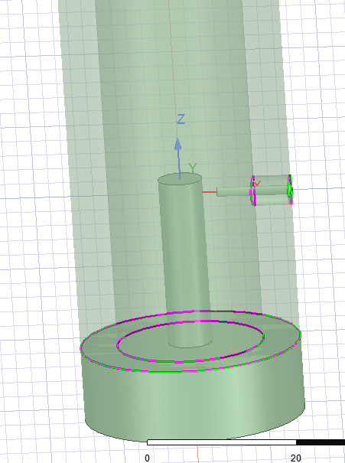
5mm
21mm
6mm>20

Slide 10
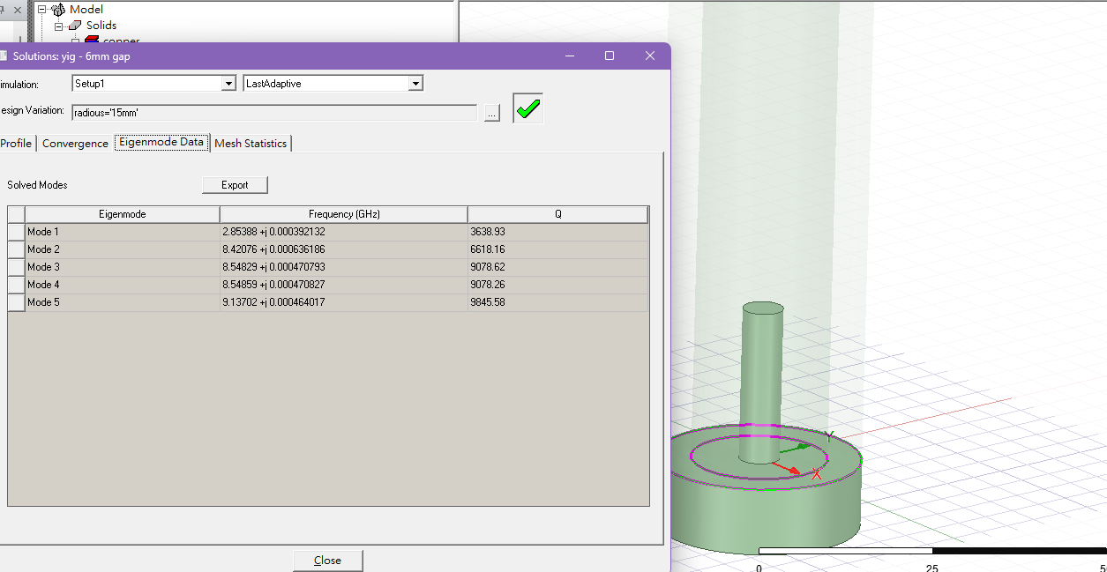
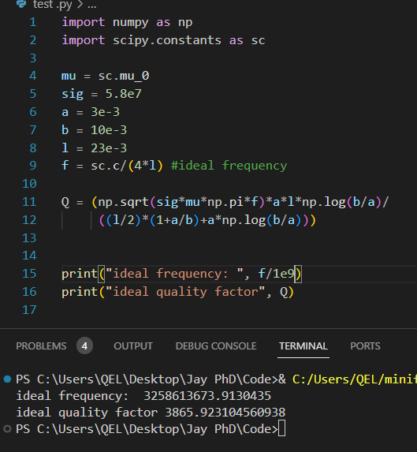
Formula: https://www.youtube.com/watch?v=SxL0aghbkqI

Slide 11
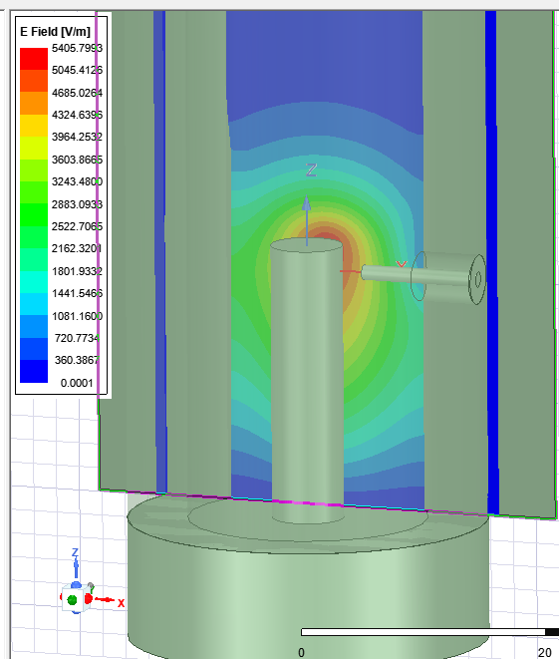
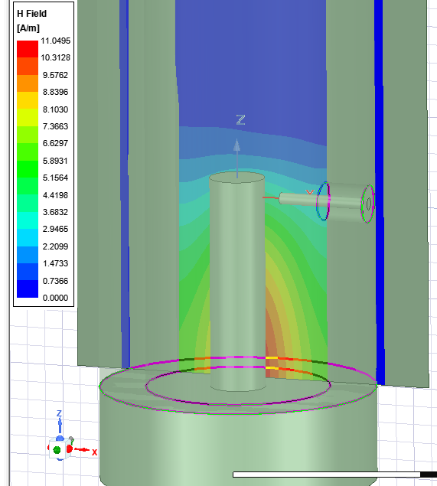

Slide 12
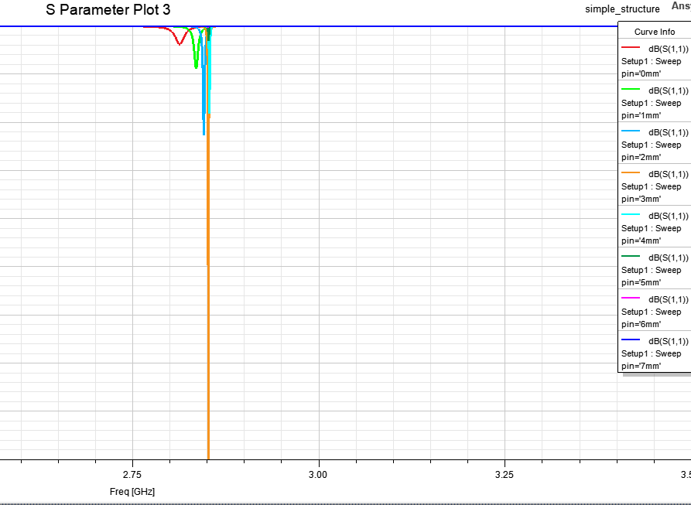
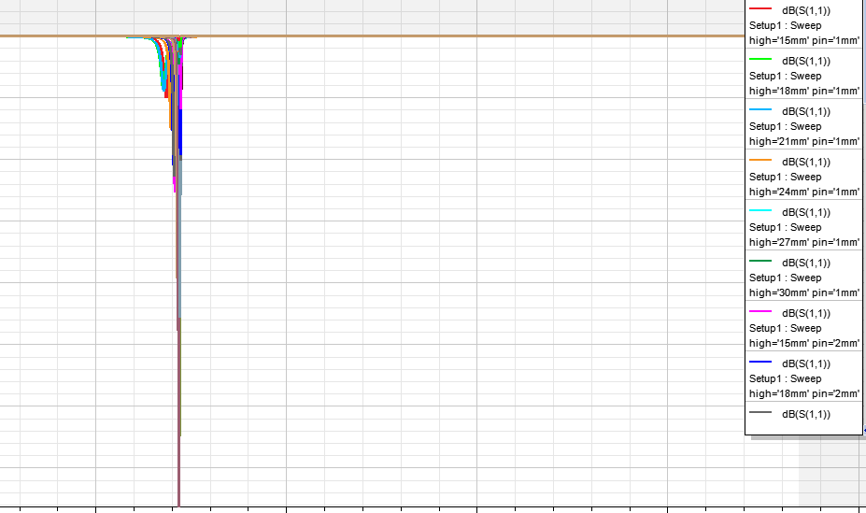

Slide 13
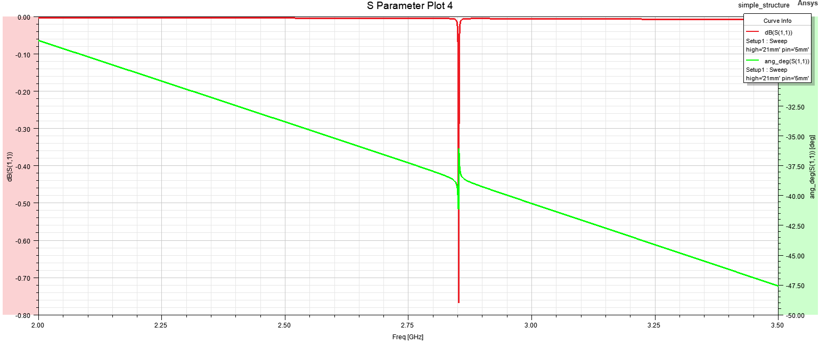
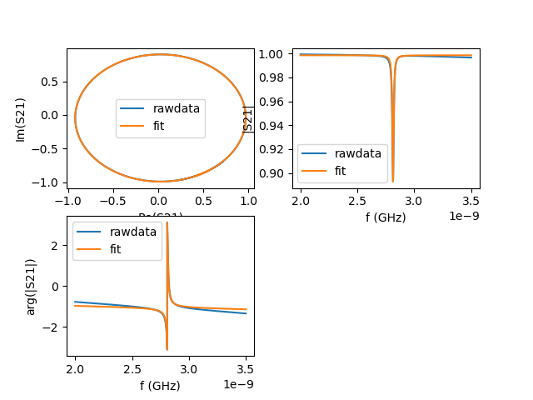
[{'Qc=': 225.10179437081274,
'Qi=': 4027.1349945999114,
'Ql=': 213.18552057336393},

Slide 14
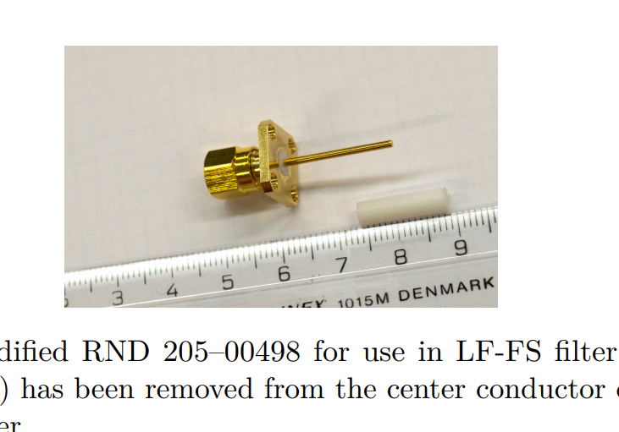
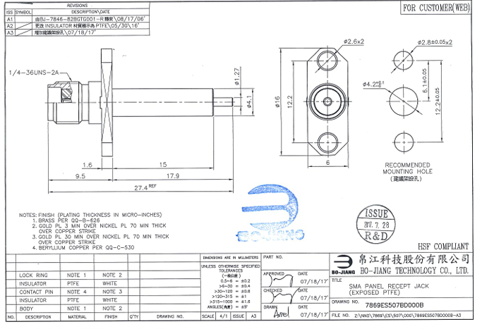

Slide 15
小結:
金屬:無氧銅(換成鋁下低溫也行)
¼ lambda 金屬: 長:23mm, 直徑:3mm
中空: 長:100mm, 直徑10mm
第一個mode:2.85GHz
Pin: 高:21mm, 距離中心金屬mm
Sma: 去掉teflon 使用，可直接用美工刀割開
外殼，根據sma去設計

Slide 16
5*5*5mm
5mm
150mm
20mm
18mm
15mm

Slide 17
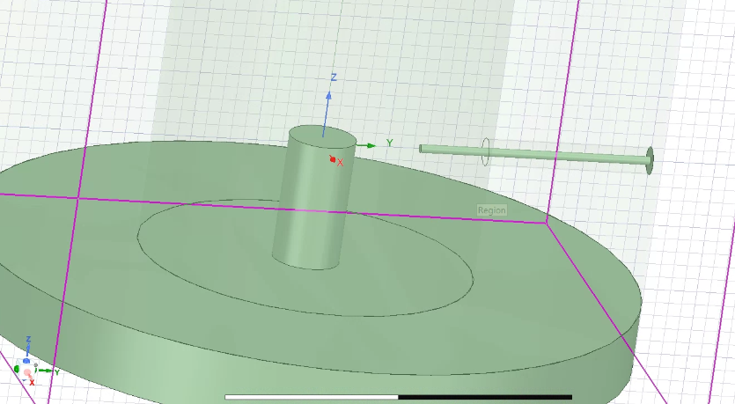
10mm
18mm

Slide 18
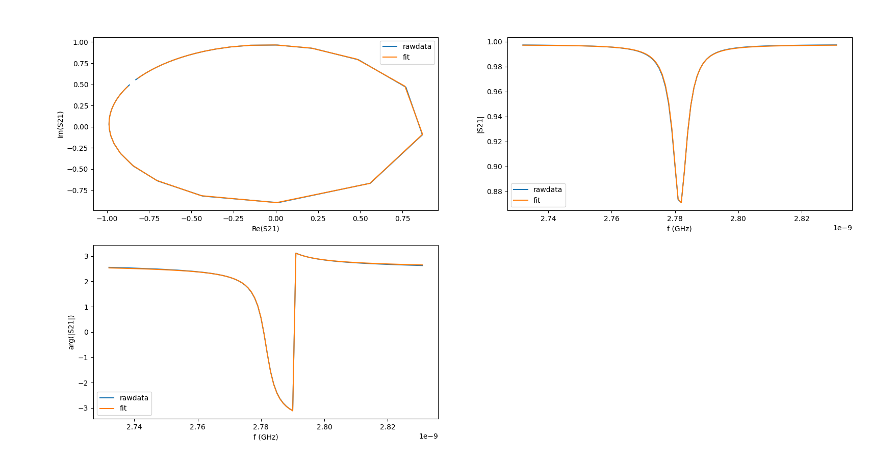
Theory Q-factor:7472.0265406605495
[{'Qc=': 538.6655282065805,
'Qi=': 7750.298052872121,
'Ql=': 503.65987901535635}]

Slide 19
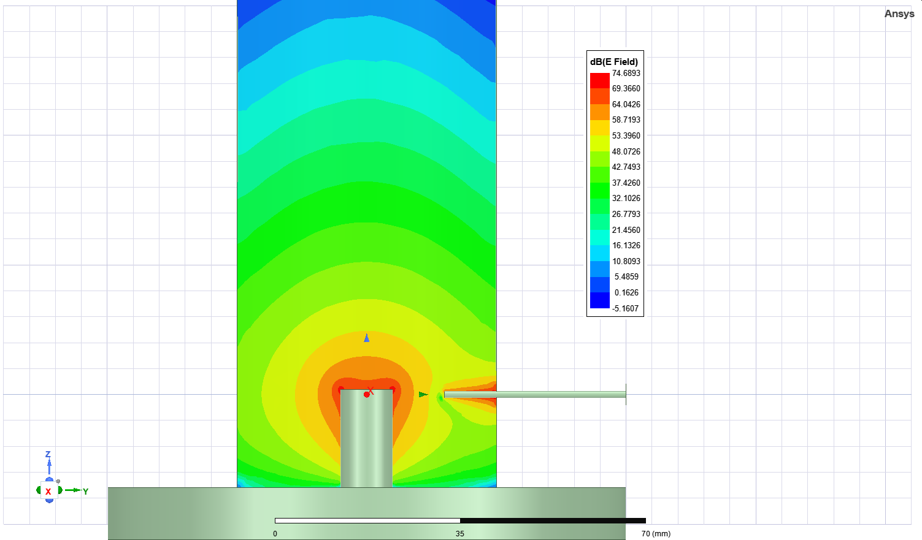

Slide 20
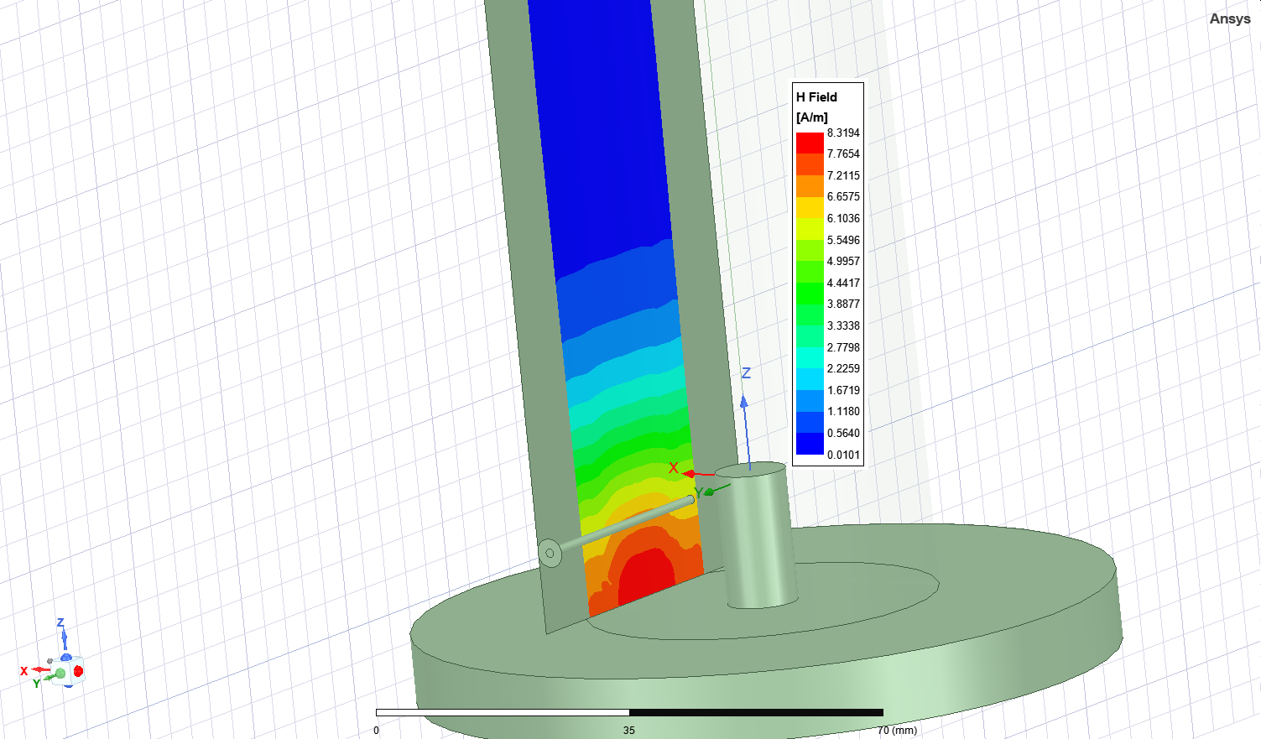

Slide 21
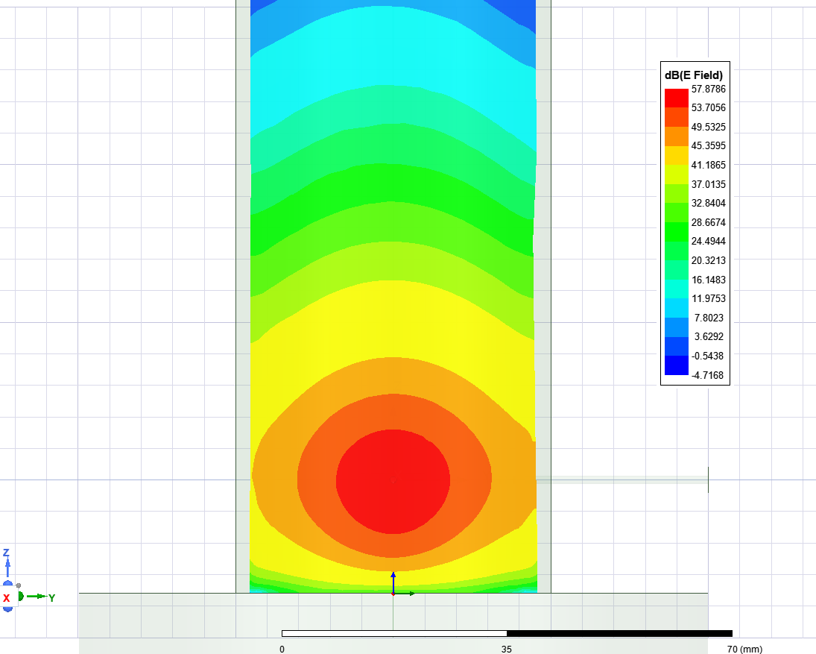
X = 0mm
X = 10mm

Slide 22
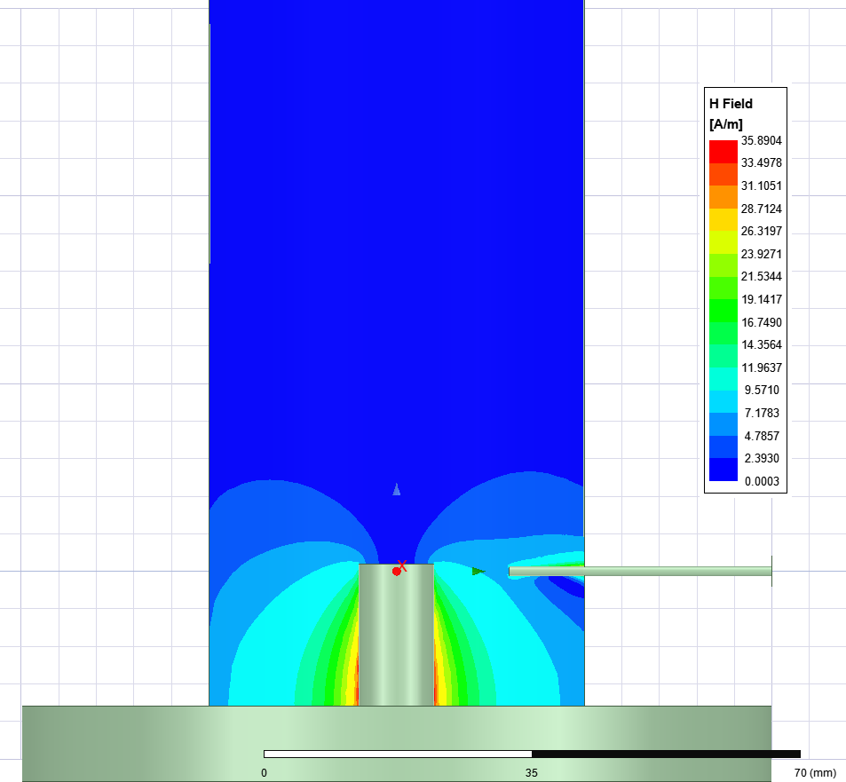
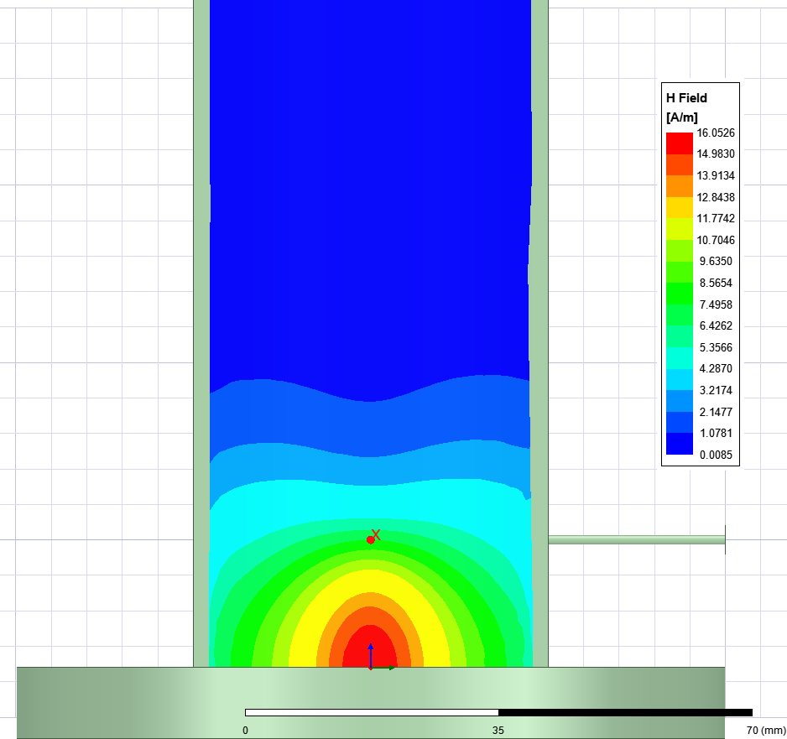
X = 0mm
X = 10mm

Slide 23
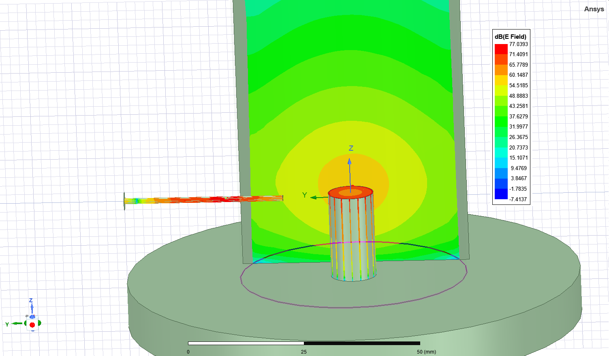
Field compare with incident pin

Slide 24
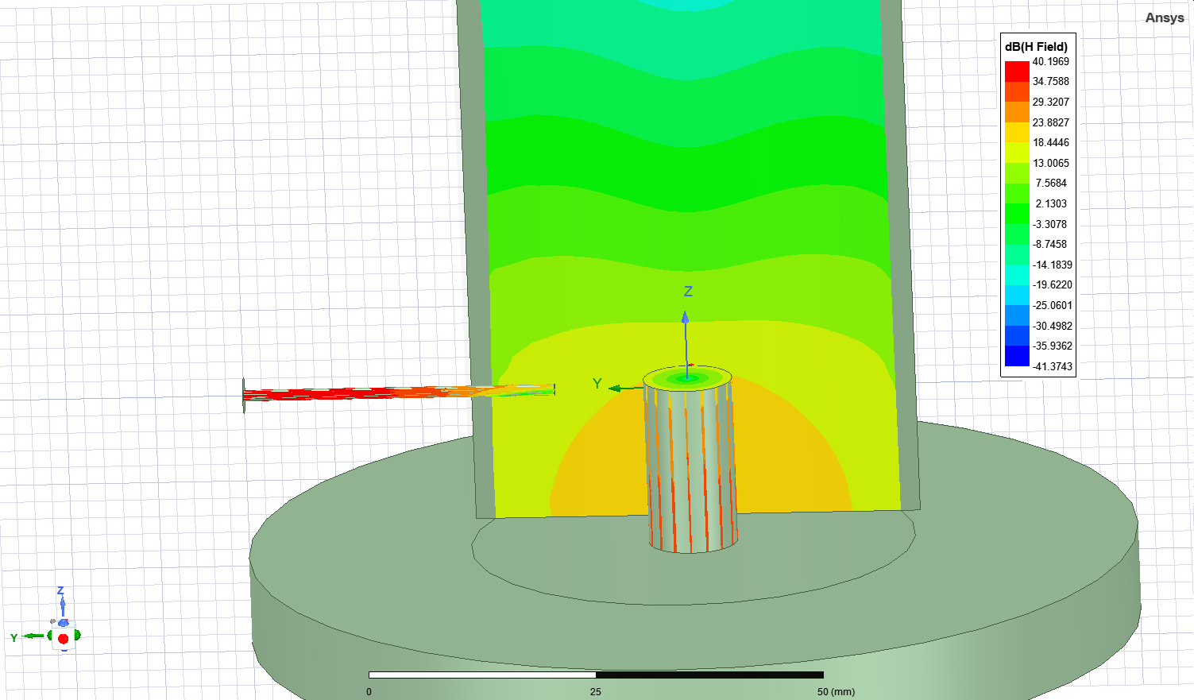
Field compare with incident pin

Slide 25
5*5*5mm
5mm
100mm
20mm
18mm
15mm

Slide 26
10mm
40mm

Slide 27
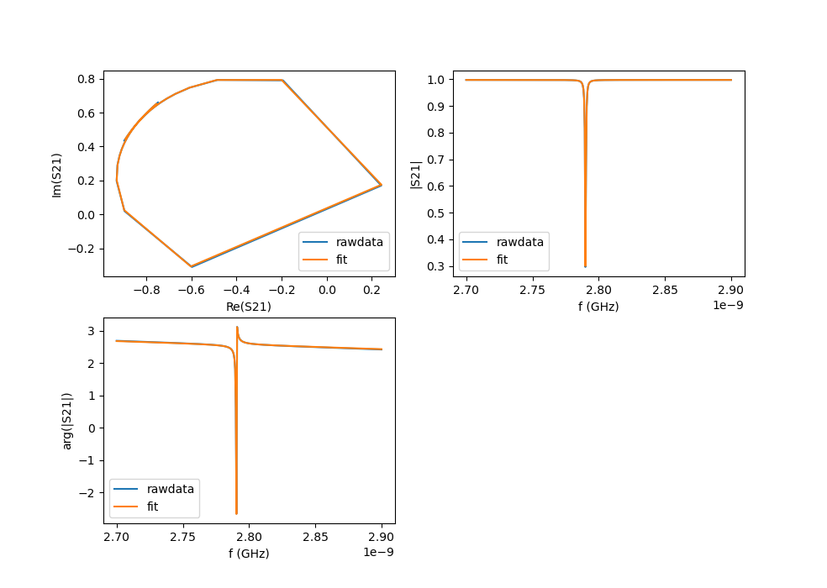
Theory Q-factor:7472.0265406605495
10db attenuation
{'Qc=': 5366.061848751606,
'Qi=': 7717.59483595476,
'Ql=': 3165.253584018868}

Slide 28
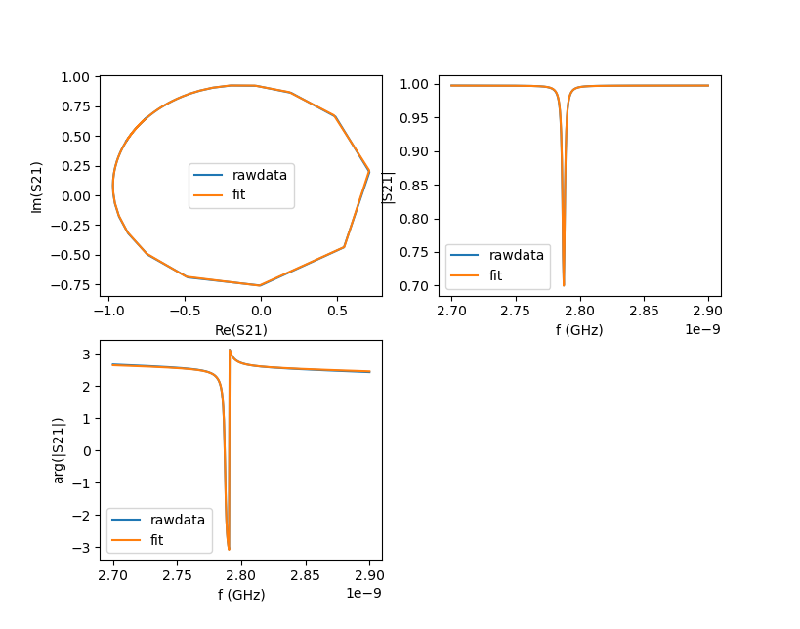
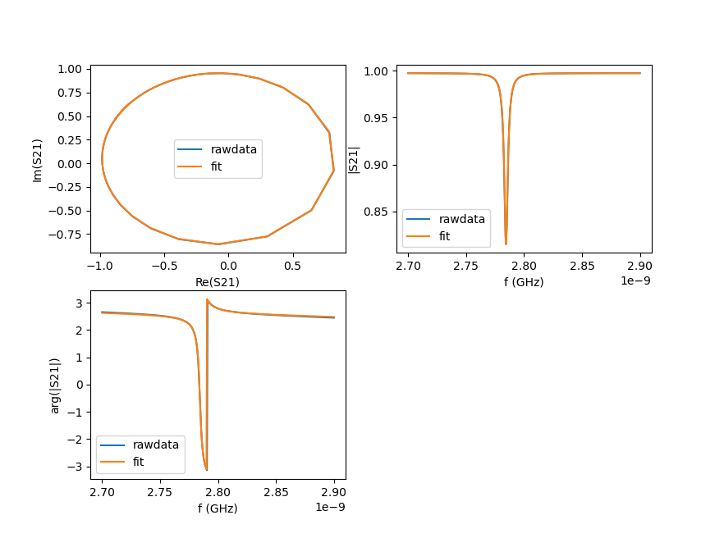
High 30mm
{'Qc=': 1375.3,
'Qi=': 7836.8,
'Ql=': 1169.98}
High=25mm
{'Qc=': 791.3, 'Qi=': 7850.1, 'Ql=': 718.88}
High = 40mm
{'Qc=': 5366.1,
'Qi=': 7717.59,
'Ql=': 3165.25}

Slide 29
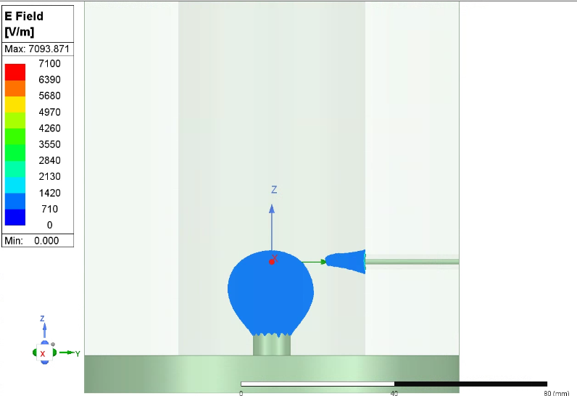
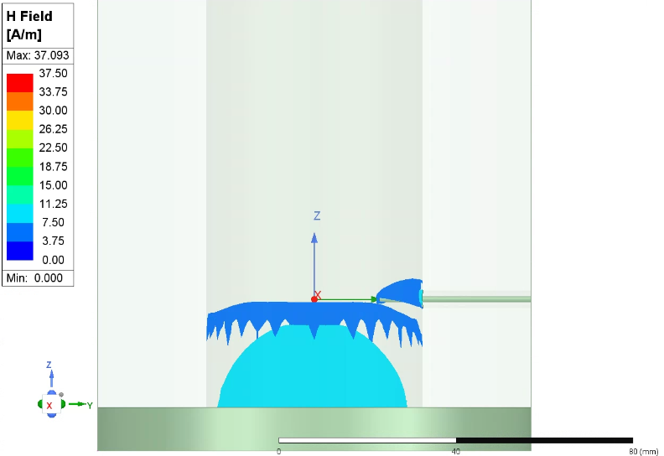

Slide 30
25mm
10mm
7mm
18mm
15+19mm
19mm
15mm
15mm
70mm

