Slide 1

AI-Powered Platform for Multi-Agent Automation Builder
Theme: Industry, Innovation, and Infrastructure
Category: Software (AI & Cloud Architecture)
Group Number: 11
Group Members: Jayraj Dhole, Dhairya Dixit, Shaunak Das, Anushka Khandar
Guide: Dr. Mahesh Pawaskar

Slide 2
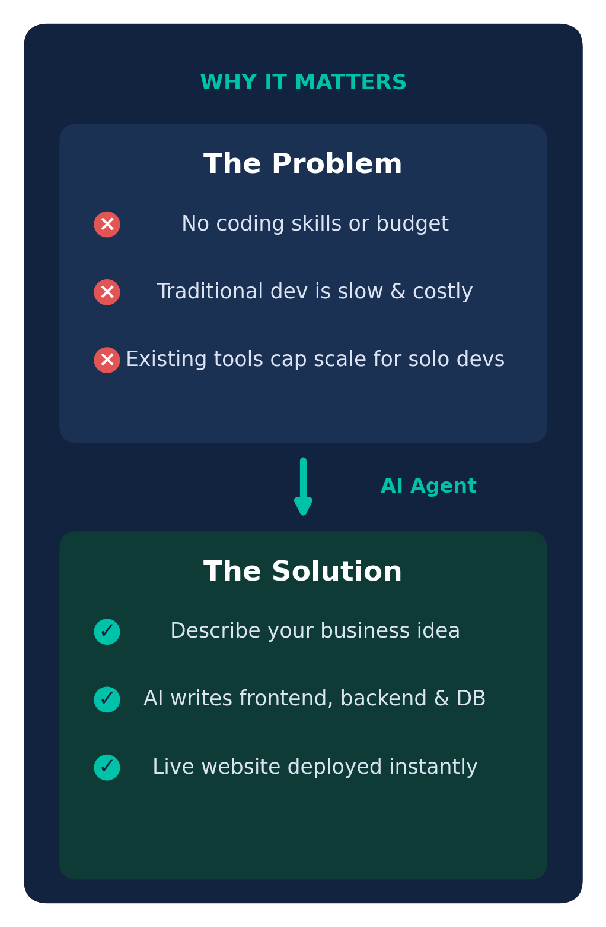
Problems & Proposed Solution
Problems:
Small business owners and non-technical founders lack the skills for full-stack web development.
Traditional development is prohibitively expensive and time-consuming.
Existing AI/hosting platforms have strict project limits and need massive server resources to scale as a solo developer.
Proposed Idea:
To enable all types of users technical or non-technical to build AI-Powered WhatsApp Chatbots, Voice Receptionists, and Full-Stack Web Applications
Innovation & Uniqueness:
No such service exists yet that is fully automated.
Easy to use.

Slide 3
Technical Approach
Technologies Used:
AI Engine: Claude 3.5 Sonnet API (or OpenAI API) via LangChain agentic framework.
Execution Environment: WebContainers — Node.js running locally in the browser.
Database: PostgreSQL, provisioned programmatically via API.
Deployment: Vercel or Netlify REST APIs.
Core Algorithms:
Agentic orchestration (ReAct-style) loop to plan and decompose the prompt.
Retrieval-augmented code generation for schema and component synthesis.
Self-correction / error-feedback loop that patches broken code from logs.
Constraint-based schema validation for per-user data isolation.

Slide 4
Feasibility & Viability
Feasibility:
Highly feasible for a small team — no GPUs or server farms to manage. Relies entirely on orchestrating pay-per-use third-party APIs and offloads compute to the user's local machine.
Potential Challenges:
Hitting provider limits as thousands of users create websites.
Database cross-contamination if all users share one database.
AI hallucinating or writing broken code.
Mitigation Strategies:
"Project-per-User" architecture.
An agentic self-correction loop runs on error logs before showing the preview.

Slide 5
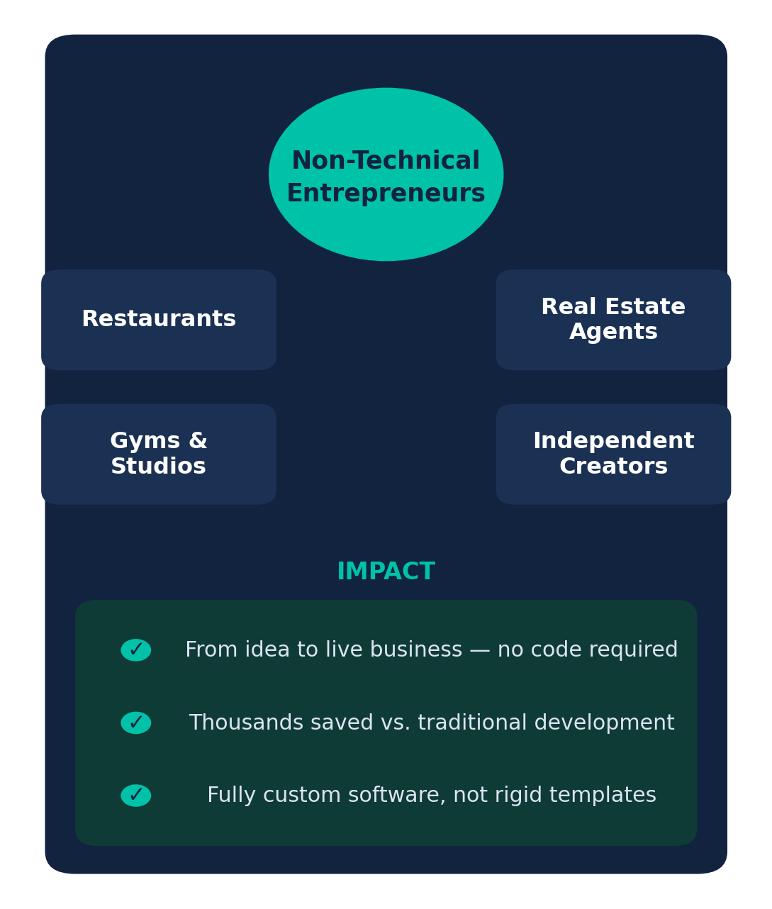
Impact & Benefits
Target Audience:
Non-technical entrepreneurs, independent creators, and local small businesses (restaurants, real estate agents, gyms).
Benefits:
Drastically reduces the barrier to entry for launching a digital business.
Turns a multi-thousand-dollar process into an instant, low-cost subscription.
Provides highly customized software rather than rigid template constraints.
Social & Educational Impact:
Democratizes software engineering — anyone with an idea can create functional, production-ready technology regardless of coding background or financial status.

Slide 6
Thank you!

Slide 7
Research & References
01 LLM API Prompting & Agentic Workflows — Anthropic / OpenAI documentation
02 StackBlitz WebContainers architecture & browser-based execution
03 Neon Serverless PostgreSQL — API docs for programmatic database provisioning
04 Vercel Deployment API — integration guidelines
Agentic AI Reasoning
Browser Execution
Serverless Database
Instant Global Deploy

