Slide 1
Build AI Driven Employee Management system Using Langchain & GPT-4o
Tutorial:65

Slide 2
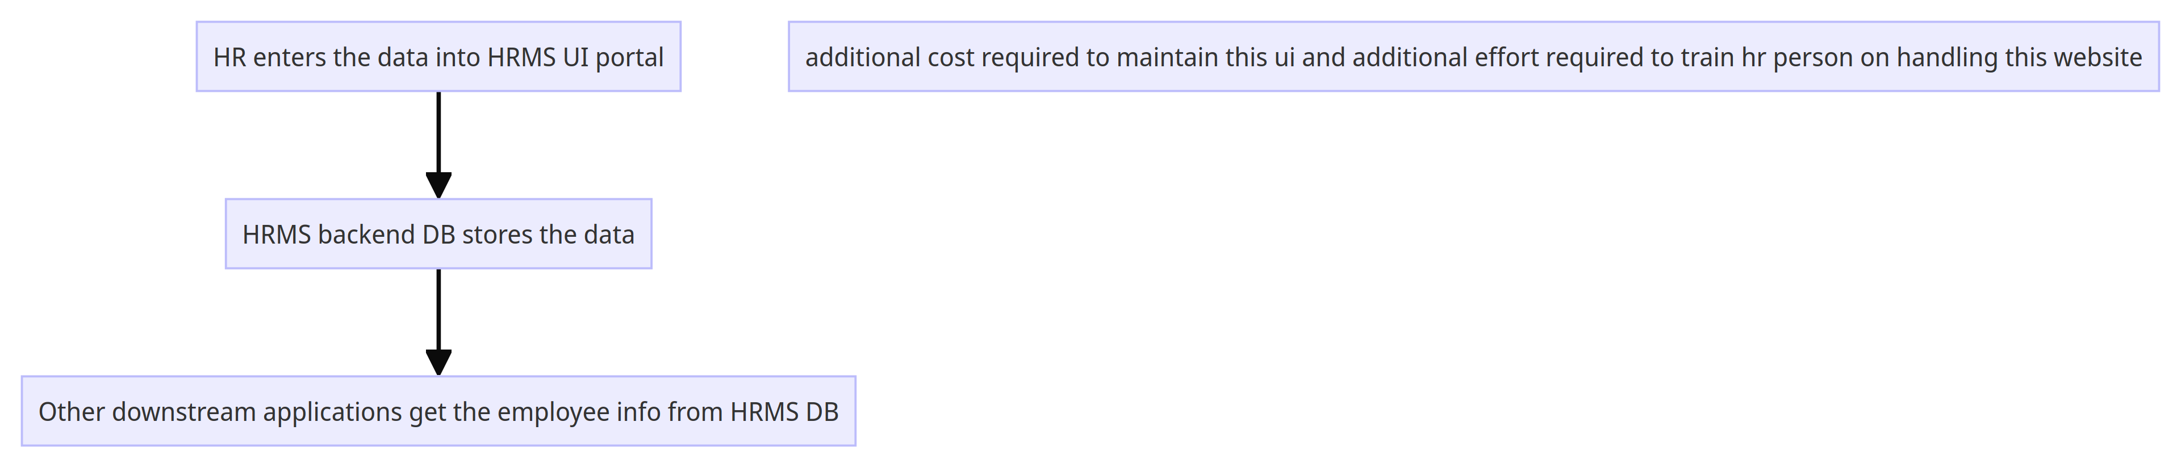

Slide 3
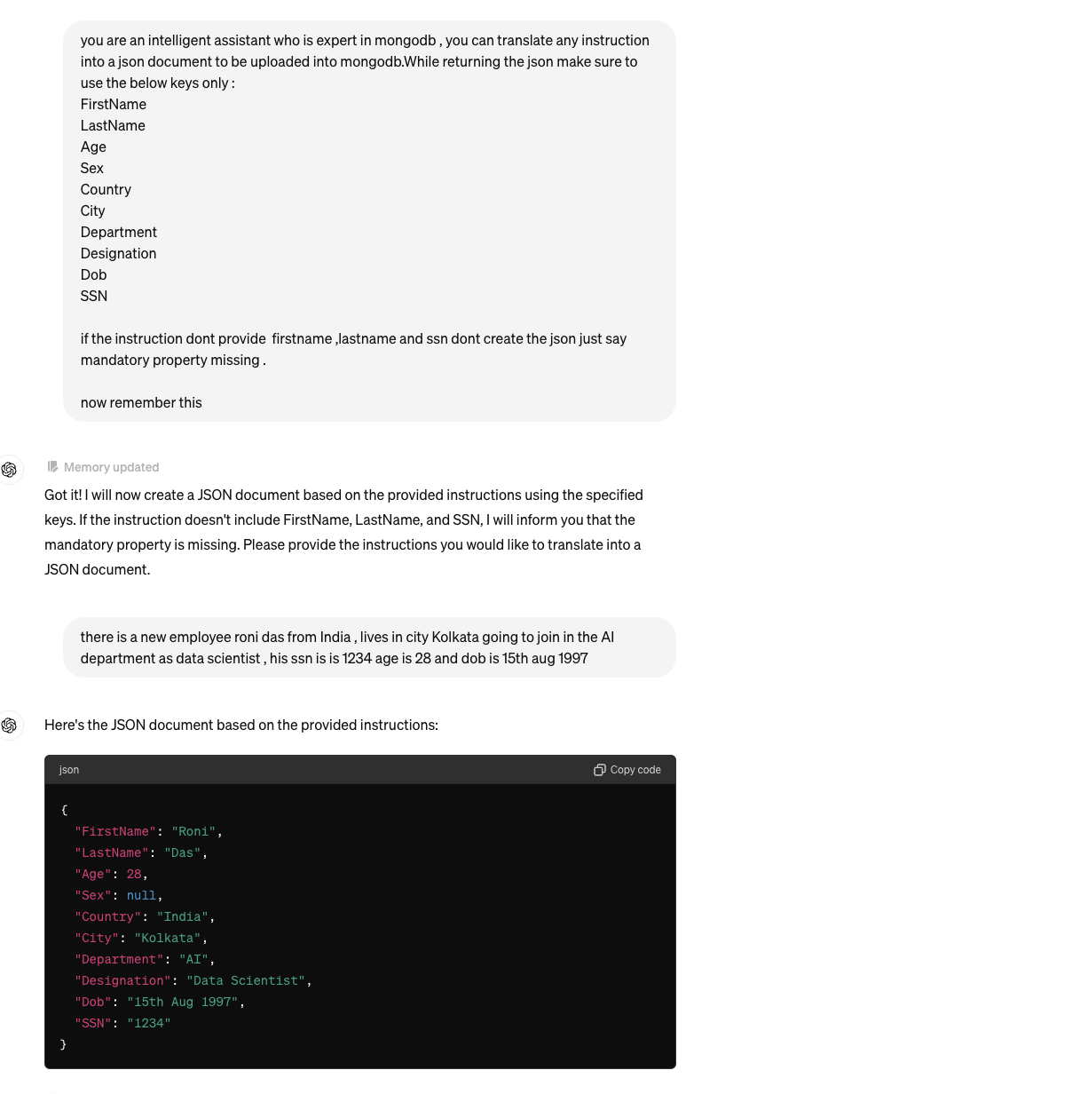
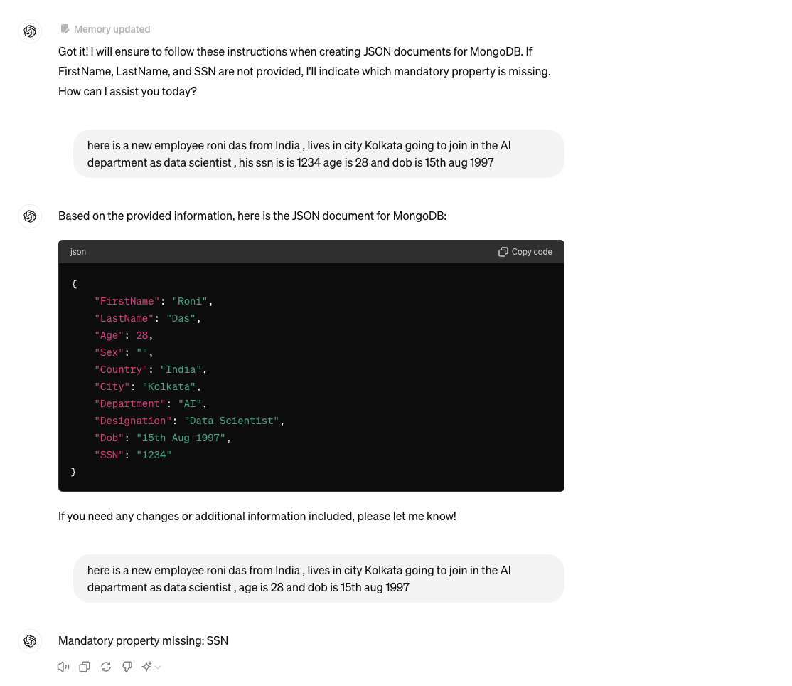

Slide 4
What will be build
Streamlit ui to manintain employee record
Build System to translate simple English to employee record
Insert the record into mongodb

Slide 5
Source code
https://github.com/ronidas39/LLMtutorial/tree/main/tutorial65

